Slide 1


Optimisation
The
University
of Auckland
  Dr. Stuart Mitchell
  Department of Engineering Science
  University of Auckland
  New Zealand
  s.mitchell@auckland.ac.nz
  December 2008 meeting of NZPUG

Slide 2
Contents of presentation
What is Mathematical Programing
The Whiskas Problem
PuLP
Further PuLP examples

Slide 3
What is Mathematical programing
A simple mathematically precise way of stating optimisation problems.
Use mathematically rigorous ways to find a solution
Examples of Optimisation Problems that can be solved with MP:
  Shortest Path Problem
  Scheduling Problems (Set partitioning)
  Knapsack problems
  Blending Problems

Slide 4
The Whiskas blending problem
Taken from
http://130.216.209.237/engsci392/pulp/ABlendingProblem
Whiskas cat food want to produce their cat food products as cheaply as possible while ensuring they meet the stated nutritional analysis requirements shown on the cans.
Thus they want to vary the quantities of each ingredient used (the main ingredients being chicken, beef, mutton, rice, wheat and gel) while still meeting their nutritional standards.

Slide 5
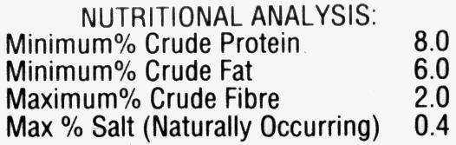
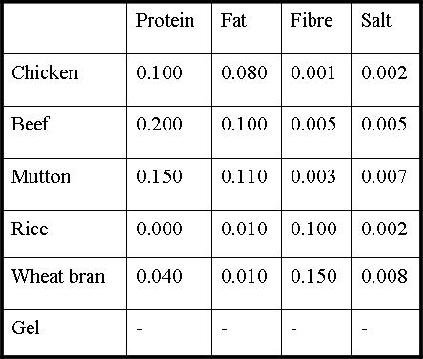
The Whiskas blending problem
$/kg
$13
$8
$10
$2
$5
$1

Slide 6
Whiskas blending problem
We wish to identify decision variables
Assume we only have chicken and beef
Let
  xc = the percentage of chicken meat
  xb = the percentage of beef used
Then we wish to
minimise $13xc + $8xb

Slide 7
Whiskas Blending Problem
What about the nutritional requirements
Subject to
xc+ xb= 100
0.100xc + 0.200xb >= 8.0
0.080xc + 0.100xb >= 6.0
0.001xc + 0.005xb <= 2.0
0.002xc + 0.005xb <= 0.4
xc>=0, xb>=0

Slide 8
MP Model

Slide 9
Ok where is the python
On google code you can find pulp-or
http://code.google.com/p/pulp-or/
This is a python module that allows the easy statement and solution of linear programing problems.
Pulp leverages features of python and the open source optimisation libraries Coin-or

Slide 10
Whiskas model in python
"""
The Full Whiskas Model Python Formulation for the PuLP Modeller
Authors: Antony Phillips, Dr Stuart Mitchell 2007
"""
# Import PuLP modeler functions
from pulp import *
# Creates a list of the Ingredients
Ingredients = ['CHICKEN', 'BEEF', 'MUTTON', 'RICE', 'WHEAT', 'GEL']
# A dictionary of the costs of each of the Ingredients is created
costs = {'CHICKEN': 0.013,
'BEEF': 0.008,
'MUTTON': 0.010,
'RICE': 0.002,
'WHEAT': 0.005,
'GEL': 0.001}
# A dictionary of the protein percent in each of the Ingredients is created
proteinPercent = {'CHICKEN': 0.100,
'BEEF': 0.200,
'MUTTON': 0.150,
'RICE': 0.000,
'WHEAT': 0.040,
'GEL': 0.000}
# A dictionary of the fat percent in each of the Ingredients is created
fatPercent = {'CHICKEN': 0.080,
'BEEF': 0.100,
'MUTTON': 0.110,
'RICE': 0.010,
'WHEAT': 0.010,
'GEL': 0.000}
# A dictionary of the fibre percent in each of the Ingredients is created
fibrePercent = {'CHICKEN': 0.001,
'BEEF': 0.005,
'MUTTON': 0.003,
'RICE': 0.100,
'WHEAT': 0.150,
'GEL': 0.000}
# A dictionary of the salt percent in each of the Ingredients is created
saltPercent = {'CHICKEN': 0.002,
'BEEF': 0.005,
'MUTTON': 0.007,
'RICE': 0.002,
'WHEAT': 0.008,
'GEL': 0.000}

Slide 11
# Create the 'prob' variable to contain the problem data
prob = LpProblem("The Whiskas Problem", LpMinimize)
# A dictionary called 'Vars' is created to contain the referenced Variables
vars = LpVariable.dicts("Ingr",Ingredients,0)
# The objective function is added to 'prob' first
prob += lpSum([costs[i]*vars[i] for i in Ingredients]), "Total Cost of Ingredients per can"
# The five constraints are added to 'prob'
prob += lpSum([vars[i] for i in Ingredients]) == 100, "PercentagesSum"
prob += lpSum([proteinPercent[i] * vars[i] for i in Ingredients]) >= 8.0, "ProteinRequirement"
prob += lpSum([fatPercent[i] * vars[i] for i in Ingredients]) >= 6.0, "FatRequirement"
prob += lpSum([fibrePercent[i] * vars[i] for i in Ingredients]) <= 2.0, "FibreRequirement"
prob += lpSum([saltPercent[i] * vars[i] for i in Ingredients]) <= 0.4, "SaltRequirement"
# The problem data is written to an .lp file
prob.writeLP("WhiskasModel2.lp")
# The problem is solved using PuLP's choice of Solver
prob.solve()
# The status of the solution is printed to the screen
print "Status:", LpStatus[prob.status]
# Each of the variables is printed with it's resolved optimum value
for v in prob.variables():
print v.name, "=", v.varValue
# The optimised objective function value is printed to the screen
print "Total Cost of Ingredients per can = ", value(prob.objective)

Slide 12
The open source future for OR
Presently the Computational OR tools used, taught within this department, are closed source.
  Excel /Storm
  AMPL, GAMS
  CPLEX, EXPRESS, ZIP
Students can not afford commercial licences of this software
Students cannot see how this software works.

Slide 13
The open source future for OR
Outcomes for students
  Ability to access free (no cost) software to implement their own solutions once they graduate
  Ability to access free (open) source code to see how the algorithms are implemented.
    Imagine the difference to 391??
  The ability to improve the software they use.

Slide 14
PuLP
PuLP is a python module that allows the easy expression of Mathematical Programs
PuLP is built to interface with separate solvers
PuLP is similar in style to:
  AMPL
  GAMS
  OPL
  LINGO
  FLOPC++ etc.

Slide 15
PuLP
Why Python?
  Core Python syntax leads to the concise statement of MP's
  Python is a scripting language so no compilation is needed and the code is platform independent
  Python interfaces easily with external solvers that do the heavy lifting
  Python comes with 'batteries included'
    The Python standard library is huge

Slide 16
PuLP
Written initially by J. S. Roy
Now maintained by S. A. Mitchell
It is available at
http://pulp-or.google-code.com
Now available for Windows and Linux

Slide 17
Generating a Yield Frontier
Total Volume of Pulp logs
40m³
Lines joining extreme points represent the Yield Frontier
Total Volume of Saw logs
20m³

Slide 18
Generating a Yield Frontier
Using pulp we formulate the bucking problem (with a single objective) as a set packing problem by log section.

Slide 19
lp = LpProblem("Bucking Model", LpMaximize)
#set up the logvolume variables
logvol=LpVariable.dicts("LogVolume(\"%s\")",logtypes,0)
#objective
lp+=lpSum([l.price * logvol[l] for l in logtypes]), "Revenue“
#setup the arc variables
x=LpVariable.dict("x(%s)",f_logs,0,1,LpInteger)
#set up a section set partitioning problem
count = 0
for s in stems:
slogs = fs_logs[s]
for i,sec in enumerate(s.sections):
lp +=( lpSum((x[log] for log in slogs
if log.startl <= sec.start
if log.endl > sec.start)) <= 1
, "Stem_Section(\"%s\",%i)" % (str(s),i))
count += 1
#add the constraints that link the log volumes
for lt in logtypes:
lp +=( lpSum((log.volume*x[log]
for log in fl_logs[lt])) - logvol[lt] == 0
, "Logtype_volume(\"%s\")" % str(lt))

Slide 20
Generating a Yield Frontier Using Pulp
We then iteratively solve the problem to find all extreme supported solutions on the Yield Frontier
Equivalent to projecting the problem into the log volume space
I added a module to PuLP that implements projection using Iterative Hull Methods (Lassez, Lassez 1992)
>>> pprob, ppoints = polytope.project(lp, totalvars)

Slide 21
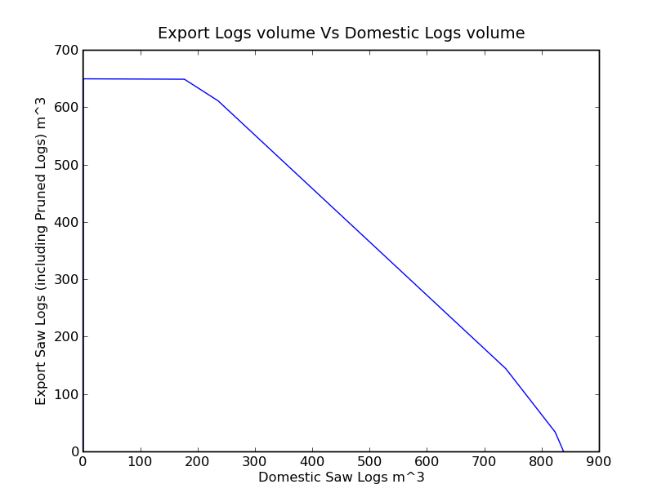
Find Yield Frontier for the Dataset
(176, 649)
(0, 650)
(235, 611)
(737,145)
(0, 0)
(823, 35)
(838, 0)

Slide 22
Find Yield Frontier for a Single Stem
\* Total projected *\
Minimize
OBJ: __dummy
Subject To
_C1: DomSaw + 1.11154598826 ex <= 2669.27592955
_C2: DomSaw + 1.34653465347 ex <= 3118.57425743
_C3: 1.00863930886 DomSaw + ex <= 2522.60691145
Bounds
__dummy = 0
End

Slide 23
Travelling tournament problem with PuLP
This problem models the allocation of teams to Home and Away games in a tournament
A full problem description and datasets are found at Michael Trick's page
http://mat.tepper.cmu.edu/TOURN/

Slide 24
Travelling tournament problem with PuLP
At IFORS 2008 M. Trick presented an approach to finding lower bounds to this problem using combinatorial benders cuts
That evening I implemented his algorithm using PuLP
Along the way I also added Powerset, Combination and Permutation operators to PuLP

Slide 25
lp = LpProblem("Travelling tournement Master", LpMinimize)
#create variables
triplist = [Trip(t1,p) for t1 in teams
for p in
allpermutations([t for t in
teams if t !=t1] ,k)
if p[0] <= p[-1]]
tripvars = LpVariable.dict("mastervar ",triplist,0,1,LpInteger)
#objective
lp += lpSum([t.cost()*tripvars[t]
for t in triplist])
#construct constraints to ensure that all teams visit each other
for t1 in teams:
for t2 in teams:
if t1 != t2:
lp += lpSum([tripvars[t] for t in triplist
if t.team == t1
if t2 in a.awayteams]) == 1, \
"Team_%s_Visits_%s"%(t1,t2)

Slide 26
Further examples
The 392 course has been converted from AMPL to PuLP
http://130.216.209.237/engsci392/pulp/OptimisationWithPuLP
There you can see a number of different ways to construct problems
Note that new language features can be added very easily only needing approval from the BDFL

