Slide 1
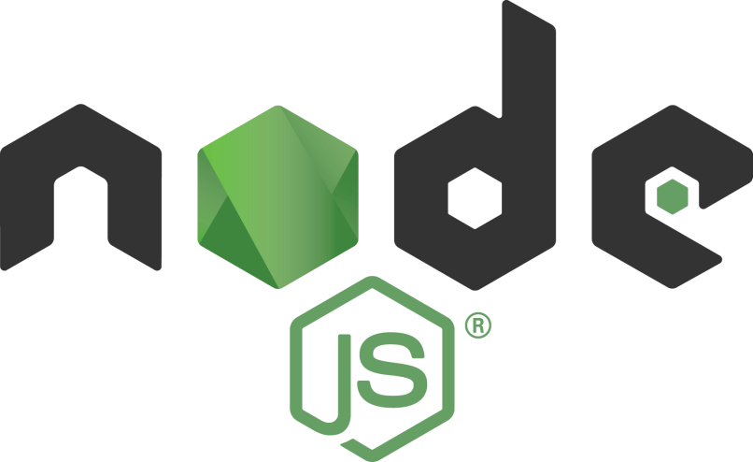
The Cluster Module
Tamar Twena-Stern

Slide 2
Agenda
Why do we have concurrency In Node.js in our servers
Lazy Initialization
Lock an object shared by multiple asynchronous functions
Update the same object concurrently

Slide 3
Node.js Single Process
Node.js Is single process with event loop
If You have a multi core machine – you will not use your entire machine power
The load on one CPU is limited – not matter how strong the CPU is
You need a way to run your application on multi process and to use the entire machine power.

Slide 4
Introducing The Cluster Module
A module that helps us to utilize all the CPUs of the machine
Contains set of functions and properties
Enables us to fork several new process
Main goal – to easily create more processes to handle more load and scale you application easily

Slide 5
How it works on a nutshell
Has a master process and a child process
All processes share the same server port
Communication done with IPC (inter process communication) messages
No shared memory
Each process is independent – has it’s own memory and resources
Not recommended to spawn a lot of processes

Slide 6
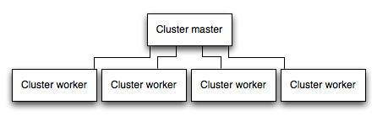
Master Slave Model

Slide 7
Demo – Base Example Of Cluster Module

Slide 8
Master And Child Process Communication
IPC channel is created between master and worker on each worker forking
Different Processes – No shared memory
Only IPC available for communication

Slide 9
Demo –Cluster Module Master Child Communication

Slide 10
Scale Our Server With The Cluster Module
Copy the servers process
Worker process will handle more load
The processes will listen to the same port
Load Balance the requests to the API among the processes
Improve our server’s throughput on a multi core machine
Response time will not improve

Slide 11
Master And Worker Sync
Client1
Client2
Client3
Client4
Master is the main process. Responsible to spawn or re-spawn workers + distribute requests between workers
Master
Worker processes forked by the child process. Responsible to return the response to client
Worker
Worker
Worker
…

Slide 12
Demo –Using Cluster Module On Our Server

Slide 13
Questions ?

