Slide 1

Node.js Garbage Collector
Tamar Twena-Stern

Slide 2
Agenda
Recap on previous solutions
Introducing Async functions
Quick Example and Observations
Advantages for the new approach

Slide 3
What Is a JavaScript Engine
A program which executes JavaScript code.
Can be implemented as
Interperter
JIT compiler
List of JavaScript Engine
V8
Rhino
SpiderMonkey
And more

Slide 4
Introduction to v8
An open source JavaScript engine
Written in c++ by Google
Used in Google chrome
Designed to increase JavaScript performance inside web browsers
Compiles a JavaScript code to machine code on execution (JIT compiler)
Does not produce any intermediate code

Slide 5
Evolution – v8 Adopted by Node.js
V8 was not designed for server
Built to power fast browsers
When it was ported to server, cam the understanding that it needs memory management

Slide 6
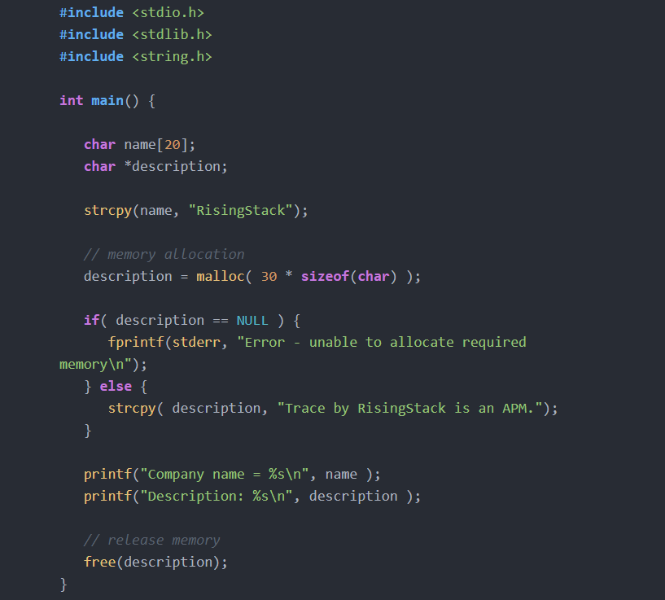
Manual Memory Management

Slide 7
Garbage Collection
Automatic memory management
Attempts to reclaim memory which not used by the program any more
Advantages
Provide developers huge simplification : They do not need to handle garbage collection themselves
Reduce memory leaks

Slide 8
V8 Memory Structure

Slide 9
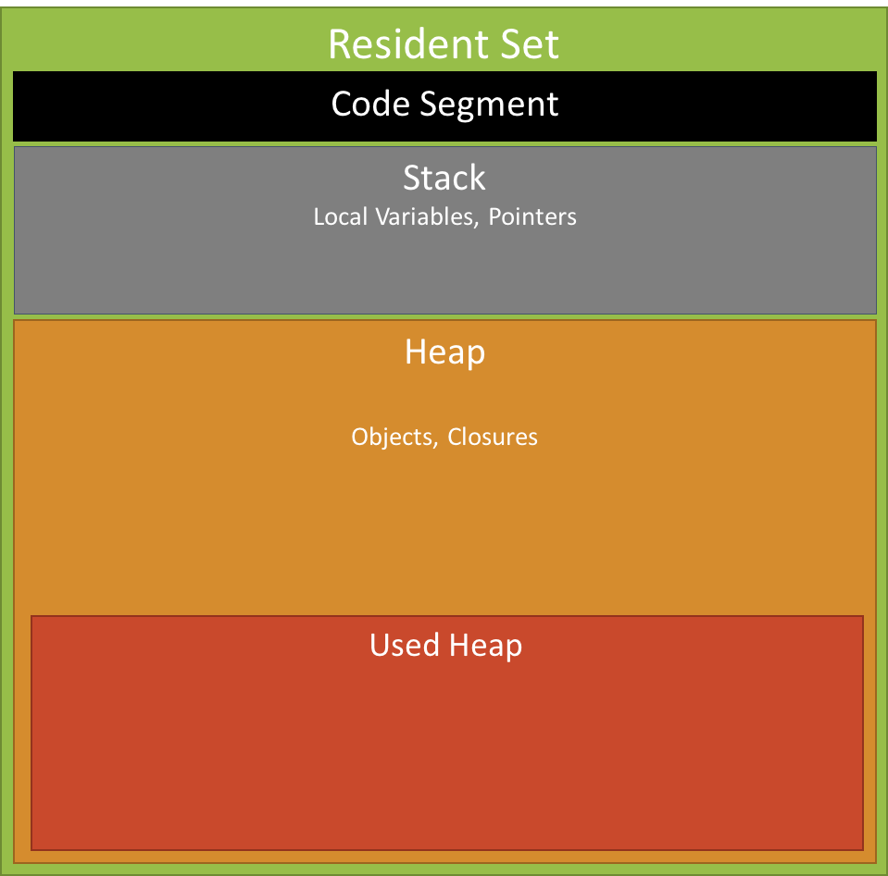
Memory Scheme Overview

Slide 10
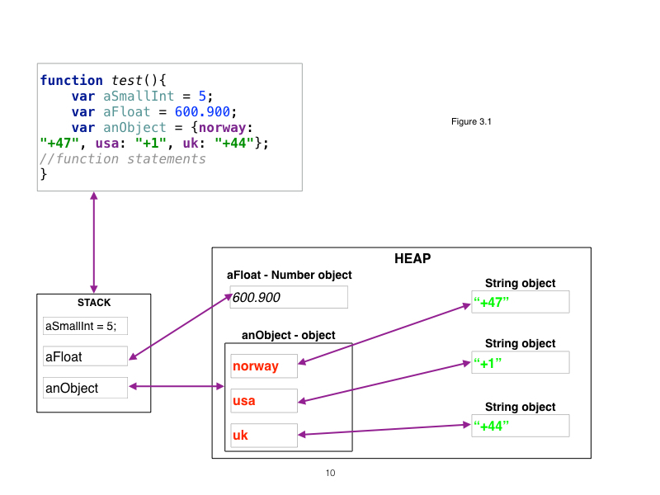
Concrete Example

Slide 11
Memory Scheme - Definitions
Resident Set (RSS) – The total portion of space that is occupied by a specific process
3 Segments–
Code – The actual code being executed
Stack –
all primitive value types (integer, boolean…)
pointers referencing objects on the heap
Heap – Storing reference types
Objects
Strings
closures

Slide 12
The Stack
LIFO data Structure
Every executing function pushes its local variables and arguments
Small size, very fast, extremely efficient
Maintains two pointers –
Stack Pointer – Points to last frame
Base Pointer – Points to base
Divided into stack frames
Stack frame - the area in the stack allotted to each function.
Each stack frame houses the calling function’s arguments, local variables and housekeeping data.

Slide 13
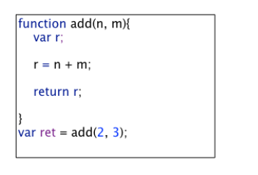
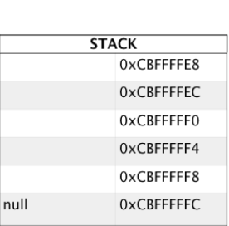
Stack - Concrete Example
Initial State
The base pointer is starting up -contains null.
The stack pointer is pointing to its latest push.
Each address slot in the stack is 4 bytes away from its immediate neighbor.
The highest address is at the bottom.
The stack pointer moves up, towards lower memory addresses.
Stack Pointer + Base Pointer

Slide 14
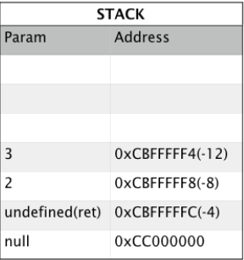
Stack – Concrete Example
Step – 2 - Preparation to call add :
Space is reserved for the return variable ret
Arguments n and m and set to values 2 and 3.
Note:
The stack pointer moved up after every push.
Each memory address is offset by 4 bytes from the base pointer
Stack Pointer
Base Pointer

Slide 15
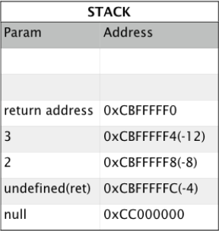
Stack – Concrete Example
Step – 3: Call Function add
The return address of add is saved(pushed).
The return address is the address where the function will return with the results.
Stack Pointer
Base Pointer

Slide 16
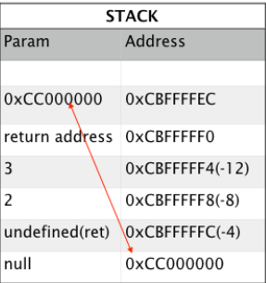
Stack – Concrete Example
Step - 4
Before starting to execute add the address of the old frame is first saved.
The base pointer moves to the new frame.
Note:
Stack also saves housekeeping data.
The housekeeping data consists of return address and the frame address.
Return address takes back the program where the program left off.
The frame address(value of base pointer) allows the stack to connect one frame with another.
Stack Pointer + Base Pointer

Slide 17
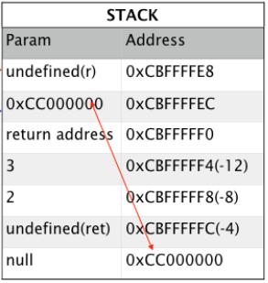
Stack – Concrete Example
Step – 5: On entering function add, space for variable r is reserved.
Note:
The stack frame consists:
The function arguments(2 and 3)
The address of the previous frame
The return address and the local variable r.
Stack Pointer
Base Pointer

Slide 18
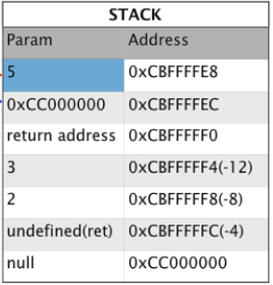
Stack – Concrete Example
Step – 6:
Addition of n and m is performed
The result of 5 is put into the variable r
Time to return to previous frame.
Items need to be popped off the stack
Back to previous frame
Stack Pointer
Base Pointer

Slide 19
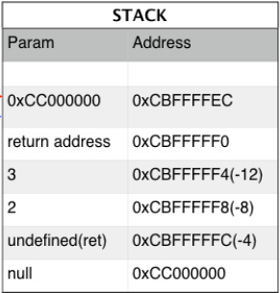
Stack – Concrete Example
Step – 7:
The result of 5 is popped off the stack
Result is held in a temporary register.
The stack pointer moves down using the return address.
Note:
The temporary register is located in the CPU.
Stack Pointer + Base Pointer

Slide 20
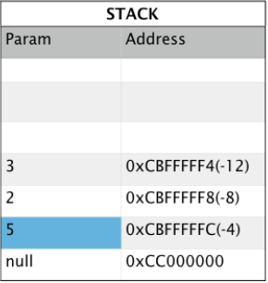
Stack – Concrete Example
Step – 8:
The saved address of the previous frame is popped off
The base pointer moves back to the previous frame.
The return address is popped off
Control is returned to module which called the program.
The result of 5 is put into the variable ret.
Stack Pointer
Base Pointer

Slide 21
Stack – Concrete Example
Step – 9:
The frame is now popped off
Stack is empty
The program terminates.
Note:
In reality the stack has frames for the calling module.

Slide 22
Summary
The stack is cleaning up after itself.
It does not need any garbage collection process.
The Stack does hold the key to the garbage collection process.
The Garbage Collection Process Start from the active objects and their pointers in the stack.

Slide 23
V8 Heap Structure
In order to understand how the garbage collector works in Node.js , we need to get to the detail of the heap structure.
The heap is constructed from the following parts :
New space
Old data space
Old pointer space
Large object space
Code space
Misc space

Slide 24
Heap – New Space
The heap “young generation” objects
Most objects are allocated there
Small space related to other heap portions
Designed to be garbage collected very quickly
The strategy –
Most objects will be deleted from new space
Only objects that survive the new space arrive to old space

Slide 25
Heap – Old Space
Most objects are moved here after surviving in new-space for a while.
Old Data Space –
Objects which contain raw data (no pointers).
Examples :
Strings
boxed numbers
arrays of unboxed doubles
Old Pointer Space
Objects which may have pointers to other objects.

Slide 26
Heap – Large Object Space
Contains objects which are larger than the size limits of other spaces.
Each object gets its own region of memory.
Large objects are never moved by the garbage collector.

Slide 27
Heap – Code Space And Misc Space
Code Space –
Code objects allocated there.
The only space with executable memory.
Misc Space - These include the
Cell space, property cell space and map space and they contain specialized data and pointers.
Garbage collection is not done on those areas

Slide 28
How The GC Works

Slide 29
High Level Explenation

Slide 30
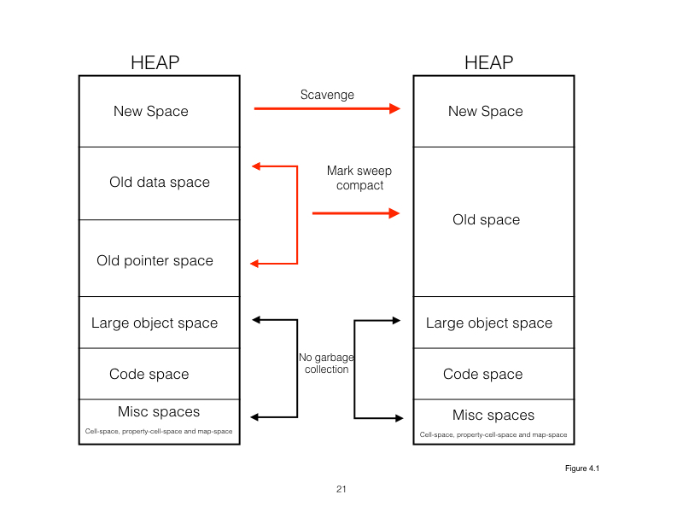
How Does It Really Work ?

Slide 31
Questions ?

