Slide 1

Generators
Tamar Twena-Stern

Slide 2
Agenda
Introducing generators
Generators basic functionality
Asynchronous control flow with generators and promises
Error handling in generators
Programming patterns which are good to implement with generators

Slide 3
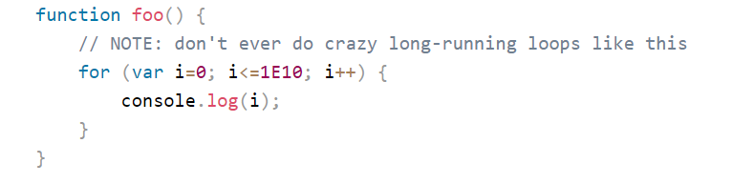
Run to Completion
It is trivial – that whenever a JavaScript function starts
It will run until it finish
No other JavaScript code will be able to run in parallel

Slide 4
Introducing Generators
A function that can be paused in the middle and resume later – once or multiple times
Allowing other code to run while they are stopped
Use the yield keyword to pause the function from inside
Restart the generator with external control using the next operator
Yield is not an asynchronous operation. The flow will continue as it is.

Slide 5
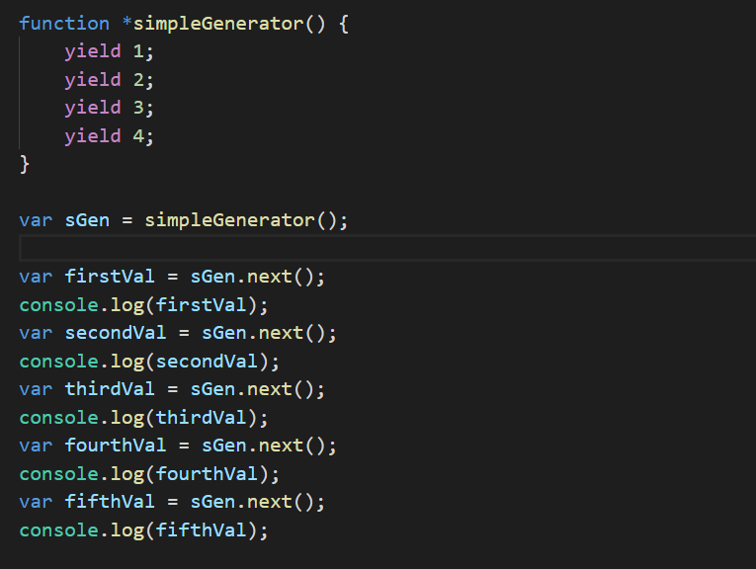
Basic Generator

Slide 6
Lets Run The Code And See The Output

Slide 7
Cooperative vs preemptive
Cooperative – a process /function itself choose when it will allow an interruption
Preemptive – a process / function can be interrupted against its will.
Generators are cooperative - meaning the generator decides when it can be interrupted

Slide 8
Sending and receiving messages
Pause and restart serve also as a 2-way message communication
You send a message to the generator with each next
You return a message from the generator in each restart

Slide 9
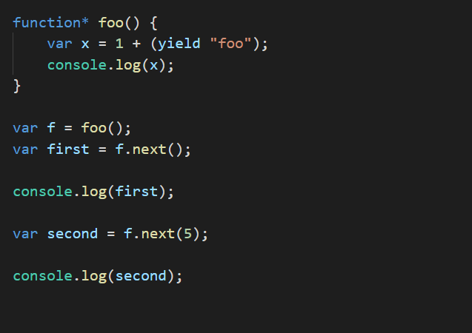
Generator message passing

Slide 10
Lets Run The Code And See What We Get

Slide 11
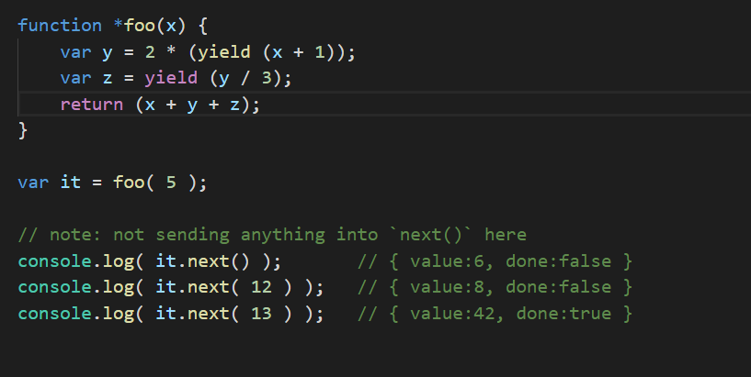
More message passing

Slide 12
Lets Run The Code And See What We Get

Slide 13
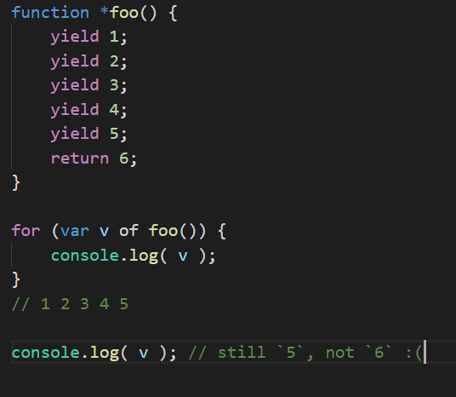
Generators As Iterators
Generators can be treated as iterators
ES6 embrace generators as iterators in syntactic level
You can work with the for … of loop

Slide 14
Lets Run The Code And See What We Get

Slide 15
Lets simplify some promise code with generators

Slide 16
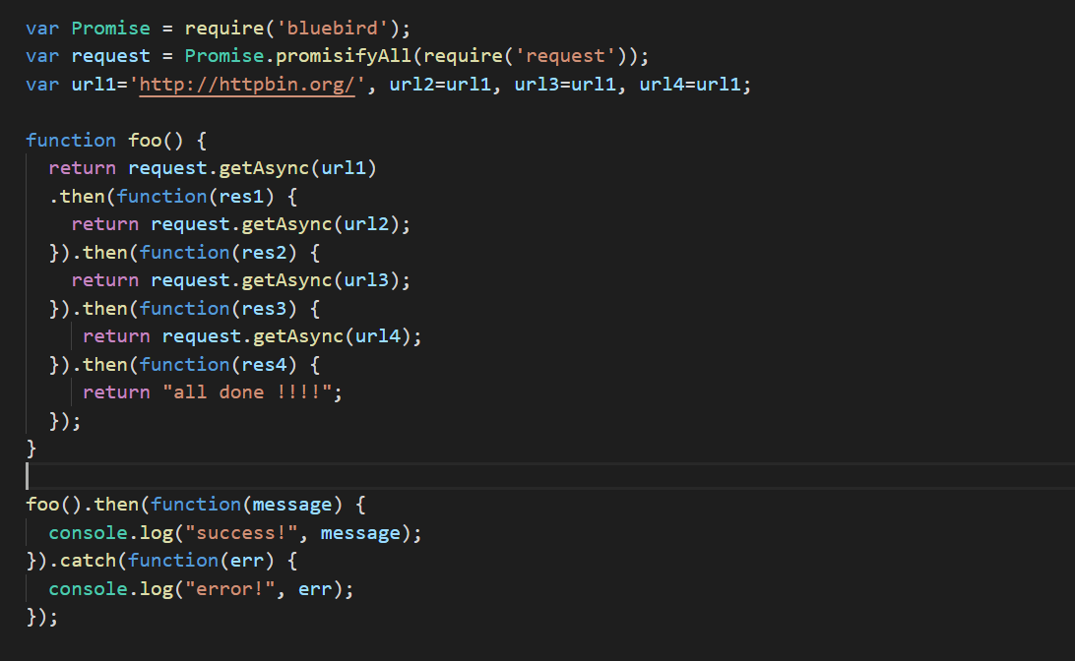
Code with promise chaining

Slide 17
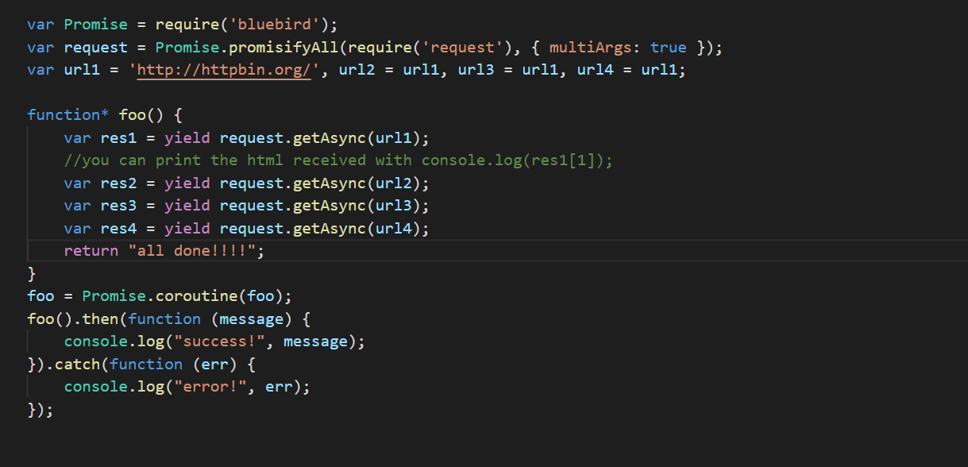
Code with generators

Slide 18
Error Handling

Slide 19
Error Handling with generators
Generators code looks synchronous
Actually asynchronous behind the scenes
Error handling is much simpler
You can use all the popular error handling techniques
try catch !
Important – You can handle synchronous and asynchronous exceptions together

Slide 20
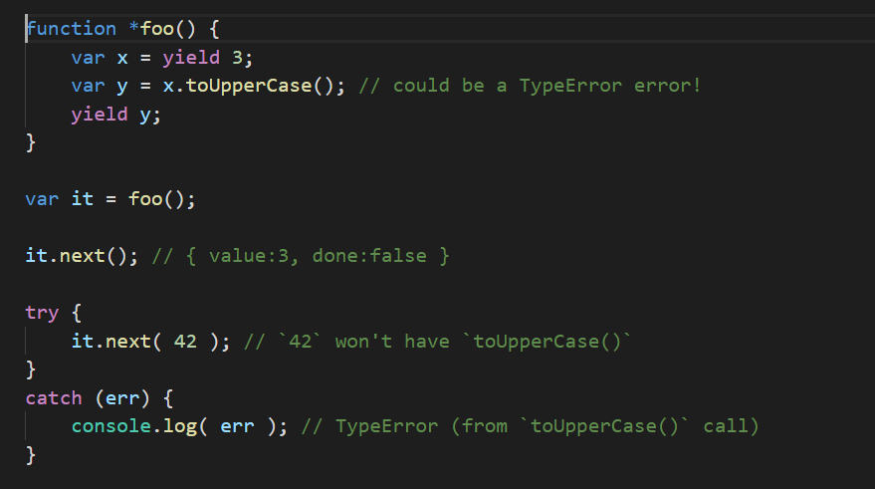
Error handling with generators

Slide 21
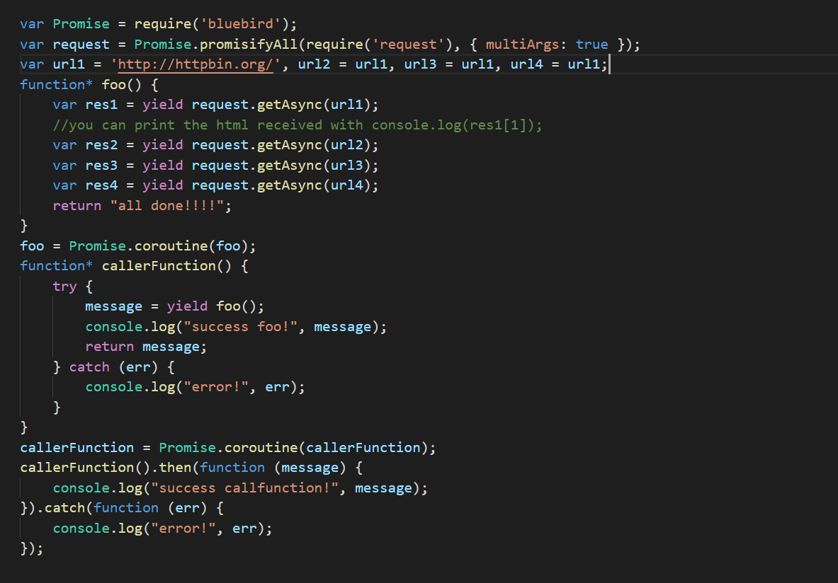
Error handling – generators and promises

Slide 22
The Best Patterns For Generators

Slide 23
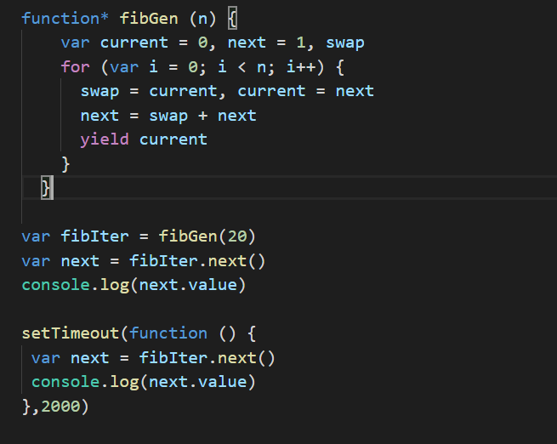
Lazy Evaluation
We can pull the values only when we need them

Slide 24
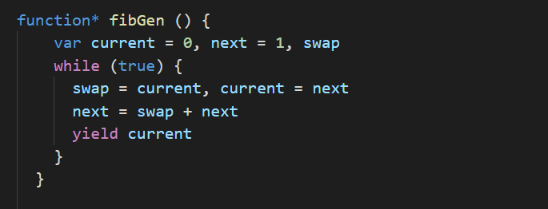
Infinite Loops
Can do some infinite sequence tricks – since we can be lazy

Slide 25
Asynchronous Control Flow
You can use the generators to write asynchronous code that will look like synchronous code
Can be done in multiple techniques – one of them is promisifying the API as we seen earlier in the presentation
Code becomes much more flat and readable

Slide 26
Questions ?

