Slide 1

Child Process And The Cluster Module
Tamar Twena-Stern

Slide 2
Agenda
Introduction to Child Process module
Child Process different operations
The cluster module – a possible solution to scale your application on a multi-core machine
Cluster Module Basic example
Cluster Module IPC
Basic Server with the cluster module

Slide 3
Child Process Module

Slide 4
Introduction
Ability to spawn a child process
Enables to access operating system functionality by running system commands in a child process
Control child process’s input stream
Listen to the child process’s output stream

Slide 5
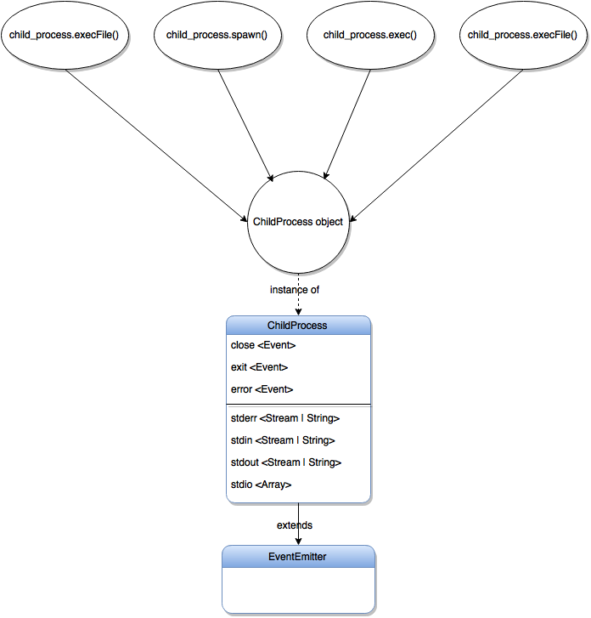
Child Process Module Operations

Slide 6
Exec Method
Spawn a subshell
execute the command in that shell
buffer generated data.
On process complete, callback function will be called with:
buffered data when the command executes successfully
error (which is an instance of Error) when the command fails

Slide 7
ExecFile Method
Executes an external application, given:
Optional arguments
Callback with the buffered output.
Uses the PATH environment variable to locate executables
When :
Execute an application and get the output.
Should not be used when
Application produces a large amount of data
Consume that data in real time.

Slide 8
Demo – Doing The Same Operation With Exec and ExecFile

Slide 9
Spawn Method
Spawn an external application in a new process.
Return a streaming interface for I/O
When to use it ?
Great for :
handling applications that produce large amounts of data
For working with data as it reads in.

Slide 10
Demo – Child Process Spawn

Slide 11
Fork Method
Open an IPC channel to allow message transferring
Each process has it’s own memory, with their own V8 instances
When ?
Offloading long running task by writing a different script for them and execute it on a new process
Most common use case – The cluster Module

Slide 12
The Cluster Module

Slide 13
Node.js Single Process
Node.js Is single process with event loop
If You have a multi core machine – you will not use your entire machine power
The load on one CPU is limited – not matter how strong the CPU is
You need a way to run your application on multi process and to use the entire machine power.

Slide 14
Introducing The Cluster Module
A module that helps us to utilize all the CPUs of the machine
Contains set of functions and properties
Enables us to fork several new process
Main goal – to easily create more processes to handle more load and scale you application easily

Slide 15
How it works on a nutshell
Has a master process and a child process
All processes share the same server port
Communication done with IPC (inter process communication) messages
No shared memory
Each process is independent – has it’s own memory and resources
Not recommended to spawn a lot of processes

Slide 16
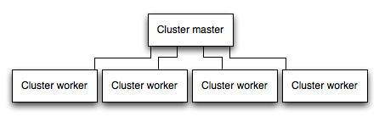
Master Slave Model

Slide 17
Demo – Base Example Of Cluster Module

Slide 18
Master And Child Process Communication
IPC channel is created between master and worker on each worker forking
Different Processes – No shared memory
Only IPC available for communication

Slide 19
Demo –Cluster Module Master Child Communication

Slide 20
Scale Our Server With The Cluster Module
Copy the servers process
Worker process will handle more load
The processes will listen to the same port
Load Balance the requests to the API among the processes
Improve our server’s throughput on a multi core machine
Response time will not improve

Slide 21
Master And Worker Sync
Client1
Client2
Client3
Client4
Master is the main process. Responsible to spawn or re-spawn workers + distribute requests between workers
Master
Worker processes forked by the child process. Responsible to return the response to client
Worker
Worker
Worker
…

Slide 22
Demo –Using Cluster Module On Our Server

Slide 23
Questions ?

