Slide 1

Concurrency problems
Tamar Twena-Stern

Slide 2
Agenda
Why do we have concurrency In Node.js in our servers
Lazy Initialization
Lock an object shared by multiple asynchronous functions
Update the same object concurrently

Slide 3
Node.js - No Concurrency In Theory
On theory , Node.js should not have concurrency problems
Single threaded with event loop
Code Never interrupted inside the event loop

Slide 4
In Practice – We have concurrency
You don’t have concurrency only if :
your critical section is completely Synchronous
Your critical section is running on the event loop alone – with no other requests / code paths
In Practice :
Multiple Requests on Server
Asynchronous code inside the critical section will cause events from other requests / code paths to run in between
Other code paths might update the same objects

Slide 5
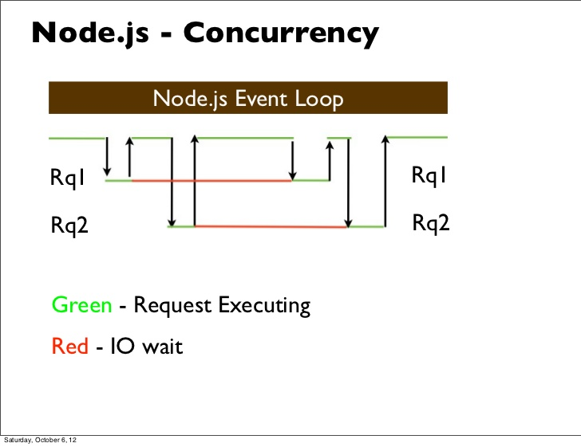
Node.js Concurrency Explained - Continue

Slide 6
Asynchronous Operations That We Don’t Expect
Using a function that uses timers in it’s internal implementation
SetInterval
SetImmediate
SetTimeout
I/O operations in the function internal implementation
Usage a function from third party library – internal implementation performs asynchronous operations

Slide 7
How To Solve Concurrency Problems In Node
Node.js programming paradigms are different
Utilize mechanisms for concurrency and implement them in Node.js
Implement lock
Implement critical section
Take general patterns and use them as they are
Optimistic locking
Transactions (if supported)
And more …

Slide 8
Lazy Initialization

Slide 9
Problem statement
Delaying specific operation until the first time it is needed
Creation of an object
Calculation of a value.
Other expensive operation
Avoid repeating the operation the next time it is needed
Initialize a member by key on an internal cache container

Slide 10
Object Oriented Use cases
Singleton design/anti pattern
Factory method
Caching layers
Returning immutable objects
And more …

Slide 11
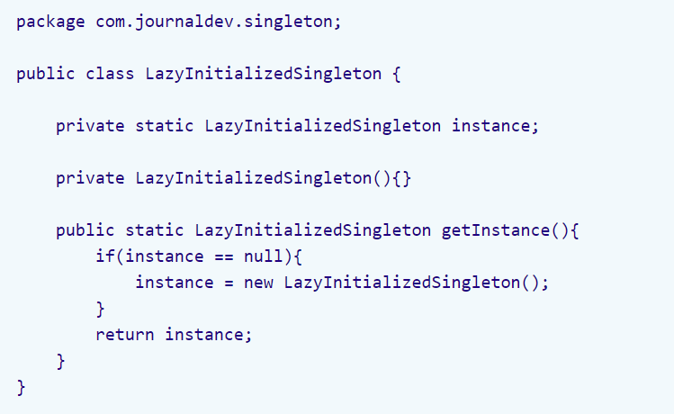
Lazy Initialization Usage – Java Singleton

Slide 12
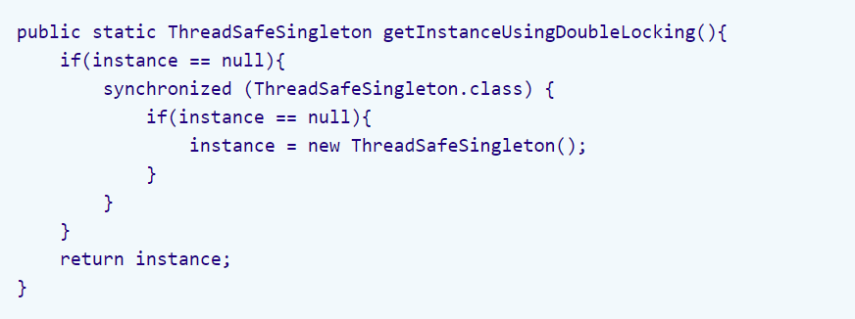
Example : Java Thread Safe Singleton

Slide 13
Lazy Initialization Concrete Usage In Node.js
Example : Caching layer implementation
Need to initialize results from DB according to a specific key
Initialize each key only once
For multiple code paths in real server – Initialization can happen twice very easily
Prevent consumers to change the objects received from cache

Slide 14
Concurrency Problem Deep Dive
2 requests intend to initialize the same value
Event loop schedule 2 DB queries in parallel
Initialization Flow starts for first query
value == null check is passed
Built in async operation in init flow
Context switch in event loop
Initialization Flow starts for second query

Slide 15
Concurrency Problem Deep Dive - Continue
Initialization flow starts for second query
Value == null check is passed
Built in async operation in init flow
Context switch in event loop
Flow for initialization first query resumes
First query initialize value in cache
Flow for initialization of second query resumes
Value initialized twice

Slide 16
Bad Solution – Critical Code Completely Synchronous
Make the critical code completely synchronous with no I/O operations or timers
This is not a good solution because
Bad performance – blocking the event loop
You would have to use other modules / third party libraries
We must implement everything by ourselves – or verify the implementation of all the libraries that we depend on
Bottom line - You cannot control the implementation of every code you use

Slide 17
Solution – Using Promise To Implement Locking
Promise wraps an a-synchronous operation
Have callback for success – then
Callback for failure - catch
On first invocation – store promise in memory container
All events that will hit the key will receive the same promise
The asynchronous operation will be performed once
Store value on then callback or return it if already exist

Slide 18
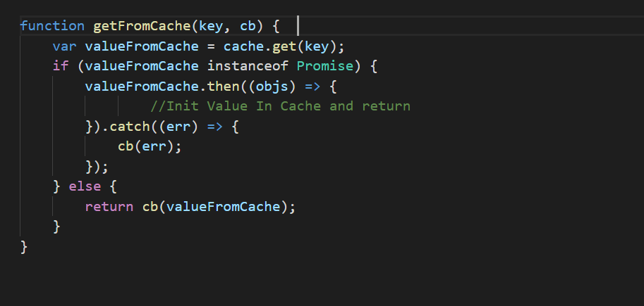
Promises Concurrent Code Example

Slide 19
Keep Your Objects Immutable

Slide 20
JavaScript Objects Immutability
Immutability is a general pattern for concurrency
Nobody can change immutable objects
Simplest approach - deep clone the return object.
When all the consumers will receive a clone of the object they will not be able to change the original objects
Objects will be concurrently safe.
Must do in the cache implementation we discussed

Slide 21
Cloning objects in JavaScript
Json.Stringify
Loadash provides deep object cloning
And more …

Slide 22
Lock An Object Shared By Multiple Asynchronous Functions

Slide 23
Problem Statement
Specific entity in DB
Has Property ‘interest rate’
Execution of a specific function do an asynchronous calculation and use the property ‘interest rate’
To keep business consistency – we must prevent the ‘interest rate’ to be changed in the middle of the computation
Other Requests update the ‘interest rate’ in the middle of calculation
Locking of the entity is required

Slide 24
Timeline Events
Update Request to Interest Rate
End Update Request
Start Interest Calculation
End Interest Calculation

Slide 25
Single Node – Lock Object + Sticky Session
If your DB would support transactions we can use them
But a lot of DBs does not support
The solution here will be combined from 2 parts
Single Node –
locking the object in memory
requests that will try to access the object will wait
Extend Solution for multi Node –
sticky session on the object
All updates will arrive to the same node

Slide 26
Lock Object Between Asynchronous Functions
Maintain a version to the object on application layer
Update version on each object update
Lock the object in memory by version number as the lock key
Events with different keys will run on the event loop
Events with the same key will be blocked and wait until lock is finished

Slide 27
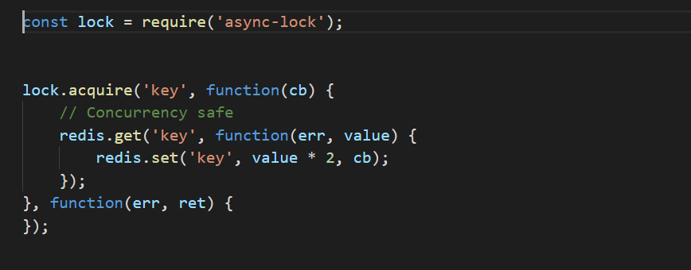
Async-lock – Critical Section In Node.js
Lock the object by the version number on 2 places :
Object Update
A-synchronous computation

Slide 28
Sticky Session – To Complete The Solution In Cluster
We must combine it with sticky session
Async lock will only provide memory lock in the same node
Requests that will arrive to different nodes will perform the update
Sticky session – A routing pattern in which all requests are routed to the same node

Slide 29
Updating the same Object Concurrently

Slide 30
Problem Statement
2 requests intend to update sane record
First request starts the update flow
Context switch in event loop
Second request starts the update flow
Context switch in event loop
First request resume the flow and update
Second request resume the flow and Update
Overriding Updates

Slide 31
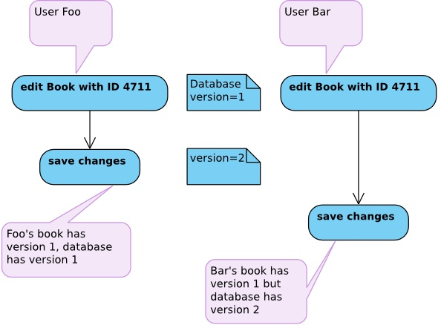
Solution – Optimistic Locking

Slide 32
Optimistic Locking Implementation
Implementation in 2 layers :
On application layer :
Maintain a version for each entity
Update the version on every entity update
On DB layer : Execute the following query for atomic update
‘update …. Where version = %current_version’

Slide 33
Pros And Cons
Pros –
Will guaranty consistency
Out of the box cluster support
Cons - Updates with a non updated version will fail - exception
For the updates to wait –
Utilize async-lock library + sticky session for example
DB Transactions – Not applicable for every DB

Slide 34
Questions ?

