Slide 1

Async / Await
Tamar Twena-Stern

Slide 2
Agenda
Recap on previous solutions
Introducing Async functions
Quick Example and Observations
Advantages for the new approach

Slide 3
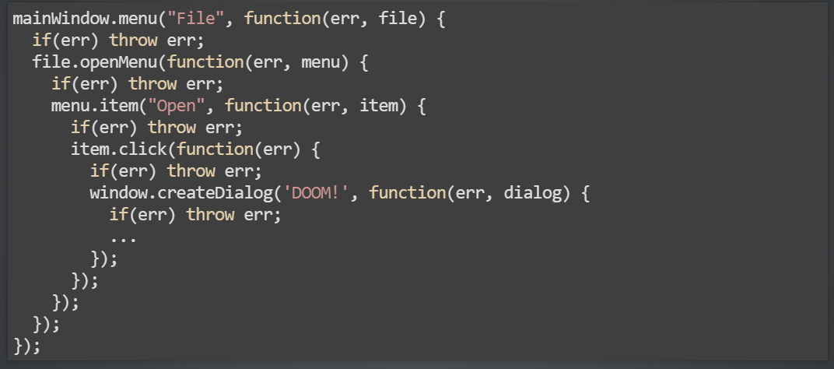
With Non Blocking I/O Born The Pyramid Of Doom

Slide 4
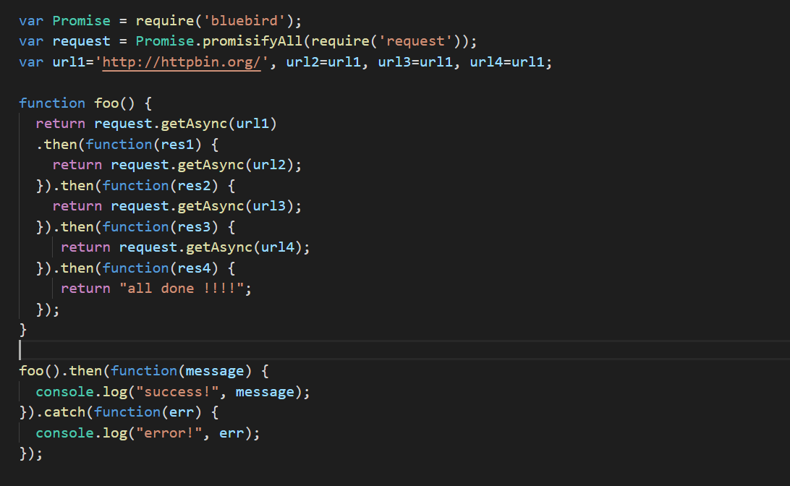
First came promises to the rescue

Slide 5
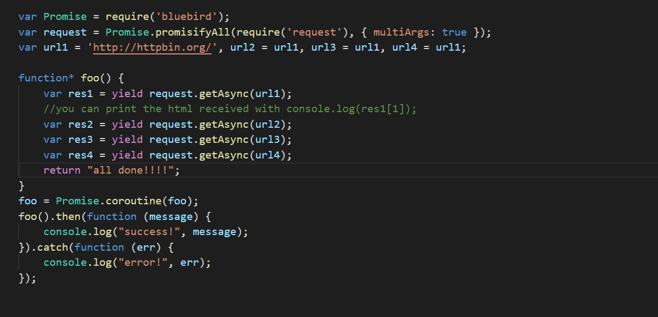
Generators + Promises – Almost Flat

Slide 6
ES7 – Async /Await

Slide 7
Async Functions
Return an Promise
Inside an async function, we can :
Use await before a function that returns a promise
Await waits for the promise to be resolved
Handle errors with easy and popular mechanism – try / catch
Behind the scenes – asynchronous code

Slide 8
Await keyword
Reserved word from ES7
Can be used only inside an Async function
Await is used to wait for a promise
Await cause the execution of the function to stop
Same concept as generators
Help simplify the code to look synchronous
Behind the scenes – asynchronous code

Slide 9
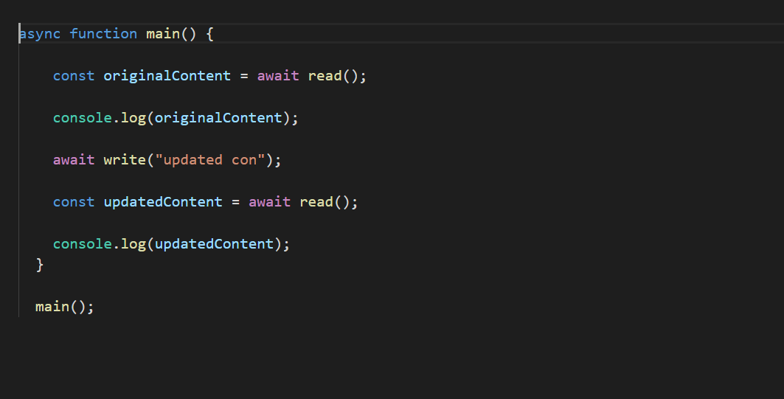
Async / Await – Almost synchronous Code

Slide 10
Observations
Await can be used only inside async function
You cannot use await on your top level code – on top level code you must resolve a promise explicitly
Await read means that the function will wait until the read operation will finish

Slide 11
Advantages

Slide 12
Concise And Clean
No need to use .than
No need to write anonymous callback function for .than or for .catch
Not creating variables that we will not need
Avoid nesting
Very intuitive

Slide 13
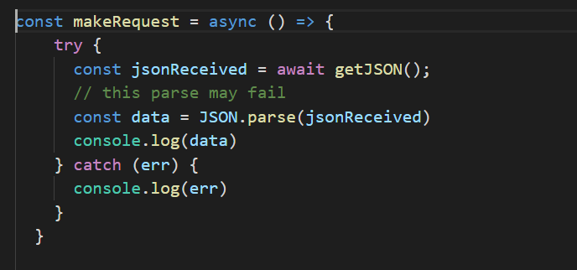
Error Handling
Use try / catch mechanism
Handle synchronous and asynchronous together in the try / catch block

Slide 14
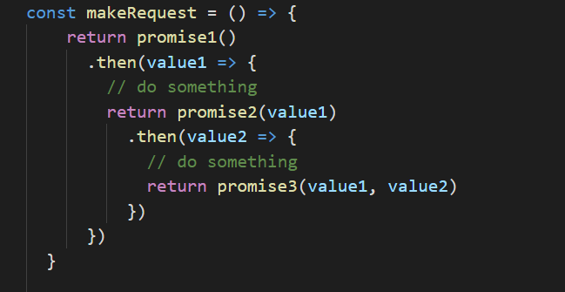
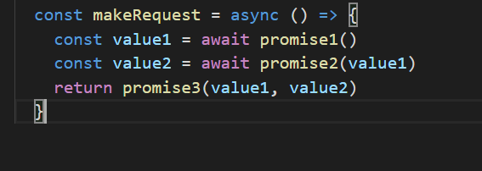
Intermediate Values

Slide 15
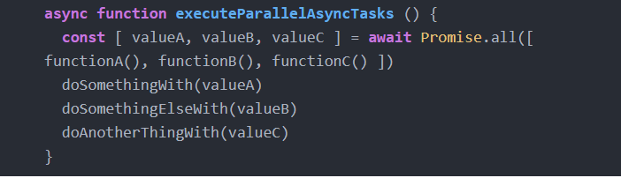
Parallel execution
Several parallel tasks execution with async await

Slide 16
Questions ?

