Slide 1

From Zero To Hero In NodeJS
Tamar Twena-Stern

Slide 2



About me
Software engineer – Manager and Architect
Leader of Edgeverve CTO group in Israel
Oecloud.io Architect
Passionate about NodeJS!

Slide 3
Agenda
NodeJS introduction
How it works in a nutshell
Why choosing nodeJS over other platforms
Building you first Node Server
Which library to choose ?
How to choose the correct Db and integrate it with Node ?
Authentication

Slide 4

Servers in our days
Requirements :
Keep latency low
Throughput high
Scaling up and out

Slide 5
What is NodeJS
Server side platform for developing servers
Web
Mobile
Enterprise
Open source, cross platform
Enables to build fast and scalable network applications

Slide 6










Who use it in Production ?

Slide 7
Traditional Approach
thread
request
client
server
request
thread
request
thread

Slide 8
NodeJS – Non Blocking
Events
Event Emitters
Event Handlers
Event Loop

Slide 9
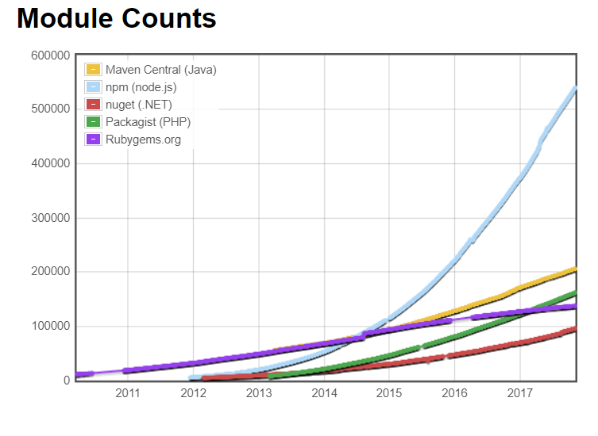
Huge amount of libraries
NPM - Largest package repository in the world

Slide 10
NodeJS vs Java
 | NodeJS | Java
Code reuse
IDEs
Build Process
maturity
JSON
Speed
Threads
Debugging + Monitoring

Slide 11
Performance : NodeJS vs Java

Slide 12
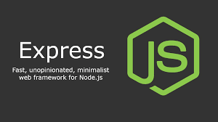
Express in NodeJS
One of the most common modules to develop servers in NodeJS.
Becomes the ‘development standard’ .

Slide 13
Demo – NodeJS Express server

Slide 14








More Possibilities

Slide 15

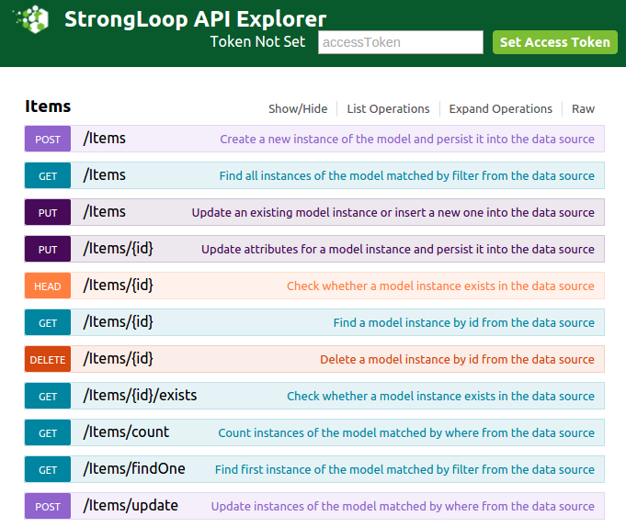
var loopback = require('loopback');
var app = module.exports =loopback();
var Item = loopback.createModel(
'Item', {
description: 'string', completed: 'boolean‘
}
);
app.model(Item);
app.use('/api', loopback.rest());
app.listen(8080);

Slide 16






Databases Connectivity
MySQL (Relational) – NodeJS mysql driver, Sequalize
Apache Cassandra – express-cassandra
MongoDB - Mongoose

Slide 17
Demo – NodeJS Connectivity To MongoDB

Slide 18
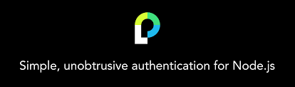
Authentication - Passport
Most common authentication middleware for NodeJS
Extremely flexible and modular
More than 300 authentication strategies

Slide 19
Demo – Passport – Basic authentication

Slide 20


Testing, Testing
describe(Persons', function() {
it('should list ALL persons on /persons GET');
it('should list a SINGLE person on /person/<id> GET');
it('should add a SINGLE person on /persons POST');
it('should update a SINGLE person on /person/<id> PUT');
it('should delete a SINGLE person on /person/<id> DELETE');
});

Slide 21
Questions ?

Slide 22
Thank You!

