Slide 1

Event loop deep dive
Tamar Twena-Stern

Slide 2
Agenda
Traditional approach – Blocking I/O
The opposite – Non blocking I/O
The event loop in a nutshell
Event loop architecture and different components
What actually happening on the operating system ?
The different phases of the event loop
Why Node.js scales well

Slide 3
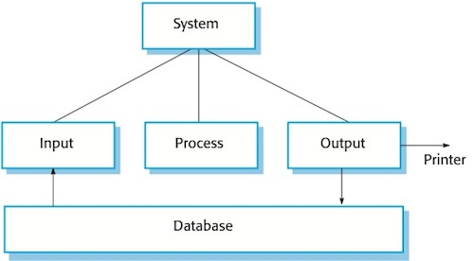
What is an I/O operation ?

Slide 4
Traditional Approach – Blocking I/O
Simple approach : wait until the I/O operation will complete
Block the program until I/O returns and leave the system idle.

Slide 5
Traditional Approach
thread
request
client
Server
request
thread
request
thread

Slide 6
Problems
The system allocates CPU and memory resources for every new thread
When the system is stressed – overhead of thread scheduling and context switching
The system waste resources for allocating threads instead of doing actual work

Slide 7
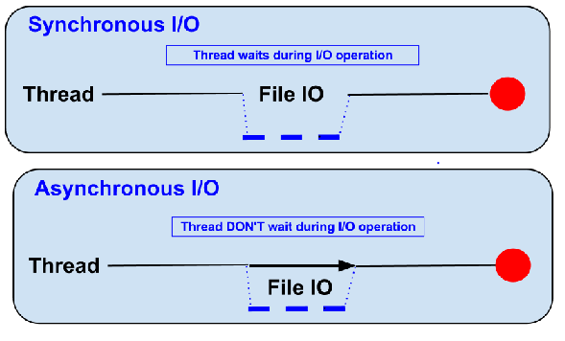
The opposite – Non Blocking I/O

Slide 8
Event Loop In A Nutshell

Slide 9
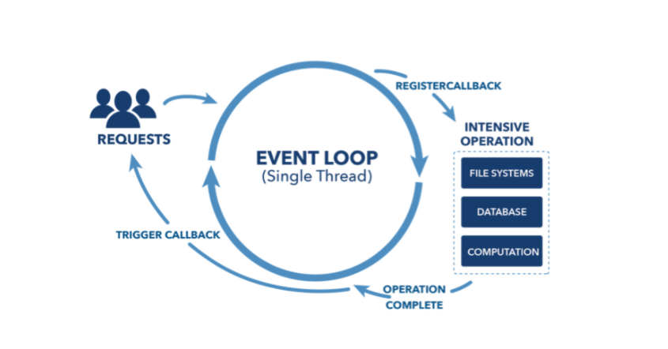
Event Loop in a nutshell

Slide 10
Event loop in a nutshell
What enables Node.js to perform non blocking I/O
Offloading I/O operations to system kernel whenever possible
Kernel informs Node.js that operation completed, callback queued in appropriate queue

Slide 11
Event loop architecture and different components

Slide 12
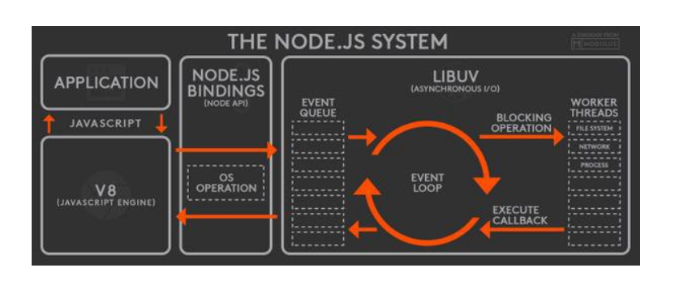
The Architecture

Slide 13
Event loop thread
Event loop runs on single thread
Each new request register a synchronous callback
Execute JavaScript callbacks
Offloads I/O operations to worker thread pool.
Handle callbacks for asynchronous I/O operations that finished.

Slide 14
Workers thread pool
Thread pool to perform heavy operations
I/O
CPU intensive operations
Bounded by fixed capacity
Implemented with libuv
Node module submit a task to libuv API with C++ add-on

Slide 15
Modules who use worker pool
I/O-intensive
DNS:
dns.lookup(), dns.lookupService()
File System: All file system APIs except
fs.FSWatcher()
explicitly synchronous operations.
CPU-intensive
Crypto:
crypto.pbkdf2()
crypto.randomBytes()
crypto.randomFill()

Slide 16
What happening on the operating system level?

Slide 17
Event loop – What the operation system do ?
Does not maintain a queue!
Monitor collection of file descriptors
File descriptor ready
Signals operating system
Notifies event loop
Translates and invoke callback

Slide 18
Worker Thread Pool implementation
Maintain a queue of tasks
Each thread pops a task from the queue
When finished – raise event to event loop
Thread pops task
Execute the task
Raise event when done

Slide 19

Libuv in a nutshell :
Multi platform C library
Provides support for async I/O based on event loop
Supports :
Epoll (Linux)
Kqueue (OSX)
Windows IOCP
Solaris event ports

Slide 20
The order of operations in the event loop

Slide 21
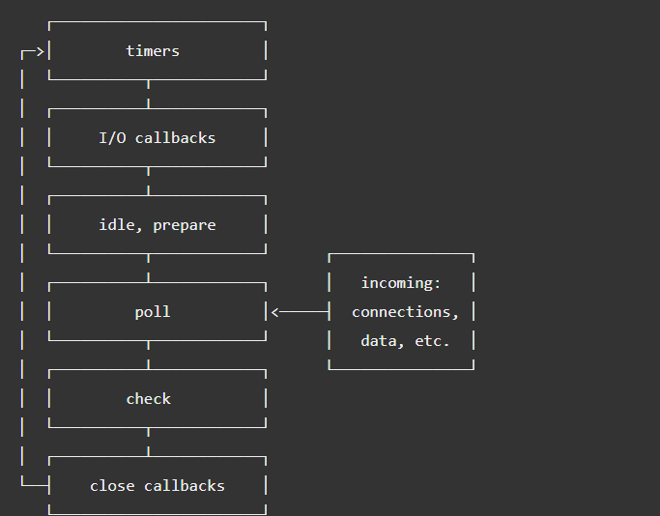
Event loop phases overview

Slide 22
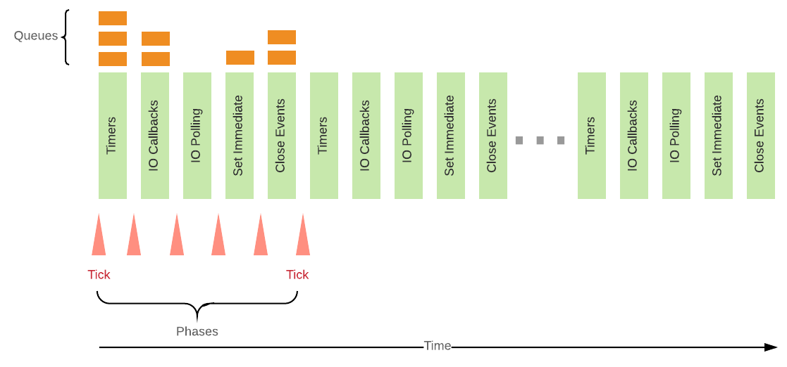
Phase General Mechanism

Slide 23
Timers Phase
setTimeout, setInterval
Timer’s callback will run as soon as they can be scheduled after the threshold
Timer’s callback scheduling controlled by the “poll” phase

Slide 24

I/O callbacks Phase
Specific system callback operations
For example : TCP socket errors

Slide 25
Poll Phase
Timers with threshold elapsed ?
Yes
No
Back to timers Phase
Poll Queue Empty ?
No
Yes
Execute Poll Queue Callbacks
Continue to “Check” phase

Slide 26
Check Phase and Close Phase
Check Phase - Execute callbacks for setImmediate timers
Close Phase – Handles an abruptly close of a socket or a handle

Slide 27
Process.nextTick()
Not part of the event loop
Runs before any I/O operation
Will be executed right away
Careful ! Starvation

Slide 28
The secret of Node Scalability

Slide 29
Why Node scales well ?
Small number of threads to handle many clients
One thread for event loop
Constant amount of threads in workers pool
Spend more time and memory working on clients actual work rather than paying space and time overheads for threads

Slide 30
Each Thread is critical !
Blocked Thread :
Long callback (event loop)
Long task (worker pool)
If thread is blocked - cannot handle requests from any other client.

Slide 31
Conclusion
Because Node has only a few threads, you must structure your application to use them wisely.
Remember - Node is fast when the work associated with each client at any given time is "small".

Slide 32
Questions ?

