Slide 1

Promises
Tamar Twena-Stern

Slide 2
Agenda
Asynchronous programming
Asynchronous programming problems
What are promises and how to use them
Implement different control flows with promises
Promise libraries
A specific problem I solved with promises

Slide 3
Asynchronous programming
synchronous activities will block the event loop.
In client and server
Asynchronous programming has evolved in JavaScript
Functions are first class citizens
No return values, only function calls.

Slide 4
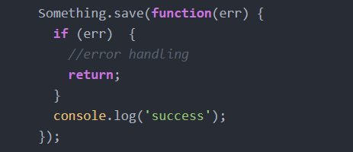
Asynchronous Code Example

Slide 5
The Problems

Slide 6
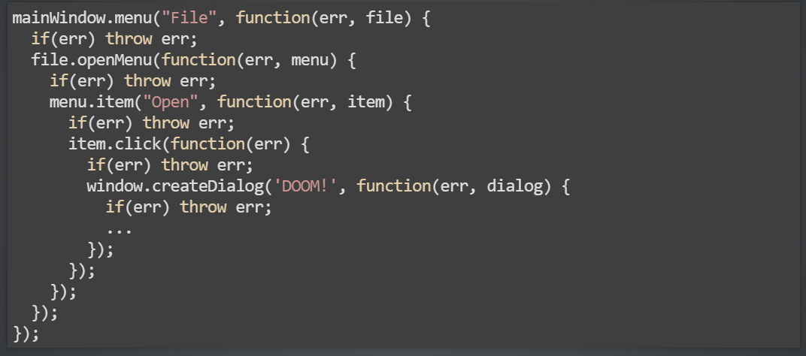
The Pyramid of Doom

Slide 7
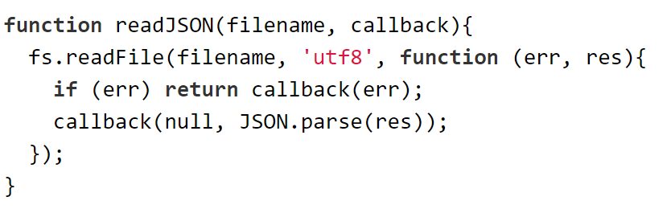
Easy To Miss Error Handling

Slide 8
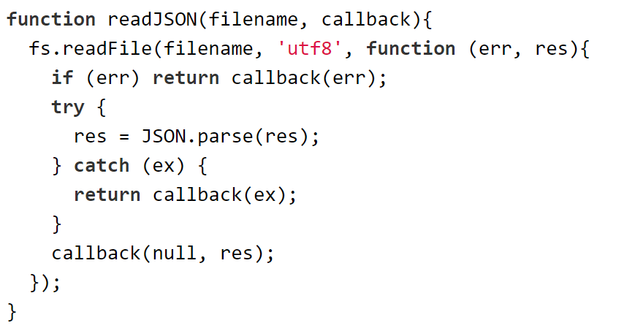
Easy to miss error handling

Slide 9
Different Control Flows
Very hard to implement control flow patterns
You want to be able to execute tasks in :
Series
Parallel
Even implementing array mapping using pure asynchronous functions very hard with plane callbacks

Slide 10
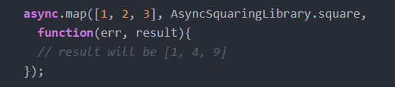
First came async library

Slide 11
Promises

Slide 12
What is a promise
A proxy for a value that we don’t know yet
Register an event handler to
Success of an asynchronous operation
Failure of an asynchronous operation
Enable an asynchronous method to return value like a synchronous method

Slide 13
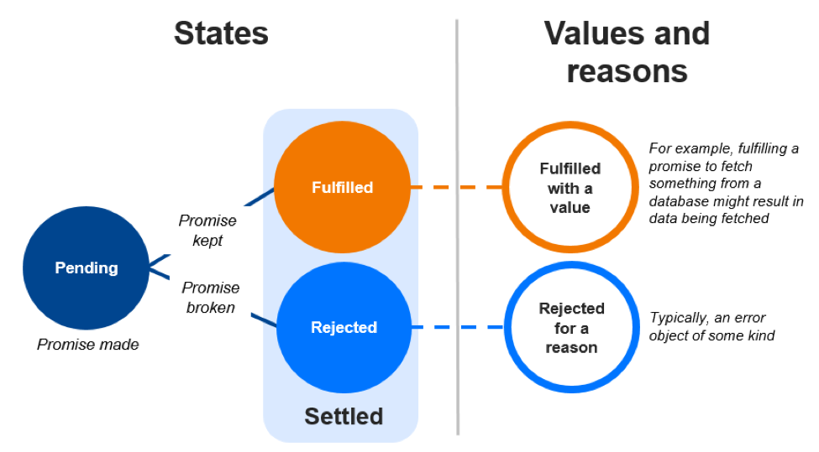
What is a promise ?

Slide 14
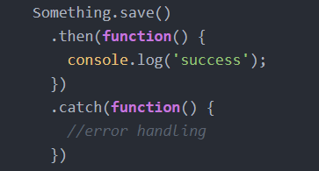
How the code looks with promises

Slide 15
Working with Promises on Asynchronous code

Slide 16
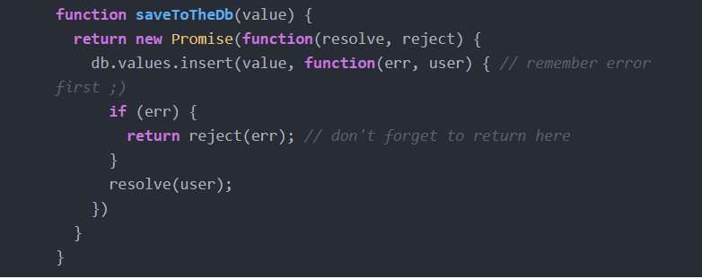
Wrapping Your API With Promise – Use “New Promise”

Slide 17
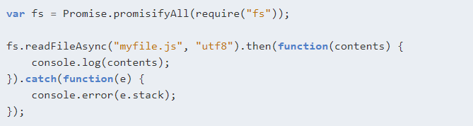
Use PromisifyAll To Automatically Convert API To Promises

Slide 18
Control Flow Patterns

Slide 19
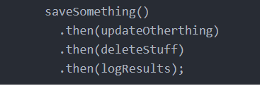
Execute In Series – Promise chaining

Slide 20
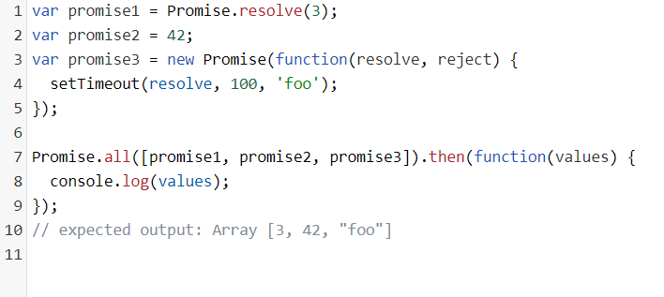
Execute in parallel – Promise.all
Receives an array of promises
Schedule them one by one
Execution will be in parallel, if the asynchronous activity will be offloaded to the worker pool
Provide a promise that will be resolved when all promises will be resolved

Slide 21
Node.js Promise libraries
Native in ES6
Bluebird – add a lot of extra functionality on native ES6
Promise.mapSeries()
Promise.reduce()
Promise.map()
Promise.Some()
Promise.any()
Promise.each()
Etc …
Q

Slide 22
I found promises useful to solve first initialization problem
I had to implement a caching layer from scratch on server
Two requests could have initialize the same value for using the same key
Without promises – all requests that were using the same value initialized it over and over again
With promises – Only one request initialized the value - others received the retrieved value and ‘then’ event listener was called
This code is on open source – can show you offline
We will discuss in detail later on in the course

Slide 23
Questions ?

