Slide 1
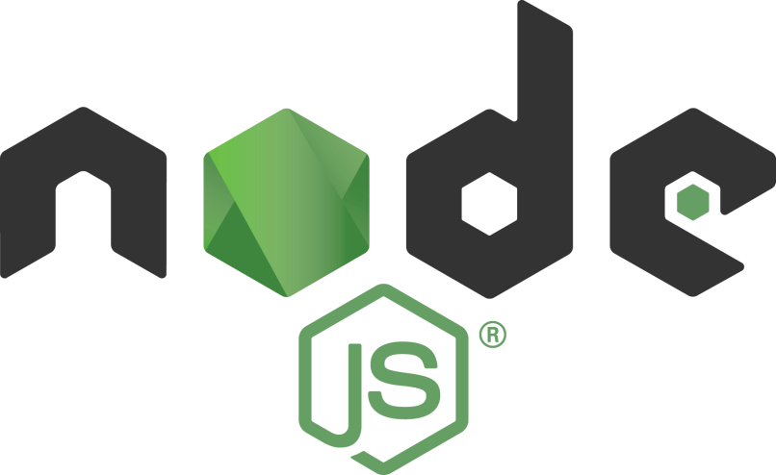
Introduction
Tamar Twena-Stern

Slide 2
Agenda
About me
Course Agenda
What you should have / install
Node.js Background + well known libraries

Slide 3


About me
Software engineer – Manager and Architect
Now writing awesome code at bitsrc.io
Former
leader of Edgeverve CTO group in Israel, Oecloud.io Architect
CTO at a start up of my own
Performance team leader at NCR
Passionate about NodeJS!

Slide 4
Course Agenda
Day 1 –
Event Loop deep dive
Promises
Generators
Async / Await
Day 2 –
Concurrency problems in Node.js
Multi Process in Node.js
Performance lesson + open discussion about performance issues you had
Node.js profiling

Slide 5
Course Agenda
Day 3 –
The Garbage collector
Memory leaks in Node.js
Security breaches in Node.js
And if we will have time :
Hot trends in open source libraries
JavaScript design patterns and the prototype chain

Slide 6
Before We Start
Make sure you have –
Node.js
Npm (or yarn)
MongoDB – locally or a server you can work with
Git client
Optional :
Jmeter
Nvm
Don’t worry – we will not use them in the first day (-:

Slide 7

Servers in our days
Requirements :
Keep latency low
Throughput high
Scaling up and out

Slide 8
What is Node.js
Server side platform for developing servers
Web
Mobile
Enterprise
Open source, cross platform
Enables to build fast and scalable network applications

Slide 9










Who use it in Production ?

Slide 10
Traditional Approach
thread
request
client
Server
request
thread
request
thread

Slide 11
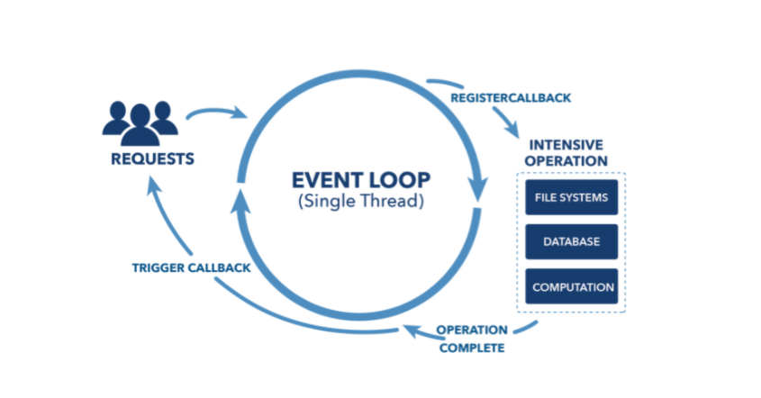
Presenting Different Approach – Node.js Event Loop

Slide 12
Performance : Node.js vs Java

Slide 13
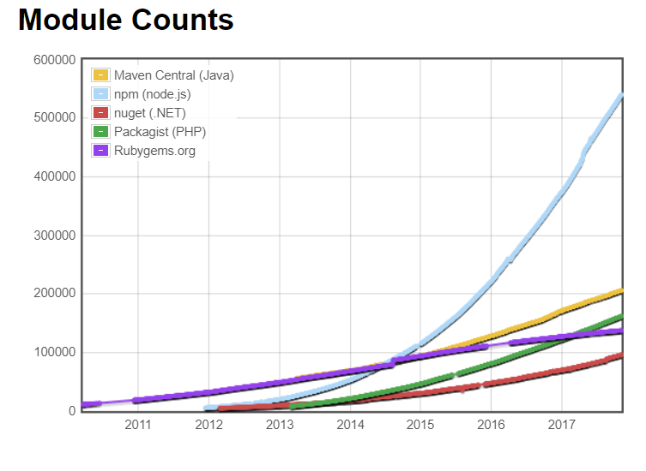
Huge amount of libraries
NPM - Largest package repository in the world

Slide 14
Basic Libraries To Start Writing My Server

Slide 15
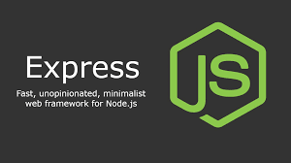
Express in NodeJS
One of the most common modules to develop servers in NodeJS.
Becomes the ‘development standard’ .

Slide 16








More Possibilities

Slide 17

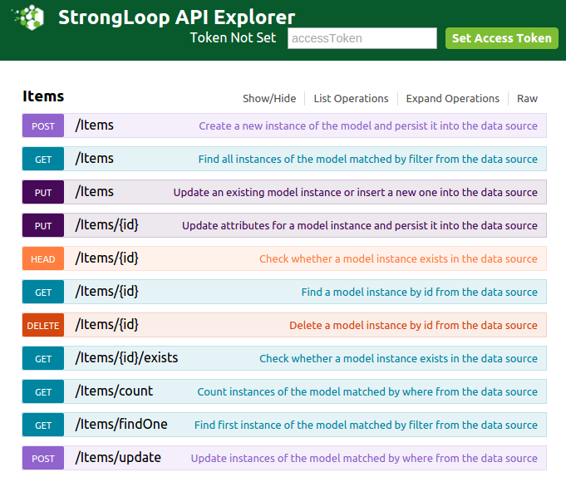
var loopback = require('loopback');
var app = module.exports =loopback();
var Item = loopback.createModel(
'Item', {
description: 'string', completed: 'boolean‘
}
);
app.model(Item);
app.use('/api', loopback.rest());
app.listen(8080);

Slide 18






Databases Connectivity
MySQL (Relational) – NodeJS mysql driver, Sequalize
Apache Cassandra – express-cassandra
MongoDB - Mongoose

Slide 19
Summary
Node.js has become extremely popular in server development
More and more companies use it
Entering into the enterprise software field as well
Even if you don’t use it in your everyday work – this is a skill that you really want to learn !

Slide 20
Questions ?

