Slide 1

Nosferatu
We will Hash Slinging Slash your electric bill
By: Connor Igo, Dan Cardin, Joe Gorse, Chris Holtsnider, Gunnar Boehm
Advisor: John Kimani
Summer 2 2015
Capstone 1

Slide 2
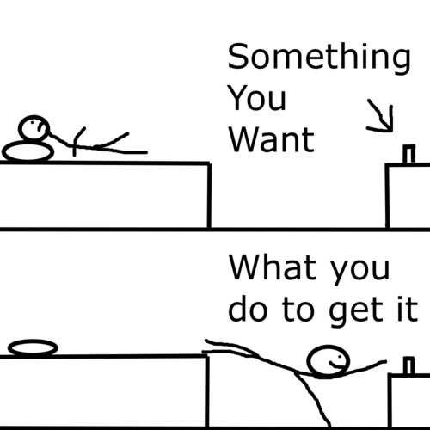
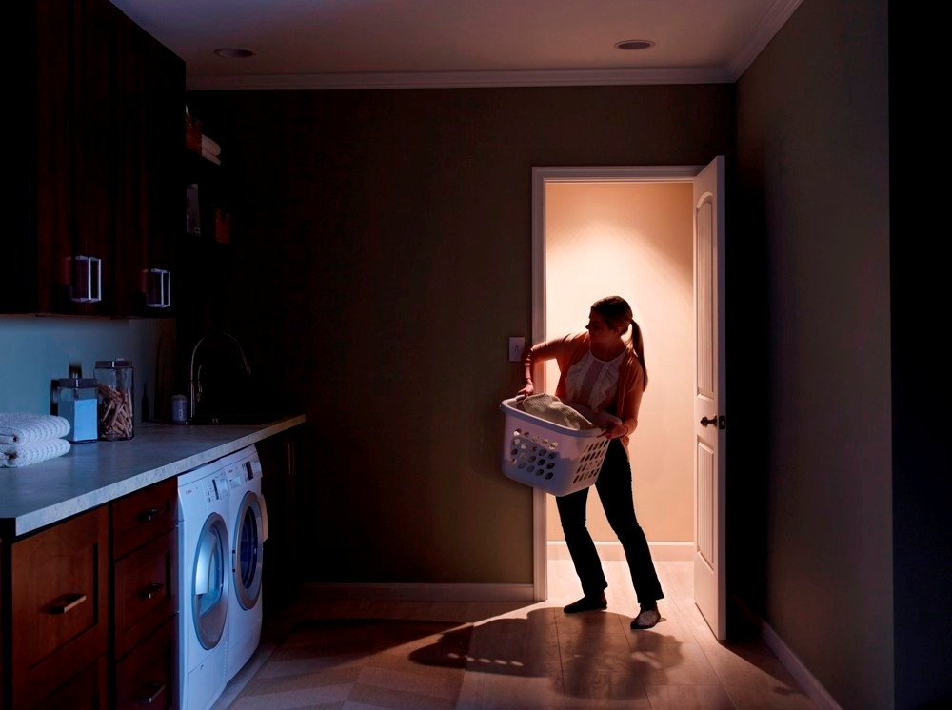
The Problem
Pesky light switches that are impossible to find in the dark
Needing to get out of your comfortable bed to turn off lights
Bumping into furniture on your way to the bathroom late at night
Notes:
Connor

Slide 3
Introduction
Nosferatu is an energy efficient, convenient new way to control your home lighting. Bringing Wi-Fi and motion sensors to your light switches allows you to set schedules and rules to manage your home lighting, as well as save money, energy and time.
Notes:
Connor

Slide 4
Uses
Walk into a room, motion sensor turns light on automatically
With rules you can set a switch to not respond to motion at certain times of day
Going away on vacation, can set a schedule to turn on some house lights to deter robbers
Turn off/on a light from your computer or phone anywhere
In bed
At work
At Conor Larkins

Slide 5
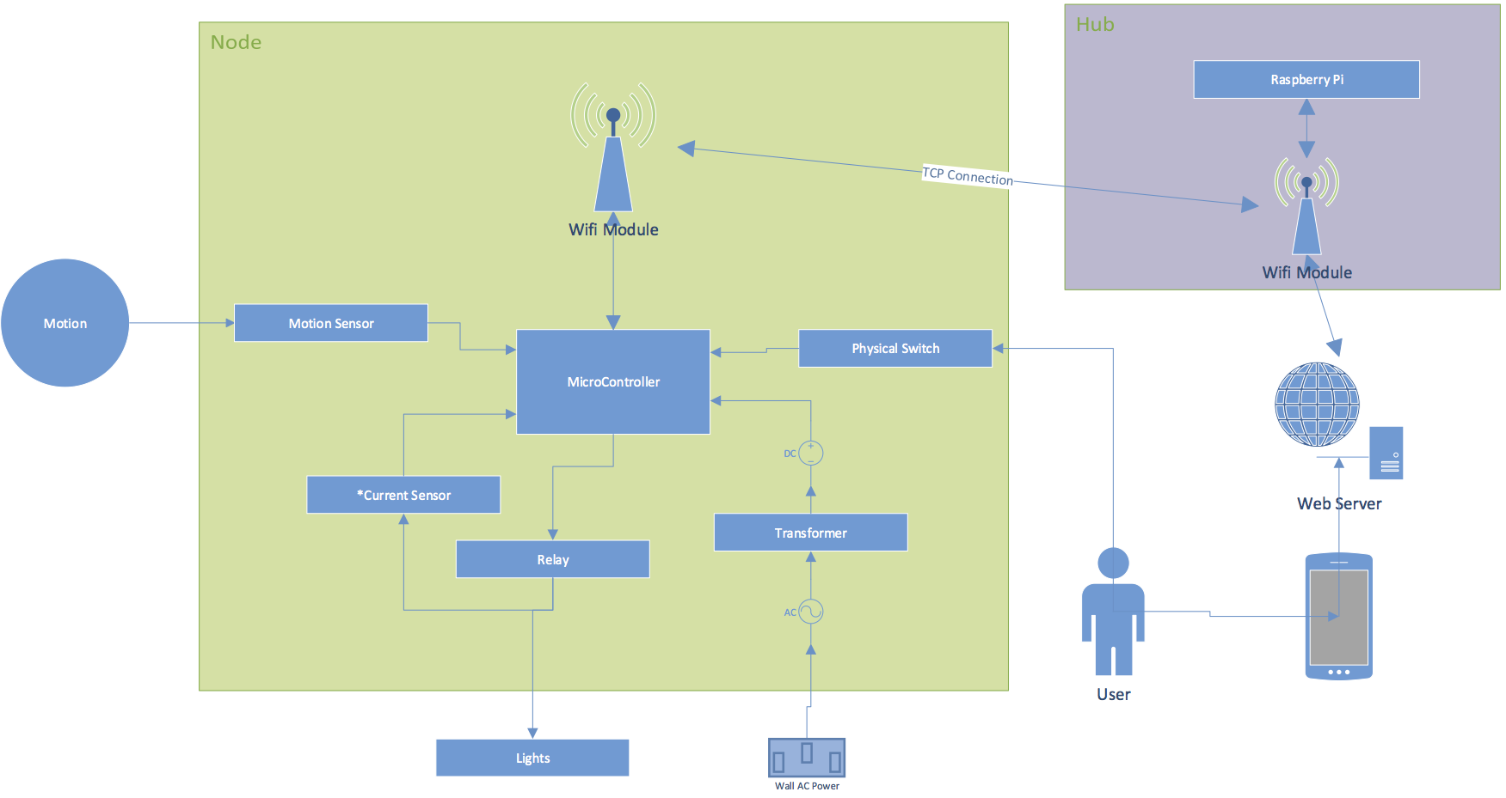
Hardware Layout
Notes:
Chris

Slide 6
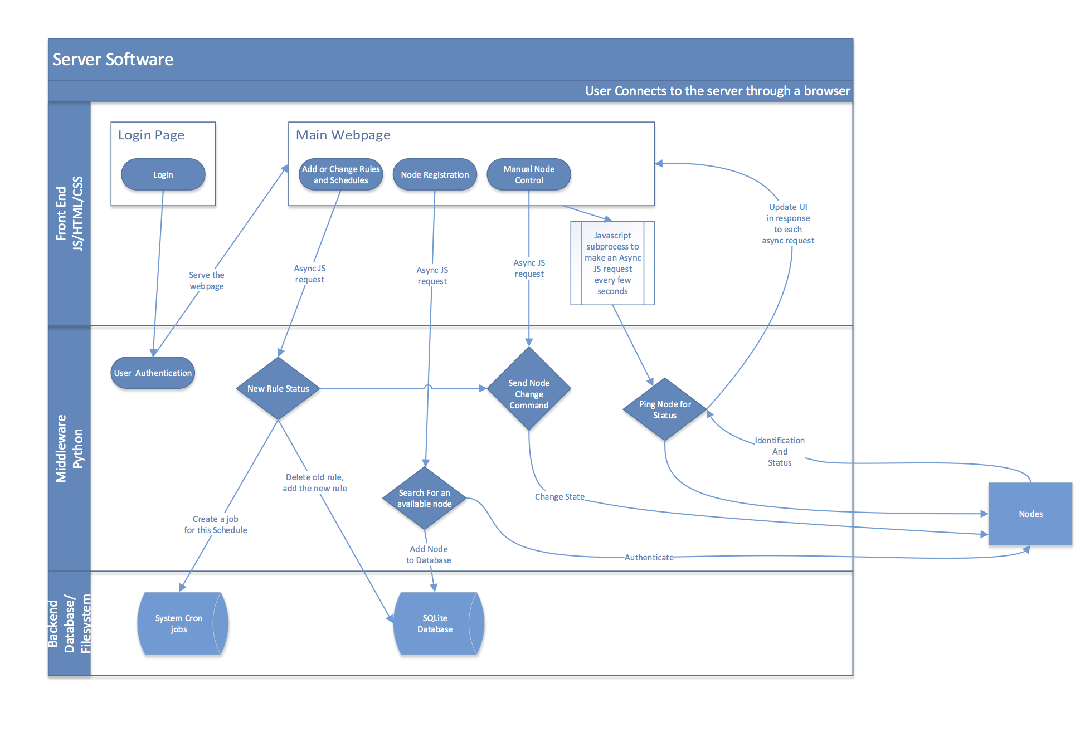
Software Layout
Notes:
Dan

Slide 7
Timeline
ID | Task Name | Start | Finish | Duration | Assigned To
1 | Assemble Node | 9/11/15 | 9/12/15 | 2d | Chris
2 | Setup Raspberry Pi | 9/11/15 | 9/11/15 | 1d | Joe
3 | Create Web Server | 9/12/15 | 9/13/15 | 2d | Dan
4 | Setup Flask | 9/12/15 | 9/13/15 | 2d | Gunnar
5 | Hub -> Microcontrollers Connection | 9/14/15 | 9/20/15 | 7d | Joe
6 | Microcontroller -> Hub Connection | 9/21/15 | 9/27/15 | 7d | Connor
7 | Relay Interface (Software) | 9/14/15 | 9/15/15 | 2d | Connor
8 | Motion Sensor Logic | 9/16/15 | 9/17/15 | 2d | Joe
9 | Web Server Logic (Base) | 9/25/15 | 10/1/15 | 7d | Dan
10 | Expand UI | 10/2/15 | 10/8/15 | 7d | Gunnar
11 | Design Node Enclosure (Create/Print) | 10/2/15 | 10/13/15 | 12d | Dan / Gunnar
12 | Setup Test Enviornment | 10/12/15 | 10/13/15 | 2d | Everyone
13 | Running Tests in Lab | 10/14/15 | 10/27/15 | 14d | Everyone
14 | Base Project Complete | 8/1/15 | 8/1/15 | 0d | Everyone
15 | Advanced Features | 10/28/15 | 11/16/15 | 20d | Everyone
16 | Presentation Prep | 11/17/15 | 11/30/15 | 14d | Everyone
Notes:
Joe – at the end w/ advanced features mention a few stretch goals we may try

Slide 8
Budget
Part List | Cost Estimate Per Part | Quantity | Cost Estimate(-tax)
Arduino | $10.00 | 4 | $40.00
Motion Sensor | $10.00 | 4 | $40.00
Wifi Module | $7.00 | 4 | $28.00
Relay | $8.00 | 4 | $32.00
Transformer | $7.00 | 4 | $28.00
Micro SD Card | $13.00 | 1 | $13.00
Button | $0.50 | 4 | $2.00
LED | $0.35 | 4 | $1.40
Rasberry Pi | $42.00 | 1 | $42.00
Wifi Source Module | $20.00 | 1 | $20.00
Wall Adapter | $3.00 | 1 | $3.00
Programming Board | $15.00 | 1 | $15.00
3D Printing Materials | $20.00 | 1 | $20.00
Totals |  |  | $284.40
Notes:
Joe

Slide 9
How ours is different
From Wi-Fi lightbulbs
Don’t need to replace an expensive lightbulb whenever it dies
More sophisticated and synchronized system/setup
From similar switches (Wemo)
Motion Sensor
Rules
Notes:
Gunnar

Slide 10
Questions?
Notes:
Everyone

