Slide 1
The Battle Of Neighborhoods
Madrid - Spain

Slide 2
Table Of Contens
Introduction
Data
Methodology
Results
Discussion
Conclusion

Slide 3
Introduction
This project is aimed at analyzing the best areas to buy a house in Madrid
The analysis will be based on
number of restaurants, schools, shops or metro lines available in the area → Using Fousquare
Neighborhoods with best renting profit → Data obtained from https://www.madrid.es

Slide 4
Methodology
Process madrid.geojson to obtain the list of Neighborhoods in Madrid
Using foursquare, look for the list of hospitals, schools, parks, restaurants, metro and bus stations, etc. in the area
Process the resulting dataframe to obtain the number of venues of each type available in each neighborhood
Using Kmeans and based on the number of venues available, classify the neighborhoods in 5 different groups.
Process the rent and sales databases
Compute the renting profit as the ratio between the annual rent and the sale price.
Filter out the non-suitable group(s) and identify the most profitable neighborhoods
Recommend one or two neighborhoods to buy a house based on the neighborhood features and the potential renting profit.

Slide 5
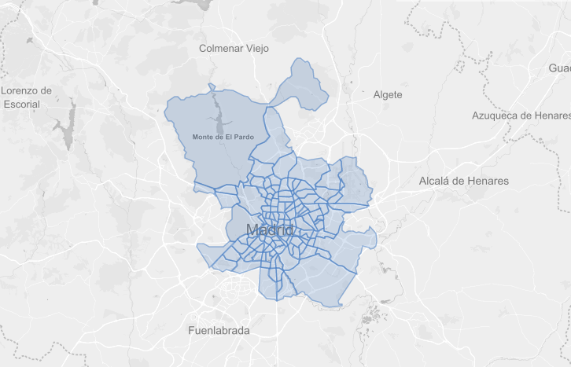
Results – Neighborhoods in Madrid
The list of neighborhoods in Madrid and their coordinates are obtained from the madrid.geojson obtained from:
https://github.com/codeforamerica/click_that_hood/blob/master/public/data/madrid.geojson

Slide 6
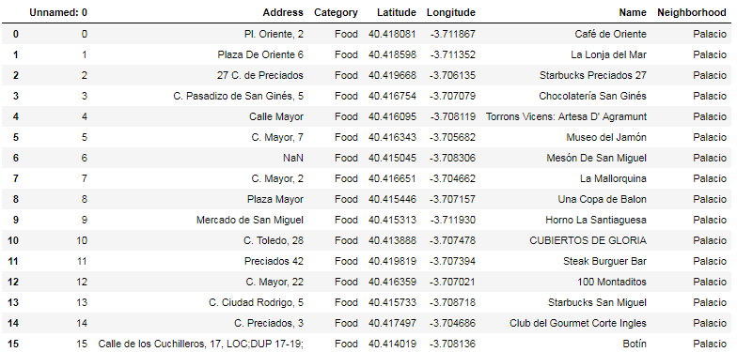
Results – Venues per Neighborhood
The following cattegories are searched with foursquare
Food (Restaurants)
Food & Drink Shop
Clothing Store
Bus Stop
Metro Station
Arts & Entertainment
Park
Athletics & Sports
Hospital
School
University
Bank
Pharmacy

Slide 7
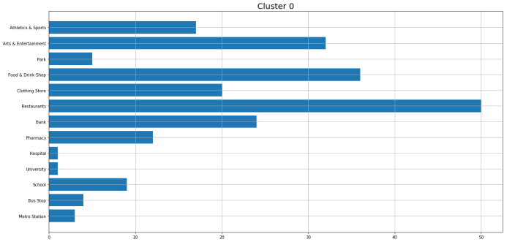
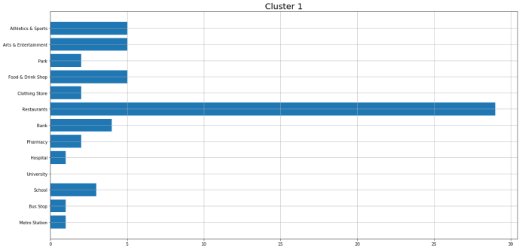
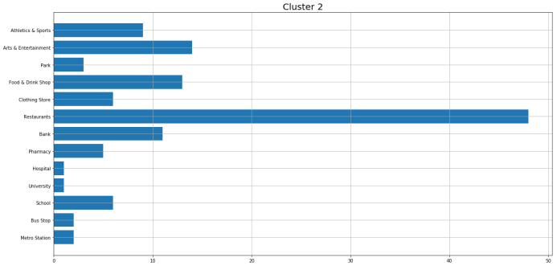
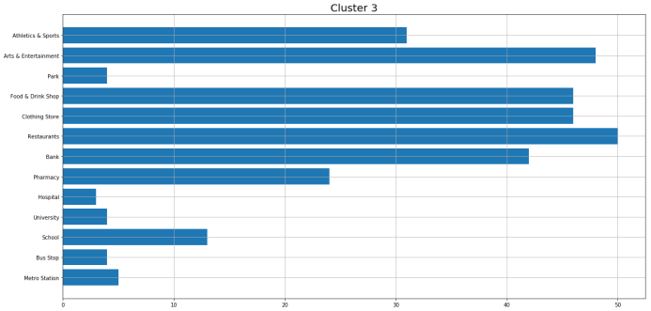
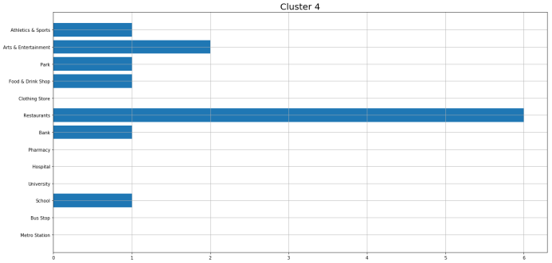
Results – Cluster Classification (I)
Neighborhoods are classified in five different groups
Cluster 0: Has a reasonable number of metro and bus stations. There are several food, clothes stores, pharmacy, banks and restaurants. There is also a hospital and several schools. We therefore classified this cluster as medium-high
Cluster 1: In general terms this cluster has worse communications (metro and bus stops), no universities and fewer facilities (shops, restaurants, arts & entertainment) than cluster 0. Compared to cluster 2, this group is also less equipped. Therefore, it is classified as medium-low
Cluster 2: In terms of facilities, this cluster is between cluster 0 and cluster 1. Therefore, it is considered as medium
Cluster 3: This is the cluster with more clothes, restaurants, banks, pharmacies, schools, etc., therefore it classified as high
Cluster 4: Neighborhoods in this group have poor or non-communications, few facilities, no hospitals... so it is considered as low

Slide 8
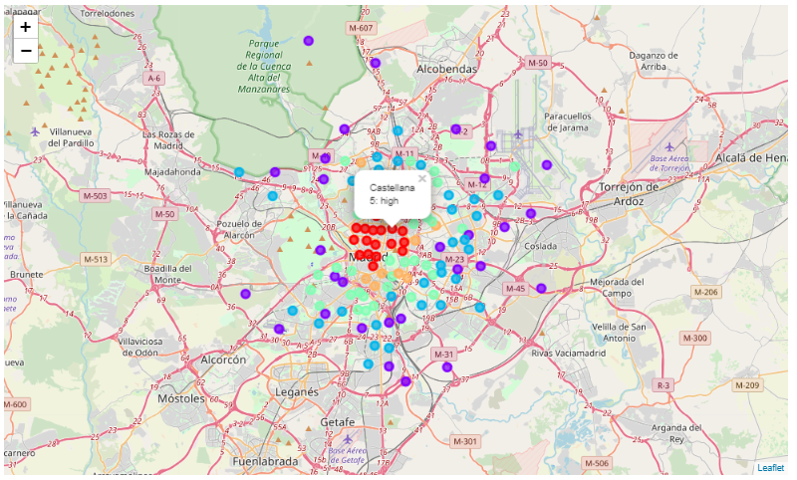
Results – Cluster Classification (II)
Cluster 0: Has a reasonable number of metro and bus stations. There are several food, clothes stores, pharmacy, banks and restaurants. There is also a hospital and several schools. We therefore classified this cluster as 4: medium-high
Cluster 1: In general terms this cluster has worse communications (metro and bus stops), no universities and fewer facilities (shops, restaurants, arts & entertainment) than cluster 0. Compared to cluster 2, this group is also less equipped. Therefore, it is classified as 2: medium-low
Cluster 2: In terms of facilities, this cluster is between cluster 0 and cluster 1. Therefore, it is considered as 3: medium
Cluster 3: This is the cluster with more clothes, restaurants, banks, pharmacies, schools, etc., therefore it classified as 5: high
Cluster 4: Neighborhoods in this group have poor or non-communications, few facilities, no hospitals... so it is considered as 1: low

Slide 9
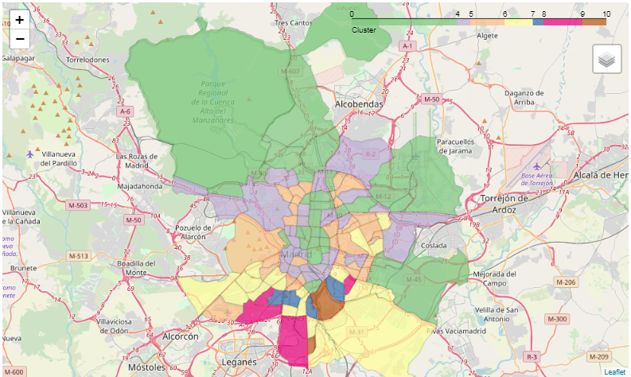
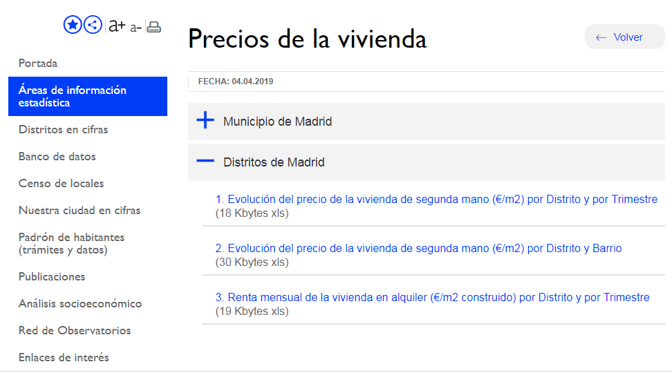
Results – Sale and Rent Prices
Renting Profit Map
Sale price per square meter in the different districts and Neighborhoods of Madrid obtained from https://www.madrid.es

Slide 10
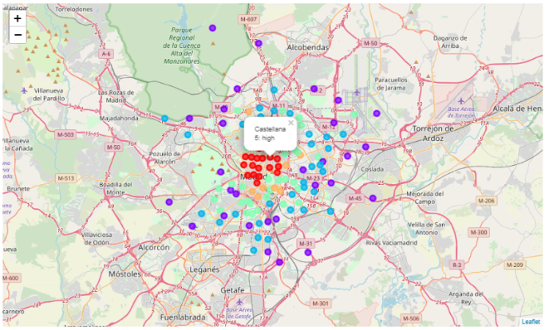

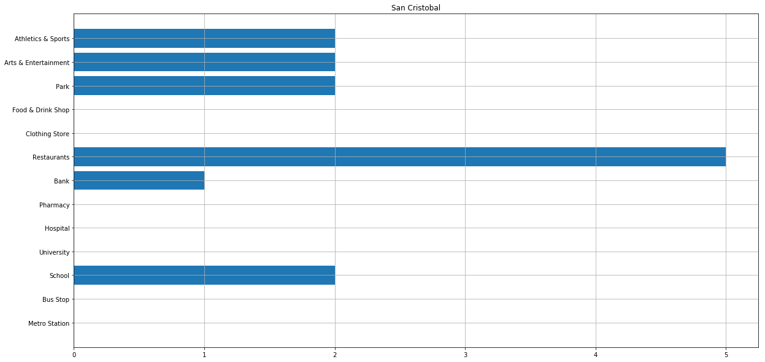
Discussion
The comparison of the cluster and profit maps included in the previous section shows that while the areas with more facilities are in the central part of the city, the neighborhoods with better renting profit are in the outskirts.
Focusing only on the profit it could conclude that the best neighborhood for buying a hose in Madrid is San Cristobal.
However this area has been classified in the “low” facilities group

Slide 11
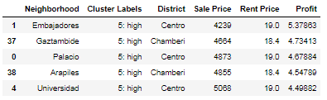
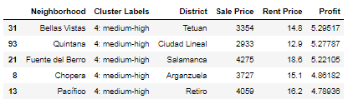
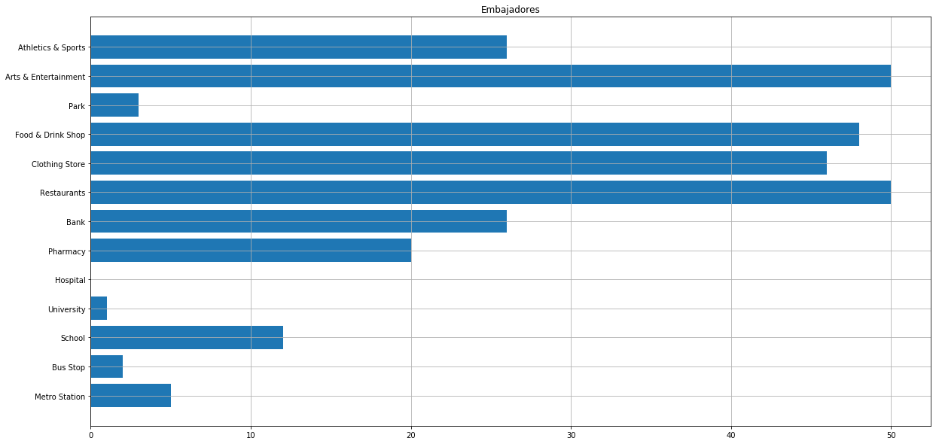
Conclusion
Selection focused on
Neighborhoods located in “high” or “medium-high” areas
with a renting profit above the 5%.
The best area to buy a house in Madrid is EMBAJADORES

