Slide 1
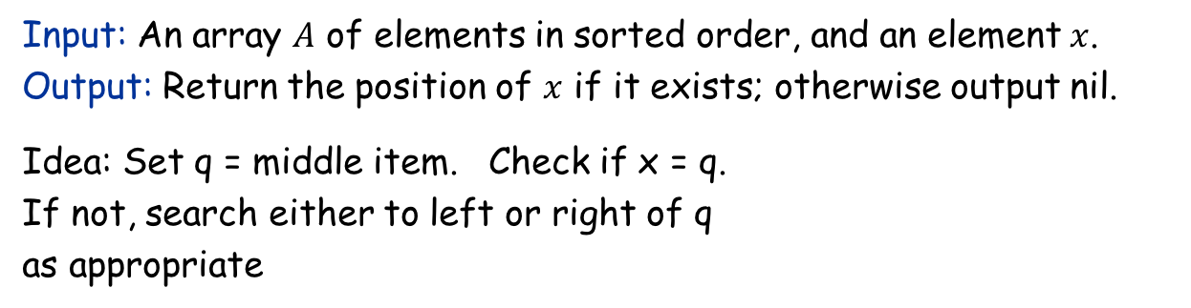
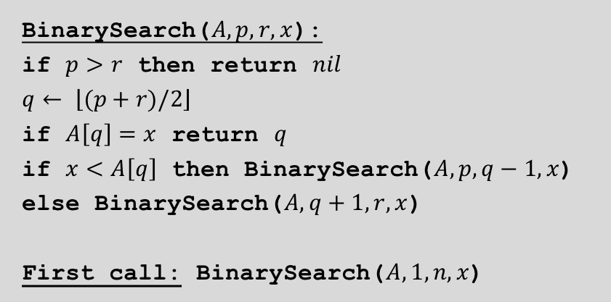
Binary search
Input: An array $A$ of elements in sorted order, and an element $x$. Output: Return the position of $x$ if it exists; otherwise output nil.
Idea: Set q = middle item. Check if x = q. If not, search either to left or right of q as appropriate
4
7
10
15
19
20
42
54
87
90
BinarySearch($A, p, r,x$):
if $p>r$ then return $nil$
$$q← \left\lfloor (p+r)/2\right\rfloor$$
if $A\left[q\right]=x$ return $q$
if $x<A\left[q\right]$ then BinarySearch($A,p,q−1,x$)
else BinarySearch($A,q+1,r,x$)
First call: BinarySearch($A,1,n,x$)

Slide 2
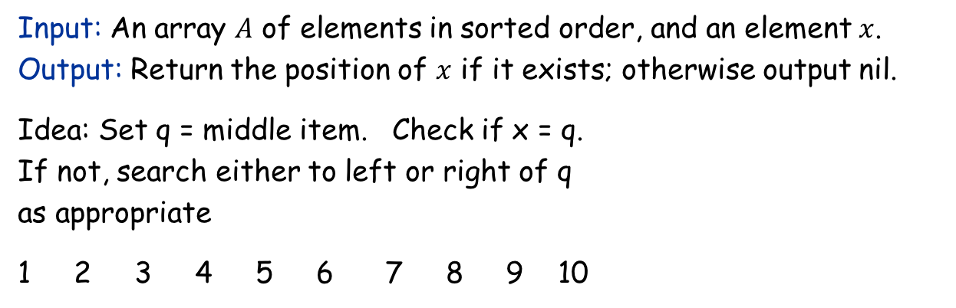
Binary search
Input: An array $A$ of elements in sorted order, and an element $x$. Output: Return the position of $x$ if it exists; otherwise output nil.
Idea: Set q = middle item. Check if x = q. If not, search either to left or right of q as appropriate
1 2 3 4 5 6 7 8 9 10
(A, 1, 10, 42)
4
7
10
15
19
20
42
54
87
90
BinarySearch($A, p, r,x$):
if $p>r$ then return $nil$
$$q← \left\lfloor (p+r)/2\right\rfloor$$
if $A\left[q\right]=x$ return $q$
if $x<A\left[q\right]$ then BinarySearch($A,p,q−1,x$)
else BinarySearch($A,q+1,r,x$)
First call: BinarySearch($A,1,n,x$)

Slide 3
Binary search
Input: An array $A$ of elements in sorted order, and an element $x$. Output: Return the position of $x$ if it exists; otherwise output nil.
Idea: Set q = middle item. Check if x = q. If not, search either to left or right of q as appropriate
1 2 3 4 5 6 7 8 9 10
(A, 1, 10, 42)
q = A[5] = 19
4
7
10
15
19
20
42
54
87
90
BinarySearch($A, p, r,x$):
if $p>r$ then return $nil$
$$q← \left\lfloor (p+r)/2\right\rfloor$$
if $A\left[q\right]=x$ return $q$
if $x<A\left[q\right]$ then BinarySearch($A,p,q−1,x$)
else BinarySearch($A,q+1,r,x$)
First call: BinarySearch($A,1,n,x$)

Slide 4
Binary search
Input: An array $A$ of elements in sorted order, and an element $x$. Output: Return the position of $x$ if it exists; otherwise output nil.
Idea: Set q = middle item. Check if x = q. If not, search either to left or right of q as appropriate
1 2 3 4 5 6 7 8 9 10
(A, 1, 10, 42)
q = A[5] = 19
(A, 6,10,42)
4
7
10
15
19
20
42
54
87
90
BinarySearch($A, p, r,x$):
if $p>r$ then return $nil$
$$q← \left\lfloor (p+r)/2\right\rfloor$$
if $A\left[q\right]=x$ return $q$
if $x<A\left[q\right]$ then BinarySearch($A,p,q−1,x$)
else BinarySearch($A,q+1,r,x$)
First call: BinarySearch($A,1,n,x$)

Slide 5
Binary search
Input: An array $A$ of elements in sorted order, and an element $x$. Output: Return the position of $x$ if it exists; otherwise output nil.
Idea: Set q = middle item. Check if x = q. If not, search either to left or right of q as appropriate
1 2 3 4 5 6 7 8 9 10
(A, 1, 10, 42)
q = A[5] = 19
(A,6,10,42)
q = A[8] = 54
4
7
10
15
19
20
42
54
87
90
BinarySearch($A, p, r,x$):
if $p>r$ then return $nil$
$$q← \left\lfloor (p+r)/2\right\rfloor$$
if $A\left[q\right]=x$ return $q$
if $x<A\left[q\right]$ then BinarySearch($A,p,q−1,x$)
else BinarySearch($A,q+1,r,x$)
First call: BinarySearch($A,1,n,x$)

Slide 6
Binary search
Input: An array $A$ of elements in sorted order, and an element $x$. Output: Return the position of $x$ if it exists; otherwise output nil.
Idea: Set q = middle item. Check if x = q. If not, search either to left or right of q as appropriate
1 2 3 4 5 6 7 8 9 10
(A, 1, 10, 42)
q = A[5] = 19
(A,6,10,42)
q = A[8] = 54
(A,6,7,42)
4
7
10
15
19
20
42
54
87
90
BinarySearch($A, p, r,x$):
if $p>r$ then return $nil$
$$q← \left\lfloor (p+r)/2\right\rfloor$$
if $A\left[q\right]=x$ return $q$
if $x<A\left[q\right]$ then BinarySearch($A,p,q−1,x$)
else BinarySearch($A,q+1,r,x$)
First call: BinarySearch($A,1,n,x$)

Slide 7
Binary search
Input: An array $A$ of elements in sorted order, and an element $x$. Output: Return the position of $x$ if it exists; otherwise output nil.
Idea: Set q = middle item. Check if x = q. If not, search either to left or right of q as appropriate
1 2 3 4 5 6 7 8 9 10
(A, 1, 10, 42)
q = A[5] = 19
(A,6,10,42)
q = A[8] = 54
(A,6,7,42)
q = A[6] = 20
4
7
10
15
19
20
42
54
87
90
BinarySearch($A, p, r,x$):
if $p>r$ then return $nil$
$$q← \left\lfloor (p+r)/2\right\rfloor$$
if $A\left[q\right]=x$ return $q$
if $x<A\left[q\right]$ then BinarySearch($A,p,q−1,x$)
else BinarySearch($A,q+1,r,x$)
First call: BinarySearch($A,1,n,x$)

Slide 8
Binary search
Input: An array $A$ of elements in sorted order, and an element $x$. Output: Return the position of $x$ if it exists; otherwise output nil.
Idea: Set q = middle item. Check if x = q. If not, search either to left or right of q as appropriate
1 2 3 4 5 6 7 8 9 10
(A, 1, 10, 42)
q = A[5] = 19
(A,6,10,42)
q = A[8] = 54
(A,6,7,42)
q = A[6] = 20
(A,7,7,42)
4
7
10
15
19
20
42
54
87
90
BinarySearch($A, p, r,x$):
if $p>r$ then return $nil$
$$q← \left\lfloor (p+r)/2\right\rfloor$$
if $A\left[q\right]=x$ return $q$
if $x<A\left[q\right]$ then BinarySearch($A,p,q−1,x$)
else BinarySearch($A,q+1,r,x$)
First call: BinarySearch($A,1,n,x$)

Slide 9
Binary search
Input: An array $A$ of elements in sorted order, and an element $x$. Output: Return the position of $x$ if it exists; otherwise output nil.
Idea: Set q = middle item. Check if x = q. If not, search either to left or right of q as appropriate
1 2 3 4 5 6 7 8 9 10
(A, 1, 10, 42)
q = A[5] = 19
(A,6,10,42)
q = A[8] = 54
(A,6,7,42)
q = A[6] = 20
(A,7,7,42)
q = A[7] = 42. FOUND
4
7
10
15
19
20
42
54
87
90
BinarySearch($A, p, r,x$):
if $p>r$ then return $nil$
$$q← \left\lfloor (p+r)/2\right\rfloor$$
if $A\left[q\right]=x$ return $q$
if $x<A\left[q\right]$ then BinarySearch($A,p,q−1,x$)
else BinarySearch($A,q+1,r,x$)
First call: BinarySearch($A,1,n,x$)

Slide 10
Binary search
Input: An array $A$ of elements in sorted order, and an element $x$. Output: Return the position of $x$ if it exists; otherwise output nil.
Idea: Set q = middle item. Check if x = q. If not, search either to left or right of q as appropriate
1 2 3 4 5 6 7 8 9 10
(A, 1, 10, 41)
4
7
10
15
19
20
42
54
87
90
BinarySearch($A, p, r,x$):
if $p>r$ then return $nil$
$$q← \left\lfloor (p+r)/2\right\rfloor$$
if $A\left[q\right]=x$ return $q$
if $x<A\left[q\right]$ then BinarySearch($A,p,q−1,x$)
else BinarySearch($A,q+1,r,x$)
First call: BinarySearch($A,1,n,x$)

Slide 11
Binary search
Input: An array $A$ of elements in sorted order, and an element $x$. Output: Return the position of $x$ if it exists; otherwise output nil.
Idea: Set q = middle item. Check if x = q. If not, search either to left or right of q as appropriate
1 2 3 4 5 6 7 8 9 10
(A, 1, 10, 41)
q = A[5] = 19
4
7
10
15
19
20
42
54
87
90
BinarySearch($A, p, r,x$):
if $p>r$ then return $nil$
$$q← \left\lfloor (p+r)/2\right\rfloor$$
if $A\left[q\right]=x$ return $q$
if $x<A\left[q\right]$ then BinarySearch($A,p,q−1,x$)
else BinarySearch($A,q+1,r,x$)
First call: BinarySearch($A,1,n,x$)

Slide 12
Binary search
Input: An array $A$ of elements in sorted order, and an element $x$. Output: Return the position of $x$ if it exists; otherwise output nil.
Idea: Set q = middle item. Check if x = q. If not, search either to left or right of q as appropriate
1 2 3 4 5 6 7 8 9 10
(A, 1, 10, 41)
q = A[5] = 19
(A, 6,10,41)
4
7
10
15
19
20
42
54
87
90
BinarySearch($A, p, r,x$):
if $p>r$ then return $nil$
$$q← \left\lfloor (p+r)/2\right\rfloor$$
if $A\left[q\right]=x$ return $q$
if $x<A\left[q\right]$ then BinarySearch($A,p,q−1,x$)
else BinarySearch($A,q+1,r,x$)
First call: BinarySearch($A,1,n,x$)

Slide 13
Binary search
Input: An array $A$ of elements in sorted order, and an element $x$. Output: Return the position of $x$ if it exists; otherwise output nil.
Idea: Set q = middle item. Check if x = q. If not, search either to left or right of q as appropriate
1 2 3 4 5 6 7 8 9 10
(A, 1, 10, 41)
q = A[5] = 19
(A,6,10,41)
q = A[8] = 54
4
7
10
15
19
20
42
54
87
90
BinarySearch($A, p, r,x$):
if $p>r$ then return $nil$
$$q← \left\lfloor (p+r)/2\right\rfloor$$
if $A\left[q\right]=x$ return $q$
if $x<A\left[q\right]$ then BinarySearch($A,p,q−1,x$)
else BinarySearch($A,q+1,r,x$)
First call: BinarySearch($A,1,n,x$)

Slide 14
Binary search
Input: An array $A$ of elements in sorted order, and an element $x$. Output: Return the position of $x$ if it exists; otherwise output nil.
Idea: Set q = middle item. Check if x = q. If not, search either to left or right of q as appropriate
1 2 3 4 5 6 7 8 9 10
(A, 1, 10, 41)
q = A[5] = 19
(A,6,10,41)
q = A[8] = 54
(A,6,7,41)
4
7
10
15
19
20
42
54
87
90
BinarySearch($A, p, r,x$):
if $p>r$ then return $nil$
$$q← \left\lfloor (p+r)/2\right\rfloor$$
if $A\left[q\right]=x$ return $q$
if $x<A\left[q\right]$ then BinarySearch($A,p,q−1,x$)
else BinarySearch($A,q+1,r,x$)
First call: BinarySearch($A,1,n,x$)

Slide 15
Binary search
Input: An array $A$ of elements in sorted order, and an element $x$. Output: Return the position of $x$ if it exists; otherwise output nil.
Idea: Set q = middle item. Check if x = q. If not, search either to left or right of q as appropriate
1 2 3 4 5 6 7 8 9 10
(A, 1, 10, 41)
q = A[5] = 19
(A,6,10,41)
q = A[8] = 54
(A,6,7,41)
q = A[6] = 20
4
7
10
15
19
20
42
54
87
90
BinarySearch($A, p, r,x$):
if $p>r$ then return $nil$
$$q← \left\lfloor (p+r)/2\right\rfloor$$
if $A\left[q\right]=x$ return $q$
if $x<A\left[q\right]$ then BinarySearch($A,p,q−1,x$)
else BinarySearch($A,q+1,r,x$)
First call: BinarySearch($A,1,n,x$)

Slide 16
Binary search
Input: An array $A$ of elements in sorted order, and an element $x$. Output: Return the position of $x$ if it exists; otherwise output nil.
Idea: Set q = middle item. Check if x = q. If not, search either to left or right of q as appropriate
1 2 3 4 5 6 7 8 9 10
(A, 1, 10, 41)
q = A[5] = 19
(A,6,10,41)
q = A[8] = 54
(A,6,7,41)
q = A[6] = 20
(A,7,7,41)
4
7
10
15
19
20
42
54
87
90
BinarySearch($A, p, r,x$):
if $p>r$ then return $nil$
$$q← \left\lfloor (p+r)/2\right\rfloor$$
if $A\left[q\right]=x$ return $q$
if $x<A\left[q\right]$ then BinarySearch($A,p,q−1,x$)
else BinarySearch($A,q+1,r,x$)
First call: BinarySearch($A,1,n,x$)

Slide 17
Binary search
Input: An array $A$ of elements in sorted order, and an element $x$. Output: Return the position of $x$ if it exists; otherwise output nil.
Idea: Set q = middle item. Check if x = q. If not, search either to left or right of q as appropriate
1 2 3 4 5 6 7 8 9 10
(A, 1, 10, 41)
q = A[5] = 19
(A,6,10,41)
q = A[8] = 54
(A,6,7,41)
q = A[6] = 20
(A,7,7,41)
q = A[7] = 42
4
7
10
15
19
20
42
54
87
90
BinarySearch($A, p, r,x$):
if $p>r$ then return $nil$
$$q← \left\lfloor (p+r)/2\right\rfloor$$
if $A\left[q\right]=x$ return $q$
if $x<A\left[q\right]$ then BinarySearch($A,p,q−1,x$)
else BinarySearch($A,q+1,r,x$)
First call: BinarySearch($A,1,n,x$)

Slide 18
Binary search
Input: An array $A$ of elements in sorted order, and an element $x$. Output: Return the position of $x$ if it exists; otherwise output nil.
Idea: Set q = middle item. Check if x = q. If not, search either to left or right of q as appropriate
1 2 3 4 5 6 7 8 9 10
(A, 1, 10, 41)
q = A[5] = 19
(A,6,10,41)
q = A[8] = 54
(A,6,7,41)
q = A[6] = 20
(A,7,7,41)
q = A[7] = 42
(A,7,6,41) 7 > 6 => Return NIL
4
7
10
15
19
20
42
54
87
90
BinarySearch($A, p, r,x$):
if $p>r$ then return $nil$
$$q← \left\lfloor (p+r)/2\right\rfloor$$
if $A\left[q\right]=x$ return $q$
if $x<A\left[q\right]$ then BinarySearch($A,p,q−1,x$)
else BinarySearch($A,q+1,r,x$)
First call: BinarySearch($A,1,n,x$)

