Slide 1
Selection Analysis
The slide on the next page illustrates the analysis of randomized selection
It assumes that the algorithm starts with N items in the array and chooses a “random” pivot at each step.
It keeps track of how many items REMAIN in the array after the partition and also whether the pivot was a “good” or bad pivot

Slide 2
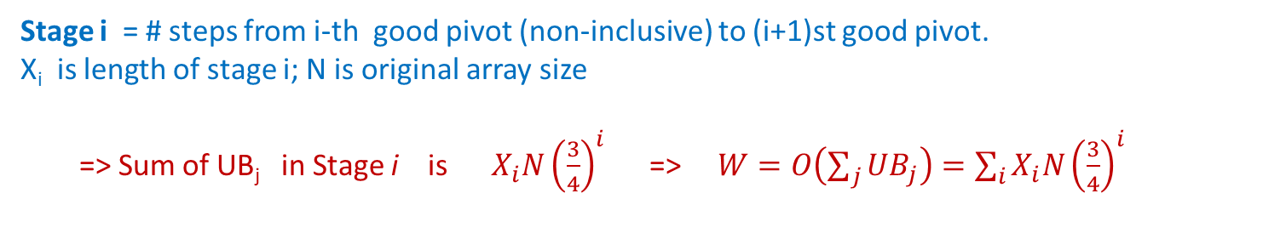
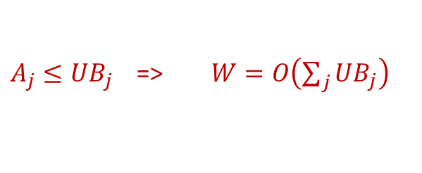
Step j | Array Size | UB_{j}
1 | 10000 | 10000.00
2 | 7000 | 7500.00
3 | 6500 | 7500.00
4 | 6300 | 7500.00
5 | 4000 | 5625.00
6 | 3900 | 5625.00
7 | 3600 | 5625.00
8 | 3300 | 5625.00
9 | 1000 | 4218.75
10 | 500 | 3164.06
11 | 100 | 2373.05
12 | 80 | 1779.79
13 | 65 | 1779.79
14 | 20 | 1334.84
15 | 8 | 1001.13
16 | 4 | 750.85
17 | 1 | 563.14
Stage i | Steps | X_{i}
1 | 1 | 1
2 | 2,3,4 | 3
3 | 5,6,7,8 | 4
4 | 9 | 1
5 | 10 | 1
6 | 11 | 1
7 | 12,13 | 2
8 | 14 | 1
9 | 15 | 1
10 | 16 | 1
11 | 17 | 1
Leftmost array shows # items in array at start of i-th step. Total work of algorithm is W = O(sum of all array sizes)
Good pivots (between 25-75 percentile of array) shown in purple. Good pivots reduce array size by at least 25%.
After bad pivot, UB_{j} = UB_{j-1} . After good pivot, UB_{j} = 0.75* UB_{j-1} . Let A_{j} be real array size
$A_{j}≤{UB}_{j}$ => $W=O\left(\sum_{j}{{UB}_{j}}\right)$
Stage i = # steps from i-th good pivot (non-inclusive) to (i+1)st good pivot. X_{i} is length of stage i; N is original array size
=> Sum of UB_{j} in Stage i is ${ X_{i}N\left(\frac{3}{4}\right)}^{i}$ => $W=O\left(\sum_{j}{{UB}_{j}}\right)=\sum_{i}{{X_{i}N\left(\frac{3}{4}\right)}^{i}}$

