Slide 1
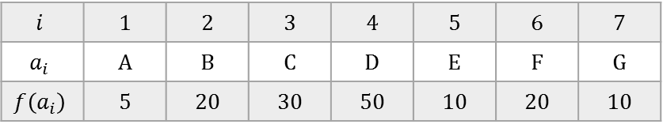
Worked example of the Optimal BST Problem
input
50
D
$$i$$ | 1 | 2 | 3 | 4 | 5 | 6 | 7
$$a_{i}$$ | A | B | C | D | E | F | G
$$f\left(a_{i}\right)$$ | 5 | 20 | 30 | 50 | 10 | 20 | 10
30
20
C
F
20
B
10
E
G
10
5
A
Optimal (min-cost) given input
Its cost is
5*4 + 20*3 + 30*2 + 50*1 + 10*3 + 20*2 + 10*3 = 290
Version of 19/03/2017

Slide 2
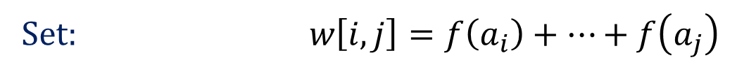
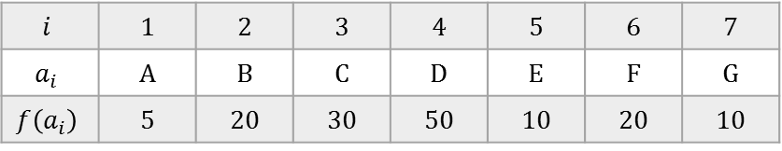

Worked example of the Optimal BST Problem
input
$$i$$ | 1 | 2 | 3 | 4 | 5 | 6 | 7
$$a_{i}$$ | A | B | C | D | E | F | G
$$f\left(a_{i}\right)$$ | 5 | 20 | 30 | 50 | 10 | 20 | 10
Set: $w\left[i,j\right]=f\left(a_{i}\right)+…+f\left(a_{j}\right)$
Define: $e\left[i,j\right]=$ the minimum cost of any BST on $a_{i},…,a_{j}$
Recurrence: $e\left[i,j\right]=\min_{i≤k≤j}{\{e\left[i,k−1\right]+e\left[k+1,j\right]+w\left[i,j\right]\} }$
Initial Conditions: for $i>j e\left[i,j\right]=0$
and $e\left[i,i\right]=w\left[i,i\right]=f\left(a_{i}\right)$

Slide 3


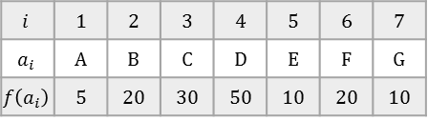
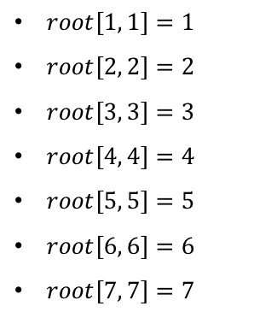

$$e\left[i, j\right]$$
i \ j | 1 | 2 | 3 | 4 | 5 | 6 | 7
1 | 5
2 |  | 20
3 |  |  | 30
4 |  |  |  | 50
5 |  |  |  |  | 10
6 |  |  |  |  |  | 20
7 |  |  |  |  |  |  | 10
$e\left[1, 1\right]=f\left(a_{1}\right)=5$
$e\left[2, 2\right]=f\left(a_{2}\right)=20$
$e\left[3, 3\right]=f\left(a_{3}\right)=30$
$e\left[4, 4\right]=f\left(a_{4}\right)=50$
$e\left[5, 5\right]=f\left(a_{5}\right)=10$
$e\left[6, 6\right]=f\left(a_{6}\right)=20$
$e\left[7 7\right]=f\left(a_{7}\right)=10$
$$root\left[i, j\right]$$
i \ j | 1 | 2 | 3 | 4 | 5 | 6 | 7
1 | 1
2 |  | 2
3 |  |  | 3
4 |  |  |  | 4
5 |  |  |  |  | 5
6 |  |  |  |  |  | 6
7 |  |  |  |  |  |  | 7
$root\left[1, 1\right]=1$
$root\left[2, 2\right]=2$
$root\left[3, 3\right]=3$
$root\left[4, 4\right]=4$
$root\left[5, 5\right]=5$
$root\left[6, 6\right]=6$
$root\left[7, 7\right]=7$
A
B
C
D
E
F
G
$$i$$ | 1 | 2 | 3 | 4 | 5 | 6 | 7
$$a_{i}$$ | A | B | C | D | E | F | G
$$f\left(a_{i}\right)$$ | 5 | 20 | 30 | 50 | 10 | 20 | 10

Slide 4
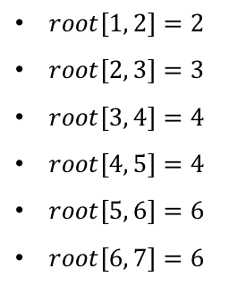
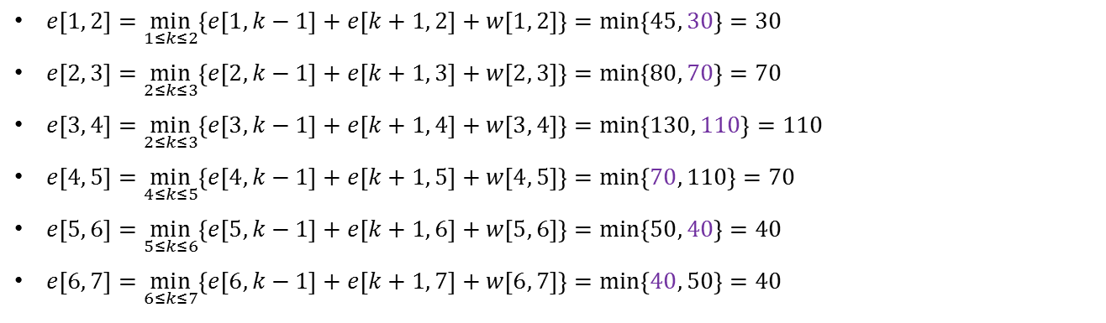
$$e\left[i, j\right]$$
i \ j | 1 | 2 | 3 | 4 | 5 | 6 | 7
1 | 5 | 30
2 |  | 20 | 70
3 |  |  | 30 | 110
4 |  |  |  | 50 | 70
5 |  |  |  |  | 10 | 40
6 |  |  |  |  |  | 20 | 40
7 |  |  |  |  |  |  | 10
$e\left[1, 2\right]=\min_{1≤k≤2}\left\{e\left[1, k−1\right]+e\left[k+1, 2\right]+w\left[1, 2\right]\right\}=\min_{ }\left\{45, 30\right\}=30$
$e\left[2, 3\right]=\min_{2≤k≤3}\left\{e\left[2, k−1\right]+e\left[k+1, 3\right]+w\left[2, 3\right]\right\}=\min_{ }\left\{80, 70\right\}=70$
$e\left[3, 4\right]=\min_{2≤k≤3}\left\{e\left[3, k−1\right]+e\left[k+1, 4\right]+w\left[3, 4\right]\right\}=\min_{ }\left\{130, 110\right\}=110$
$e\left[4, 5\right]=\min_{4≤k≤5}\left\{e\left[4, k−1\right]+e\left[k+1, 5\right]+w\left[4, 5\right]\right\}=\min_{ }\left\{70, 110\right\}=70$
$e\left[5, 6\right]=\min_{5≤k≤6}\left\{e\left[5, k−1\right]+e\left[k+1, 6\right]+w\left[5, 6\right]\right\}=\min_{ }\left\{50, 40\right\}=40$
$e\left[6, 7\right]=\min_{6≤k≤7}\left\{e\left[6, k−1\right]+e\left[k+1, 7\right]+w\left[6, 7\right]\right\}=\min_{ }\left\{40, 50\right\}=40$
$$root\left[i, j\right]$$
i \ j | 1 | 2 | 3 | 4 | 5 | 6 | 7
1 | 1 | 2
2 |  | 2 | 3
3 |  |  | 3 | 4
4 |  |  |  | 4 | 4
5 |  |  |  |  | 5 | 6
6 |  |  |  |  |  | 6 | 6
7 |  |  |  |  |  |  | 7
$root\left[1, 2\right]=2$
$root\left[2, 3\right]=3$
$root\left[3, 4\right]=4$
$root\left[4, 5\right]=4$
$root\left[5, 6\right]=6$
$root\left[6, 7\right]=6$
B
C
D
D
F
F
A
B
C
E
E
G
$$i$$ | 1 | 2 | 3 | 4 | 5 | 6 | 7
$$a_{i}$$ | A | B | C | D | E | F | G
$$f\left(a_{i}\right)$$ | 5 | 20 | 30 | 50 | 10 | 20 | 10

Slide 5
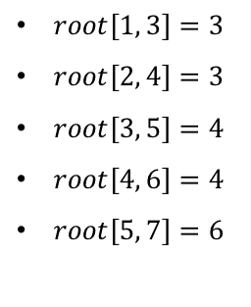
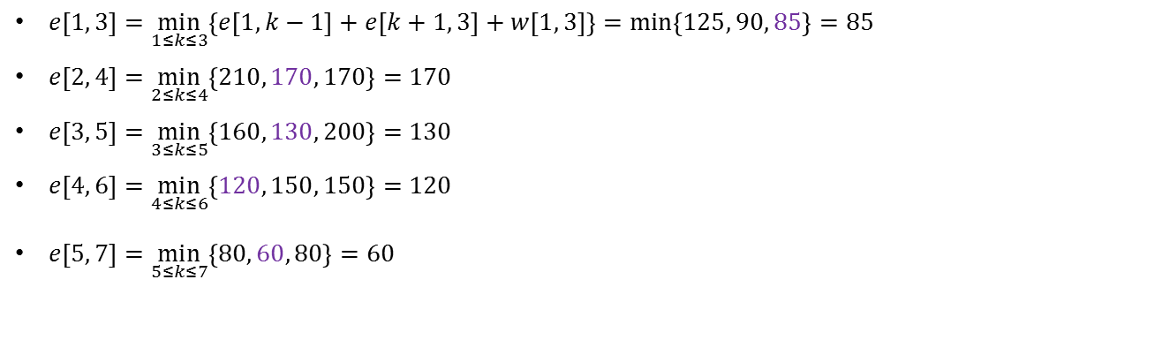
$$e\left[i, j\right]$$
i \ j | 1 | 2 | 3 | 4 | 5 | 6 | 7
1 | 5 | 30 | 85
2 |  | 20 | 70 | 170
3 |  |  | 30 | 110 | 130
4 |  |  |  | 50 | 70 | 120
5 |  |  |  |  | 10 | 40 | 60
6 |  |  |  |  |  | 20 | 40
7 |  |  |  |  |  |  | 10
$e\left[1, 3\right]=\min_{1≤k≤3}\left\{e\left[1, k−1\right]+e\left[k+1, 3\right]+w\left[1, 3\right]\right\}=\min_{ }\left\{125, 90, 85\right\}=85$
$e\left[2, 4\right]=\min_{2≤k≤4}\left\{210, 170, 170\right\}=170$
$e\left[3, 5\right]=\min_{3≤k≤5}\left\{160, 130, 200\right\}=130$
$e\left[4, 6\right]=\underset{ }{\min_{4≤k≤6}}\left\{120, 150, 150\right\}=120$
$e\left[5, 7\right]=\underset{ }{\min_{5≤k≤7}}\left\{80, 60, 80\right\}=60$
$$root\left[i, j\right]$$
i \ j | 1 | 2 | 3 | 4 | 5 | 6 | 7
1 | 1 | 2 | 3
2 |  | 2 | 3 | 3
3 |  |  | 3 | 4 | 4
4 |  |  |  | 4 | 4 | 4
5 |  |  |  |  | 5 | 6 | 6
6 |  |  |  |  |  | 6 | 6
7 |  |  |  |  |  |  | 7
$root\left[1, 3\right]=3$
$root\left[2, 4\right]=3$
$root\left[3, 5\right]=4$
$root\left[4, 6\right]=4$
$root\left[5, 7\right]=6$
C
C
D
D
F
B
B
D
C
E
F
E
G
A
E
$$i$$ | 1 | 2 | 3 | 4 | 5 | 6 | 7
$$a_{i}$$ | A | B | C | D | E | F | G
$$f\left(a_{i}\right)$$ | 5 | 20 | 30 | 50 | 10 | 20 | 10

Slide 6

$$e\left[i, j\right]$$
i \ j | 1 | 2 | 3 | 4 | 5 | 6 | 7
1 | 5 | 30 | 85
2 |  | 20 | 70 | 170
3 |  |  | 30 | 110 | 130
4 |  |  |  | 50 | 70 | 120
5 |  |  |  |  | 10 | 40 | 60
6 |  |  |  |  |  | 20 | 40
7 |  |  |  |  |  |  | 10
$e\left[1, 4\right]=\min_{1≤k≤4}\left\{e\left[1, k−1\right]+e\left[k+1, 4\right]+w\left[1, 4\right]\right\}$
$=\min_{1≤k≤4}\left\{\begin{aligned}e\left[1,0\right]+e\left[2,4\right]+105, e\left[1,1\right]+e\left[3,4\right]+105, \\ \\ e\left[1,2\right]+e\left[4,4\right]+105, e\left[1,3\right]+e\left[5,4\right]+105\end{aligned}\right\}$
$$=\min_{1≤k≤4}\left\{\begin{aligned}0 +170 +105, 5+110+105, \\ \\ 30+50+105, 85+0+105\end{aligned}\right\}$$
$\underset{ }{=min}\left\{275, 220,185,190\right\}$
$=185$
$$root\left[i, j\right]$$
i \ j | 1 | 2 | 3 | 4 | 5 | 6 | 7
1 | 1 | 2 | 3
2 |  | 2 | 3 | 3
3 |  |  | 3 | 4 | 4
4 |  |  |  | 4 | 4 | 4
5 |  |  |  |  | 5 | 6 | 6
6 |  |  |  |  |  | 6 | 6
7 |  |  |  |  |  |  | 7
$$i$$ | 1 | 2 | 3 | 4 | 5 | 6 | 7
$$a_{i}$$ | A | B | C | D | E | F | G
$$f\left(a_{i}\right)$$ | 5 | 20 | 30 | 50 | 10 | 20 | 10

Slide 7
$$e\left[i, j\right]$$
i \ j | 1 | 2 | 3 | 4 | 5 | 6 | 7
1 | 5 | 30 | 85 | 185
2 |  | 20 | 70 | 170
3 |  |  | 30 | 110 | 130
4 |  |  |  | 50 | 70 | 120
5 |  |  |  |  | 10 | 40 | 60
6 |  |  |  |  |  | 20 | 40
7 |  |  |  |  |  |  | 10
$e\left[1, 4\right]=\min_{1≤k≤4}\left\{e\left[1, k−1\right]+e\left[k+1, 4\right]+w\left[1, 4\right]\right\}$
$=\min_{1≤k≤4}\left\{\begin{aligned}e\left[1,0\right]+e\left[2,4\right]+105, e\left[1,1\right]+e\left[3,4\right]+105, \\ \\ e\left[1,2\right]+e\left[4,4\right]+105, e\left[1,3\right]+e\left[5,4\right]+105\end{aligned}\right\}$
$$=\min_{1≤k≤4}\left\{\begin{aligned}0 +170 +105, 5+110+105, \\ \\ 30+50+105, 85+0+105\end{aligned}\right\}$$
$\underset{ }{=min}\left\{275, 220,185,190\right\}$
$=185$
$$root\left[i, j\right]$$
i \ j | 1 | 2 | 3 | 4 | 5 | 6 | 7
1 | 1 | 2 | 3 | 3
2 |  | 2 | 3 | 3
3 |  |  | 3 | 4 | 4
4 |  |  |  | 4 | 4 | 4
5 |  |  |  |  | 5 | 6 | 6
6 |  |  |  |  |  | 6 | 6
7 |  |  |  |  |  |  | 7
$$i$$ | 1 | 2 | 3 | 4 | 5 | 6 | 7
$$a_{i}$$ | A | B | C | D | E | F | G
$$f\left(a_{i}\right)$$ | 5 | 20 | 30 | 50 | 10 | 20 | 10

Slide 8

$$e\left[i, j\right]$$
i \ j | 1 | 2 | 3 | 4 | 5 | 6 | 7
1 | 5 | 30 | 85 | 185
2 |  | 20 | 70 | 170
3 |  |  | 30 | 110 | 130
4 |  |  |  | 50 | 70 | 120
5 |  |  |  |  | 10 | 40 | 60
6 |  |  |  |  |  | 20 | 40
7 |  |  |  |  |  |  | 10
$e\left[1, 4\right]=\min_{1≤k≤4}\left\{e\left[1, k−1\right]+e\left[k+1, 4\right]+w\left[1, 4\right]\right\}=\min_{ }\left\{275, 220,185,190\right\}=185$
T_{1,4}
a₃
T_{1,2}
T_{4,4}
$$root\left[i, j\right]$$
i \ j | 1 | 2 | 3 | 4 | 5 | 6 | 7
1 | 1 | 2 | 3 | 3
2 |  | 2 | 3 | 3
3 |  |  | 3 | 4 | 4
4 |  |  |  | 4 | 4 | 4
5 |  |  |  |  | 5 | 6 | 6
6 |  |  |  |  |  | 6 | 6
7 |  |  |  |  |  |  | 7
$root\left[1, 4\right]=3$
$$i$$ | 1 | 2 | 3 | 4 | 5 | 6 | 7
$$a_{i}$$ | A | B | C | D | E | F | G
$$f\left(a_{i}\right)$$ | 5 | 20 | 30 | 50 | 10 | 20 | 10

Slide 9
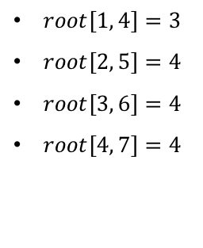
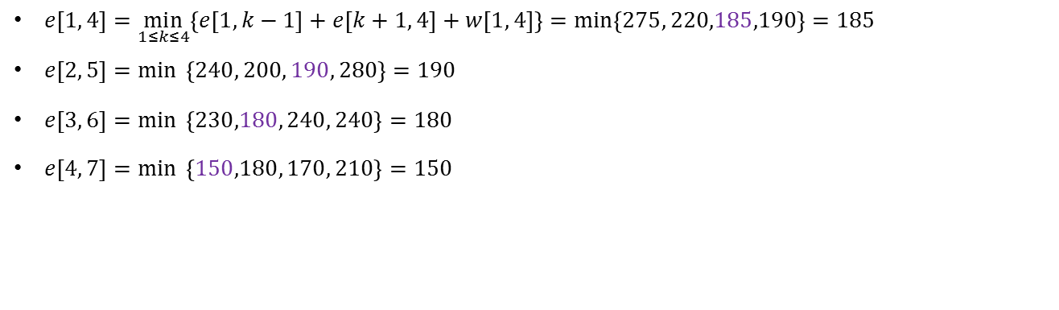
$$e\left[i, j\right]$$
i \ j | 1 | 2 | 3 | 4 | 5 | 6 | 7
1 | 5 | 30 | 85 | 185
2 |  | 20 | 70 | 170 | 190
3 |  |  | 30 | 110 | 130 | 180
4 |  |  |  | 50 | 70 | 120 | 150
5 |  |  |  |  | 10 | 40 | 60
6 |  |  |  |  |  | 20 | 40
7 |  |  |  |  |  |  | 10
$e\left[1, 4\right]=\min_{1≤k≤4}\left\{e\left[1, k−1\right]+e\left[k+1, 4\right]+w\left[1, 4\right]\right\}=\min_{ }\left\{275, 220,185,190\right\}=185$
$e\left[2, 5\right]=\min_{ }{ \left\{240, 200, 190, 280\right\}}=190$
$e\left[3, 6\right]=\min_{ }{ \left\{230,180, 240, 240\right\}}=180$
$e\left[4, 7\right]=\underset{ }{\min_{ }}{ \left\{150,180, 170, 210\right\}}=150$
$$root\left[i, j\right]$$
i \ j | 1 | 2 | 3 | 4 | 5 | 6 | 7
1 | 1 | 2 | 3 | 3
2 |  | 2 | 3 | 3 | 4
3 |  |  | 3 | 4 | 4 | 4
4 |  |  |  | 4 | 4 | 4 | 4
5 |  |  |  |  | 5 | 6 | 6
6 |  |  |  |  |  | 6 | 6
7 |  |  |  |  |  |  | 7
$root\left[1, 4\right]=3$
$root\left[2, 5\right]=4$
$root\left[3, 6\right]=4$
$root\left[4, 7\right]=4$
C
D
D
D
B
D
C
E
C
F
F
A
B
E
E
G
$$i$$ | 1 | 2 | 3 | 4 | 5 | 6 | 7
$$a_{i}$$ | A | B | C | D | E | F | G
$$f\left(a_{i}\right)$$ | 5 | 20 | 30 | 50 | 10 | 20 | 10

Slide 10

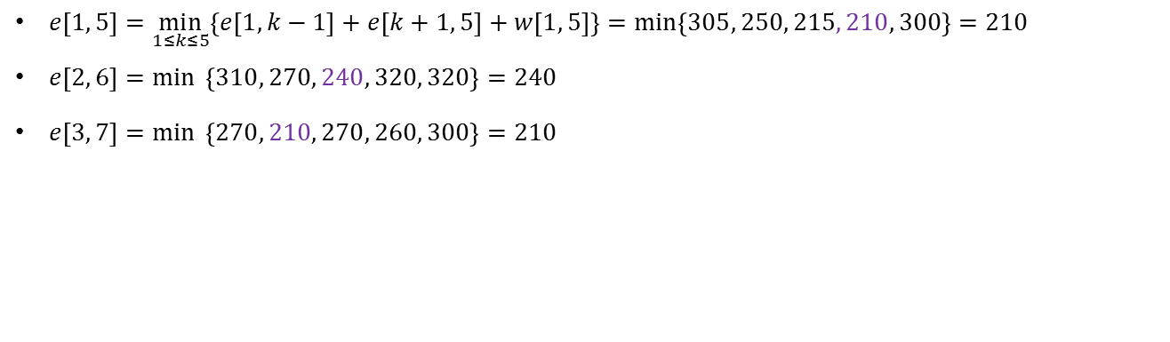
$$e\left[i, j\right]$$
i \ j | 1 | 2 | 3 | 4 | 5 | 6 | 7
1 | 5 | 30 | 85 | 185 | 210
2 |  | 20 | 70 | 170 | 190 | 240
3 |  |  | 30 | 110 | 130 | 180 | 210
4 |  |  |  | 50 | 70 | 120 | 150
5 |  |  |  |  | 10 | 40 | 60
6 |  |  |  |  |  | 20 | 40
7 |  |  |  |  |  |  | 10
$e\left[1, 5\right]=\min_{1≤k≤5}\left\{e\left[1, k−1\right]+e\left[k+1, 5\right]+w\left[1, 5\right]\right\}=\min_{ }\left\{305, 250, 215, 210, 300\right\}=210$
$e\left[2, 6\right]=\min_{ }{ \left\{310, 270, 240, 320, 320\right\}}=240$
$e\left[3, 7\right]=\min_{ }{ \left\{270, 210, 270, 260, 300\right\}}=210$
$$root\left[i, j\right]$$
i \ j | 1 | 2 | 3 | 4 | 5 | 6 | 7
1 | 1 | 2 | 3 | 3 | 4
2 |  | 2 | 3 | 3 | 4 | 4
3 |  |  | 3 | 4 | 4 | 4 | 4
4 |  |  |  | 4 | 4 | 4 | 4
5 |  |  |  |  | 5 | 6 | 6
6 |  |  |  |  |  | 6 | 6
7 |  |  |  |  |  |  | 7
$root\left[1, 5\right]=4$
$root\left[2, 6\right]=4$
$root\left[3, 7\right]=4$
D
D
D
C
E
C
F
C
F
B
B
E
E
G
A
$$i$$ | 1 | 2 | 3 | 4 | 5 | 6 | 7
$$a_{i}$$ | A | B | C | D | E | F | G
$$f\left(a_{i}\right)$$ | 5 | 20 | 30 | 50 | 10 | 20 | 10

Slide 11

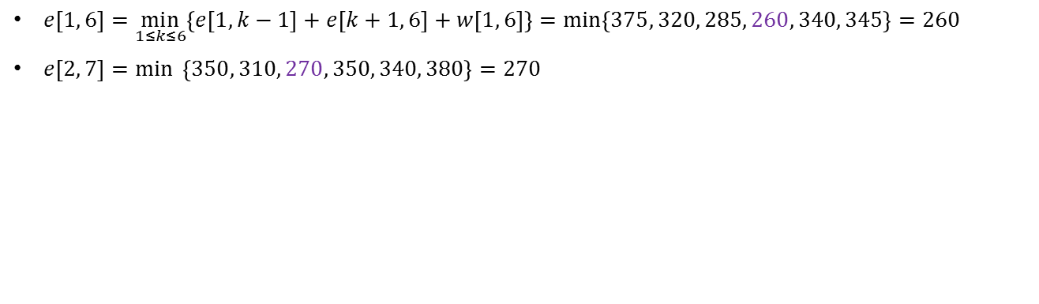
$$e\left[i, j\right]$$
i \ j | 1 | 2 | 3 | 4 | 5 | 6 | 7
1 | 5 | 30 | 85 | 185 | 210 | 260
2 |  | 20 | 70 | 170 | 190 | 240 | 270
3 |  |  | 30 | 110 | 130 | 180 | 210
4 |  |  |  | 50 | 70 | 120 | 150
5 |  |  |  |  | 10 | 40 | 60
6 |  |  |  |  |  | 20 | 40
7 |  |  |  |  |  |  | 10
$e\left[1, 6\right]=\min_{1≤k≤6}\left\{e\left[1, k−1\right]+e\left[k+1, 6\right]+w\left[1, 6\right]\right\}=\min_{ }\left\{375, 320, 285, 260, 340, 345\right\}=260$
$e\left[2, 7\right]=\min_{ }{ \left\{350, 310, 270, 350, 340, 380\right\}}=270$
$$root\left[i, j\right]$$
i \ j | 1 | 2 | 3 | 4 | 5 | 6 | 7
1 | 1 | 2 | 3 | 3 | 4 | 4
2 |  | 2 | 3 | 3 | 4 | 4 | 4
3 |  |  | 3 | 4 | 4 | 4 | 4
4 |  |  |  | 4 | 4 | 4 | 4
5 |  |  |  |  | 5 | 6 | 6
6 |  |  |  |  |  | 6 | 6
7 |  |  |  |  |  |  | 7
$root\left[1, 6\right]=4$
$root\left[2, 7\right]=4$
D
D
C
F
C
F
B
E
B
E
G
A
$$i$$ | 1 | 2 | 3 | 4 | 5 | 6 | 7
$$a_{i}$$ | A | B | C | D | E | F | G
$$f\left(a_{i}\right)$$ | 5 | 20 | 30 | 50 | 10 | 20 | 10

Slide 12

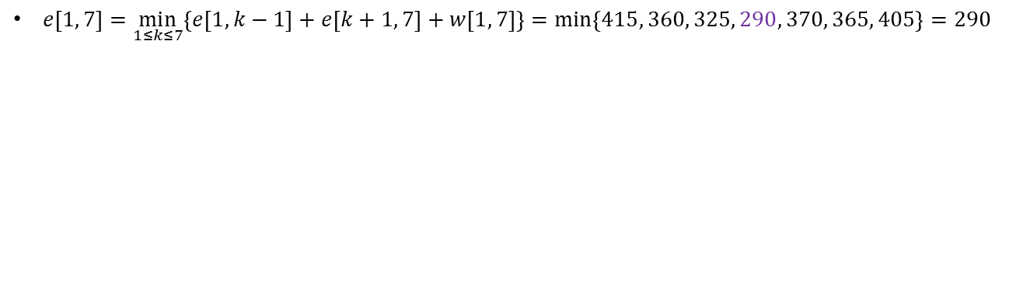
$$e\left[i, j\right]$$
i \ j | 1 | 2 | 3 | 4 | 5 | 6 | 7
1 | 5 | 30 | 85 | 185 | 210 | 260 | 290
2 |  | 20 | 70 | 170 | 190 | 240 | 270
3 |  |  | 30 | 110 | 130 | 180 | 210
4 |  |  |  | 50 | 70 | 120 | 150
5 |  |  |  |  | 10 | 40 | 60
6 |  |  |  |  |  | 20 | 40
7 |  |  |  |  |  |  | 10
$e\left[1, 7\right]=\min_{1≤k≤7}\left\{e\left[1, k−1\right]+e\left[k+1, 7\right]+w\left[1, 7\right]\right\}=\min_{ }\left\{415, 360, 325, 290, 370, 365, 405\right\}=290$
Optimal Tree: Cost = 290
50
D
30
C
F
20
20
B
10
E
G
10
$$root\left[i, j\right]$$
i \ j | 1 | 2 | 3 | 4 | 5 | 6 | 7
1 | 1 | 2 | 3 | 3 | 4 | 4 | 4
2 |  | 2 | 3 | 3 | 4 | 4 | 4
3 |  |  | 3 | 4 | 4 | 4 | 4
4 |  |  |  | 4 | 4 | 4 | 4
5 |  |  |  |  | 5 | 6 | 6
6 |  |  |  |  |  | 6 | 6
7 |  |  |  |  |  |  | 7
$root\left[1, 7\right]=4$
5
A
$$i$$ | 1 | 2 | 3 | 4 | 5 | 6 | 7
$$a_{i}$$ | A | B | C | D | E | F | G
$$f\left(a_{i}\right)$$ | 5 | 20 | 30 | 50 | 10 | 20 | 10

Slide 13
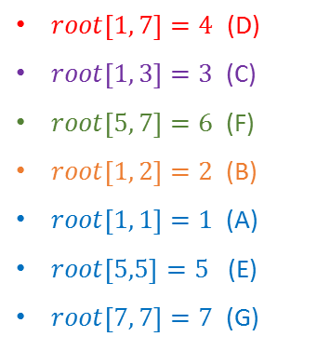
$$e\left[i, j\right]$$
i \ j | 1 | 2 | 3 | 4 | 5 | 6 | 7
1 | 5 | 30 | 85 | 185 | 210 | 260 | 290
2 |  | 20 | 70 | 170 | 190 | 240 | 270
3 |  |  | 30 | 110 | 130 | 180 | 210
4 |  |  |  | 50 | 70 | 120 | 150
5 |  |  |  |  | 10 | 40 | 60
6 |  |  |  |  |  | 20 | 40
7 |  |  |  |  |  |  | 10
$e\left[1, 7\right]=\min_{1≤k≤7}\left\{e\left[1, k−1\right]+e\left[k+1, 7\right]+w\left[1, 7\right]\right\}=\min_{ }\left\{415, 360, 325, 290, 370, 365, 405\right\}=290$
Optimal Tree: Cost = 290
50
D
30
C
F
20
20
B
10
E
G
10
$$root\left[i, j\right]$$
i \ j | 1 | 2 | 3 | 4 | 5 | 6 | 7
1 | 1 | 2 | 3 | 3 | 4 | 4 | 4
2 |  | 2 | 3 | 3 | 4 | 4 | 4
3 |  |  | 3 | 4 | 4 | 4 | 4
4 |  |  |  | 4 | 4 | 4 | 4
5 |  |  |  |  | 5 | 6 | 6
6 |  |  |  |  |  | 6 | 6
7 |  |  |  |  |  |  | 7
$root\left[1, 7\right]=4$ (D)
$root\left[1, 3\right]=3$ (C)
$root\left[5, 7\right]=6$ (F)
$root\left[1, 2\right]=2$ (B)
$root\left[1, 1\right]=1$ (A)
$root\left[5,5\right]=5$ (E)
$root\left[7, 7\right]=7$ (G)
5
A
$$i$$ | 1 | 2 | 3 | 4 | 5 | 6 | 7
$$a_{i}$$ | A | B | C | D | E | F | G
$$f\left(a_{i}\right)$$ | 5 | 20 | 30 | 50 | 10 | 20 | 10

