Slide 1
Prim’s Worked Example

Slide 2
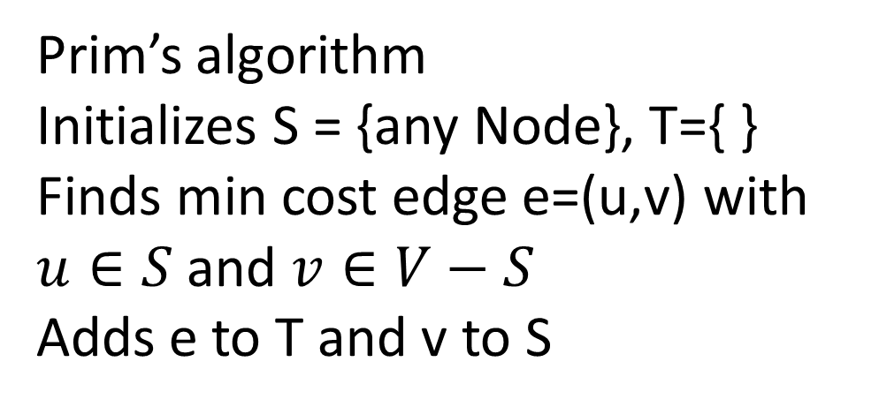
b
8
c
7
d
Prim’s algorithm Initializes S = {any Node}, T={ }
Finds min cost edge e=(u,v) with $u∈S$ and $v∈V−S$
Adds e to T and v to S
4
9
2
11
4
14
a
i
e
6
7
10
8
1
g
2
f
h

Slide 3
b
8
c
7
d
Prim’s algorithm Initializes S = {any Node}, T={ }
Finds min cost edge e=(u,v) with $u∈S$ and $v∈V−S$
Adds e to T and v to S
4
9
2
11
4
14
a
i
e
8
6
7
10
1
g
2
f
h
S = {a}
T = { }

Slide 4
b
8
c
7
d
Prim’s algorithm Initializes S = {any Node}, T={ }
Finds min cost edge e=(u,v) with $u∈S$ and $v∈V−S$
Adds e to T and v to S
4
9
2
11
4
14
a
i
e
8
6
7
10
1
g
2
f
h
S = {a, b}
T = { (a,b) }

Slide 5
b
8
c
7
d
Prim’s algorithm Initializes S = {any Node}, T={ }
Finds min cost edge e=(u,v) with $u∈S$ and $v∈V−S$
Adds e to T and v to S
4
9
2
11
4
14
a
i
e
8
6
7
10
1
g
2
f
h
S = {a, b, c}
T = { (a,b), (b,c) }

Slide 6
b
8
c
7
d
Prim’s algorithm Initializes S = {any Node}, T={ }
Finds min cost edge e=(u,v) with $u∈S$ and $v∈V−S$
Adds e to T and v to S
4
9
2
11
4
14
a
i
e
8
6
7
10
1
g
2
f
h
S = {a, b, c, i}
T = { (a,b), (b,c), (c,i) }

Slide 7
b
8
c
7
d
Prim’s algorithm Initializes S = {any Node}, T={ }
Finds min cost edge e=(u,v) with $u∈S$ and $v∈V−S$
Adds e to T and v to S
4
9
2
11
4
14
a
i
e
8
6
7
10
1
g
2
f
h
S = {a, b, c, i, f}
T = { (a,b), (b,c), (c,i), (c,f) }

Slide 8
b
8
c
7
d
Prim’s algorithm Initializes S = {any Node}, T={ }
Finds min cost edge e=(u,v) with $u∈S$ and $v∈V−S$
Adds e to T and v to S
4
9
2
11
4
14
a
i
e
8
6
7
10
1
g
2
f
h
S = {a, b, c, i, f, g}
T = { (a,b), (b,c), (c,i), (c,f), (f,g) }

Slide 9
b
8
c
7
d
Prim’s algorithm Initializes S = {any Node}, T={ }
Finds min cost edge e=(u,v) with $u∈S$ and $v∈V−S$
Adds e to T and v to S
4
9
2
11
4
14
a
i
e
8
6
7
10
1
g
2
f
h
S = {a, b, c, i, f, g, h}
T = { (a,b), (b,c), (c,i), (c,f), (f,g) }

Slide 10
b
8
c
7
d
Prim’s algorithm Initializes S = {any Node}, T={ }
Finds min cost edge e=(u,v) with $u∈S$ and $v∈V−S$
Adds e to T and v to S
4
9
2
11
4
14
a
i
e
8
6
7
10
1
g
2
f
h
S = {a, b, c, i, f, g, h, d}
T = { (a,b), (b,c), (c,i), (c,f), (f,g), (c,d)}

Slide 11
b
8
c
7
d
Prim’s algorithm Initializes S = {any Node}, T={ }
Finds min cost edge e=(u,v) with $u∈S$ and $v∈V−S$
Adds e to T and v to S
4
9
2
11
4
14
a
i
e
8
6
7
10
1
g
2
f
h
S = {a, b, c, i, f, g, h, d, e}
T = { (a,b), (b,c), (c,i), (c,f), (f,g), (c,d) (d,e) }

Slide 12
b
8
c
7
d
The same thing again but now keeping key values associated with each vertex. These key values will be kept in Heap. Only black vertices will be in heap Key value is min-cost between S and the vertex.
4
9
2
11
4
14
a
i
e
8
6
7
10
b: 4
c: ∞
d: ∞
e: ∞
f: ∞
g: ∞
h: 8
i: ∞
1
g
2
f
h
S = {a}
T = { }

Slide 13
b
8
c
7
d
The same thing again but now keeping key values associated with each vertex. These key values will be kept in Heap. Only black vertices will be in heap Key value is min-cost between S and the vertex.
4
9
2
11
4
14
a
i
e
8
6
7
10
b: 4
c: 8
d: ∞
e: ∞
f: ∞
g: ∞
h: 8
i: ∞
1
g
2
f
h
S = {a, b}
T = { (a,b) }

Slide 14
b
8
c
7
d
The same thing again but now keeping key values associated with each vertex. These key values will be kept in Heap. Only black vertices will be in heap Key value is min-cost between S and the vertex.
4
9
2
11
4
14
a
i
e
8
6
7
10
b: 4
c: 8
d: 7
e: ∞
f: 4
g: ∞
h: 8
i: 2
1
g
2
f
h
S = {a, b, c}
T = { (a,b), (b,c) }

Slide 15
b
8
c
7
d
The same thing again but now keeping key values associated with each vertex. These key values will be kept in Heap. Only black vertices will be in heap Key value is min-cost between S and the vertex.
4
9
2
11
4
14
a
i
e
8
6
7
10
b: 4
c: 8
d: 7
e: ∞
f: 4
g: 6
h: 7
i: 2
1
g
2
f
h
S = {a, b, c, i}
T = { (a,b), (b,c), (c,i) }

Slide 16
b
8
c
7
d
The same thing again but now keeping key values associated with each vertex. These key values will be kept in Heap. Only black vertices will be in heap Key value is min-cost between S and the vertex.
4
9
2
11
4
14
a
i
e
8
6
7
10
b: 4
c: 8
d: 7
e: 10
f: 4
g: 2
h: 7
i: 2
1
g
2
f
h
S = {a, b, c, i, f}
T = { (a,b), (b,c), (c,i), (c,f) }

Slide 17
b
8
c
7
d
The same thing again but now keeping key values associated with each vertex. These key values will be kept in Heap. Only black vertices will be in heap Key value is min-cost between S and the vertex.
4
9
2
11
4
14
a
i
e
8
6
7
10
b: 4
c: 8
d: 7
e: 10
f: 4
g: 2
h: 1
i: 2
1
g
2
f
h
S = {a, b, c, i, f, g}
T = { (a,b), (b,c), (c,i), (c,f), (f,g) }

Slide 18
b
8
c
7
d
The same thing again but now keeping key values associated with each vertex. These key values will be kept in Heap. Only black vertices will be in heap Key value is min-cost between S and the vertex.
4
9
2
11
4
14
a
i
e
8
6
7
10
b: 4
c: 8
d: 7
e: 10
f: 4
g: 2
h: 1
i: 2
1
g
2
f
h
S = {a, b, c, i, f, g, h}
T = { (a,b), (b,c), (c,i), (c,f), (f,g) }

Slide 19
b
8
c
7
d
The same thing again but now keeping key values associated with each vertex. These key values will be kept in Heap. Only black vertices will be in heap Key value is min-cost between S and the vertex.
4
9
2
11
4
14
a
i
e
8
6
7
10
b: 4
c: 8
d: 7
e: 9
f: 4
g: 2
h: 1
i: 2
1
g
2
f
h
S = {a, b, c, i, f, g, h, d}
T = { (a,b), (b,c), (c,i), (c,f), (f,g), (c,d) }

Slide 20
b
8
c
7
d
The same thing again but now keeping key values associated with each vertex. These key values will be kept in Heap. Only black vertices will be in heap Key value is min-cost between S and the vertex.
4
9
2
11
4
14
a
i
e
8
6
7
10
b: 4
c: 8
d: 7
e: 9
f: 4
g: 2
h: 1
i: 2
1
g
2
f
h
S = {a, b, c, i, f, g, h, d, e}
T = { (a,b), (b,c), (c,i), (c,f), (f,g), (c,d) (d,e) }

