Slide 1
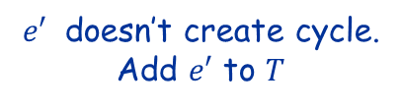
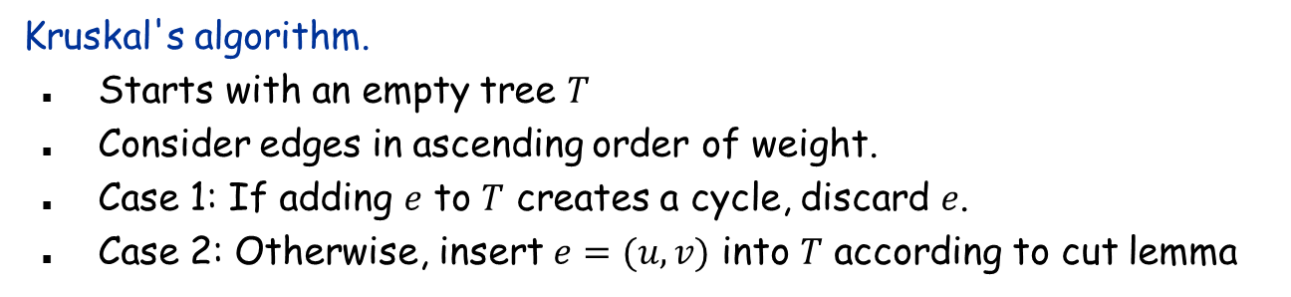




Kruskal's Algorithm: Proof of Correctness Version of March 17, 2019
Kruskal's algorithm.
Starts with an empty tree $T$
Consider edges in ascending order of weight.
Case 1: If adding $e$ to $T$ creates a cycle, discard $e$.
Case 2: Otherwise, insert $e=(u, v)$ into $T$ according to cut lemma
v
$$e′$$
$$S$$
$$e$$
u
Case 1
Case 2
$e$ creates cycle. Don’t add $e$ to $T$
$e′$ doesn’t create cycle. Add $e′$ to $T$

Slide 2
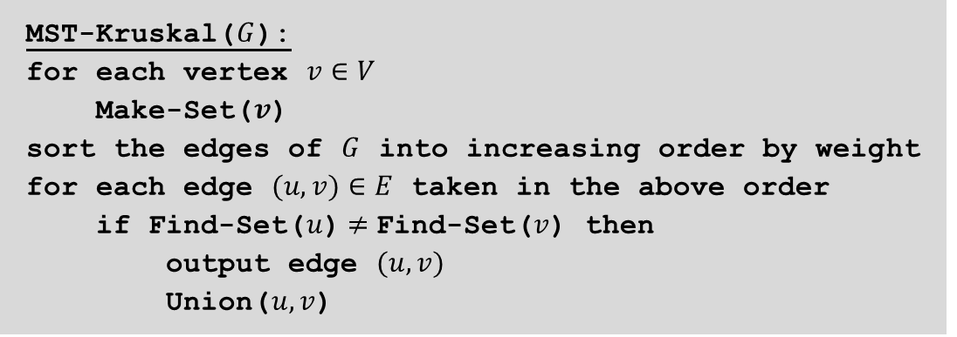
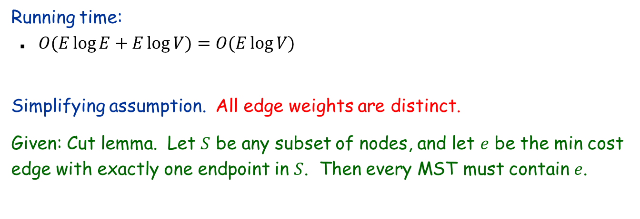
Kruskal’s Algorithm
MST-Kruskal($G$):
for each vertex $v∈V$
Make-Set($v$)
sort the edges of $G$ into increasing order by weight
for each edge $(u, v)∈E$ taken in the above order
if Find-Set($u$)$≠$Find-Set($v$) then
output edge $(u,v)$
Union($u, v$)
Running time:
$O(E\log{E+E\log{V)=O(E\log{V)}}}$
Simplifying assumption. All edge weights are distinct.
Given: Cut lemma. Let $S$ be any subset of nodes, and let $e$ be the min cost edge with exactly one endpoint in $S$. Then every MST must contain $e$.

Slide 3
Proof of Correctness of Kruskal’s Algorithm:
Three steps:
Prove that Kruskal’s algorithm always produces a tree,
Prove that it produces an acyclic graph
Prove that it produces a connected graph
=> It produces a tree
Prove that every edge chosen by Kruskal’s algorithm is in every MST.
Finally show (iii) that (i) and (ii) together imply correctness of Kruskal’s algorithm, i.e., that it produces a minimum spanning tree
Uses same simplifying assumption as in the proof of Prim’s algorithm, that all edges have different weights.
Also assumes that input graph is connected; otherwise result could never be a tree.

Slide 4
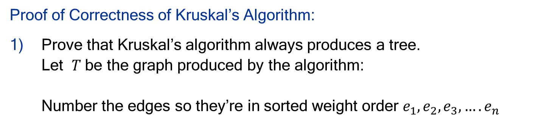
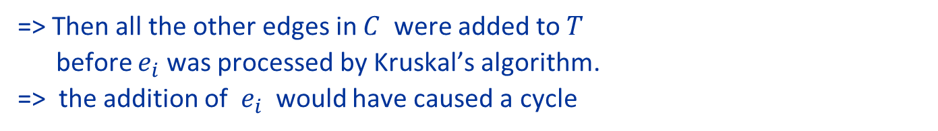
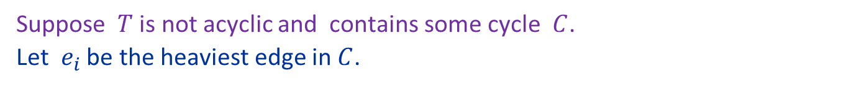
Proof of Correctness of Kruskal’s Algorithm:
Prove that Kruskal’s algorithm always produces a tree. Let $T$be the graph produced by the algorithm: Number the edges so they’re in sorted weight order $e_{1},e_{2},e_{3},….e_{n}$
$T$ is acyclic:
Suppose $T$ is not acyclic and contains some cycle $C$. Let $e_{i}$ be the heaviest edge in $C$.
=> Then all the other edges in $C$ were added to $T$ before $e_{i}$ was processed by Kruskal’s algorithm. => the addition of $e_{i}$ would have caused a cycle
=> Kruskal’s algorithm would not have added $e_{i}$ to $T$
=> But $e_{i}∈C⊆T.$Contradiction.
=> $T$ is acyclic.

Slide 5


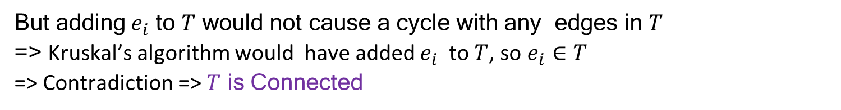

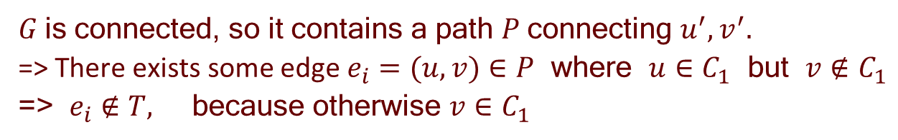

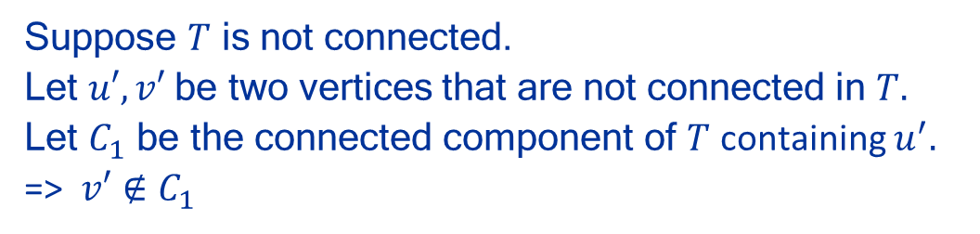



Proof of Correctness of Kruskal’s Algorithm:
Prove that Kruskal’s algorithm always produces a tree. Let $T$be the graph produced by the algorithm: Number the edges so they’re in sorted weight order $e_{1},e_{2},e_{3},….e_{n}$
b) $T$ is Connected:
$$u$$
$$e_{i}$$
$$v$$
Suppose $T$ is not connected. Let $u′,v′$be two vertices that are not connected in $T.$ Let $C_{1}$ be the connected component of $T$ containing $u^{′}.$ => $v′∉C_{1}$
$$u′$$
$$v′$$
$$C_{1}$$
$G$is connected, so it contains a path $P$connecting $u^{′},v^{′}.$ => There exists some edge $e_{i}=(u,v)∈P$ where $u∈C_{1 }$but $v∉C_{1}$ => $e_{i}∉T,$ because otherwise $v∈C_{1}$
But adding${ e}_{i}$ to $T$ would not cause a cycle with any edges in $T$ => Kruskal’s algorithm would have added $e_{i}$ to $T$, so $e_{i}∈T$ => Contradiction => $T$ is Connected

Slide 6
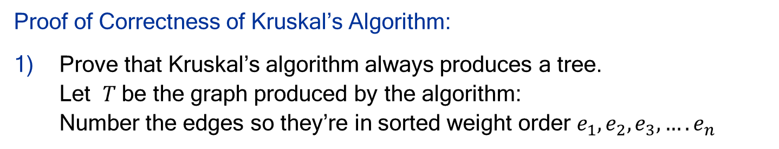
Proof of Correctness of Kruskal’s Algorithm:
Prove that Kruskal’s algorithm always produces a tree. Let $T$be the graph produced by the algorithm: Number the edges so they’re in sorted weight order $e_{1},e_{2},e_{3},….e_{n}$
$T$ is acyclic:
b) $T$ is Connected:
=> $T$ is a tree!

Slide 7
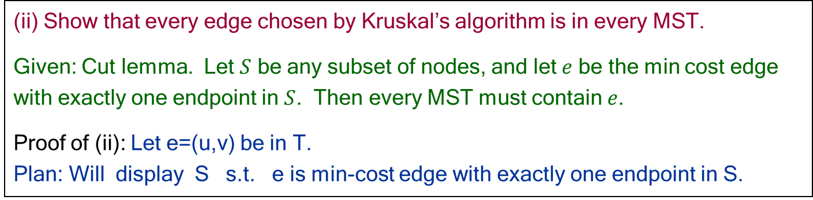
(ii) Show that every edge chosen by Kruskal’s algorithm is in every MST.
Given: Cut lemma. Let $S$ be any subset of nodes, and let $e$ be the min cost edge with exactly one endpoint in $S$. Then every MST must contain $e$.
Proof of (ii): Let e=(u,v) be in T. Plan: Will display S s.t. e is min-cost edge with exactly one endpoint in S.
(a) Removing e from T creates two separated connected components, S, V-S Label component containing u as S. Note: (*) T is a tree, so e is only edge in T connecting S, V-S (otherwise T contains a cycle).
(b) Suppose exists other edge e’ with exactly one endpoint in S and w(e’) < w(e)
Kruskal would process e’ before e
e’ would have been added to tree by Kruskal Note: When e’ checked, edges in tree are subset of T-{e} so S and V-S are disconnected so adding e’ would not cause a cycle.
e’ AND e are in T, contradicting (*)
e IS the min cost edge with exactly one endpoint in S.
Cut Lemma tells us that every MST must contain e!
e’
u
e
v
S
V-S

Slide 8
Proof of Correctness of Kruskal’s Algorithm:
Three steps:
Prove that Kruskal’s algorithm always produces a tree. DONE!
Prove every edge chosen by Kruskal’s algorithm is in every MST. DONE!
Remains to show (iii) that (i) and (ii) together imply correctness of Kruskal’s algorithm, i.e., that it produces a minimum spanning tree
From (i) Kruskal’s algorithm produces a tree, so it has V-1 edges
From (ii) we know that all of these V-1 edges are in EVERY MST
But, since every spanning tree has exactly V-1 edges and every MST contains the V-1 edges that are in T, every MST must be exactly T!
DONE!

