Slide 1
Dijkstra Worked Example
Version of March 28, 2019

Slide 2
b
8
c
7
d
Dijkstra’s algorithm
Finds Shortest Path Tree from initial node (a)
Path in tree from (a) to every node is the shortest path in the graph from a to that node
4
9
5
11
4
14
a
i
e
6
7
30
8
1
g
8
f
h

Slide 3
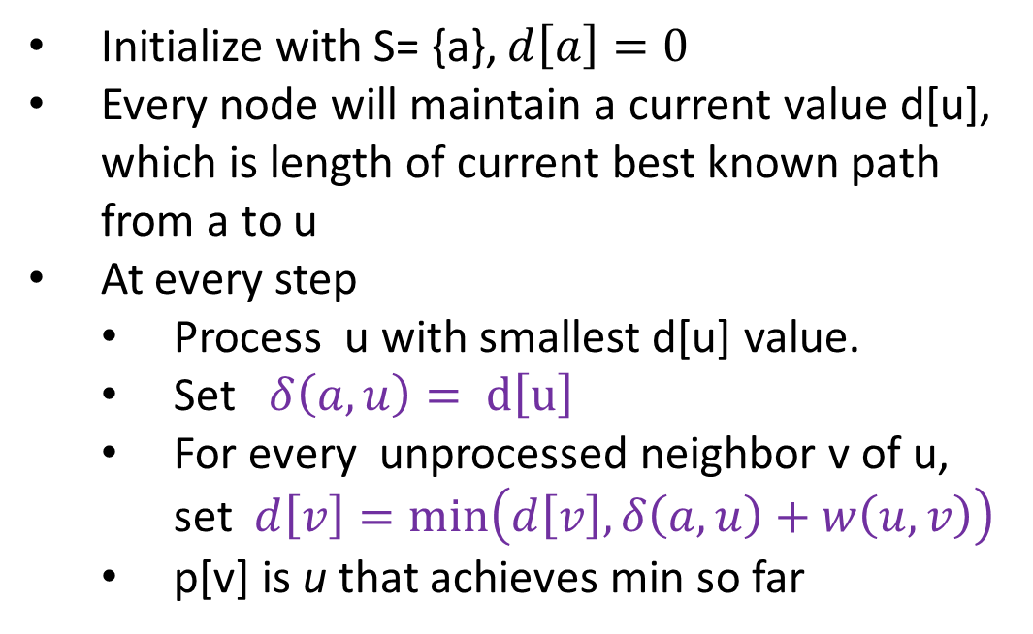
b
8
c
7
d
4
9
Initialize with S= {a}, $d\left[a\right]=0$
Every node will maintain a current value d[u], which is length of current best known path from a to u
At every step
Process u with smallest d[u] value.
Set $δ\left(a,u\right)= d\left[u\right]$
For every unprocessed neighbor v of u, set $d\left[v\right]=\min\left(d\left[v\right], δ\left(a,u\right)+w\left(u,v\right)\right)$
p[v] is u that achieves min so far
5
11
4
14
a
i
e
6
7
30
8
1
g
8
f
h

Slide 4
b
8
c
7
d
4
9
Initialize with S= {a}, $d\left[a\right]=0$
Every node will maintain a current value d[u], which is length of current best known path from a to u
At every step
Process u with smallest d[u] value.
Set $δ\left(a,u\right)= d\left[u\right]$
For every unprocessed neighbor v of u, set $d\left[v\right]=\min\left(d\left[v\right], δ\left(a,u\right)+w\left(u,v\right)\right)$
p[v] is u that achieves min so far
5
11
4
14
a
i
e
6
7
30
8
1
g
8
f
h
u | a | b | c | d | e | f | g | h | i
d[u] | 0 | ∞ | ∞ | ∞ | ∞ | ∞ | ∞ | ∞ | ∞
p[u] | -

Slide 5
b
8
c
7
d
4
9
Initialize with S= {a}, $d\left[a\right]=0$
Every node will maintain a current value d[u], which is length of current best known path from a to u
At every step
Process u with smallest d[u] value.
Set $δ\left(a,u\right)= d\left[u\right]$
For every unprocessed neighbor v of u, set $d\left[v\right]=\min\left(d\left[v\right], δ\left(a,u\right)+w\left(u,v\right)\right)$
p[v] is u that achieves min so far
5
11
4
14
a
i
e
6
7
30
8
1
g
8
f
h
u | a | b | c | d | e | f | g | h | i
d[u] | 0 | 4 | ∞ | ∞ | ∞ | ∞ | ∞ | 8 | ∞
p[u] | - | a |  |  |  |  |  | a

Slide 6
b
8
c
7
d
4
9
Initialize with S= {a}, $d\left[a\right]=0$
Every node will maintain a current value d[u], which is length of current best known path from a to u
At every step
Process u with smallest d[u] value.
Set $δ\left(a,u\right)= d\left[u\right]$
For every unprocessed neighbor v of u, set $d\left[v\right]=\min\left(d\left[v\right], δ\left(a,u\right)+w\left(u,v\right)\right)$
p[v] is u that achieves min so far
5
11
4
14
a
i
e
6
7
30
8
1
g
8
f
h
u | a | b | c | d | e | f | g | h | i
d[u] | 0 | 4 | 12 | ∞ | ∞ | ∞ | ∞ | 8 | ∞
p[u] | - | a | b |  |  |  |  | a

Slide 7
b
8
c
7
d
4
9
Initialize with S= {a}, $d\left[a\right]=0$
Every node will maintain a current value d[u], which is length of current best known path from a to u
At every step
Process u with smallest d[u] value.
Set $δ\left(a,u\right)= d\left[u\right]$
For every unprocessed neighbor v of u, set $d\left[v\right]=\min\left(d\left[v\right], δ\left(a,u\right)+w\left(u,v\right)\right)$
p[v] is u that achieves min so far
5
11
4
14
a
i
e
6
7
30
8
1
g
8
f
h
u | a | b | c | d | e | f | g | h | i
d[u] | 0 | 4 | 12 | ∞ | ∞ | ∞ | 9 | 8 | 15
p[u] | - | a | b |  |  |  | h | a | h

Slide 8
b
8
c
7
d
4
9
Initialize with S= {a}, $d\left[a\right]=0$
Every node will maintain a current value d[u], which is length of current best known path from a to u
At every step
Process u with smallest d[u] value.
Set $δ\left(a,u\right)= d\left[u\right]$
For every unprocessed neighbor v of u, set $d\left[v\right]=\min\left(d\left[v\right], δ\left(a,u\right)+w\left(u,v\right)\right)$
p[v] is u that achieves min so far
5
11
4
14
a
i
e
6
7
30
8
1
g
8
f
h
u | a | b | c | d | e | f | g | h | i
d[u] | 0 | 4 | 12 | ∞ | ∞ | 17 | 9 | 8 | 15
p[u] | - | a | b |  |  | g | h | a | h

Slide 9
b
8
c
7
d
4
9
Initialize with S= {a}, $d\left[a\right]=0$
Every node will maintain a current value d[u], which is length of current best known path from a to u
At every step
Process u with smallest d[u] value.
Set $δ\left(a,u\right)= d\left[u\right]$
For every unprocessed neighbor v of u, set $d\left[v\right]=\min\left(d\left[v\right], δ\left(a,u\right)+w\left(u,v\right)\right)$
p[v] is u that achieves min so far
5
11
4
14
a
i
e
6
7
30
8
1
g
8
f
h
u | a | b | c | d | e | f | g | h | i
d[u] | 0 | 4 | 12 | 19 | ∞ | 16 | 9 | 8 | 15
p[u] | - | a | b | c |  | c | h | a | h

Slide 10
b
8
c
7
d
4
9
Initialize with S= {a}, $d\left[a\right]=0$
Every node will maintain a current value d[u], which is length of current best known path from a to u
At every step
Process u with smallest d[u] value.
Set $δ\left(a,u\right)= d\left[u\right]$
For every unprocessed neighbor v of u, set $d\left[v\right]=\min\left(d\left[v\right], δ\left(a,u\right)+w\left(u,v\right)\right)$
p[v] is u that achieves min so far
5
11
4
14
a
i
e
6
7
30
8
1
g
8
f
h
u | a | b | c | d | e | f | g | h | i
d[u] | 0 | 4 | 12 | 19 | ∞ | 16 | 9 | 8 | 15
p[u] | - | a | b | c |  | c | h | a | h

Slide 11
b
8
c
7
d
4
9
Initialize with S= {a}, $d\left[a\right]=0$
Every node will maintain a current value d[u], which is length of current best known path from a to u
At every step
Process u with smallest d[u] value.
Set $δ\left(a,u\right)= d\left[u\right]$
For every unprocessed neighbor v of u, set $d\left[v\right]=\min\left(d\left[v\right], δ\left(a,u\right)+w\left(u,v\right)\right)$
p[v] is u that achieves min so far
5
11
4
14
a
i
e
6
7
30
8
1
g
8
f
h
u | a | b | c | d | e | f | g | h | i
d[u] | 0 | 4 | 12 | 19 | 46 | 16 | 9 | 8 | 15
p[u] | - | a | b | c | f | c | h | a | h

Slide 12
b
8
c
7
d
4
9
Initialize with S= {a}, $d\left[a\right]=0$
Every node will maintain a current value d[u], which is length of current best known path from a to u
At every step
Process u with smallest d[u] value.
Set $δ\left(a,u\right)= d\left[u\right]$
For every unprocessed neighbor v of u, set $d\left[v\right]=\min\left(d\left[v\right], δ\left(a,u\right)+w\left(u,v\right)\right)$
p[v] is u that achieves min so far
5
11
4
14
a
i
e
6
7
30
8
1
g
8
f
h
u | a | b | c | d | e | f | g | h | i
d[u] | 0 | 4 | 12 | 19 | 28 | 16 | 9 | 8 | 15
p[u] | - | a | b | c | d | c | h | a | h

Slide 13
b
8
c
7
d
4
9
Initialize with S= {a}, $d\left[a\right]=0$
Every node will maintain a current value d[u], which is length of current best known path from a to u
At every step
Process u with smallest d[u] value.
Set $δ\left(a,u\right)= d\left[u\right]$
For every unprocessed neighbor v of u, set $d\left[v\right]=\min\left(d\left[v\right], δ\left(a,u\right)+w\left(u,v\right)\right)$
p[v] is u that achieves min so far
5
11
4
14
a
i
e
6
7
30
8
1
g
8
f
h
u | a | b | c | d | e | f | g | h | i
d[u] | 0 | 4 | 12 | 19 | 28 | 16 | 9 | 8 | 15
p[u] | - | a | b | c | d | c | h | a | h

Slide 14
b
8
c
7
d
4
9
Initialize with S= {a}, $d\left[a\right]=0$
Every node will maintain a current value d[u], which is length of current best known path from a to u
At every step
Process u with smallest d[u] value.
Set $δ\left(a,u\right)= d\left[u\right]$
For every unprocessed neighbor v of u, set $d\left[v\right]=\min\left(d\left[v\right], δ\left(a,u\right)+w\left(u,v\right)\right)$
p[v] is u that achieves min so far
5
11
4
14
a
i
e
6
7
30
8
1
g
8
f
h
u | a | b | c | d | e | f | g | h | i
d[u] | 0 | 4 | 12 | 19 | 28 | 16 | 9 | 8 | 15
p[u] | - | a | b | c | d | c | h | a | h
$d\left[u\right]$ now contains the shortest path distances from a to u. The shortest path is the unique path from a to u in the red tree ((p[u],u) edges)

