Slide 1
Simple Automaton Example
Version of April 6, 2019

Slide 2
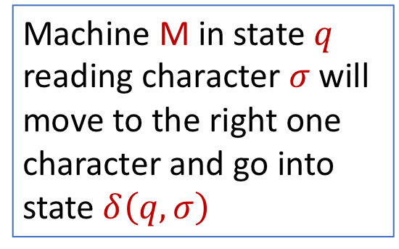
Machine M in state $q$ reading character $σ$ will move to the right one character and go into state $δ\left(q,σ\right)$
a
 | input
state | a | b
0 | 1 | 0
1 | 0 | 0
b
0
1
a
b
0
Starting in state 0. Reading Character a
a | b | a | b | b | b | b | a | a | b | a

Slide 3

Machine M in state $q$ reading character $σ$ will move to the right one character and go into state $δ\left(q,σ\right)$
a
 | input
state | a | b
0 | 1 | 0
1 | 0 | 0
b
0
1
a
b
0
1
Starting in state 0. Reading Character a
a | b | a | b | b | b | b | a | a | b | a
$$φ\left(a\right)=q_{1}$$
Goes into state 1

Slide 4
Machine M in state $q$ reading character $σ$ will move to the right one character and go into state $δ\left(q,σ\right)$
a
 | input
state | a | b
0 | 1 | 0
1 | 0 | 0
b
0
1
a
b
0
1
Now in state 1. Reading Character b
a | b | a | b | b | b | b | a | a | b | a

Slide 5

Machine M in state $q$ reading character $σ$ will move to the right one character and go into state $δ\left(q,σ\right)$
a
 | input
state | a | b
0 | 1 | 0
1 | 0 | 0
b
0
1
a
b
0
1 | 0
Now in state 1. Reading Character b
a | b | a | b | b | b | b | a | a | b | a
$$φ\left(ab\right)=q_{0}$$
Goes into state 0

Slide 6
Machine M in state $q$ reading character $σ$ will move to the right one character and go into state $δ\left(q,σ\right)$
a
 | input
state | a | b
0 | 1 | 0
1 | 0 | 0
b
0
1
a
b
0
1 | 0
Now in state 0. Reading Character a
a | b | a | b | b | b | b | a | a | b | a

Slide 7

Machine M in state $q$ reading character $σ$ will move to the right one character and go into state $δ\left(q,σ\right)$
a
 | input
state | a | b
0 | 1 | 0
1 | 0 | 0
b
0
1
a
b
0
1 | 0 | 1
Now in state 0. Reading Character a
a | b | a | b | b | b | b | a | a | b | a
$$φ\left(aba\right)=q_{1}$$
Goes into state 1

Slide 8

Machine M in state $q$ reading character $σ$ will move to the right one character and go into state $δ\left(q,σ\right)$
a
 | input
state | a | b
0 | 1 | 0
1 | 0 | 0
b
0
1
a
b
0
1 | 0 | 1 | 0
a | b | a | b | b | b | b | a | a | b | a
$$φ\left(abab\right)=q_{0}$$

Slide 9

Machine M in state $q$ reading character $σ$ will move to the right one character and go into state $δ\left(q,σ\right)$
a
 | input
state | a | b
0 | 1 | 0
1 | 0 | 0
b
0
1
a
b
0
1 | 0 | 1 | 0 | 0
a | b | a | b | b | b | b | a | a | b | a
$$φ\left(ababb\right)=q_{0}$$

Slide 10

Machine M in state $q$ reading character $σ$ will move to the right one character and go into state $δ\left(q,σ\right)$
a
 | input
state | a | b
0 | 1 | 0
1 | 0 | 0
b
0
1
a
b
0
1 | 0 | 1 | 0 | 0 | 0
a | b | a | b | b | b | b | a | a | b | a
$$φ\left(ababbb\right)=q_{0}$$

Slide 11

Machine M in state $q$ reading character $σ$ will move to the right one character and go into state $δ\left(q,σ\right)$
a
 | input
state | a | b
0 | 1 | 0
1 | 0 | 0
b
0
1
a
b
0
1 | 0 | 1 | 0 | 0 | 0 | 0
a | b | a | b | b | b | b | a | a | b | a
$$φ\left(ababbbb\right)=q_{0}$$

Slide 12

Machine M in state $q$ reading character $σ$ will move to the right one character and go into state $δ\left(q,σ\right)$
a
 | input
state | a | b
0 | 1 | 0
1 | 0 | 0
b
0
1
a
b
0
1 | 0 | 1 | 0 | 0 | 0 | 0 | 1
a | b | a | b | b | b | b | a | a | b | a
$$φ\left(ababbbba\right)=q_{1}$$

Slide 13

Machine M in state $q$ reading character $σ$ will move to the right one character and go into state $δ\left(q,σ\right)$
a
 | input
state | a | b
0 | 1 | 0
1 | 0 | 0
b
0
1
a
b
0
1 | 0 | 1 | 0 | 0 | 0 | 0 | 1 | 0
a | b | a | b | b | b | b | a | a | b | a
$$φ\left(ababbbbaa\right)=q_{0}$$

Slide 14

Machine M in state $q$ reading character $σ$ will move to the right one character and go into state $δ\left(q,σ\right)$
a
 | input
state | a | b
0 | 1 | 0
1 | 0 | 0
b
0
1
a
b
0
1 | 0 | 1 | 0 | 0 | 0 | 0 | 1 | 0 | 0
a | b | a | b | b | b | b | a | a | b | a
$$φ\left(ababbbbaab\right)=q_{0}$$

Slide 15
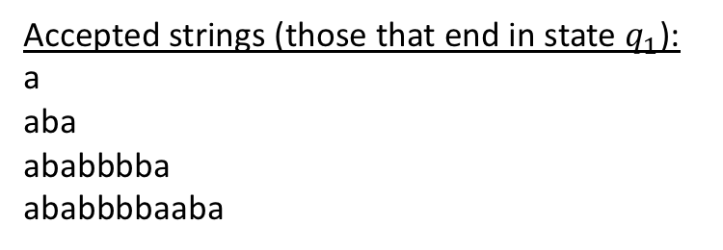

Machine M in state $q$ reading character $σ$ will move to the right one character and go into state $δ\left(q,σ\right)$
a
 | input
state | a | b
0 | 1 | 0
1 | 0 | 0
b
0
1
a
b
0
1 | 0 | 1 | 0 | 0 | 0 | 0 | 1 | 0 | 0 | 1
Accepted strings (those that end in state $q_{1}$): a aba ababbbba
ababbbbaaba
a | b | a | b | b | b | b | a | a | b | a
$$φ\left(ababbbbaaba\right)=q_{1}$$

