Slide 1
String Matching Automaton Example

Slide 2
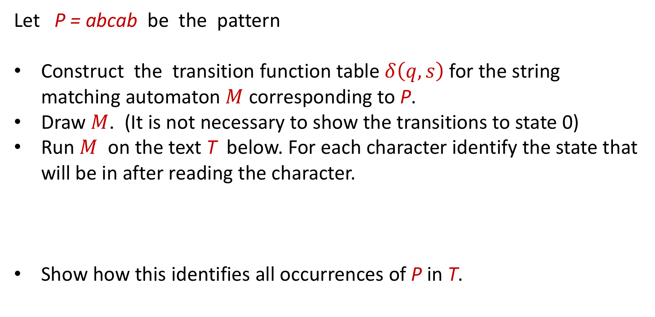
String-Matching Automata
Let $\text{P} \text{=} \text{abcab}$ be the pattern
Construct the transition function table $δ\left(q,s\right)$ for the string matching automaton $M$ corresponding to $\text{P}$.
Draw $M$. (It is not necessary to show the transitions to state 0)
Run $M$ on the text $\text{T}$ below. For each character identify the state that will be in after reading the character.
Show how this identifies all occurrences of $\text{P}$ in $\text{T}$.
$$T$$ | = | a | c | a | b | c | a | b | c | a | b | a | b | c | a | b | c | a | b | c | a | b | a

Slide 3
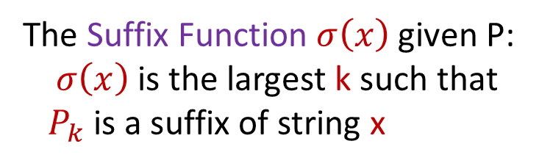
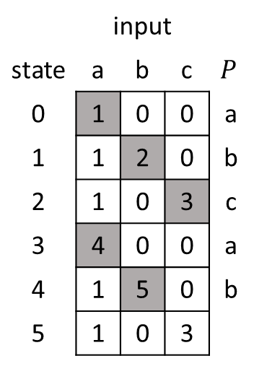
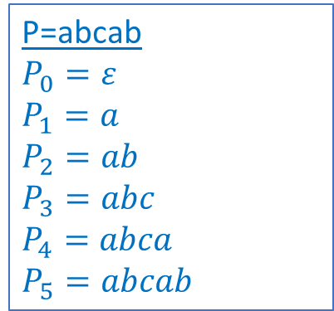
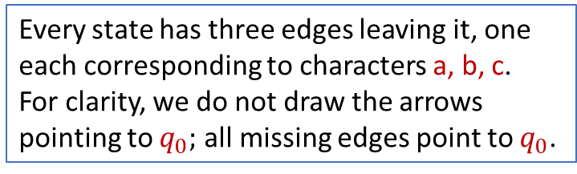

The start state is 0 and the only accepting state is$m$.
P=abcab $P_{0}=ε$ $P_{1}=a$
$P_{2}=ab$ $P_{3}=abc$ $P_{4}=abca$
$P_{5}=abcab$
The Suffix Function $σ\left(x\right)$ given P:
$σ\left(x\right)$ is the largest k such that $P_{k}$ is a suffix of string x
Every state has three edges leaving it, one each corresponding to characters a, b, c. For clarity, we do not draw the arrows pointing to $q_{0};$ all missing edges point to $q_{0}$.
$$δ\left(q,s\right)=σ\left(P_{q}s\right)$$
 | input
state | a | b | c | $$P$$
0 | 1 | 0 | 0 | a
1 | 1 | 2 | 0 | b
2 | 1 | 0 | 3 | c
3 | 4 | 0 | 0 | a
4 | 1 | 5 | 0 | b
5 | 1 | 0 | 3
a
a
a
a
a
b
c
a
b
0
1
2
3
4
5
c
c

Slide 4

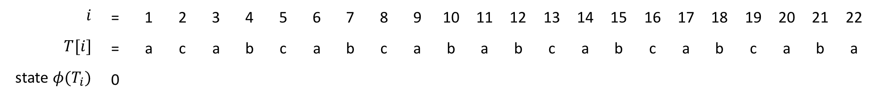
 | input
state | a | b | c | $$P$$
0 | 1 | 0 | 0 | a
1 | 1 | 2 | 0 | b
2 | 1 | 0 | 3 | c
3 | 4 | 0 | 0 | a
4 | 1 | 5 | 0 | b
5 | 1 | 0 | 3
a
a
a
a
a
b
c
a
b
0
1
2
3
4
5
c
c
$$i$$ | = | 1 | 2 | 3 | 4 | 5 | 6 | 7 | 8 | 9 | 10 | 11 | 12 | 13 | 14 | 15 | 16 | 17 | 18 | 19 | 20 | 21 | 22
$$T[i]$$ | = | a | c | a | b | c | a | b | c | a | b | a | b | c | a | b | c | a | b | c | a | b | a
state $φ(T_{i})$ | 0

Slide 5
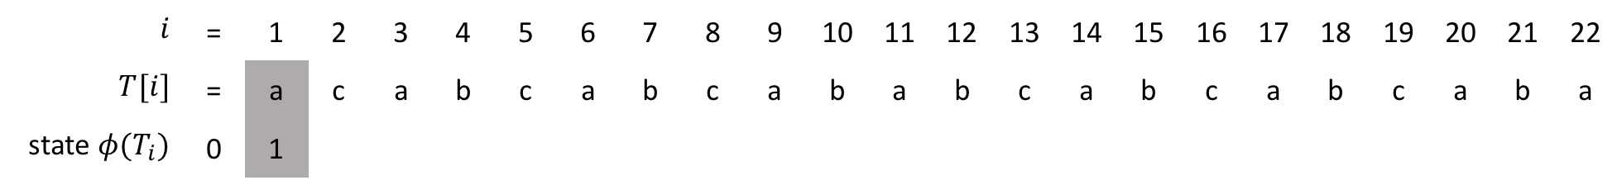
 | input
state | a | b | c | $$P$$
0 | 1 | 0 | 0 | a
1 | 1 | 2 | 0 | b
2 | 1 | 0 | 3 | c
3 | 4 | 0 | 0 | a
4 | 1 | 5 | 0 | b
5 | 1 | 0 | 3
a
a
a
a
a
b
c
a
b
0
1
2
3
4
5
c
c
$$i$$ | = | 1 | 2 | 3 | 4 | 5 | 6 | 7 | 8 | 9 | 10 | 11 | 12 | 13 | 14 | 15 | 16 | 17 | 18 | 19 | 20 | 21 | 22
$$T[i]$$ | = | a | c | a | b | c | a | b | c | a | b | a | b | c | a | b | c | a | b | c | a | b | a
state $φ(T_{i})$ | 0 | 1

Slide 6
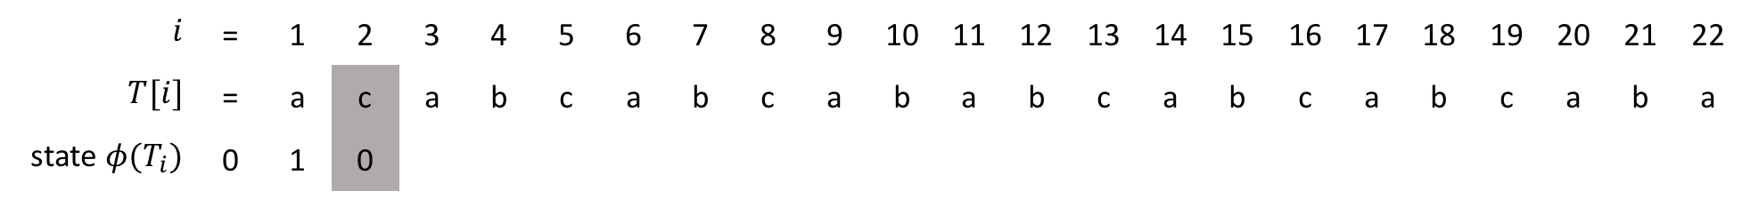
 | input
state | a | b | c | $$P$$
0 | 1 | 0 | 0 | a
1 | 1 | 2 | 0 | b
2 | 1 | 0 | 3 | c
3 | 4 | 0 | 0 | a
4 | 1 | 5 | 0 | b
5 | 1 | 0 | 3
a
a
a
a
a
b
c
a
b
0
1
2
3
4
5
c
c
$$i$$ | = | 1 | 2 | 3 | 4 | 5 | 6 | 7 | 8 | 9 | 10 | 11 | 12 | 13 | 14 | 15 | 16 | 17 | 18 | 19 | 20 | 21 | 22
$$T[i]$$ | = | a | c | a | b | c | a | b | c | a | b | a | b | c | a | b | c | a | b | c | a | b | a
state $φ(T_{i})$ | 0 | 1 | 0

Slide 7
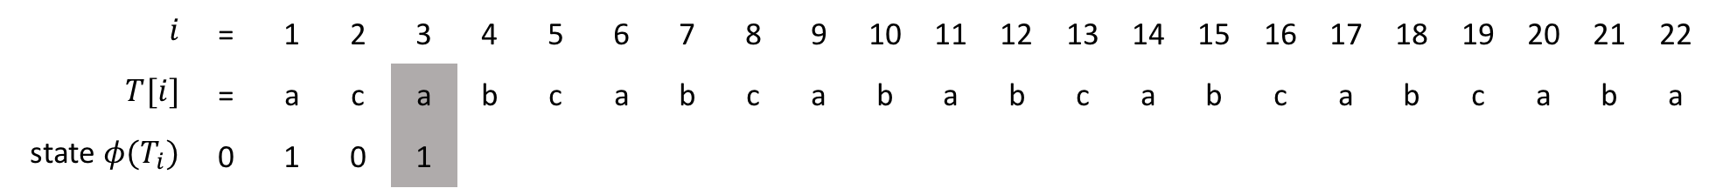
 | input
state | a | b | c | $$P$$
0 | 1 | 0 | 0 | a
1 | 1 | 2 | 0 | b
2 | 1 | 0 | 3 | c
3 | 4 | 0 | 0 | a
4 | 1 | 5 | 0 | b
5 | 1 | 0 | 3
a
a
a
a
a
b
c
a
b
0
1
2
3
4
5
c
c
$$i$$ | = | 1 | 2 | 3 | 4 | 5 | 6 | 7 | 8 | 9 | 10 | 11 | 12 | 13 | 14 | 15 | 16 | 17 | 18 | 19 | 20 | 21 | 22
$$T[i]$$ | = | a | c | a | b | c | a | b | c | a | b | a | b | c | a | b | c | a | b | c | a | b | a
state $φ(T_{i})$ | 0 | 1 | 0 | 1

Slide 8
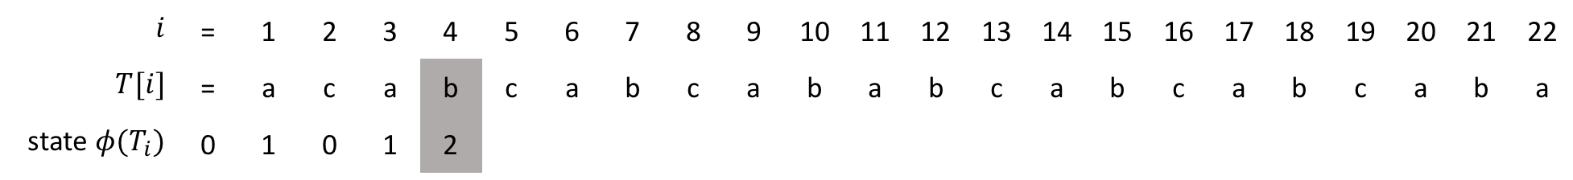
 | input
state | a | b | c | $$P$$
0 | 1 | 0 | 0 | a
1 | 1 | 2 | 0 | b
2 | 1 | 0 | 3 | c
3 | 4 | 0 | 0 | a
4 | 1 | 5 | 0 | b
5 | 1 | 0 | 3
a
a
a
a
a
b
c
a
b
0
1
2
3
4
5
c
c
$$i$$ | = | 1 | 2 | 3 | 4 | 5 | 6 | 7 | 8 | 9 | 10 | 11 | 12 | 13 | 14 | 15 | 16 | 17 | 18 | 19 | 20 | 21 | 22
$$T[i]$$ | = | a | c | a | b | c | a | b | c | a | b | a | b | c | a | b | c | a | b | c | a | b | a
state $φ(T_{i})$ | 0 | 1 | 0 | 1 | 2

Slide 9
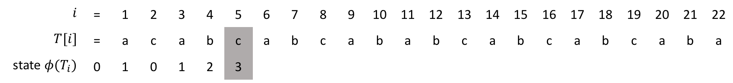
 | input
state | a | b | c | $$P$$
0 | 1 | 0 | 0 | a
1 | 1 | 2 | 0 | b
2 | 1 | 0 | 3 | c
3 | 4 | 0 | 0 | a
4 | 1 | 5 | 0 | b
5 | 1 | 0 | 3
a
a
a
a
a
b
c
a
b
0
1
2
3
4
5
c
c
$$i$$ | = | 1 | 2 | 3 | 4 | 5 | 6 | 7 | 8 | 9 | 10 | 11 | 12 | 13 | 14 | 15 | 16 | 17 | 18 | 19 | 20 | 21 | 22
$$T[i]$$ | = | a | c | a | b | c | a | b | c | a | b | a | b | c | a | b | c | a | b | c | a | b | a
state $φ(T_{i})$ | 0 | 1 | 0 | 1 | 2 | 3

Slide 10
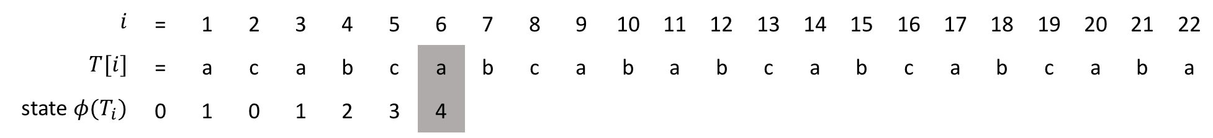
 | input
state | a | b | c | $$P$$
0 | 1 | 0 | 0 | a
1 | 1 | 2 | 0 | b
2 | 1 | 0 | 3 | c
3 | 4 | 0 | 0 | a
4 | 1 | 5 | 0 | b
5 | 1 | 0 | 3
a
a
a
a
a
b
c
a
b
0
1
2
3
4
5
c
c
$$i$$ | = | 1 | 2 | 3 | 4 | 5 | 6 | 7 | 8 | 9 | 10 | 11 | 12 | 13 | 14 | 15 | 16 | 17 | 18 | 19 | 20 | 21 | 22
$$T[i]$$ | = | a | c | a | b | c | a | b | c | a | b | a | b | c | a | b | c | a | b | c | a | b | a
state $φ(T_{i})$ | 0 | 1 | 0 | 1 | 2 | 3 | 4

Slide 11
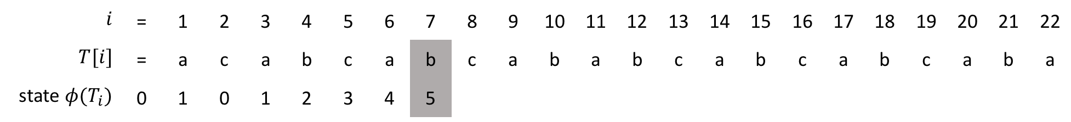
 | input
state | a | b | c | $$P$$
0 | 1 | 0 | 0 | a
1 | 1 | 2 | 0 | b
2 | 1 | 0 | 3 | c
3 | 4 | 0 | 0 | a
4 | 1 | 5 | 0 | b
5 | 1 | 0 | 3
a
a
a
a
a
b
c
a
b
0
1
2
3
4
5
c
c
$$i$$ | = | 1 | 2 | 3 | 4 | 5 | 6 | 7 | 8 | 9 | 10 | 11 | 12 | 13 | 14 | 15 | 16 | 17 | 18 | 19 | 20 | 21 | 22
$$T[i]$$ | = | a | c | a | b | c | a | b | c | a | b | a | b | c | a | b | c | a | b | c | a | b | a
state $φ(T_{i})$ | 0 | 1 | 0 | 1 | 2 | 3 | 4 | 5

Slide 12
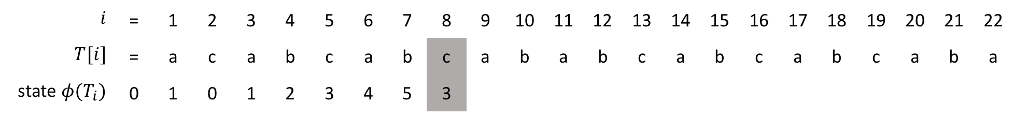
 | input
state | a | b | c | $$P$$
0 | 1 | 0 | 0 | a
1 | 1 | 2 | 0 | b
2 | 1 | 0 | 3 | c
3 | 4 | 0 | 0 | a
4 | 1 | 5 | 0 | b
5 | 1 | 0 | 3
a
a
a
a
a
b
c
a
b
0
1
2
3
4
5
c
c
$$i$$ | = | 1 | 2 | 3 | 4 | 5 | 6 | 7 | 8 | 9 | 10 | 11 | 12 | 13 | 14 | 15 | 16 | 17 | 18 | 19 | 20 | 21 | 22
$$T[i]$$ | = | a | c | a | b | c | a | b | c | a | b | a | b | c | a | b | c | a | b | c | a | b | a
state $φ(T_{i})$ | 0 | 1 | 0 | 1 | 2 | 3 | 4 | 5 | 3

Slide 13
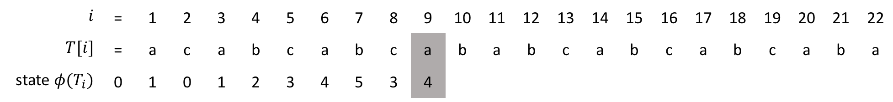
 | input
state | a | b | c | $$P$$
0 | 1 | 0 | 0 | a
1 | 1 | 2 | 0 | b
2 | 1 | 0 | 3 | c
3 | 4 | 0 | 0 | a
4 | 1 | 5 | 0 | b
5 | 1 | 0 | 3
a
a
a
a
a
b
c
a
b
0
1
2
3
4
5
c
c
$$i$$ | = | 1 | 2 | 3 | 4 | 5 | 6 | 7 | 8 | 9 | 10 | 11 | 12 | 13 | 14 | 15 | 16 | 17 | 18 | 19 | 20 | 21 | 22
$$T[i]$$ | = | a | c | a | b | c | a | b | c | a | b | a | b | c | a | b | c | a | b | c | a | b | a
state $φ(T_{i})$ | 0 | 1 | 0 | 1 | 2 | 3 | 4 | 5 | 3 | 4

Slide 14
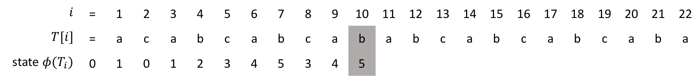
 | input
state | a | b | c | $$P$$
0 | 1 | 0 | 0 | a
1 | 1 | 2 | 0 | b
2 | 1 | 0 | 3 | c
3 | 4 | 0 | 0 | a
4 | 1 | 5 | 0 | b
5 | 1 | 0 | 3
a
a
a
a
a
b
c
a
b
0
1
2
3
4
5
c
c
$$i$$ | = | 1 | 2 | 3 | 4 | 5 | 6 | 7 | 8 | 9 | 10 | 11 | 12 | 13 | 14 | 15 | 16 | 17 | 18 | 19 | 20 | 21 | 22
$$T[i]$$ | = | a | c | a | b | c | a | b | c | a | b | a | b | c | a | b | c | a | b | c | a | b | a
state $φ(T_{i})$ | 0 | 1 | 0 | 1 | 2 | 3 | 4 | 5 | 3 | 4 | 5

Slide 15
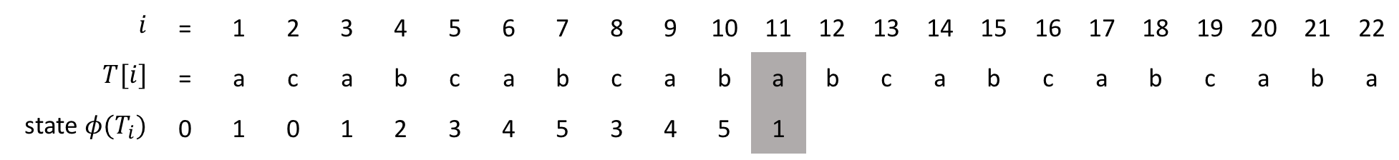
 | input
state | a | b | c | $$P$$
0 | 1 | 0 | 0 | a
1 | 1 | 2 | 0 | b
2 | 1 | 0 | 3 | c
3 | 4 | 0 | 0 | a
4 | 1 | 5 | 0 | b
5 | 1 | 0 | 3
a
a
a
a
a
b
c
a
b
0
1
2
3
4
5
c
c
$$i$$ | = | 1 | 2 | 3 | 4 | 5 | 6 | 7 | 8 | 9 | 10 | 11 | 12 | 13 | 14 | 15 | 16 | 17 | 18 | 19 | 20 | 21 | 22
$$T[i]$$ | = | a | c | a | b | c | a | b | c | a | b | a | b | c | a | b | c | a | b | c | a | b | a
state $φ(T_{i})$ | 0 | 1 | 0 | 1 | 2 | 3 | 4 | 5 | 3 | 4 | 5 | 1

Slide 16
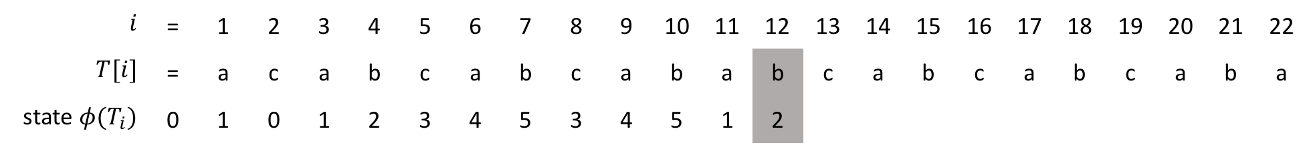
 | input
state | a | b | c | $$P$$
0 | 1 | 0 | 0 | a
1 | 1 | 2 | 0 | b
2 | 1 | 0 | 3 | c
3 | 4 | 0 | 0 | a
4 | 1 | 5 | 0 | b
5 | 1 | 0 | 3
a
a
a
a
a
b
c
a
b
0
1
2
3
4
5
c
c
$$i$$ | = | 1 | 2 | 3 | 4 | 5 | 6 | 7 | 8 | 9 | 10 | 11 | 12 | 13 | 14 | 15 | 16 | 17 | 18 | 19 | 20 | 21 | 22
$$T[i]$$ | = | a | c | a | b | c | a | b | c | a | b | a | b | c | a | b | c | a | b | c | a | b | a
state $φ(T_{i})$ | 0 | 1 | 0 | 1 | 2 | 3 | 4 | 5 | 3 | 4 | 5 | 1 | 2

Slide 17
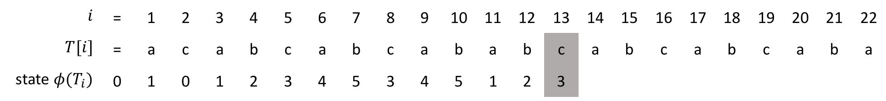
 | input
state | a | b | c | $$P$$
0 | 1 | 0 | 0 | a
1 | 1 | 2 | 0 | b
2 | 1 | 0 | 3 | c
3 | 4 | 0 | 0 | a
4 | 1 | 5 | 0 | b
5 | 1 | 0 | 3
a
a
a
a
a
b
c
a
b
0
1
2
3
4
5
c
c
$$i$$ | = | 1 | 2 | 3 | 4 | 5 | 6 | 7 | 8 | 9 | 10 | 11 | 12 | 13 | 14 | 15 | 16 | 17 | 18 | 19 | 20 | 21 | 22
$$T[i]$$ | = | a | c | a | b | c | a | b | c | a | b | a | b | c | a | b | c | a | b | c | a | b | a
state $φ(T_{i})$ | 0 | 1 | 0 | 1 | 2 | 3 | 4 | 5 | 3 | 4 | 5 | 1 | 2 | 3

Slide 18
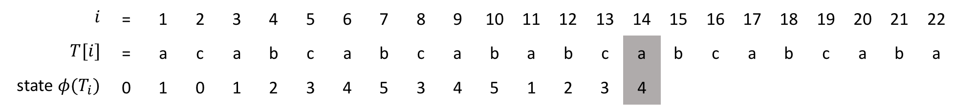
 | input
state | a | b | c | $$P$$
0 | 1 | 0 | 0 | a
1 | 1 | 2 | 0 | b
2 | 1 | 0 | 3 | c
3 | 4 | 0 | 0 | a
4 | 1 | 5 | 0 | b
5 | 1 | 0 | 3
a
a
a
a
a
b
c
a
b
0
1
2
3
4
5
c
c
$$i$$ | = | 1 | 2 | 3 | 4 | 5 | 6 | 7 | 8 | 9 | 10 | 11 | 12 | 13 | 14 | 15 | 16 | 17 | 18 | 19 | 20 | 21 | 22
$$T[i]$$ | = | a | c | a | b | c | a | b | c | a | b | a | b | c | a | b | c | a | b | c | a | b | a
state $φ(T_{i})$ | 0 | 1 | 0 | 1 | 2 | 3 | 4 | 5 | 3 | 4 | 5 | 1 | 2 | 3 | 4

Slide 19
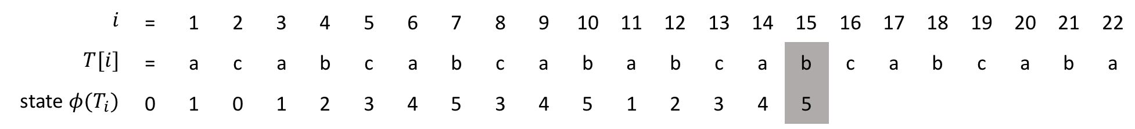
 | input
state | a | b | c | $$P$$
0 | 1 | 0 | 0 | a
1 | 1 | 2 | 0 | b
2 | 1 | 0 | 3 | c
3 | 4 | 0 | 0 | a
4 | 1 | 5 | 0 | b
5 | 1 | 0 | 3
a
a
a
a
a
b
c
a
b
0
1
2
3
4
5
c
c
$$i$$ | = | 1 | 2 | 3 | 4 | 5 | 6 | 7 | 8 | 9 | 10 | 11 | 12 | 13 | 14 | 15 | 16 | 17 | 18 | 19 | 20 | 21 | 22
$$T[i]$$ | = | a | c | a | b | c | a | b | c | a | b | a | b | c | a | b | c | a | b | c | a | b | a
state $φ(T_{i})$ | 0 | 1 | 0 | 1 | 2 | 3 | 4 | 5 | 3 | 4 | 5 | 1 | 2 | 3 | 4 | 5

Slide 20
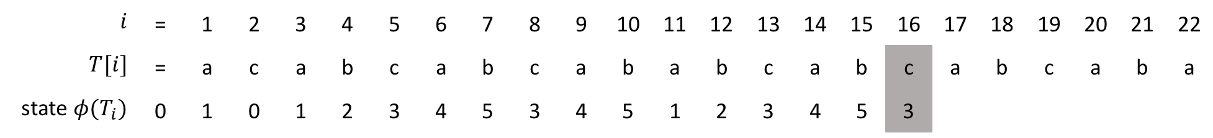
 | input
state | a | b | c | $$P$$
0 | 1 | 0 | 0 | a
1 | 1 | 2 | 0 | b
2 | 1 | 0 | 3 | c
3 | 4 | 0 | 0 | a
4 | 1 | 5 | 0 | b
5 | 1 | 0 | 3
a
a
a
a
a
b
c
a
b
0
1
2
3
4
5
c
c
$$i$$ | = | 1 | 2 | 3 | 4 | 5 | 6 | 7 | 8 | 9 | 10 | 11 | 12 | 13 | 14 | 15 | 16 | 17 | 18 | 19 | 20 | 21 | 22
$$T[i]$$ | = | a | c | a | b | c | a | b | c | a | b | a | b | c | a | b | c | a | b | c | a | b | a
state $φ(T_{i})$ | 0 | 1 | 0 | 1 | 2 | 3 | 4 | 5 | 3 | 4 | 5 | 1 | 2 | 3 | 4 | 5 | 3

Slide 21
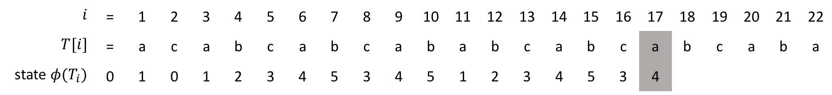
 | input
state | a | b | c | $$P$$
0 | 1 | 0 | 0 | a
1 | 1 | 2 | 0 | b
2 | 1 | 0 | 3 | c
3 | 4 | 0 | 0 | a
4 | 1 | 5 | 0 | b
5 | 1 | 0 | 3
a
a
a
a
a
b
c
a
b
0
1
2
3
4
5
c
c
$$i$$ | = | 1 | 2 | 3 | 4 | 5 | 6 | 7 | 8 | 9 | 10 | 11 | 12 | 13 | 14 | 15 | 16 | 17 | 18 | 19 | 20 | 21 | 22
$$T[i]$$ | = | a | c | a | b | c | a | b | c | a | b | a | b | c | a | b | c | a | b | c | a | b | a
state $φ(T_{i})$ | 0 | 1 | 0 | 1 | 2 | 3 | 4 | 5 | 3 | 4 | 5 | 1 | 2 | 3 | 4 | 5 | 3 | 4

Slide 22
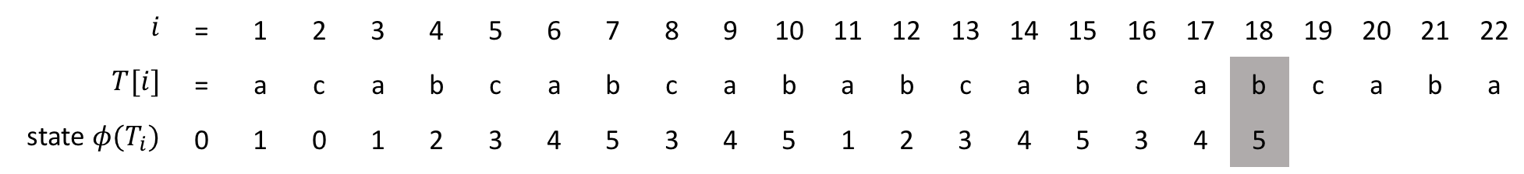
 | input
state | a | b | c | $$P$$
0 | 1 | 0 | 0 | a
1 | 1 | 2 | 0 | b
2 | 1 | 0 | 3 | c
3 | 4 | 0 | 0 | a
4 | 1 | 5 | 0 | b
5 | 1 | 0 | 3
a
a
a
a
a
b
c
a
b
0
1
2
3
4
5
c
c
$$i$$ | = | 1 | 2 | 3 | 4 | 5 | 6 | 7 | 8 | 9 | 10 | 11 | 12 | 13 | 14 | 15 | 16 | 17 | 18 | 19 | 20 | 21 | 22
$$T[i]$$ | = | a | c | a | b | c | a | b | c | a | b | a | b | c | a | b | c | a | b | c | a | b | a
state $φ(T_{i})$ | 0 | 1 | 0 | 1 | 2 | 3 | 4 | 5 | 3 | 4 | 5 | 1 | 2 | 3 | 4 | 5 | 3 | 4 | 5

Slide 23
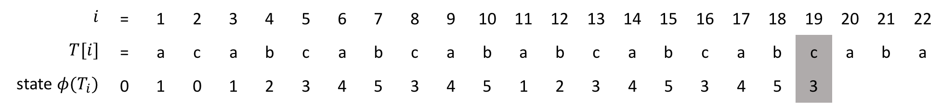
 | input
state | a | b | c | $$P$$
0 | 1 | 0 | 0 | a
1 | 1 | 2 | 0 | b
2 | 1 | 0 | 3 | c
3 | 4 | 0 | 0 | a
4 | 1 | 5 | 0 | b
5 | 1 | 0 | 3
a
a
a
a
a
b
c
a
b
0
1
2
3
4
5
c
c
$$i$$ | = | 1 | 2 | 3 | 4 | 5 | 6 | 7 | 8 | 9 | 10 | 11 | 12 | 13 | 14 | 15 | 16 | 17 | 18 | 19 | 20 | 21 | 22
$$T[i]$$ | = | a | c | a | b | c | a | b | c | a | b | a | b | c | a | b | c | a | b | c | a | b | a
state $φ(T_{i})$ | 0 | 1 | 0 | 1 | 2 | 3 | 4 | 5 | 3 | 4 | 5 | 1 | 2 | 3 | 4 | 5 | 3 | 4 | 5 | 3

Slide 24
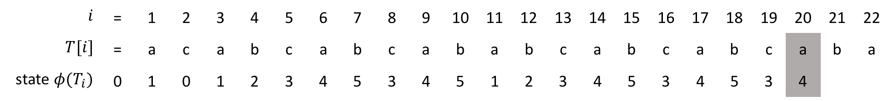
 | input
state | a | b | c | $$P$$
0 | 1 | 0 | 0 | a
1 | 1 | 2 | 0 | b
2 | 1 | 0 | 3 | c
3 | 4 | 0 | 0 | a
4 | 1 | 5 | 0 | b
5 | 1 | 0 | 3
a
a
a
a
a
b
c
a
b
0
1
2
3
4
5
c
c
$$i$$ | = | 1 | 2 | 3 | 4 | 5 | 6 | 7 | 8 | 9 | 10 | 11 | 12 | 13 | 14 | 15 | 16 | 17 | 18 | 19 | 20 | 21 | 22
$$T[i]$$ | = | a | c | a | b | c | a | b | c | a | b | a | b | c | a | b | c | a | b | c | a | b | a
state $φ(T_{i})$ | 0 | 1 | 0 | 1 | 2 | 3 | 4 | 5 | 3 | 4 | 5 | 1 | 2 | 3 | 4 | 5 | 3 | 4 | 5 | 3 | 4

Slide 25
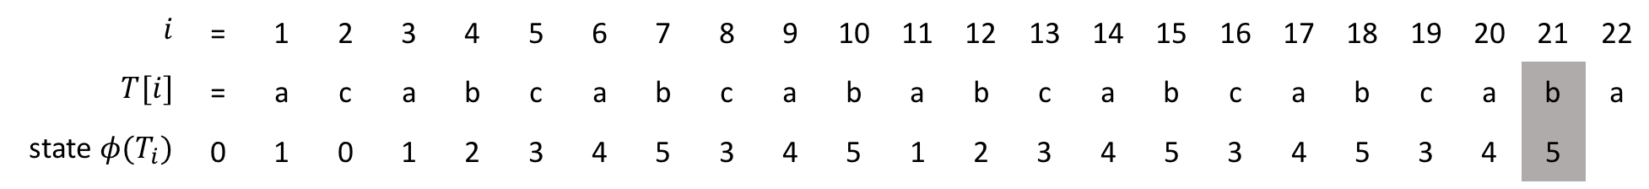
 | input
state | a | b | c | $$P$$
0 | 1 | 0 | 0 | a
1 | 1 | 2 | 0 | b
2 | 1 | 0 | 3 | c
3 | 4 | 0 | 0 | a
4 | 1 | 5 | 0 | b
5 | 1 | 0 | 3
a
a
a
a
a
b
c
a
b
0
1
2
3
4
5
c
c
$$i$$ | = | 1 | 2 | 3 | 4 | 5 | 6 | 7 | 8 | 9 | 10 | 11 | 12 | 13 | 14 | 15 | 16 | 17 | 18 | 19 | 20 | 21 | 22
$$T[i]$$ | = | a | c | a | b | c | a | b | c | a | b | a | b | c | a | b | c | a | b | c | a | b | a
state $φ(T_{i})$ | 0 | 1 | 0 | 1 | 2 | 3 | 4 | 5 | 3 | 4 | 5 | 1 | 2 | 3 | 4 | 5 | 3 | 4 | 5 | 3 | 4 | 5

Slide 26
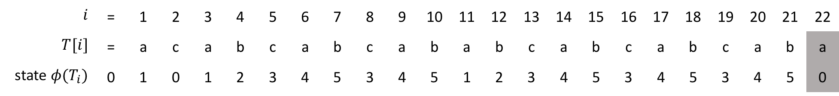
c
 | input
state | a | b | c | $$P$$
0 | 1 | 0 | 0 | a
1 | 1 | 2 | 0 | b
2 | 1 | 0 | 3 | c
3 | 4 | 0 | 0 | a
4 | 1 | 5 | 0 | b
5 | 1 | 0 | 3
a
a
a
a
a
b
c
a
b
0
1
2
3
4
5
c
c
$$i$$ | = | 1 | 2 | 3 | 4 | 5 | 6 | 7 | 8 | 9 | 10 | 11 | 12 | 13 | 14 | 15 | 16 | 17 | 18 | 19 | 20 | 21 | 22
$$T[i]$$ | = | a | c | a | b | c | a | b | c | a | b | a | b | c | a | b | c | a | b | c | a | b | a
state $φ(T_{i})$ | 0 | 1 | 0 | 1 | 2 | 3 | 4 | 5 | 3 | 4 | 5 | 1 | 2 | 3 | 4 | 5 | 3 | 4 | 5 | 3 | 4 | 5 | 0

Slide 27
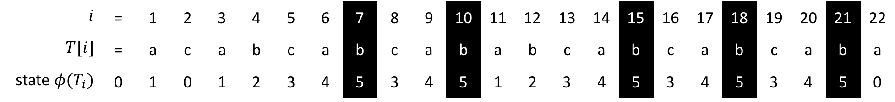
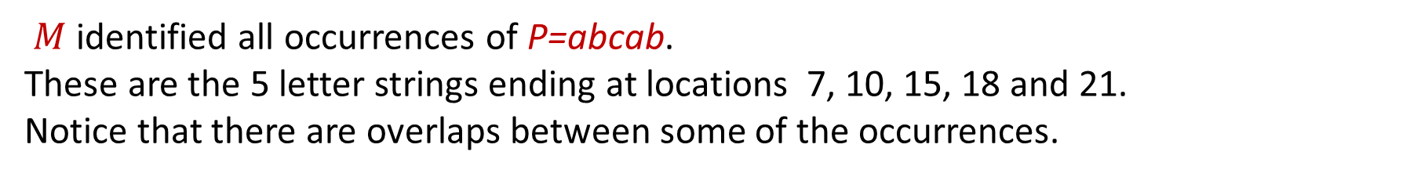
$M$ identified all occurrences of $\text{P}\text{=}\text{abcab}$.
These are the 5 letter strings ending at locations 7, 10, 15, 18 and 21.
Notice that there are overlaps between some of the occurrences.
 | input
state | a | b | c | $$P$$
0 | 1 | 0 | 0 | a
1 | 1 | 2 | 0 | b
2 | 1 | 0 | 3 | c
3 | 4 | 0 | 0 | a
4 | 1 | 5 | 0 | b
5 | 1 | 0 | 3
a
a
a
a
a
b
c
a
b
0
1
2
3
4
5
c
c
$$i$$ | = | 1 | 2 | 3 | 4 | 5 | 6 | 7 | 8 | 9 | 10 | 11 | 12 | 13 | 14 | 15 | 16 | 17 | 18 | 19 | 20 | 21 | 22
$$T[i]$$ | = | a | c | a | b | c | a | b | c | a | b | a | b | c | a | b | c | a | b | c | a | b | a
state $φ(T_{i})$ | 0 | 1 | 0 | 1 | 2 | 3 | 4 | 5 | 3 | 4 | 5 | 1 | 2 | 3 | 4 | 5 | 3 | 4 | 5 | 3 | 4 | 5 | 0

