Slide 1
COMP3711: Extra DP Review
Spring 2019
HKUST

Slide 2
What is DP
Dynamic Programming (DP) bears similarities to Divide and Conquer (D&C)
Both partition a problem into smaller subproblems => build solution of larger problems from solutions of smaller problems
In D&C, work top-down. Solve exact smaller problems that need to be solved to solve larger problem
In DP, (usually) work bottom-up.
Solve all smaller size problems => build larger problem solutions from them.
many large subproblems reuse solution to same smaller problem.
DP often used for optimization problems
Problems have many feasible solutions; we want the best solution.
Main idea of DP
Analyze the structure of an optimal solution
Recursively define the value of an optimal solution
Compute the value of an optimal solution (usually bottom-up)

Slide 3
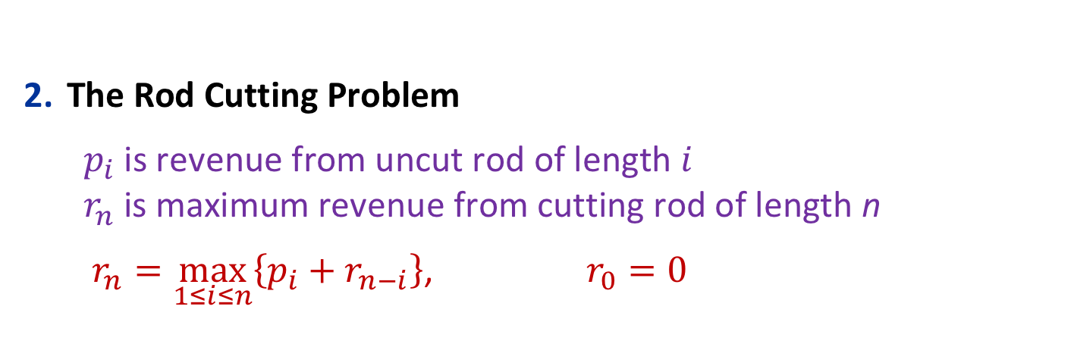
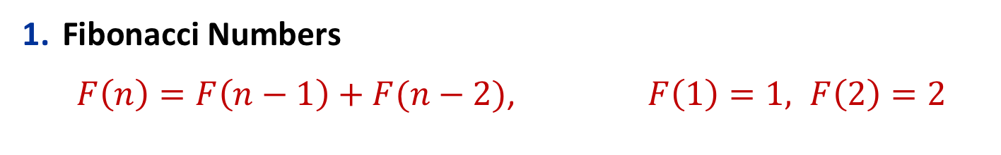


Some Recurrences
Fibonacci Numbers
$F\left(n\right)=F\left(n−1\right)+F(n−2)$, $F\left(1\right)=1, F\left(2\right)=2$
$$Θ(n)$$
The Rod Cutting Problem
$p_{i}$ is revenue from uncut rod of length $i$ $r_{n}$ is maximum revenue from cutting rod of length n
$r_{n}=\max_{1≤i≤n}\left\{p_{i}+r_{n−i}\right\}$, $r_{0}=0$
$$Θ \left(n^{2}\right)$$

Slide 4

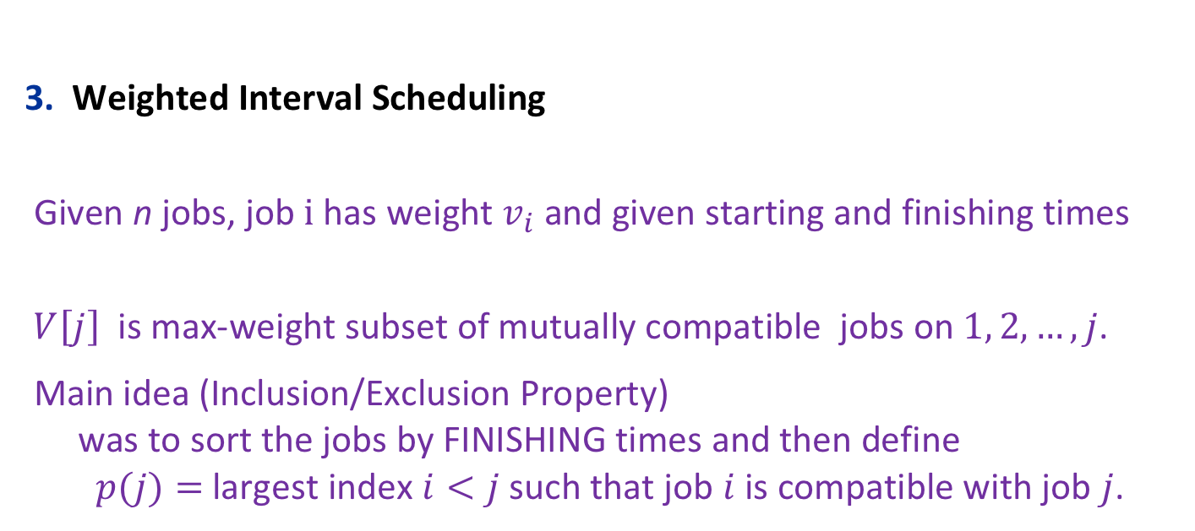
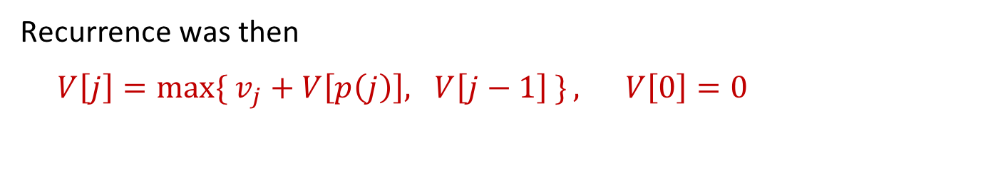
More Recurrences
Weighted Interval Scheduling
Given n jobs, job $i$ has weight $v_{i}$and given starting and finishing times
$V\left[j\right]$ is max-weight subset of mutually compatible jobs on $1, 2, …, j$.
Main idea (Inclusion/Exclusion Property) was to sort the jobs by FINISHING times and then define $p(j)=$ largest index $i<j$ such that job $i$ is compatible with job $j$.
$$Θ(nlog{n)}$$
Recurrence was then
$V\left[j\right]=\max{\{ v_{j}+V\left[p\left(j\right)\right], V\left[j−1\right] \}}, V\left[0\right]=0$

Slide 5
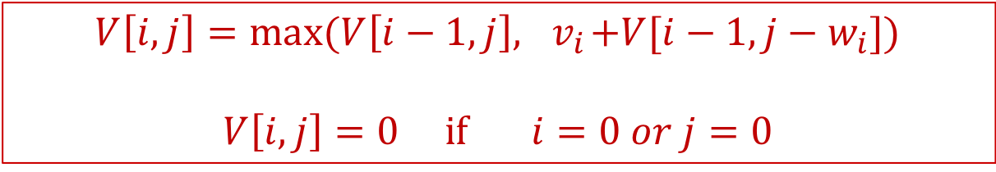
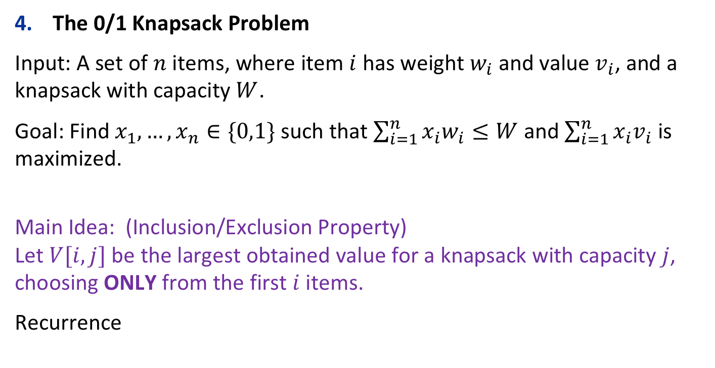

More Recurrences
$$Θ \left(n^{2}\right)$$
The 0/1 Knapsack Problem
Input: A set of $n$ items, where item $i$ has weight $w_{i}$ and value $v_{i}$, and a knapsack with capacity $W$.
Goal: Find $x_{1},…,x_{n}∈\{0,1\}$ such that $\sum_{i=1}^{n}{x_{i}w_{i}≤W}$ and $\sum_{i=1}^{n}{x_{i}v_{i}}$ is maximized.
Main Idea: (Inclusion/Exclusion Property) Let $V[i,j]$ be the largest obtained value for a knapsack with capacity $j$, choosing ONLY from the first $i$ items.
Recurrence
$$V\left[i,j\right]=\max{(V\left[i−1,j\right],{ v}_{i}+V[i−1,j−w_{i}])}$$
$$V\left[i,j\right]=0 if i=0 or j=0$$

Slide 6
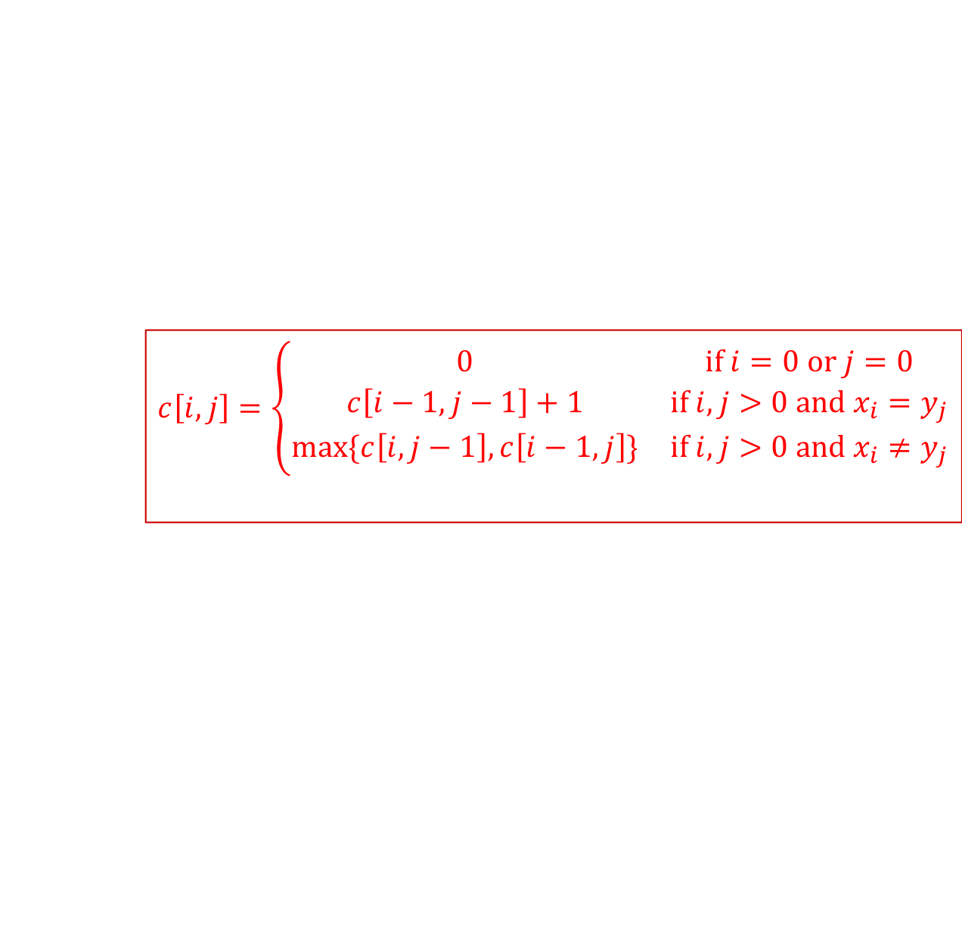

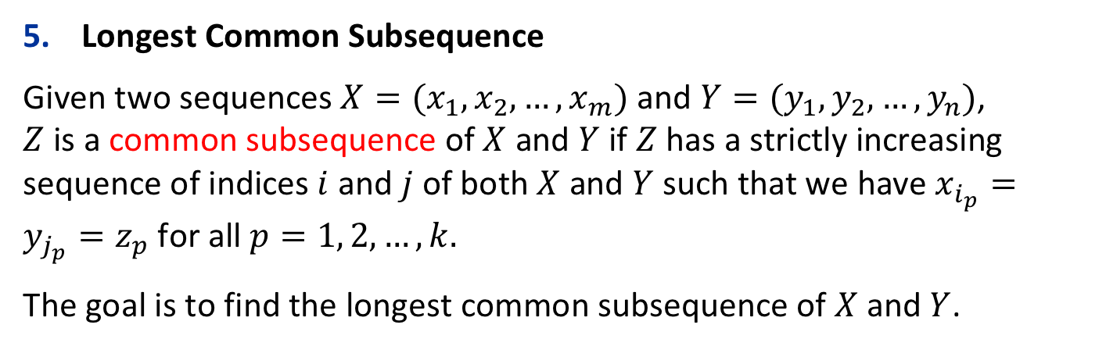
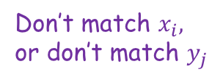


More Recurrences
$$Θ \left(mn\right)$$
Longest Common Subsequence
Given two sequences $X=(x_{1},x_{2},…,x_{m})$ and $Y=(y_{1},y_{2},…,y_{n})$, $Z$ is a common subsequence of $X$ and $Y$ if $Z$ has a strictly increasing sequence of indices $i$ and $j$ of both $X$ and $Y$ such that we have $x_{i_{p}}=y_{j_{p}}=z_{p}$ for all $p=1, 2,…,k.$
The goal is to find the longest common subsequence of $X$ and $Y$.
Main Idea: Let $c[i,j]$ to be the length of the longest common subsequence of $X[1..i]$ and $Y[1..j]$.
$$c\left[i,j\right]=\left\{\begin{matrix}0 & if i=0 or j=0 \\ c\left[i−1,j−1\right]+1 & if i,j>0 and x_{i}=y_{j} \\ \max{\{c\left[i,j−1\right],c\left[i−1,j\right]\}} & if i,j>0 and x_{i}≠y_{j}\end{matrix}\right.$$
Match $x_{i},y_{j}$
Don’t match $x_{i},$ or don’t match $y_{j}$

Slide 7


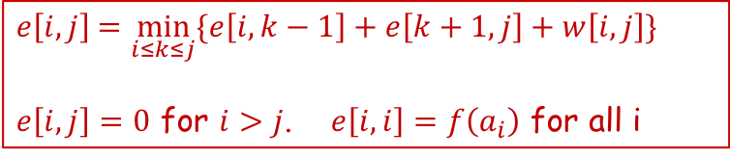


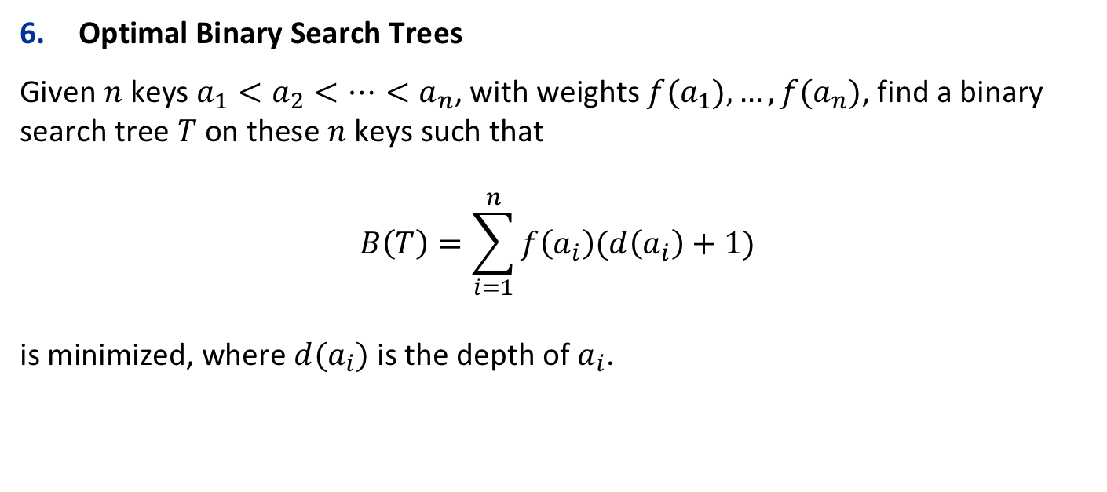




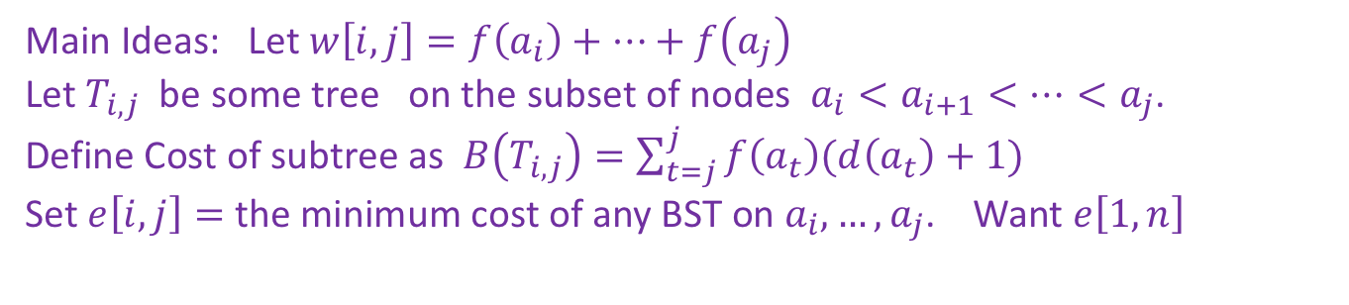

More Recurrences
$$Θ \left(n^{3}\right)$$
Optimal Binary Search Trees
Given $n$ keys $a_{1}<a_{2}<…<a_{n}$, with weights $f(a_{1}),…, f(a_{n})$, find a binary search tree $T$ on these $n$ keys such that $$B\left(T\right)=\sum_{i=1}^{n}{f\left(a_{i}\right)(d\left(a_{i}\right)+1)}$$ is minimized, where $d(a_{i})$ is the depth of $a_{i}$.
$$T_{i,j}$$
$$ak$$
$$T_{i,k−1}$$
$$T_{k+1,j}$$
$$ai$$
$$a_{k−1}$$
$$a_{k+1}$$
$$aj$$
Main Ideas: Let$w\left[i,j\right]=f\left(a_{i}\right)+…+f\left(a_{j}\right)$ Let $T_{i,j}$ be some tree on the subset of nodes $a_{i}<a_{i+1}<…<a_{j}$. Define Cost of subtree as $B\left(T_{i,j}\right)=\sum_{t=j}^{j}{f\left(a_{t}\right)(d\left(a_{t}\right)+1)}$ Set $e\left[i,j\right]=$ the minimum cost of any BST on $a_{i},…,a_{j}$. Want $e\left[1,n\right]$
$e\left[i,j\right]$ $=\min_{i≤k≤j}{\{e\left[i,k−1\right]+e\left[k+1,j\right]+w\left[i,j\right]\} }$
$e\left[i,j\right]=0$ for $i>j$. $e\left[i,i\right]=f\left(a_{i}\right)$ for all i

Slide 8
A Problem From an Old Exam
1) A message containing letters from A − Z is being encoded to numbers using the following mapping:
“A” → 1 “B” → 2 . . . “Z” → 26
Given an encoded message A containing n digits, design a O(n) time dynamic programming algorithm to determine the total number of ways to decode A.
For example, encoded message ”23”, could be decoded as “BC”(2, 3) or “W”(23).
The number of ways to decode “23” is 2.

Slide 9
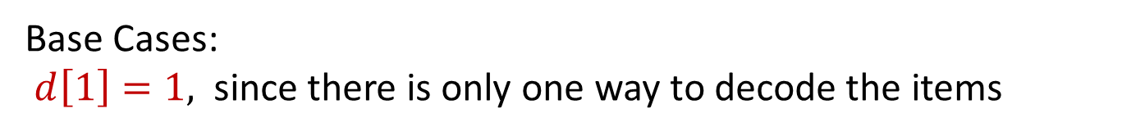

A Problem From an Old Exam
1) “A” → 1, “B” → 2, . . ., “Z” → 26
Given an encoded message A containing n digits in 1-9, design a O(n) time dynamic programming algorithm to determine the total number of ways to decode A.
Let $d[i]$ be the total number of ways to decode A[1..i].
Base Cases:
$d\left[1\right]=1,$ since there is only one way to decode the items
Working through the possibilities (checking whether A[1 2] can encode a single letter or not, shows
$$d\left[2\right]=\left\{\begin{matrix}1 & if 10 ∗A\left[i−1\right]+A\left[i\right]>26 \\ 2 & otherwise\end{matrix}\right.$$

Slide 10

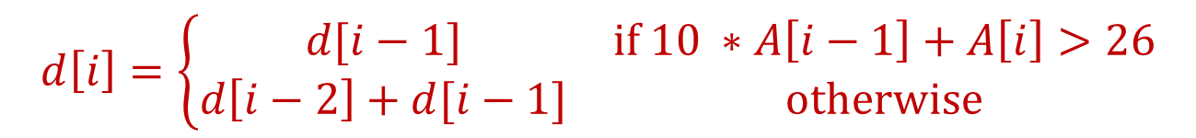
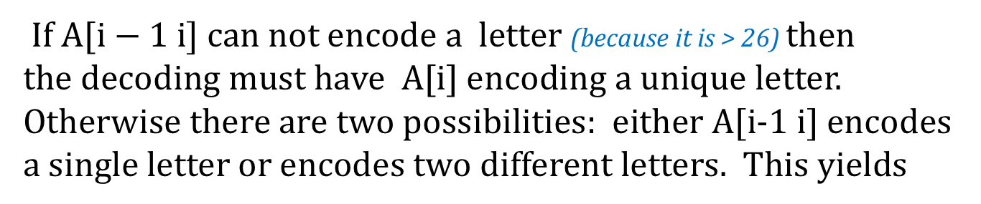
A Problem From an Old Exam
1) “A” → 1, “B” → 2, . . ., “Z” → 26
Given an encoded message A containing n digits in 1-9, design a O(n) time dynamic programming algorithm to determine the total number of ways to decode A.
Let $d[i]$ be the total number of ways to decode A[1..i].
General Case: If $i>2,$
If A[$i−1 i]$ can not encode a letter (because it is > 26) then the decoding must have A[i] encoding a unique letter.
Otherwise there are two possibilities: either A[i-1 i] encodes a single letter or encodes two different letters. This yields
$$d\left[i\right]=\left\{\begin{matrix}d[i−1] & if 10 ∗A\left[i−1\right]+A\left[i\right]>26 \\ d\left[i−2\right]+d[i−1] & otherwise\end{matrix}\right.$$

Slide 11

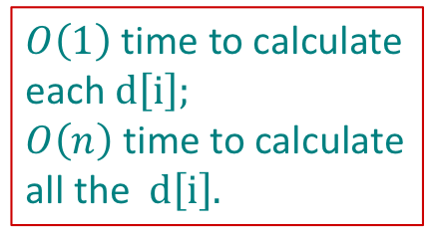
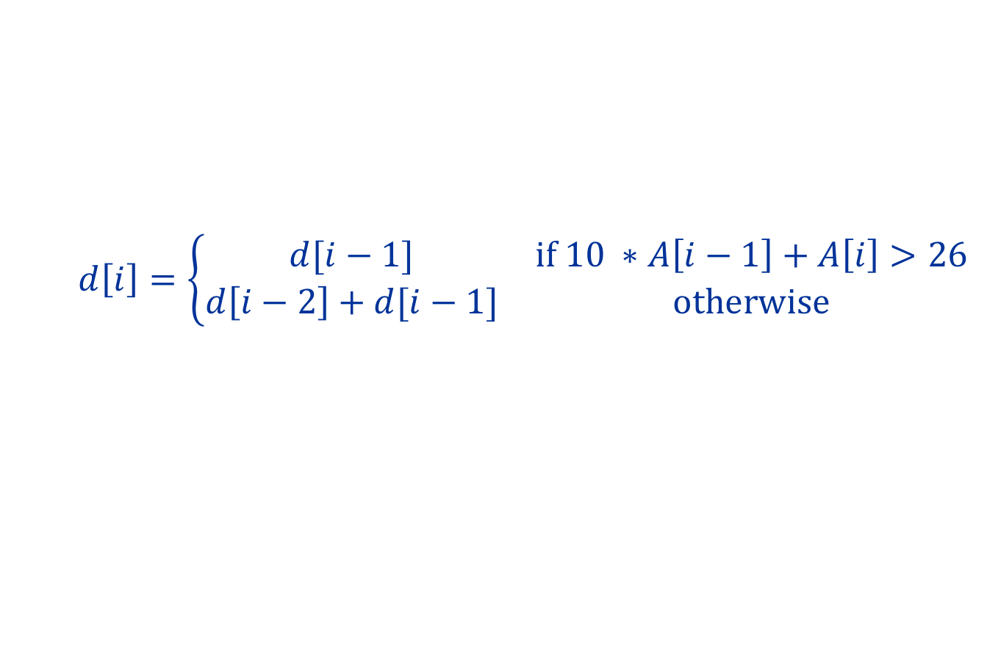

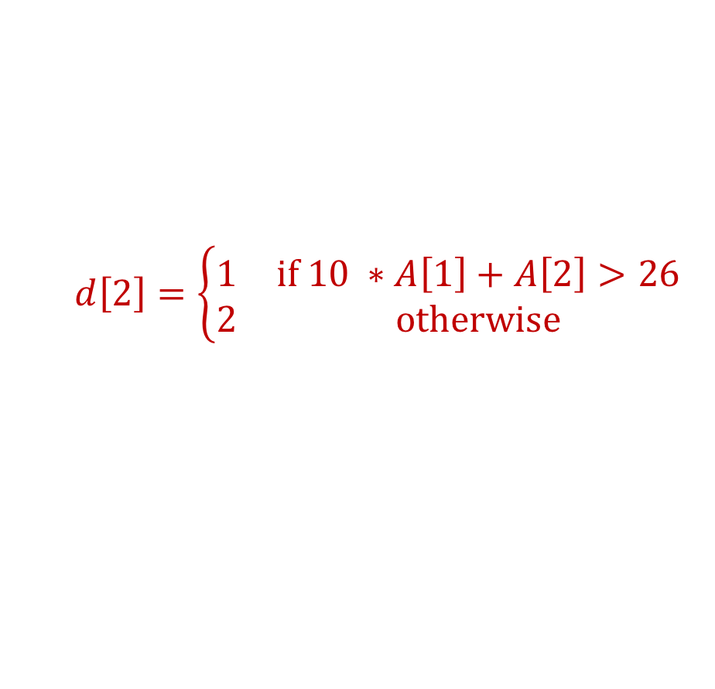
A Problem From an Old Exam
1) “A” → 1, “B” → 2, . . ., “Z” → 26
Given an encoded message A containing n digits in 1-9, design a O(n) time dynamic programming algorithm to determine the total number of ways to decode A.
Let $d[i]$ be the total number of ways to decode A[1..i])
Base Case: $d\left[1\right]=1$
$O\left(1\right)$ time to calculate each $d\left[i\right];$ $O\left(n\right)$ time to calculate all the $d\left[i\right].$
$$d\left[2\right]=\left\{\begin{matrix}1 & if 10 ∗A\left[1\right]+A\left[2\right]>26 \\ 2 & otherwise\end{matrix}\right.$$
General Case: If $i>2,$
$$d\left[i\right]=\left\{\begin{matrix}d[i−1] & if 10 ∗A\left[i−1\right]+A\left[i\right]>26 \\ d\left[i−2\right]+d[i−1] & otherwise\end{matrix}\right.$$

Slide 12
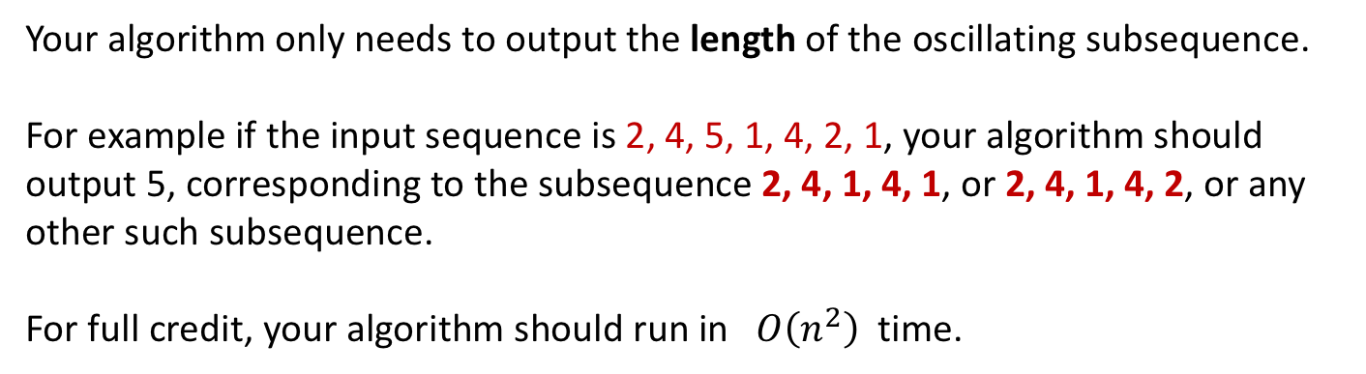
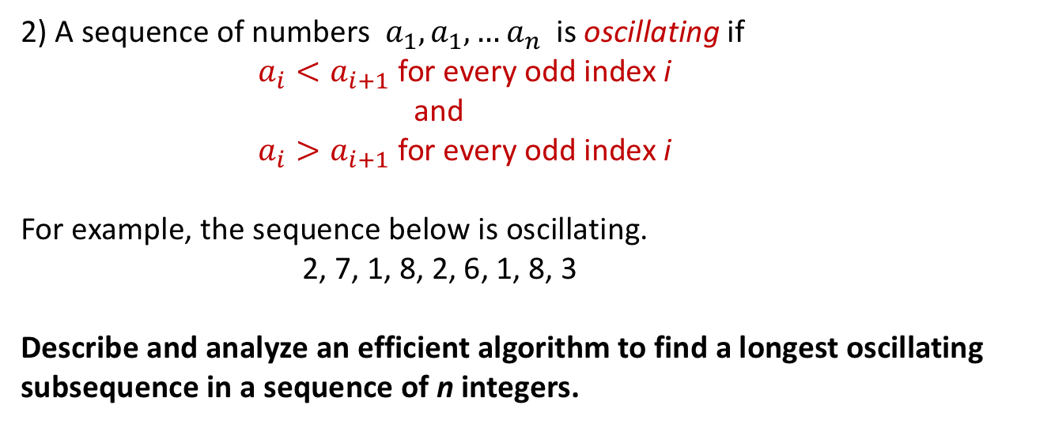
Another Problem From an Old Exam
2) A sequence of numbers $a_{1},a_{1},…a_{n}$is oscillating if
$a_{i}<a_{i+1}$ for every odd index i
and
$a_{i}>a_{i+1}$ for every odd index i
For example, the sequence below is oscillating. 2, 7, 1, 8, 2, 6, 1, 8, 3
Describe and analyze an efficient algorithm to find a longest oscillating subsequence in a sequence of n integers.
Your algorithm only needs to output the length of the oscillating subsequence.
For example if the input sequence is 2, 4, 5, 1, 4, 2, 1, your algorithm should output 5, corresponding to the subsequence 2, 4, 1, 4, 1, or 2, 4, 1, 4, 2, or any other such subsequence.
For full credit, your algorithm should run in$O\left(n^{2}\right)$ time.

Slide 13
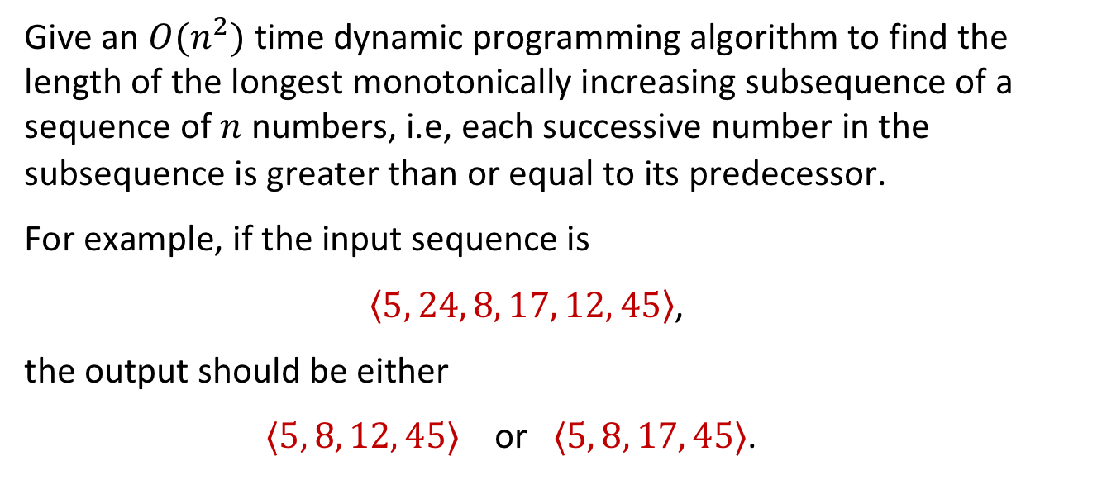
Recall Old Tutorial Question
Give an $O(n^{2})$ time dynamic programming algorithm to find the length of the longest monotonically increasing subsequence of a sequence of $n$ numbers, i.e, each successive number in the subsequence is greater than or equal to its predecessor.
For example, if the input sequence is
$\left\langle 5, 24, 8, 17, 12, 45\right\rangle$,
the output should be either
$⟨5, 8, 12, 45⟩$ or $⟨5, 8, 17, 45⟩$.
The tutorial question asked to find the actual subsequence.
We have modified it here to only find the length

Slide 14
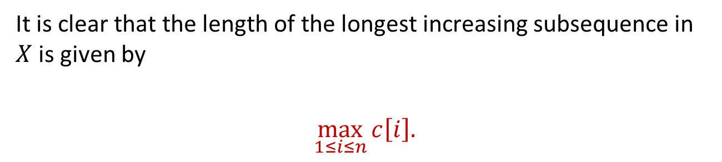
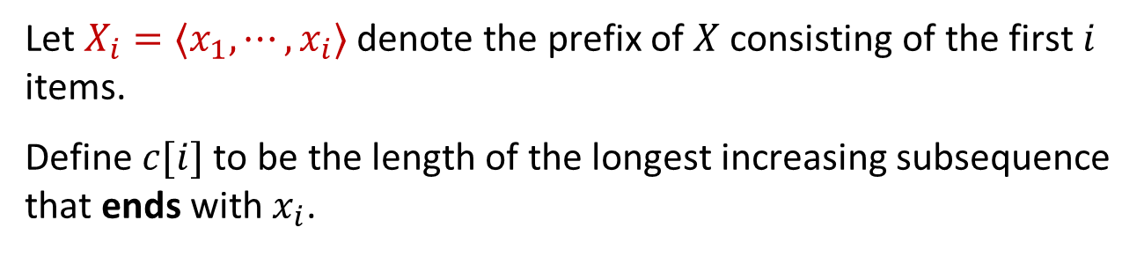
Solution to Tutorial Question
Let $X_{i}=⟨x_{1},⋯,x_{i}⟩$ denote the prefix of $X$ consisting of the first $i$ items.
Define $c[i]$ to be the length of the longest increasing subsequence that ends with $x_{i}$.
It is clear that the length of the longest increasing subsequence in $X$ is given by
$$\max_{1≤i≤n}{c\left[i\right].}$$

Slide 15
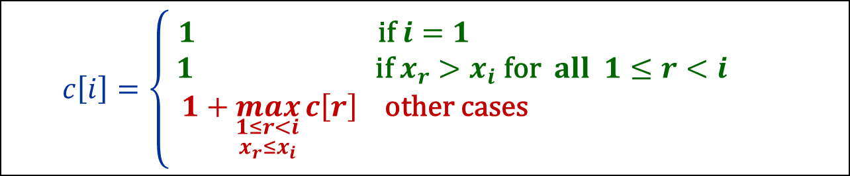
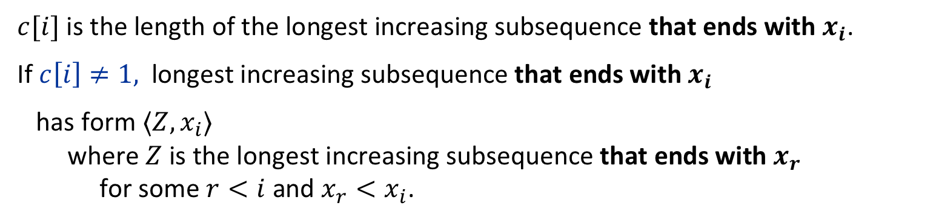
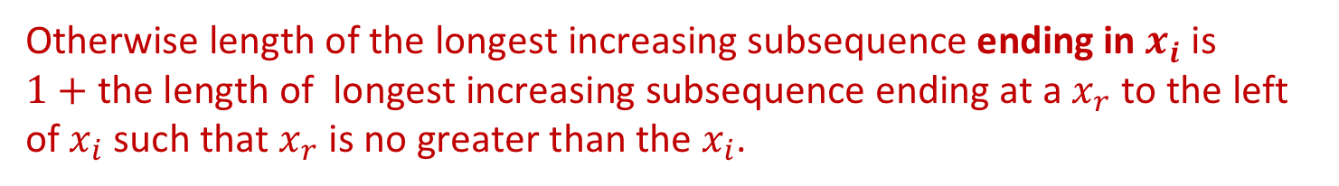
Solution to Tutorial Question
$c[i]$ is the length of the longest increasing subsequence that ends with $x_{i}$.
If $c\left[i\right]≠1,$ longest increasing subsequence that ends with $x_{i}$
has form $⟨Z,x_{i}⟩$ where $Z$ is the longest increasing subsequence that ends with $x_{r}$ for some $r<i$ and $x_{r}<x_{i}$.
If $i=1$ or all items to its left are $>$ than $x_{i}$, answer must be $1$.
Otherwise length of the longest increasing subsequence ending in $x_{i}$ is $1+$ the length of longest increasing subsequence ending at a $x_{r}$ to the left of $x_{i}$ such that $x_{r}$ is no greater than the $x_{i}$.
This yields the following recurrence relation:
$$c\left[i\right]=\left\{\begin{aligned}1 \text{if} i=1 \\ 1 \text{if} x_{r}>x_{i} \text{for} all 1≤r<i \\ 1+\max_{\begin{aligned}1≤r<i \\ x_{r}≤x_{i}\end{aligned}}{c\left[r\right] \text{other} \text{cases} }\end{aligned}\right.$$

Slide 16
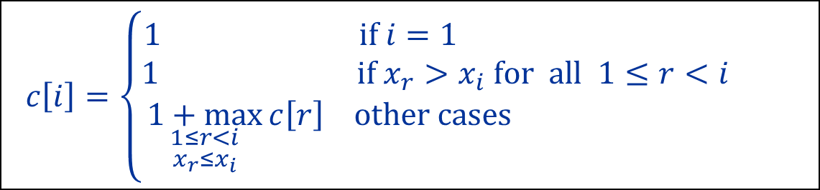
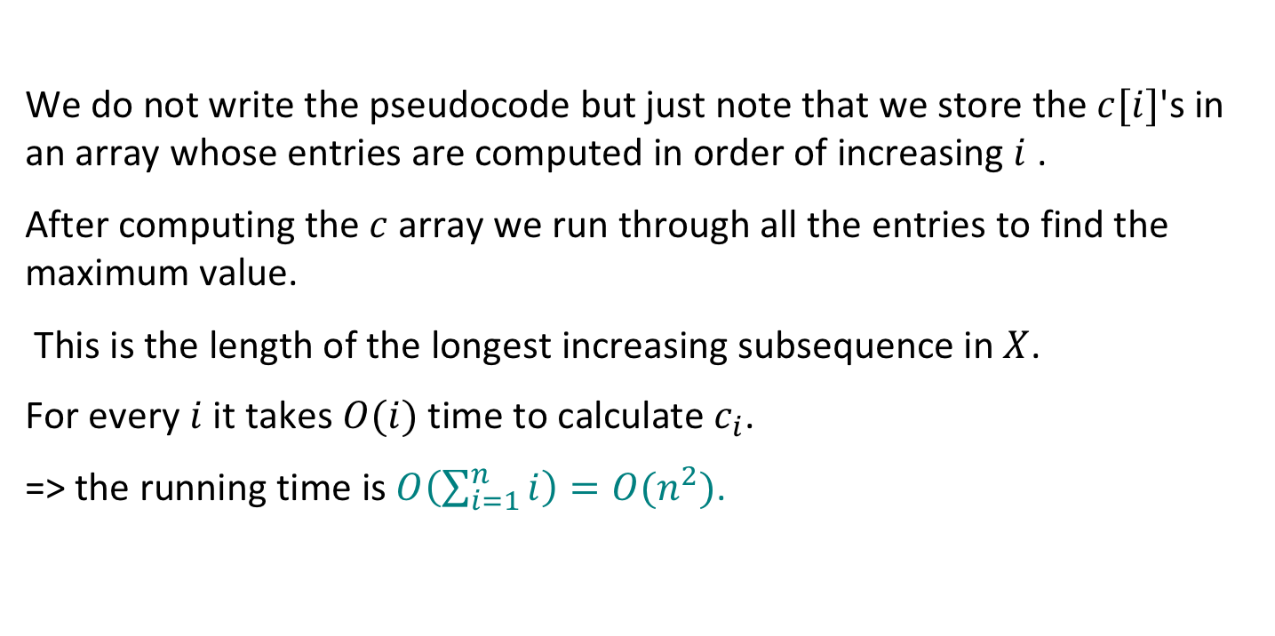
Solution to Tutorial Question
$$c\left[i\right]=\left\{\begin{aligned}1 \text{if} i=1 \\ 1 \text{if} x_{r}>x_{i} \text{for} all 1≤r<i \\ \underset{\begin{aligned}1≤r<i \\ x_{r}≤x_{i}\end{aligned}}{1+max}{c\left[r\right] \text{other} \text{cases} }\end{aligned}\right.$$
We do not write the pseudocode but just note that we store the $c[i]$'s in an array whose entries are computed in order of increasing $i$ .
After computing the $c$ array we run through all the entries to find the maximum value.
This is the length of the longest increasing subsequence in $X$.
For every $i$ it takes $O(i)$ time to calculate $c_{i}$.
=> the running time is $O\left(\sum_{i=1}^{n}{i}\right)=O(n^{2})$.

Slide 17
Back to Problem From an Old Exam
2) A sequence of numbers $a_{1},a_{1},…a_{n}$is oscillating if
$a_{i}<a_{i+1}$ for every odd index i
and
$a_{i}>a_{i+1}$ for every odd index i
For example, the sequence below is oscillating. 2, 7, 1, 8, 2, 6, 1, 8, 3
Describe and analyze an efficient algorithm to find a longest oscillating subsequence in a sequence of n integers.
Your algorithm only needs to output the length of the oscillating subsequence.
For example if the input sequence is 2, 4, 5, 1, 4, 2, 1, your algorithm should output 5, corresponding to the subsequence 2, 4, 1, 4, 1, or 2, 4, 1, 4, 2, or any other such subsequence.
For full credit, your algorithm should run in$O\left(n^{2}\right)$ time.

Slide 18
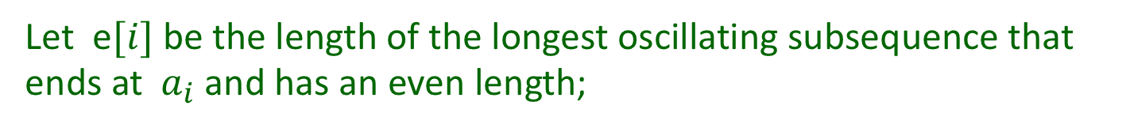


Solution
Uses similar idea to tutorial solution.
Let $o[i]$ be the length of the longest oscillating subsequence that ends at $a_{i}$ and has an odd length;
Let e$[i]$ be the length of the longest oscillating subsequence that ends at $a_{i}$ and has an even length;
Base Case: $o\left[1\right]=1; e\left[1\right]=−∞.$

Slide 19
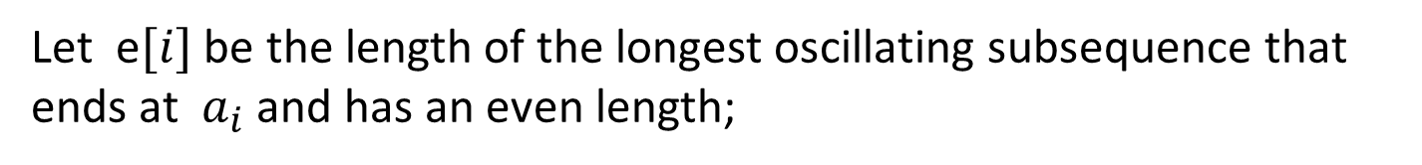
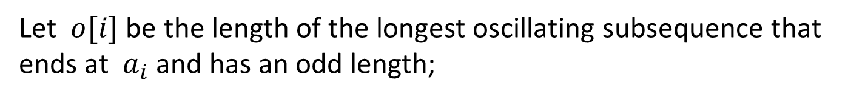
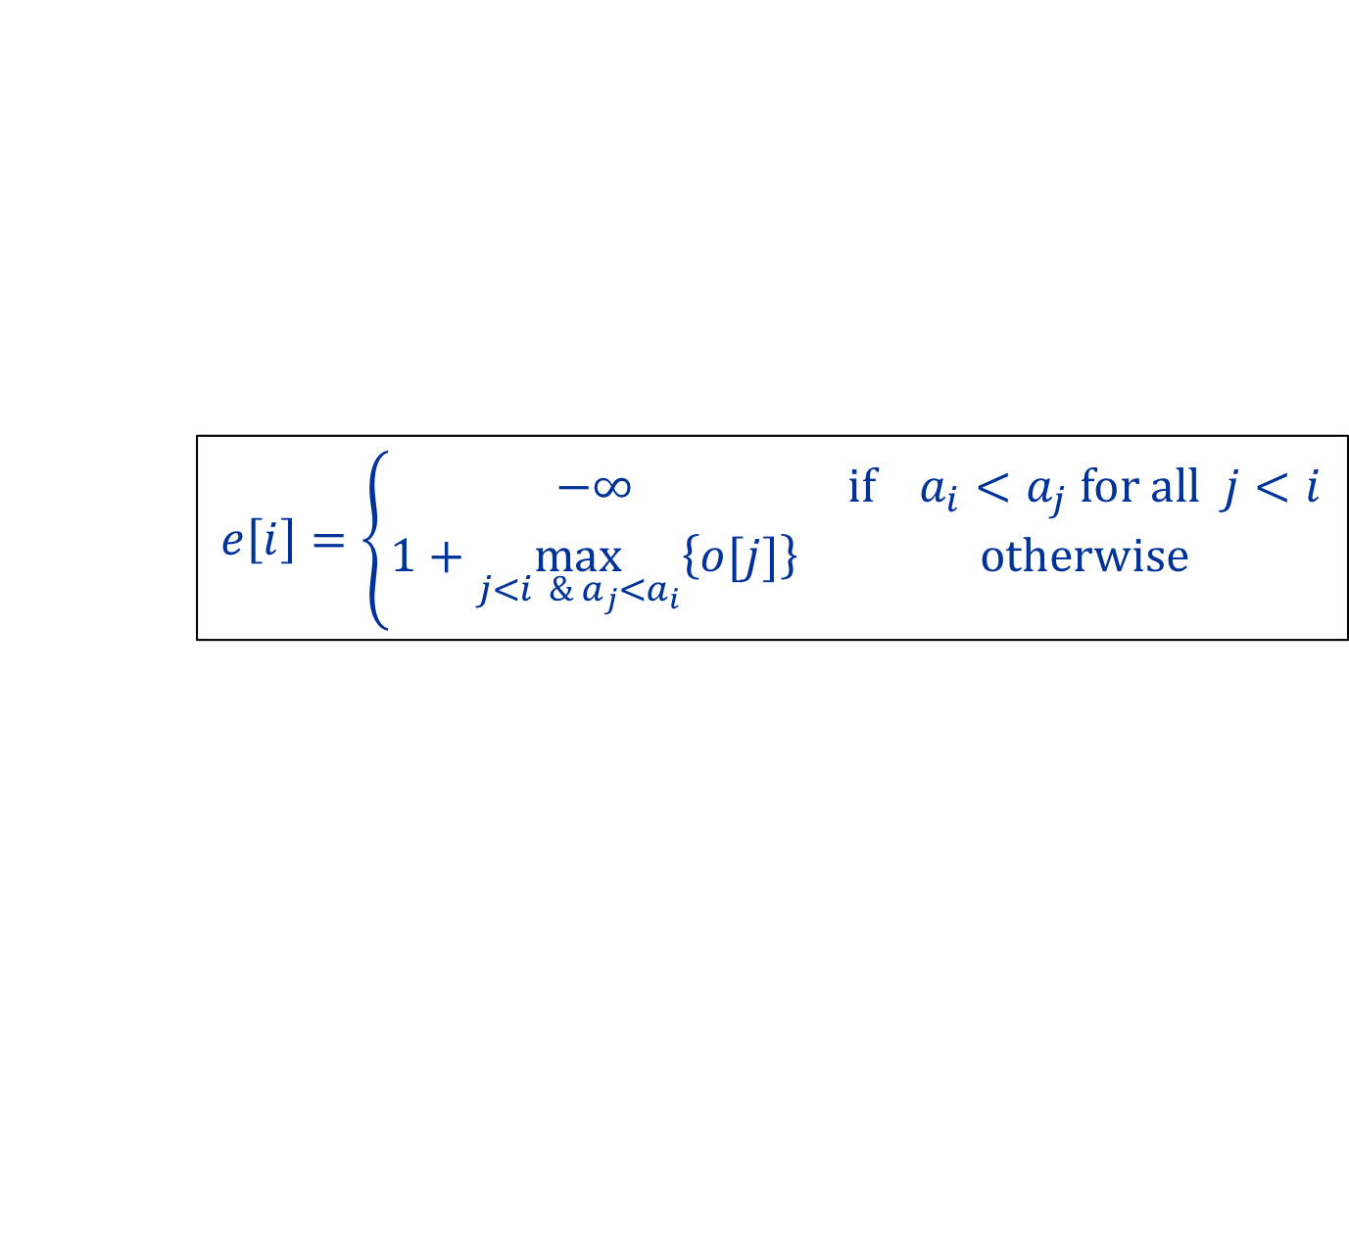

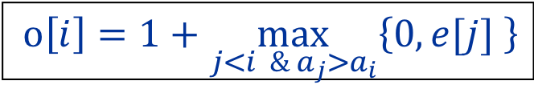
Solution
Uses similar idea to tutorial solution.
Let $o[i]$ be the length of the longest oscillating subsequence that ends at $a_{i}$ and has an odd length;
Let e$[i]$ be the length of the longest oscillating subsequence that ends at $a_{i}$ and has an even length;
General Case:
$o\left[i\right]=1+\max_{j<i \&{ a}_{j}>a_{i}}\left\{0,e[j] \right\}$
$$e\left[i\right]=\left\{\begin{matrix}−∞ & if a_{i}<a_{j} for all j<i \\ 1+\max_{j<i \&{ a}_{j}<a_{i}}\left\{o[j]\right\} & otherwise\end{matrix}\right.$$
Can then calculate the values in the tables in order
$$o\left[1\right], e\left[1\right],o\left[2\right], e\left[2\right], o\left[3\right], e\left[3\right],….$$

Slide 20
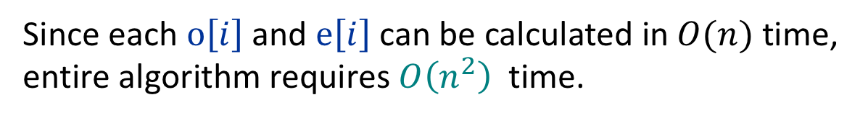
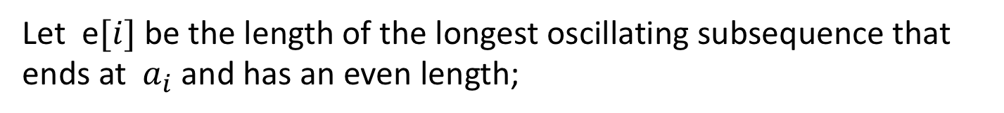

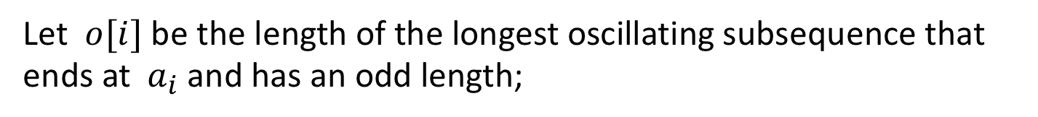
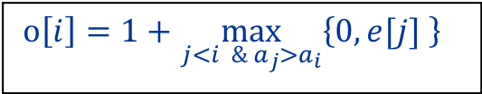
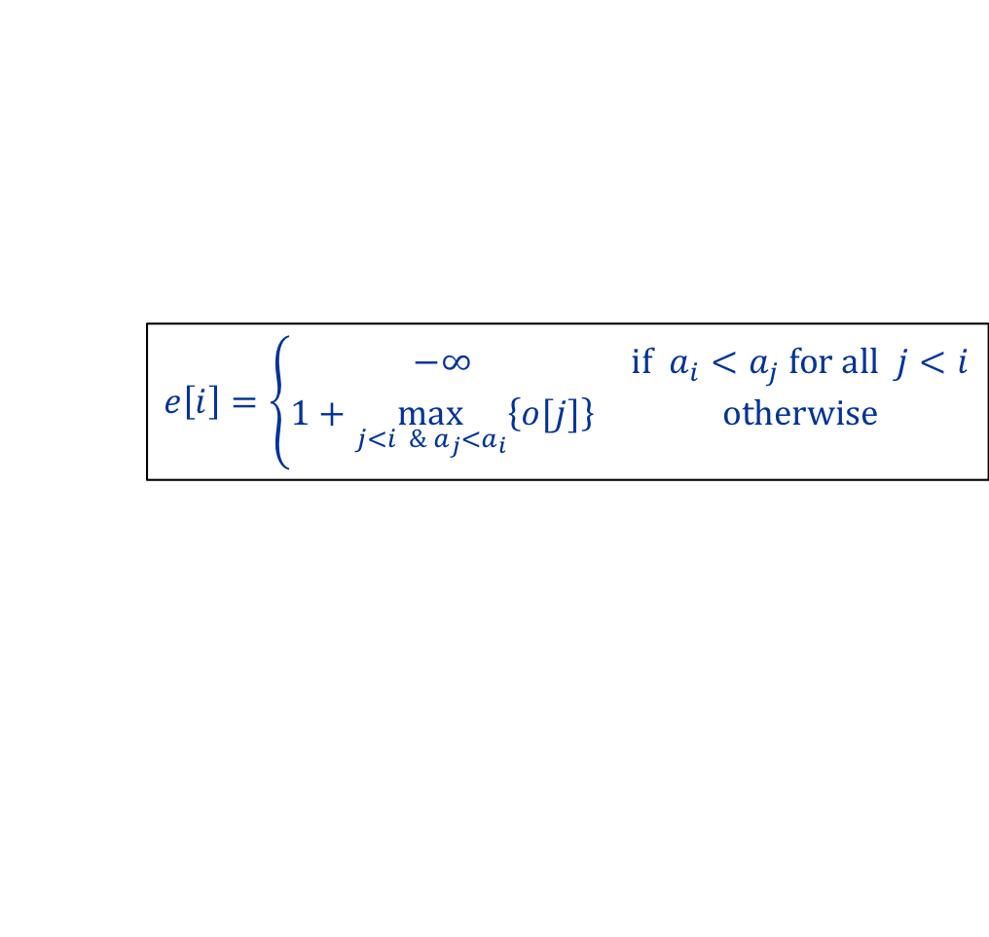
Solution
Let $o[i]$ be the length of the longest oscillating subsequence that ends at $a_{i}$ and has an odd length;
Let e$[i]$ be the length of the longest oscillating subsequence that ends at $a_{i}$ and has an even length;
Base Case: $o\left[1\right]=1; e\left[1\right]=−∞.$
General Case
$$e\left[i\right]=\left\{\begin{matrix}−∞ & if a_{i}<a_{j} for all j<i \\ 1+\max_{j<i \&{ a}_{j}<a_{i}}\left\{o[j]\right\} & otherwise\end{matrix}\right.$$
$o\left[i\right]=1+\max_{j<i \&{ a}_{j}>a_{i}}\left\{0,e[j] \right\}$
Final solution is maximum of all the $o\left[i\right], e\left[i\right]$
Since each $o\left[i\right]$ and $e\left[i\right]$ can be calculated in$O(n)$ time, entire algorithm requires $O\left(n^{2}\right)$ time.

Slide 21
Dynamic Programming: Summary
1. Structure: Analyze structure of an optimal solution, and thereby define subproblems that need to be solved
2. Recurrence: Establish the relationship between the optimal value of the problem and those of some subproblems (optimal substructure).
3. Bottom-up computation: Compute the optimal values of the smallest subproblems first, save them in the table. Then compute optimal values of larger subproblems, and so on, until the optimal value of the original problem is computed.
4. Construction of optimal solution: Record the optimal decisions made for each subproblem. At the end, assemble the optimal solution by tracing the back computation in the previous step.
Remark: The first two steps are interdependent and are the most important steps. The last two steps are usually straightforward.

