Slide 1
COMP 3711
Bubble Sort

Slide 2
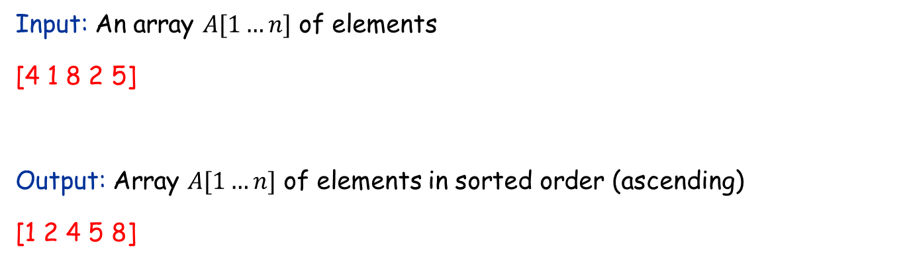
The Sorting Problem
Input: An array $A[1…n]$ of elements
[4 1 8 2 5]
Output: Array $A[1…n]$ of elements in sorted order (ascending)
[1 2 4 5 8]

Slide 3
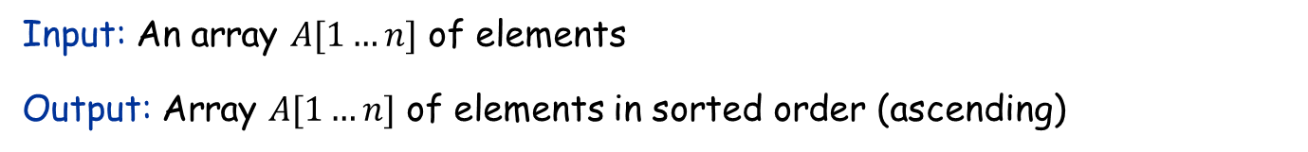
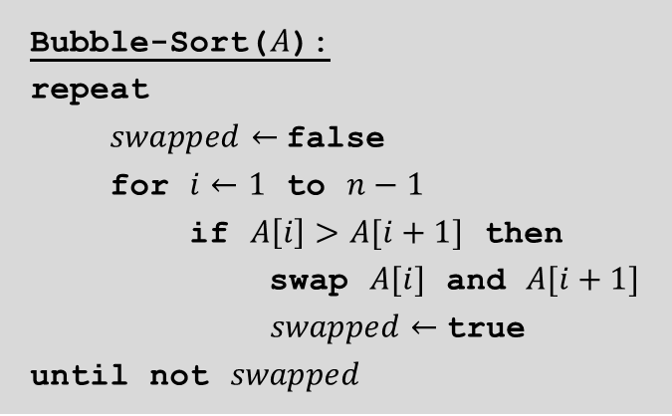
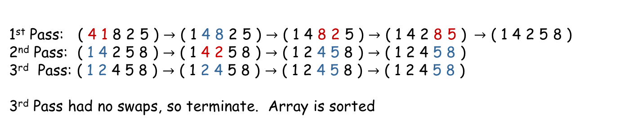
Bubble Sort
Input: An array $A[1…n]$ of elements
Output: Array $A[1…n]$ of elements in sorted order (ascending)
Bubble-Sort($A$):
repeat
$swapped←$false
for $i←1$ to $n−1$
if $A\left[i\right]>A[i+1]$ then
swap $A[i]$ and $A[i+1]$
$swapped←$true
until not $swapped$
(*) Walk through all items from first to last
Compare each item to its successor
If they are in wrong order, swap them
If any item was swapped go to (*)
1st Pass: ( 4 1 8 2 5 ) $→$ ( 1 4 8 2 5 ) $→$ ( 1 4 8 2 5 ) $→$ ( 1 4 2 8 5 ) $→$ ( 1 4 2 5 8 )
2nd Pass: ( 1 4 2 5 8 ) $→$ ( 1 4 2 5 8 ) $→$ ( 1 2 4 5 8 ) $→$ ( 1 2 4 5 8 )
3rd Pass: ( 1 2 4 5 8 ) $→$ ( 1 2 4 5 8 ) $→$ ( 1 2 4 5 8 ) $→$ ( 1 2 4 5 8 )
3rd Pass had no swaps, so terminate. Array is sorted

Slide 4
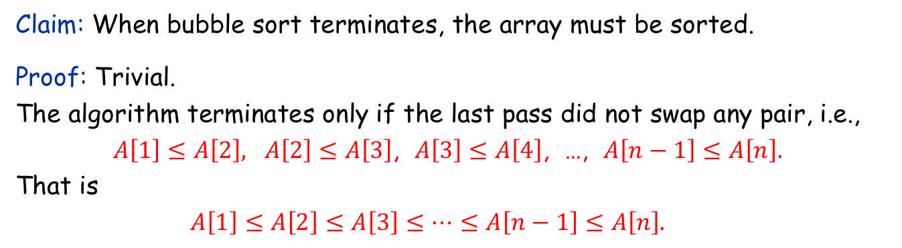
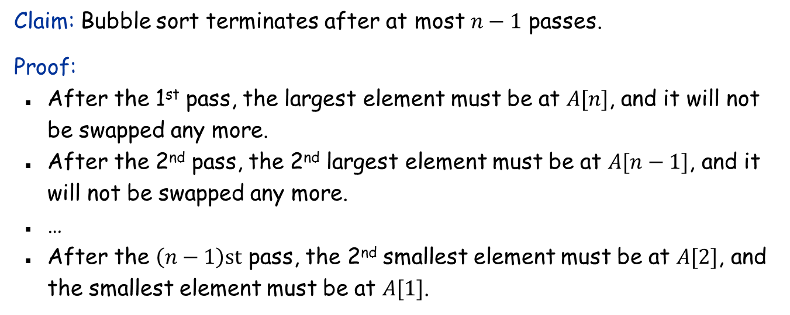
Correctness of bubble sort
Claim: When bubble sort terminates, the array must be sorted.
Proof: Trivial. The algorithm terminates only if the last pass did not swap any pair, i.e., $A\left[1\right]≤A\left[2\right], A\left[2\right]≤A\left[3\right]$, $A\left[3\right]≤A\left[4\right]$, …, $A\left[n−1\right]≤A\left[n\right].$ That is $A\left[1\right]≤A\left[2\right]≤A\left[3\right]≤…≤A\left[n−1\right]≤A\left[n\right].$
SORTED!
Claim: Bubble sort terminates after at most $n−1$ passes.
Proof:
After the 1st pass, the largest element must be at $A[n]$, and it will not be swapped any more.
After the 2nd pass, the 2nd largest element must be at $A[n−1]$, and it will not be swapped any more.
…
After the $\left(n−1\right)st$ pass, the 2nd smallest element must be at $A[2]$, and the smallest element must be at $A[1]$.

Slide 5
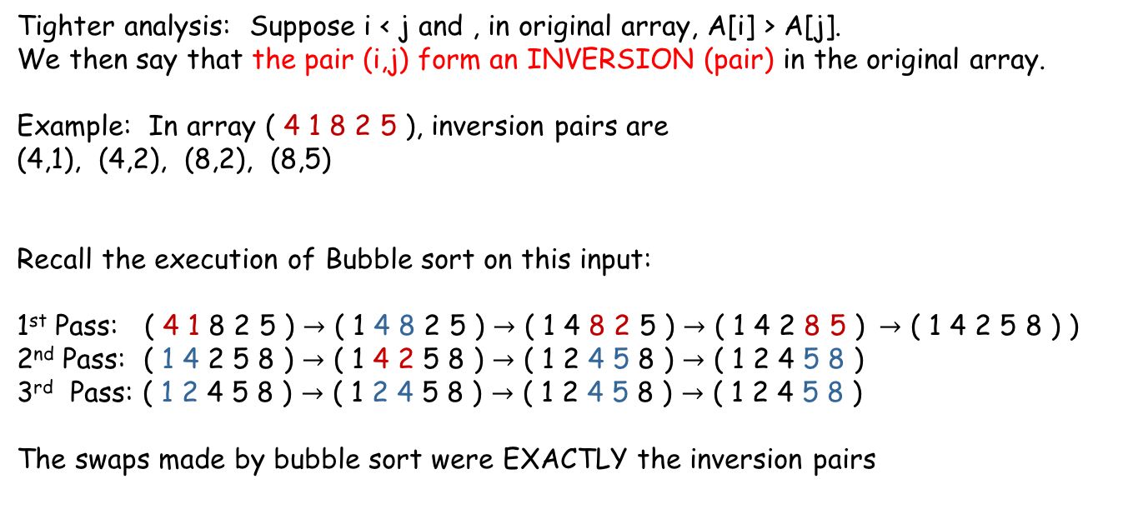
Running time of bubble sort
Claim: Bubble sort terminates after at most $n−1$ passes.
Since each phase requires $O(n)$ comparisons and there are $O(n)$ passes => entire algorithm requires $O\left(n^{2}\right)$ comparisons
Tighter analysis: Suppose i < j and , in original array, A[i] > A[j]. We then say that the pair (i,j) form an INVERSION (pair) in the original array.
Example: In array ( 4 1 8 2 5 ), inversion pairs are
(4,1), (4,2), (8,2), (8,5)
Recall the execution of Bubble sort on this input:
1st Pass: ( 4 1 8 2 5 ) $→$ ( 1 4 8 2 5 ) $→$ ( 1 4 8 2 5 ) $→$ ( 1 4 2 8 5 ) $→$ ( 1 4 2 5 8 ) )
2nd Pass: ( 1 4 2 5 8 ) $→$ ( 1 4 2 5 8 ) $→$ ( 1 2 4 5 8 ) $→$ ( 1 2 4 5 8 )
3rd Pass: ( 1 2 4 5 8 ) $→$ ( 1 2 4 5 8 ) $→$ ( 1 2 4 5 8 ) $→$ ( 1 2 4 5 8 )
The swaps made by bubble sort were EXACTLY the inversion pairs

Slide 6
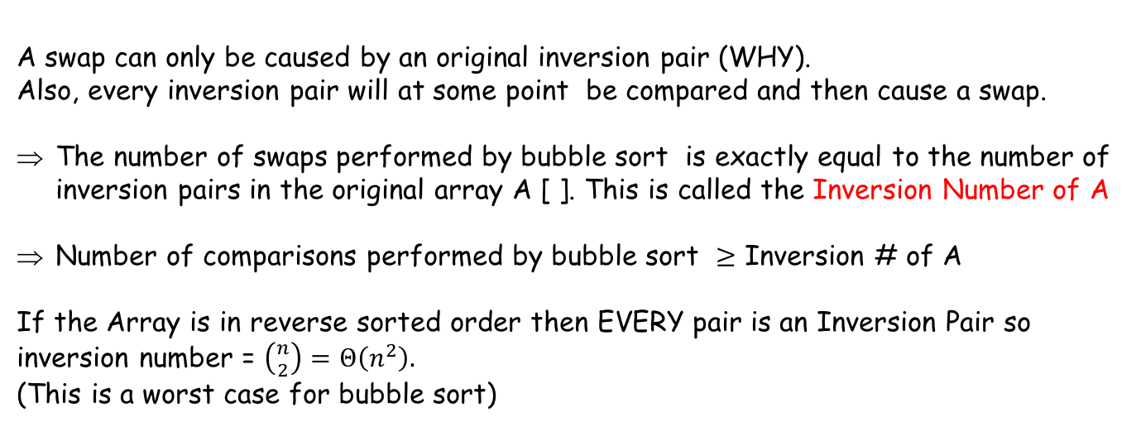
Running time of bubble sort
Claim: Bubble sort terminates after at most $n−1$ passes.
Since each phase requires $O(n)$ comparisons and there are $O(n)$ passes => entire algorithm requires $O\left(n^{2}\right)$ comparisons
Tighter analysis: Suppose i < j and , in original array, A[i] > A[j]. We then say that the pair (i,j) form an INVERSION (pair) in the original array.
A swap can only be caused by an original inversion pair (WHY). Also, every inversion pair will at some point be compared and then cause a swap.
The number of swaps performed by bubble sort is exactly equal to the number of inversion pairs in the original array A [ ]. This is called the Inversion Number of A
Number of comparisons performed by bubble sort $≥$ Inversion # of A
If the Array is in reverse sorted order then EVERY pair is an Inversion Pair so inversion number = $\left({n \atop 2}\right)=$ $Θ\left(n^{2}\right).$
(This is a worst case for bubble sort)
Worst case running time of Bubble Sort is $Θ\left(n^{2}\right).$

