Slide 1
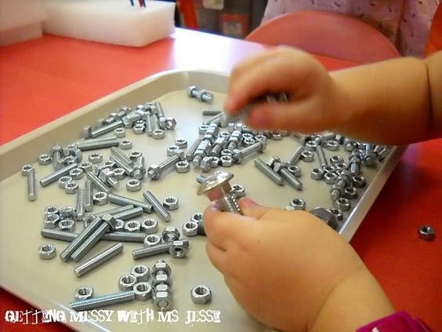
Matching Nuts & Bolts

Slide 2
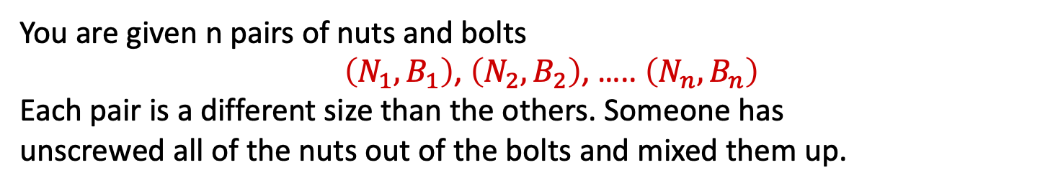
Matching Nuts & Bolts
Nuts
N₃ | N₇ | N₅ | N₈ | N₆ | N₁ | N₉ | N₂ | N₄
Bolts
B₂ | B₅ | B₁ | B₈ | B₄ | B₆ | B₉ | B₃ | B₇
↓
Nuts
N₁ | N₂ | N₃ | N₄ | N₅ | N₆ | N₇ | N₈ | N₉
Bolts
B₁ | B₂ | B₃ | B₄ | B₅ | B₆ | B₇ | B₈ | B₉
You are given n pairs of nuts and bolts
$\left(N_{1},B_{1}\right)$, $\left(N_{2},B_{2}\right)$, ….. $\left(N_{n},B_{n}\right)$
Each pair is a different size than the others. Someone has
unscrewed all of the nuts out of the bolts and mixed them up.
Problem: Match all nuts up with their corresponding bolts.

Slide 3
Matching Nuts & Bolts
Nuts
N₃ | N₇ | N₅ | N₈ | N₆ | N₁ | N₉ | N₂ | N₄
Bolts
B₂ | B₅ | B₁ | B₈ | B₄ | B₆ | B₉ | B₃ | B₇
↓
Nuts
N₁ | N₂ | N₃ | N₄ | N₅ | N₆ | N₇ | N₈ | N₉
Bolts
B₁ | B₂ | B₃ | B₄ | B₅ | B₆ | B₇ | B₈ | B₉
If we could separately
(i) sort all the bolts by increasing size and then
(ii) sort all the nuts by increasing thread size
=> problem would be easily solvable in O (n log n ) time.
After sorting, just match them up in order from smallest to largest.
We can't do this because we can't compare the sizes of
two nuts directly or the sizes of two bolts directly.

Slide 4
Matching Nuts & Bolts
Nuts
N₃ | N₇ | N₅ | N₈ | N₆ | N₁ | N₉ | N₂ | N₄
Bolts
B₂ | B₅ | B₁ | B₈ | B₄ | B₆ | B₉ | B₃ | B₇
↓
Nuts
N₁ | N₂ | N₃ | N₄ | N₅ | N₆ | N₇ | N₈ | N₉
Bolts
B₁ | B₂ | B₃ | B₄ | B₅ | B₆ | B₇ | B₈ | B₉
Only operation available is to try to screw a bolt B into a nut N
and then, by seeing whether the bolt
(a) goes loosely in, (b) perfectly fits or (c) can't go in at all,
decide whether their thread sizes satisfy
(a) B<N, (b) B = N or (c) B>n.
.
Observation: Given bolt B, above permits finding all NUTS bigger/=/less than B in O(N) time.
Given nut N, above permits finding all BOLTS bigger/=/less than N in O(N) time

Slide 5
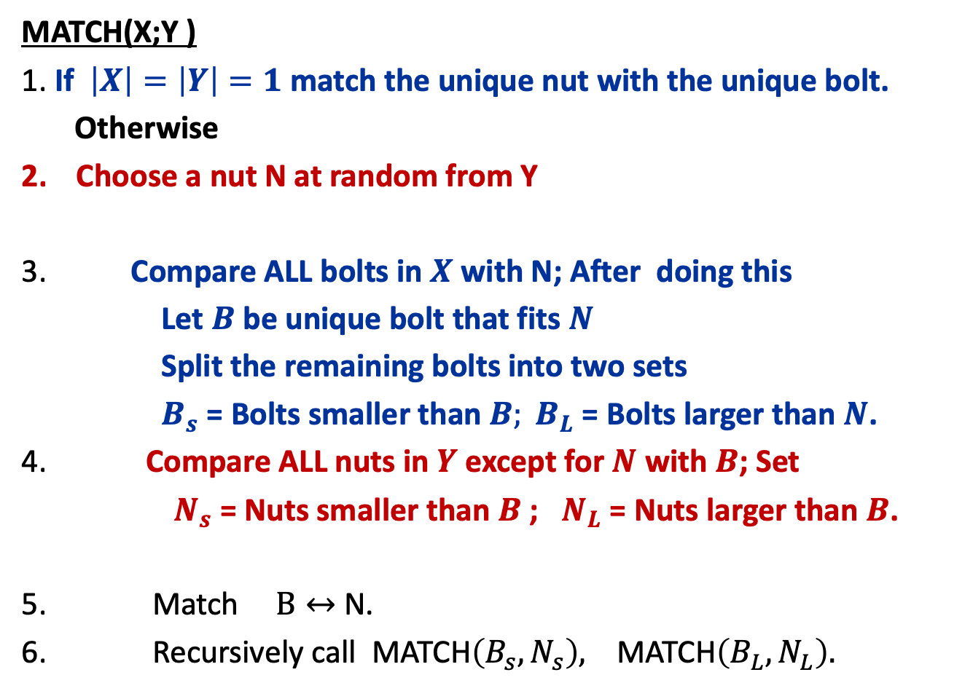
Hint: Try to use a modified Quicksort
Let $X=\left\{B_{1},B_{2},…,B_{n}\right\}$; $Y=\left\{N_{1},N_{2},…,N_{n}\right\}$;
MATCH(X;Y )
1. If $\left|X\right|=\left|Y\right|=1$match the unique nut with the unique bolt.
Otherwise
Choose a nut N at random from Y
3. Compare ALL bolts in $X$ with N; After doing this
Let $B$ be unique bolt that fits $N$
Split the remaining bolts into two sets
$B_{s}$ = Bolts smaller than $B; B_{L}$ = Bolts larger than $N$.
4. Compare ALL nuts in $Y$ except for $N$ with $B$; Set
$N_{s}$ = Nuts smaller than $B$ ; $N_{L}$ = Nuts larger than $B$.
Match $B↔$ N.
Recursively call MATCH$\left(B_{s},N_{s}\right),$ MATCH$\left(B_{L},N_{L}\right).$

Slide 6
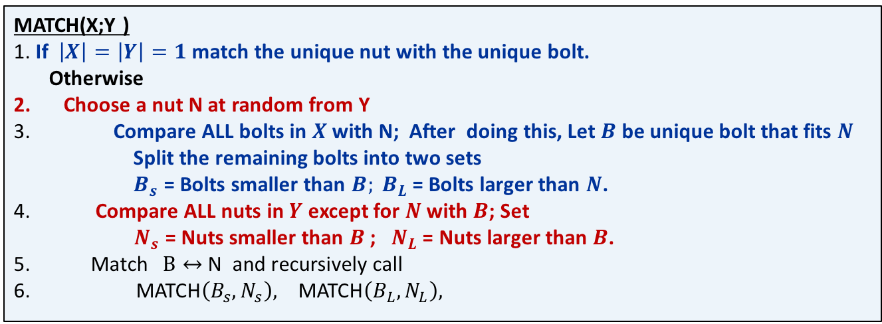
MATCH(X;Y )
1. If $\left|X\right|=\left|Y\right|=1$match the unique nut with the unique bolt.
Otherwise
Choose a nut N at random from Y
3. Compare ALL bolts in $X$ with N; After doing this, Let $B$ be unique bolt that fits $N$
Split the remaining bolts into two sets
$B_{s}$ = Bolts smaller than $B; B_{L}$ = Bolts larger than $N$.
4. Compare ALL nuts in $Y$ except for $N$ with $B$; Set
$N_{s}$ = Nuts smaller than $B$ ; $N_{L}$ = Nuts larger than $B$.
5. Match $B↔$ N and recursively call
6. MATCH$\left(B_{s},N_{s}\right),$ MATCH$\left(B_{L},N_{L}\right),$
Visualize X and Y as being stored in two separate ARRAYS.
Choosing the random nut in 2 is like choosing a random pivot upon
which to partition X array (the bolts) in Quicksort.
Steps 3-4 can be implemented in O (n ) time using almost exactly the same code as partition in Quicksort.
After Steps 3,4,5 the X and Y arrays have been partitioned around their
pivots and the recursive calls are done into the two pairs of subarrays.
The analysis is then EXACTLY like Quicksort and this algorithm takes
O (n log n ) Expected time to match the nuts and bolts.

Slide 7
MATCH(X;Y )
1. If $\left|X\right|=\left|Y\right|=1$match the unique nut with the unique bolt.
Otherwise
Choose a nut N at random from Y
3. Compare ALL bolts in $X$ with N; After doing this, Let $B$ be unique bolt that fits $N$
Split the remaining bolts into two sets
$B_{s}$ = Bolts smaller than $B; B_{L}$ = Bolts larger than $N$.
4. Compare ALL nuts in $Y$ except for $N$ with $B$; Set
$N_{s}$ = Nuts smaller than $B$ ; $N_{L}$ = Nuts larger than $B$.
5. Match $B↔$ N and recursively call
6. MATCH$\left(B_{s},N_{s}\right),$ MATCH$\left(B_{L},N_{L}\right),$
Visualize X and Y as being stored in two separate ARRAYS.
The analysis is then EXACTLY like Quicksort and this algorithm takes
O (n log n ) Expected time to match the nuts and bolts.
To see why this analysis is the same as Quicksort’s, forget about the nuts and bolts and consider the algorithm from the point of view of sorting Y.
Step 2 chooses a random nut N as a pivot.
Steps 3-4 does O(n) work and partitions Y around N. Step 6 then recursively calls the algorithm on the subarrays to left and right of N. This exactly mimics Quicksort!

Slide 8
Worked Example
We will see how to transform the top into the bottom
Nuts
N₃ | N₇ | N₅ | N₈ | N₆ | N₁ | N₉ | N₂ | N₄
Bolts
B₂ | B₅ | B₁ | B₈ | B₄ | B₆ | B₉ | B₃ | B₇
↓
Nuts
N₁ | N₂ | N₃ | N₄ | N₅ | N₆ | N₇ | N₈ | N₉
Bolts
B₁ | B₂ | B₃ | B₄ | B₅ | B₆ | B₇ | B₈ | B₉

Slide 9
1st Call
Nuts
N₃ | N₇ | N₅ | N₈ | N₆ | N₁ | N₉ | N₂ | N₄
I
Bolts
B₂ | B₅ | B₁ | B₈ | B₄ | B₆ | B₉ | B₃ | B₇
↓
Nuts
N₃ | N₇ | N₅ | N₈ | N₆ | N₁ | N₉ | N₂ | N₄
II
Bolts
B₂ | B₁ | B₃ | B₄ | B₇ | B₆ | B₉ | B₅ | B₈
↓
Nuts
N₃ | N₁ | N₂ | N₄ | N₆ | N₇ | N₉ | N₅ | N₈
III
Bolts
B₂ | B₁ | B₃ | B₄ | B₇ | B₆ | B₉ | B₅ | B₈
Step I: Starting Position. Pivot Nut is Yellow. Nuts & Bolts to be partitioned are Red
Step II: Compare Red bolts to Pivot Nut, finding Matching Bolt (Yellow) and Partitioning remaining Red Bolts
Step III: Partition Red Nuts around Matching Yellow Bolt. Set matching Nut/Bolt as Gray

Slide 10
2nd Call
Nuts
N₃ | N₁ | N₂ | N₄ | N₆ | N₇ | N₉ | N₅ | N₈
I
Bolts
B₂ | B₁ | B₃ | B₄ | B₇ | B₆ | B₉ | B₅ | B₈
↓
Nuts
N₃ | N₁ | N₂ | N₄ | N₆ | N₇ | N₉ | N₅ | N₈
II
Bolts
B₁ | B₂ | B₃ | B₄ | B₇ | B₆ | B₉ | B₅ | B₈
↓
Nuts
N₁ | N₂ | N₃ | N₄ | N₆ | N₇ | N₉ | N₅ | N₈
III
Bolts
B₁ | B₂ | B₃ | B₄ | B₇ | B₆ | B₅ | B₈ | B₉
Step I: Starting Position. Pivot Nut is Yellow. Nuts & Bolts to be partitioned are Red
Step II: Compare Red bolts to Pivot Nut, finding Matching Bolt (Yellow) and Partitioning remaining Red Bolts
Step III: Partition Red Nuts around Matching Yellow Bolt. Set matching Nut/Bolt as Gray

Slide 11
3rd Call
Nuts
N₁ | N₂ | N₃ | N₄ | N₆ | N₇ | N₉ | N₅ | N₈
I
Bolts
B₁ | B₂ | B₃ | B₄ | B₇ | B₆ | B₅ | B₈ | B₉
↓
Nuts
N₁ | N₂ | N₃ | N₄ | N₆ | N₇ | N₉ | N₅ | N₈
II
Bolts
B₁ | B₂ | B₃ | B₄ | B₇ | B₆ | B₅ | B₈ | B₉
↓
Nuts
N₁ | N₂ | N₃ | N₄ | N₆ | N₇ | N₅ | N₈ | N₉
III
Bolts
B₁ | B₂ | B₃ | B₄ | B₇ | B₆ | B₅ | B₈ | B₉
Step I: Starting Position. Pivot Nut is Yellow. Nuts & Bolts to be partitioned are Red
Step II: Compare Red bolts to Pivot Nut, finding Matching Bolt (Yellow) and Partitioning remaining Red Bolts
Step III: Partition Red Nuts around Matching Yellow Bolt. Set matching Nut/Bolt as Gray

Slide 12
4th Call
Nuts
N₁ | N₂ | N₃ | N₄ | N₆ | N₇ | N₅ | N₈ | N₉
I
Bolts
B₁ | B₂ | B₃ | B₄ | B₇ | B₆ | B₅ | B₈ | B₉
↓
Nuts
N₁ | N₂ | N₃ | N₄ | N₆ | N₇ | N₅ | N₈ | N₉
II
Bolts
B₁ | B₂ | B₃ | B₄ | B₇ | B₆ | B₅ | B₈ | B₉
↓
Nuts
N₁ | N₂ | N₃ | N₄ | N₆ | N₇ | N₅ | N₈ | N₉
III
Bolts
B₁ | B₂ | B₃ | B₄ | B₇ | B₆ | B₅ | B₈ | B₉
Step I: Starting Position. Pivot Nut is Yellow. Nuts & Bolts to be partitioned are Red
Step II: Compare Red bolts to Pivot Nut, finding Matching Bolt (Yellow) and Partitioning remaining Red Bolts
Step III: Partition Red Nuts around Matching Yellow Bolt. Set matching Nut/Bolt as Gray
12

Slide 13
5th Call
Nuts
N₁ | N₂ | N₃ | N₄ | N₆ | N₇ | N₅ | N₈ | N₉
I
Bolts
B₁ | B₂ | B₃ | B₄ | B₇ | B₆ | B₅ | B₈ | B₉
↓
Nuts
N₁ | N₂ | N₃ | N₄ | N₆ | N₇ | N₅ | N₈ | N₉
II
Bolts
B₁ | B₂ | B₃ | B₄ | B₇ | B₆ | B₅ | B₈ | B₉
↓
Nuts
N₁ | N₂ | N₃ | N₄ | N₅ | N₇ | N₆ | N₈ | N₉
III
Bolts
B₁ | B₂ | B₃ | B₄ | B₅ | B₆ | B₇ | B₈ | B₉
Step I: Starting Position. Pivot Nut is Yellow. Nuts & Bolts to be partitioned are Red
Step II: Compare Red bolts to Pivot Nut, finding Matching Bolt (Yellow) and Partitioning remaining Red Bolts
Step III: Partition Red Nuts around Matching Yellow Bolt. Set matching Nut/Bolt as Gray
13

Slide 14
6th Call
Nuts
N₁ | N₂ | N₃ | N₄ | N₅ | N₇ | N₆ | N₈ | N₉
I
Bolts
B₁ | B₂ | B₃ | B₄ | B₅ | B₆ | B₇ | B₈ | B₉
↓
Nuts
N₁ | N₂ | N₃ | N₄ | N₅ | N₇ | N₆ | N₈ | N₉
II
Bolts
B₁ | B₂ | B₃ | B₄ | B₅ | B₆ | B₇ | B₈ | B₉
↓
Nuts
N₁ | N₂ | N₃ | N₄ | N₅ | N₆ | N₇ | N₈ | N₉
III
Bolts
B₁ | B₂ | B₃ | B₄ | B₅ | B₆ | B₇ | B₈ | B₉
Step I: Starting Position. Pivot Nut is Yellow. Nuts & Bolts to be partitioned are Red
Step II: Compare Red bolts to Pivot Nut, finding Matching Bolt (Yellow) and Partitioning remaining Red Bolts
Step III: Partition Red Nuts around Matching Yellow Bolt. Set matching Nut/Bolt as Gray
14

Slide 15
7th Call
Nuts
N₁ | N₂ | N₃ | N₄ | N₅ | N₆ | N₇ | N₈ | N₉
I
Bolts
B₁ | B₂ | B₃ | B₄ | B₅ | B₆ | B₇ | B₈ | B₉
↓
Nuts
N₁ | N₂ | N₃ | N₄ | N₅ | N₆ | N₇ | N₈ | N₉
II
Bolts
B₁ | B₂ | B₃ | B₄ | B₅ | B₆ | B₇ | B₈ | B₉
↓
Nuts
N₁ | N₂ | N₃ | N₄ | N₅ | N₆ | N₇ | N₈ | N₉
III
Bolts
B₁ | B₂ | B₃ | B₄ | B₅ | B₆ | B₇ | B₈ | B₉
Step I: Starting Position. Pivot Nut is Yellow. Nuts & Bolts to be partitioned are Red
Step II: Compare Red bolts to Pivot Nut, finding Matching Bolt (Yellow) and Partitioning remaining Red Bolts
Step III: Partition Red Nuts around Matching Yellow Bolt. Set matching Nut/Bolt as Gray
15

Slide 16
8th Call
Nuts
N₁ | N₂ | N₃ | N₄ | N₅ | N₆ | N₇ | N₈ | N₉
I
Bolts
B₁ | B₂ | B₃ | B₄ | B₅ | B₆ | B₇ | B₈ | B₉
↓
Nuts
N₁ | N₂ | N₃ | N₄ | N₅ | N₆ | N₇ | N₈ | N₉
II
Bolts
B₁ | B₂ | B₃ | B₄ | B₅ | B₆ | B₇ | B₈ | B₉
↓
Nuts
N₁ | N₂ | N₃ | N₄ | N₅ | N₆ | N₇ | N₈ | N₉
III
Bolts
B₁ | B₂ | B₃ | B₄ | B₅ | B₆ | B₇ | B₈ | B₉
Step I: Starting Position. Pivot Nut is Yellow. Nuts & Bolts to be partitioned are Red
Step II: Compare Red bolts to Pivot Nut, finding Matching Bolt (Yellow) and Partitioning remaining Red Bolts
Step III: Partition Red Nuts around Matching Yellow Bolt. Set matching Nut/Bolt as Gray
16

Slide 17
8th Call
Nuts
N₁ | N₂ | N₃ | N₄ | N₅ | N₆ | N₇ | N₈ | N₉
I
Bolts
B₁ | B₂ | B₃ | B₄ | B₅ | B₆ | B₇ | B₈ | B₉
↓
Nuts
N₁ | N₂ | N₃ | N₄ | N₅ | N₆ | N₇ | N₈ | N₉
II
Bolts
B₁ | B₂ | B₃ | B₄ | B₅ | B₆ | B₇ | B₈ | B₉
↓
Nuts
N₁ | N₂ | N₃ | N₄ | N₅ | N₆ | N₇ | N₈ | N₉
III
Bolts
B₁ | B₂ | B₃ | B₄ | B₅ | B₆ | B₇ | B₈ | B₉
Step I: Starting Position. Pivot Nut is Yellow. Nuts & Bolts to be partitioned are Red
Step II: Compare Red bolts to Pivot Nut, finding Matching Bolt (Yellow) and Partitioning remaining Red Bolts
Step III: Partition Red Nuts around Matching Yellow Bolt. Set matching Nut/Bolt as Gray
17

Slide 18
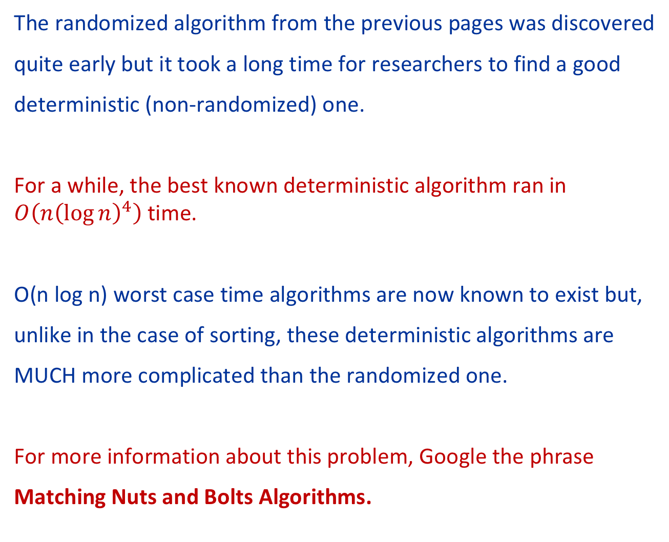
More
The randomized algorithm from the previous pages was discovered
quite early but it took a long time for researchers to find a good
deterministic (non-randomized) one.
For a while, the best known deterministic algorithm ran in $O\left(n{\left(\log{n}\right)}^{4}\right)$ time.
O(n log n) worst case time algorithms are now known to exist but,
unlike in the case of sorting, these deterministic algorithms are
MUCH more complicated than the randomized one.
For more information about this problem, Google the phrase
Matching Nuts and Bolts Algorithms.

