Slide 1
COMP3711: Design and Analysis of Algorithms
Tutorial 4
HKUST

Slide 2
Question 1: Matching Nuts and Bolts
See External Powerpoint Slides.

Slide 3
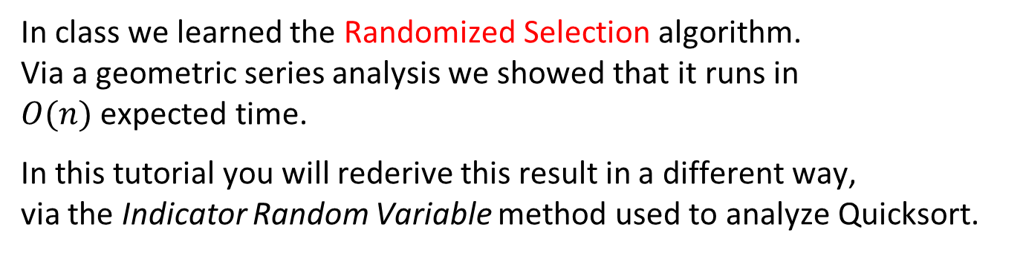
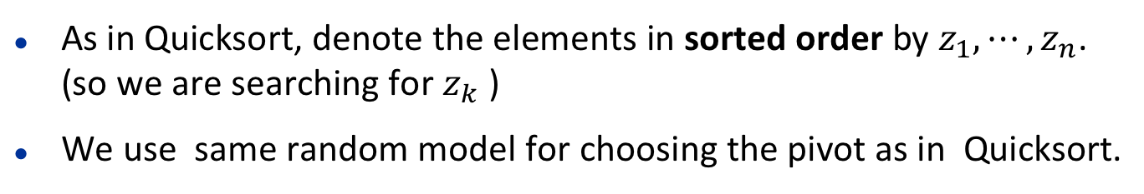
Question 2
In class we learned the Randomized Selection algorithm. Via a geometric series analysis we showed that it runs in $O(n)$ expected time.
In this tutorial you will rederive this result in a different way, via the Indicator Random Variable method used to analyze Quicksort.
Recall the Randomized Selection algorithm to find the $k$-th smallest element.
Pick a random pivot, partition to divide the array into 3 parts:
left subarray, pivot item, right subarray.
Compare to pivot and then either stop immediately or recursively solve the problem in the left OR the right part of the array.
As in Quicksort, denote the elements in sorted order by $z_{1},⋯,z_{n}$. (so we are searching for $z_{k}$ )
We use same random model for choosing the pivot as in Quicksort.

Slide 4
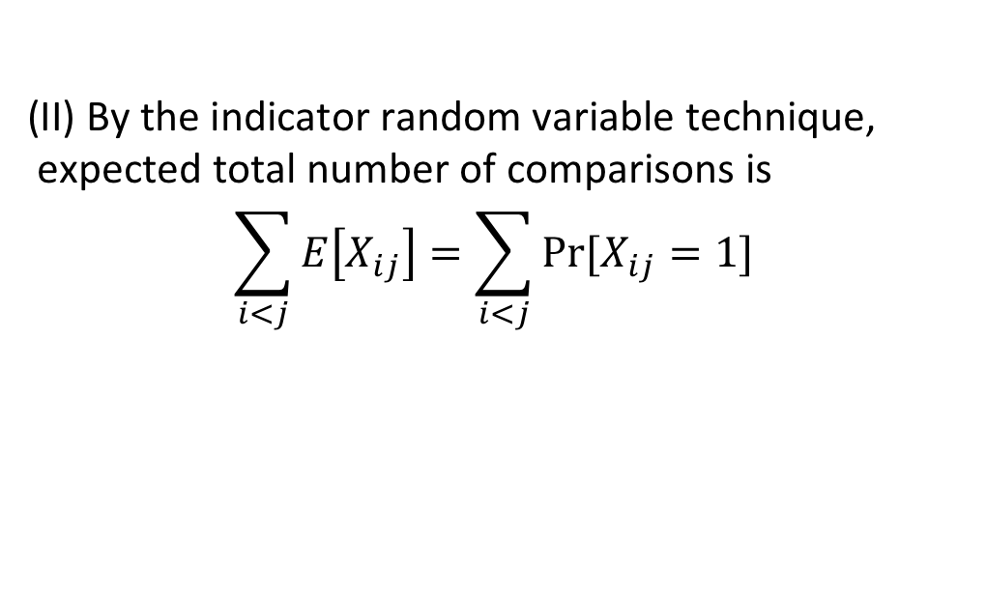
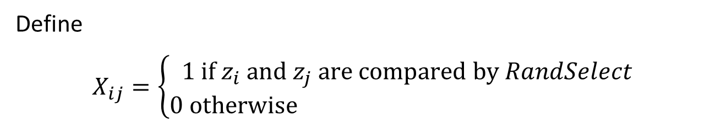
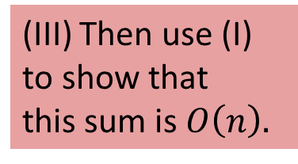
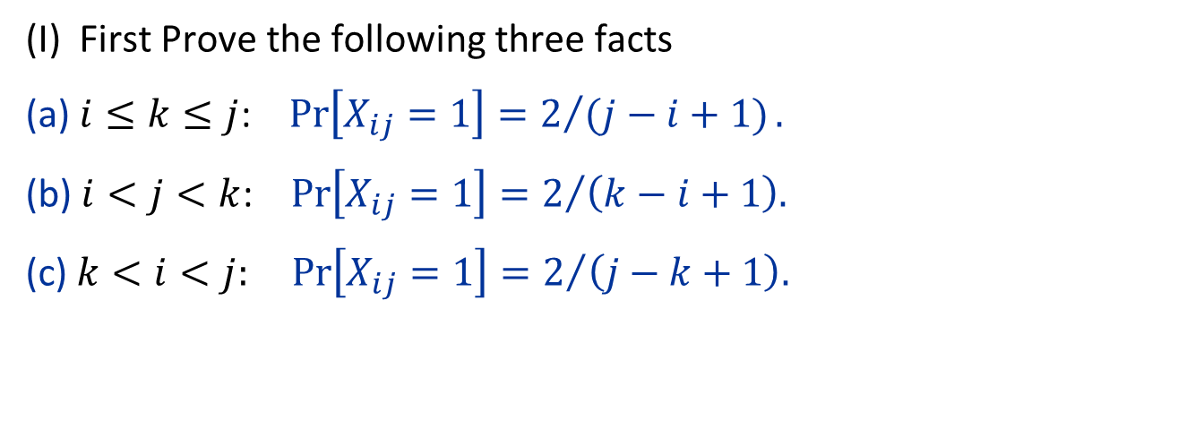
Question 2 (iii)
Define
$X_{ij}=\left\{\begin{aligned}\text{1} \text{if} z_{i} \text{and} z_{j} \text{are} \text{compared} \text{by} RandSelect \\ \text{0 }\text{otherwise} \end{aligned}\right.$
(I) First Prove the following three facts
(a) $i≤k≤j$: $\operatorname{Pr}\left[X_{ij}=1\right]=2/{(j−i+1)}.$
(b) $i<j<k$: $\operatorname{Pr}\left[X_{ij}=1\right]=2/{\left(k−i+1\right).}$
(c)$k<i<j:\operatorname{Pr}\left[X_{ij}=1\right]=2/{\left(j−k+1\right).}$
(III) Then use (I) to show that this sum is $O\left(n\right).$
(II) By the indicator random variable technique, expected total number of comparisons is
$$\sum_{i<j}{E\left[X_{ij}\right]=\sum_{i<j}{Pr⁡[X_{ij}=1]} }$$

Slide 5
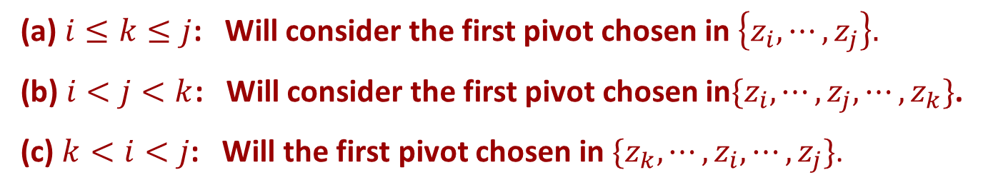
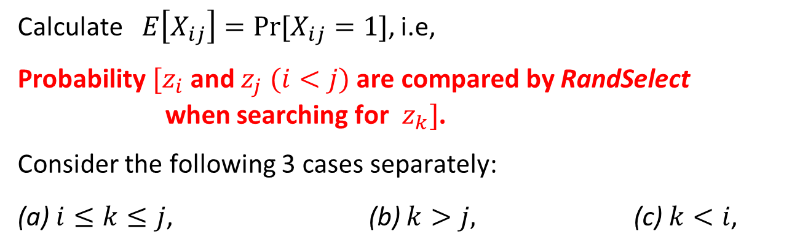
Solution 2
Calculate$E\left[X_{ij}\right]=Pr⁡[X_{ij}=1]$, i.e,
Probability $[z_{i}$ and $z_{j}$ $(i<j)$ are compared by RandSelect when searching for $z_{k}]$.
Consider the following 3 cases separately:
(a)$i≤k≤j$, (b) $k>j, \text{(}\text{c}\text{) }k<i\text{, }$
Analysis will be variation of analysis of Quicksort. The three cases will need to be approached slightly differently.
(a) $i≤k≤j$: Will consider the first pivot chosen in $\left\{z_{i},⋯,z_{j}\right\}.$
(b) $i<j<k$: Will consider the first pivot chosen in$\{z_{i},⋯,z_{j},⋯,z_{k}\}$.
(c) $k<i<j$: Will the first pivot chosen in $\{z_{k},⋯,z_{i},⋯,z_{j}\}$.

Slide 6
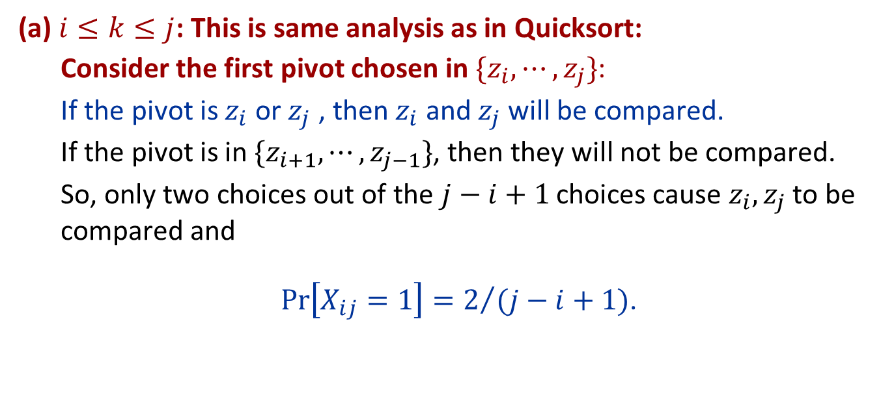
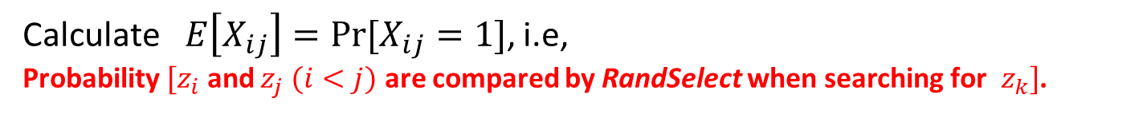
Solution 2 (cont)
Calculate$E\left[X_{ij}\right]=Pr⁡[X_{ij}=1]$, i.e, Probability $[z_{i}$ and $z_{j}$ $(i<j)$ are compared by RandSelect $\text{when} \text{searching} \text{for} z_{k}]$.
(a) $i≤k≤j$: This is same analysis as in Quicksort:
Consider the first pivot chosen in $\{z_{i},⋯,z_{j}\}$:
If the pivot is $z_{i}$ or $z_{j}$ , then $z_{i}$ and $z_{j}$ will be compared.
If the pivot is in $\{z_{i+1},⋯,z_{j−1}\}$, then they will not be compared.
So, only two choices out of the $j−i+1$ choices cause $z_{i}, z_{j}$ to be compared and
$\operatorname{Pr}\left[X_{ij}=1\right]=2/{(j−i+1)}$.

Slide 7
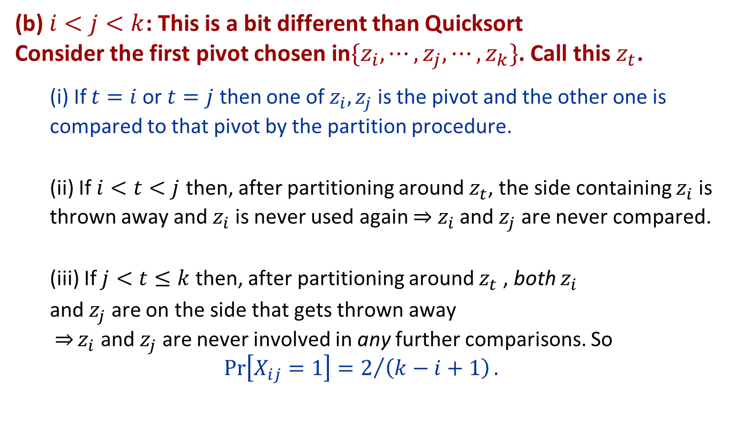
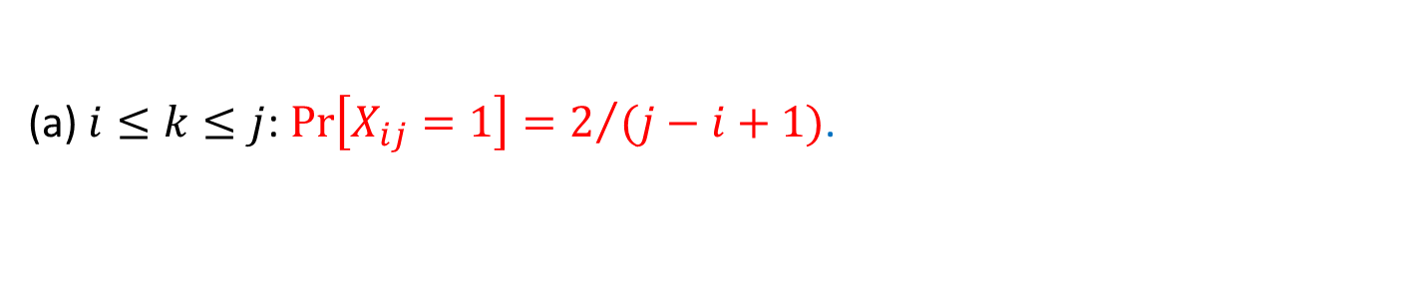
Solution 2 (cont)
Calculate$E\left[X_{ij}\right]=Pr⁡[X_{ij}=1]$, i.e, Probability $[z_{i}$ and $z_{j}$ $(i<j)$ are compared by RandSelect $\text{when} \text{searching} \text{for} z_{k}]$.
(a) $i≤k≤j$: $\operatorname{Pr}\left[X_{ij}=1\right]=2/{(j−i+1)}$.
(b) $i<j<k$: This is a bit different than Quicksort Consider the first pivot chosen in$\{z_{i},⋯,z_{j},⋯,z_{k}\}$. Call this $z_{t}$.
(i) If $t=i$or $t=j$ then one of $z_{i}, z_{j}$ is the pivot and the other one is compared to that pivot by the partition procedure.
(ii) If $i<t<j$ then, after partitioning around $z_{t}$, the side containing $z_{i}$ is thrown away and $z_{i}$ is never used again $z_{i}$ and $z_{j}$ are never compared.
(iii) If $j<t≤k$ then, after partitioning around $z_{t}$ , both $z_{i}$
and $z_{j}$ are on the side that gets thrown away $\underset{⇒}{}z_{i}$ and $z_{j}$ are never involved in any further comparisons. So
$$\operatorname{Pr}\left[X_{ij}=1\right]=2/{\left(k−i+1\right)}.$$

Slide 8
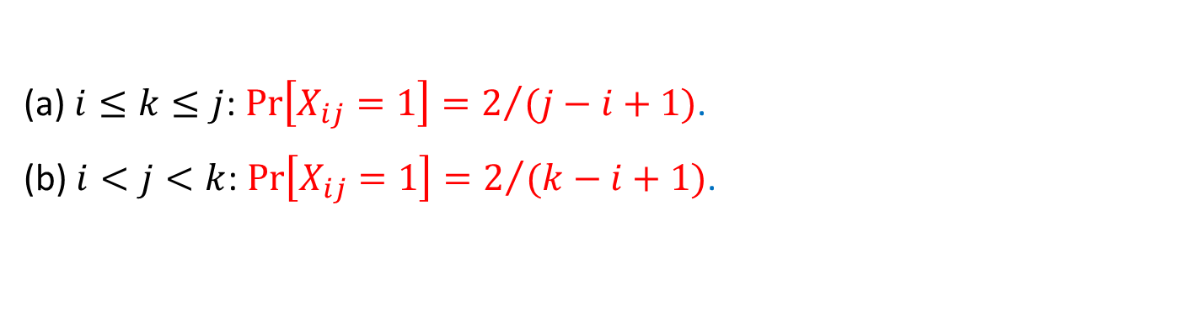
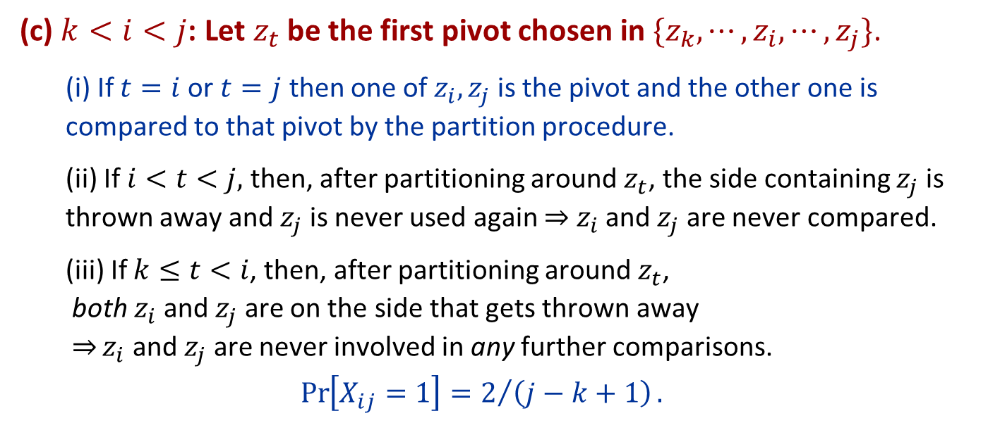
Solution 2 (cont)
Calculate$E\left[X_{ij}\right]=Pr⁡[X_{ij}=1]$, i.e, Probability $[z_{i}$ and $z_{j}$ $(i<j)$ are compared by RandSelect $\text{when} \text{searching} \text{for} z_{k}]$.
(a) $i≤k≤j$: $\operatorname{Pr}\left[X_{ij}=1\right]=2/{(j−i+1)}$.
(b) $i<j<k$: $\operatorname{Pr}\left[X_{ij}=1\right]=2/{(k−i+1)}$.
(c) $k<i<j$: Let$z_{t}$ be the first pivot chosen in $\{z_{k},⋯,z_{i},⋯,z_{j}\}$.
(i) If $t=i$or $t=j$ then one of $z_{i}, z_{j}$ is the pivot and the other one is compared to that pivot by the partition procedure.
(ii) If $i<t<j,$ then, after partitioning around $z_{t}$, the side containing $z_{j}$ is thrown away and $z_{j}$ is never used again $z_{i}$ and $z_{j}$ are never compared.
(iii) If $k≤t<i$, then, after partitioning around $z_{t}$, both $z_{i}$and $z_{j}$ are on the side that gets thrown away $\underset{⇒}{}z_{i}$ and $z_{j}$ are never involved in any further comparisons.
$$\operatorname{Pr}\left[X_{ij}=1\right]=2/{\left(j−k+1\right)}.$$

Slide 9
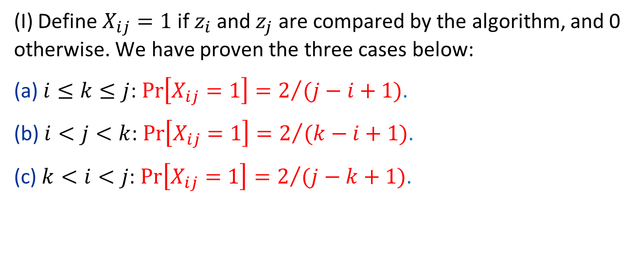
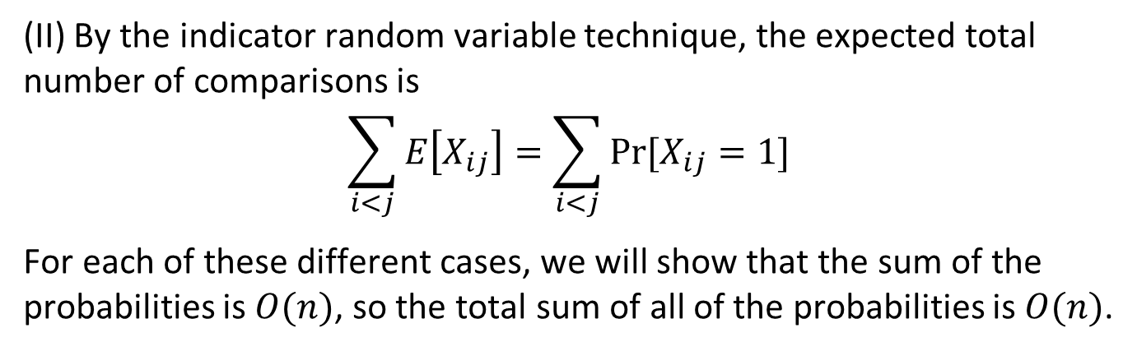
Solution 2 (cont)
(I) Define $X_{ij}=1$ if $z_{i}$ and $z_{j}$ are compared by the algorithm, and 0 otherwise. We have proven the three cases below:
(a) $i≤k≤j$: $\operatorname{Pr}\left[X_{ij}=1\right]=2/{(j−i+1)}$.
(b) $i<j<k$: $\operatorname{Pr}\left[X_{ij}=1\right]=2/{(k−i+1)}$.
(c) $k<i<j$: $\operatorname{Pr}\left[X_{ij}=1\right]=2/{(j−k+1)}$.
(II) By the indicator random variable technique, the expected total number of comparisons is
$$\sum_{i<j}{E\left[X_{ij}\right]=\sum_{i<j}{Pr⁡[X_{ij}=1]}}$$
For each of these different cases, we will show that the sum of the probabilities is $O(n)$, so the total sum of all of the probabilities is $O(n)$.

Slide 10
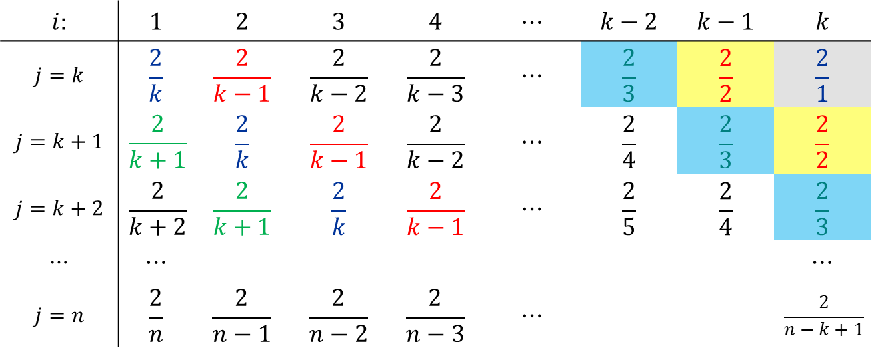
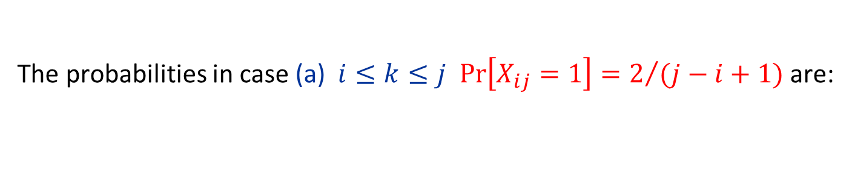
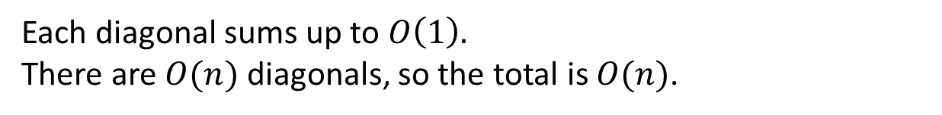
Solution 2 (cont)
The probabilities in case (a) $i≤k≤j$ $\operatorname{Pr}\left[X_{ij}=1\right]=2/{(j−i+1)}$ are:
$$i:$$ | $$1$$ | $$2$$ | $$3$$ | $$4$$ | $$⋯$$ | $$k−2$$ | $$k−1$$ | $$k$$
$$j=k$$ | $$\frac{2}{k}$$ | $$\frac{2}{k−1}$$ | $$\frac{2}{k−2}$$ | $$\frac{2}{k−3}$$ | $$⋯$$ | $$\frac{2}{3}$$ | $$\frac{2}{2}$$ | $$\frac{2}{1}$$
$$j=k+1$$ | $$\frac{2}{k+1}$$ | $$\frac{2}{k}$$ | $$\frac{2}{k−1}$$ | $$\frac{2}{k−2}$$ | $$⋯$$ | $$\frac{2}{4}$$ | $$\frac{2}{3}$$ | $$\frac{2}{2}$$
$$j=k+2$$ | $$\frac{2}{k+2}$$ | $$\frac{2}{k+1}$$ | $$\frac{2}{k}$$ | $$\frac{2}{k−1}$$ | $$⋯$$ | $$\frac{2}{5}$$ | $$\frac{2}{4}$$ | $$\frac{2}{3}$$
$$⋯$$ | $$⋯$$ |  |  |  |  |  |  | $$⋯$$
$$j=n$$ | $$\frac{2}{n}$$ | $$\frac{2}{n−1}$$ | $$\frac{2}{n−2}$$ | $$\frac{2}{n−3}$$ | $$⋯$$ |  |  | $$\frac{2}{n−k+1}$$
Each diagonal sums up to $O\left(1\right).$
There are $O(n)$ diagonals, so the total is $O(n)$.

Slide 11
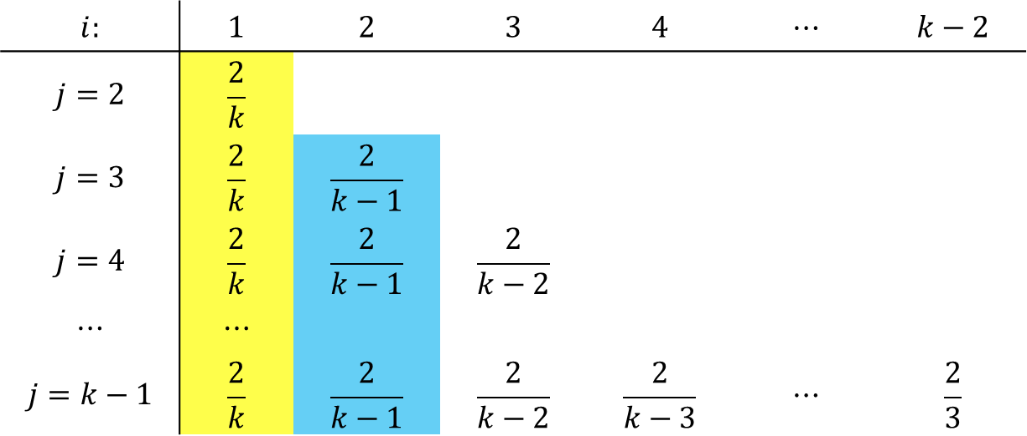
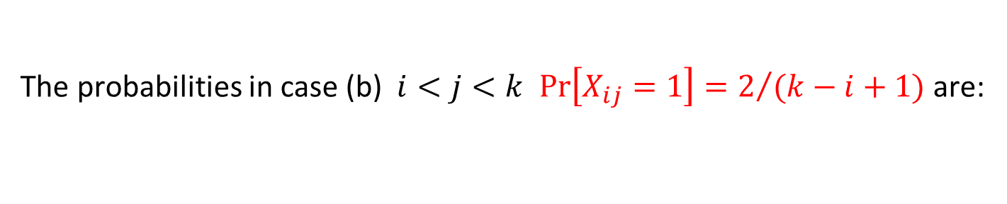
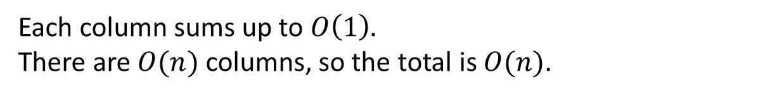
Solution 2 (cont)
The probabilities in case (b) $i<j<k$ $\operatorname{Pr}\left[X_{ij}=1\right]=2/{(k−i+1)}$ are:
$$i:$$ | $$1$$ | $$2$$ | $$3$$ | $$4$$ | $$⋯$$ | $$k−2$$
$$j=2$$ | $$\frac{2}{k}$$
$$j=3$$ | $$\frac{2}{k}$$ | $$\frac{2}{k−1}$$
$$j=4$$ | $$\frac{2}{k}$$ | $$\frac{2}{k−1}$$ | $$\frac{2}{k−2}$$
$$⋯$$ | $$⋯$$
$$j=k−1$$ | $$\frac{2}{k}$$ | $$\frac{2}{k−1}$$ | $$\frac{2}{k−2}$$ | $$\frac{2}{k−3}$$ | $$⋯$$ | $$\frac{2}{3}$$
Each column sums up to $O\left(1\right).$
There are $O(n)$ columns, so the total is $O(n)$.

Slide 12
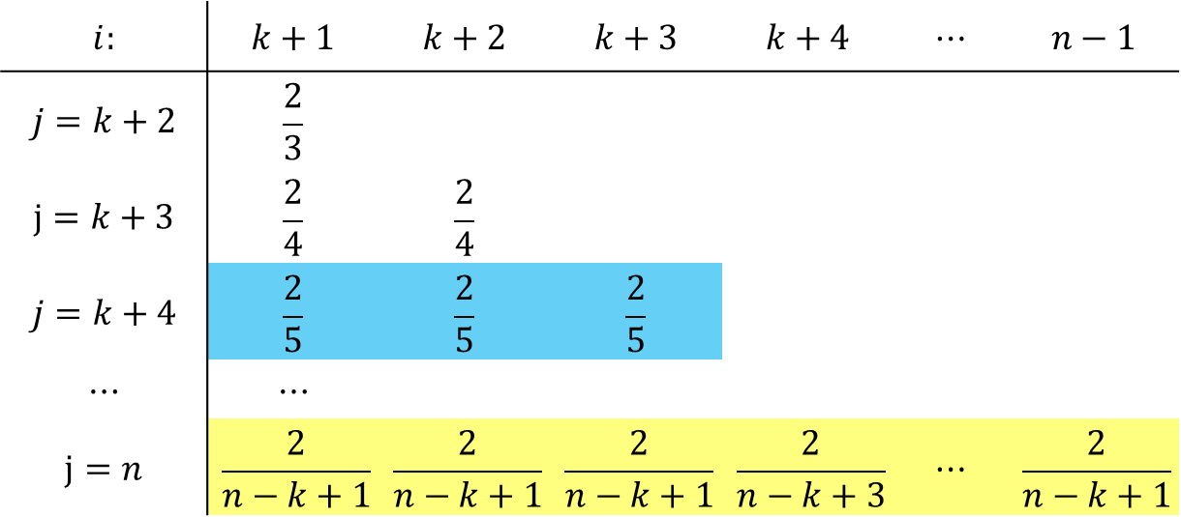
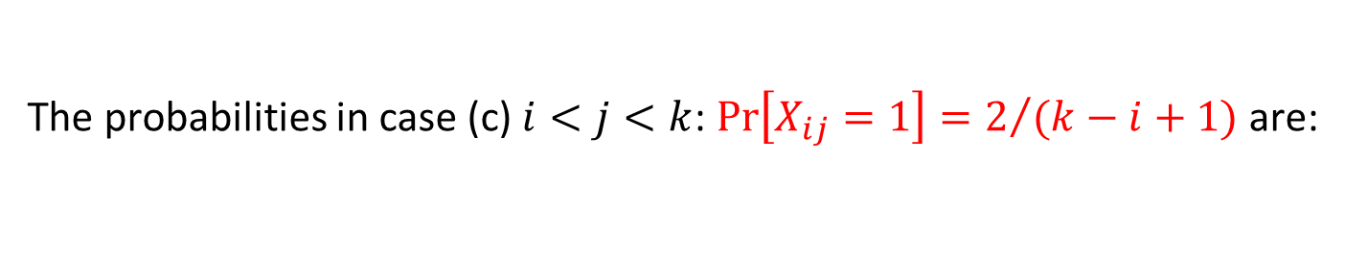
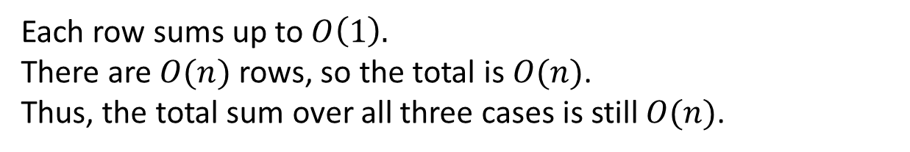
Solution 2 (cont)
The probabilities in case (c) $i<j<k$: $\operatorname{Pr}\left[X_{ij}=1\right]=2/{(k−i+1)}$ are:
$$i:$$ | $$k+1$$ | $$k+2$$ | $$k+3$$ | $$k+4$$ | $$⋯$$ | $$n−1$$
$$j=k+2$$ | $$\frac{2}{3}$$
$$j=k+3$$ | $$\frac{2}{4}$$ | $$\frac{2}{4}$$
$$j=k+4$$ | $$\frac{2}{5}$$ | $$\frac{2}{5}$$ | $$\frac{2}{5}$$
$$⋯$$ | $$⋯$$
$$j=n$$ | $$\frac{2}{n−k+1}$$ | $$\frac{2}{n−k+1}$$ | $$\frac{2}{n−k+1}$$ | $$\frac{2}{n−k+3}$$ | $$⋯$$ | $$\frac{2}{n−k+1}$$
Each row sums up to $O\left(1\right).$ There are $O(n)$ rows, so the total is $O(n)$.
Thus, the total sum over all three cases is still $O(n)$.

Slide 13
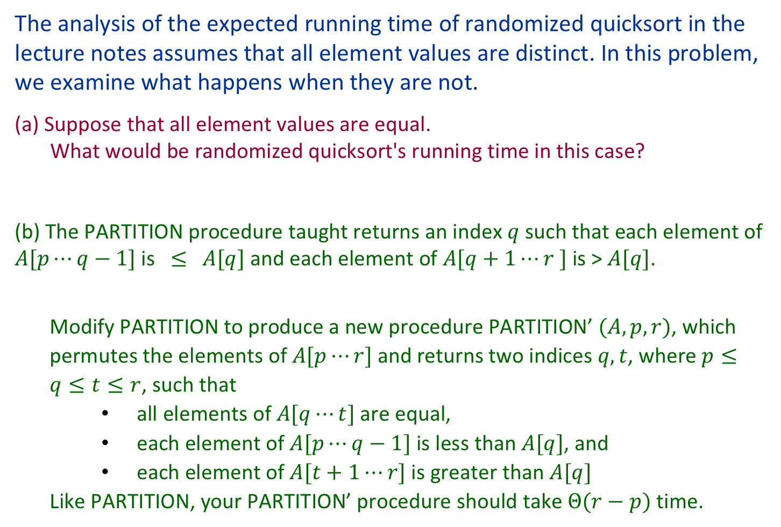
Question 3
The analysis of the expected running time of randomized quicksort in the lecture notes assumes that all element values are distinct. In this problem, we examine what happens when they are not.
(a) Suppose that all element values are equal. What would be randomized quicksort's running time in this case?
(b) The PARTITION procedure taught returns an index $q$ such that each element of $A[p⋯q−1]$ is $≤$ $A[q]$ and each element of $A[q+1⋯r ]$is > $A[q]$.
Modify PARTITION to produce a new procedure PARTITION’$(A,p,r)$, which permutes the elements of $A[p⋯r]$and returns two indices $q, t$, where $p≤q≤t≤r$, such that
all elements of $A[q⋯t]$are equal,
each element of $A[p⋯q−1]$ is less than $A[q]$, and
each element of $A[t+1⋯r]$ is greater than $A[q]$
Like PARTITION, your PARTITION’ procedure should take $Θ(r−p)$ time.

Slide 14
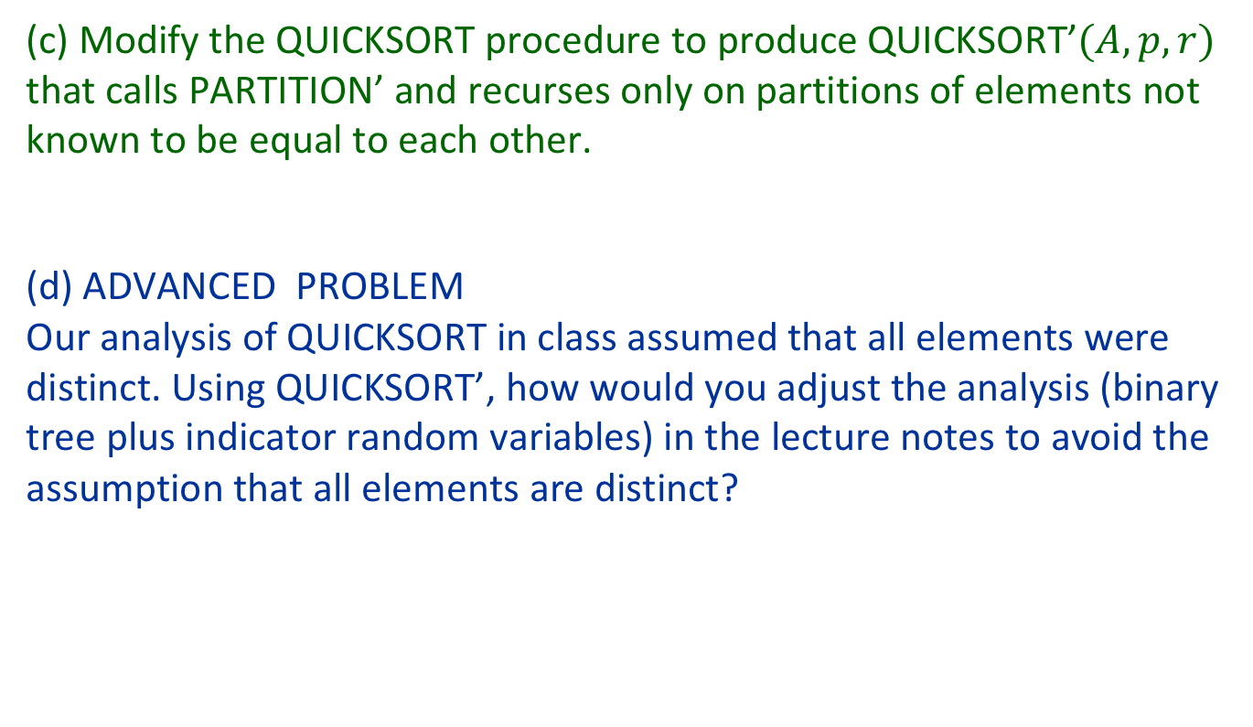
Question 3 (cont)
(c) Modify the QUICKSORT procedure to produce QUICKSORT’$(A, p, r)$ that calls PARTITION’ and recurses only on partitions of elements not known to be equal to each other.
(d) ADVANCED PROBLEM Our analysis of QUICKSORT in class assumed that all elements were distinct. Using QUICKSORT’, how would you adjust the analysis (binary tree plus indicator random variables) in the lecture notes to avoid the assumption that all elements are distinct?

Slide 15
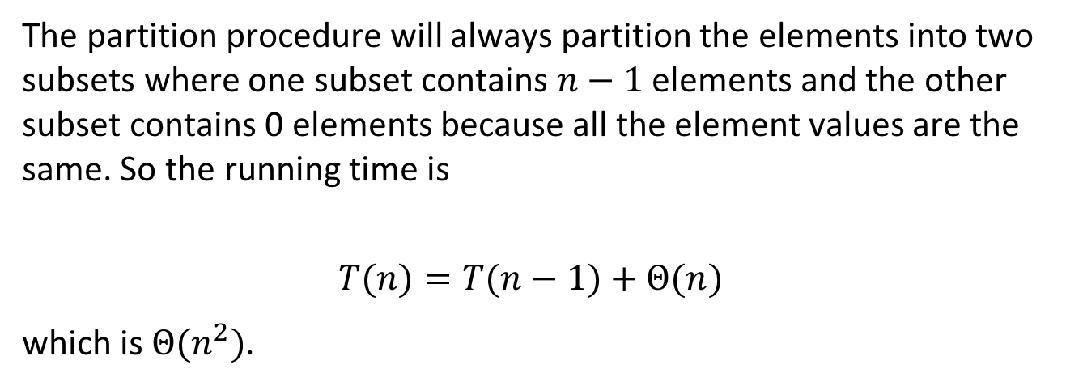
Solution 3
(a) Suppose that all element values are equal. What would be randomized quicksort's running time in this case?
The partition procedure will always partition the elements into two subsets where one subset contains $n−1$ elements and the other subset contains 0 elements because all the element values are the same. So the running time is
$$T(n)=T(n−1)+Θ(n)$$
which is $Θ(n^{2})$.

Slide 16
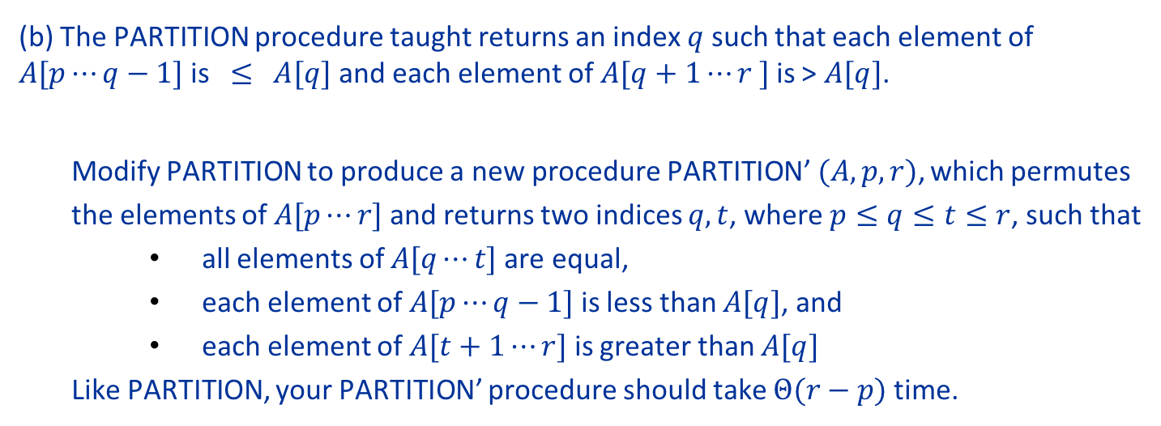
(b) The PARTITION procedure taught returns an index $q$ such that each element of $A[p⋯q−1]$ is $≤$ $A[q]$ and each element of $A[q+1⋯r ]$is > $A[q]$.
Modify PARTITION to produce a new procedure PARTITION’$(A,p,r)$, which permutes the elements of $A[p⋯r]$and returns two indices $q, t$, where $p≤q≤t≤r$, such that
all elements of $A[q⋯t]$are equal,
each element of $A[p⋯q−1]$ is less than $A[q]$, and
each element of $A[t+1⋯r]$ is greater than $A[q]$
Like PARTITION, your PARTITION’ procedure should take $Θ(r−p)$ time.
Input
1 | 3 | 7 | 6 | 7 | 4 | 9 | 8 | 10 | 7
Partition
1 | 3 | 7 | 6 | 7 | 4 | 7 | 8 | 10 | 9
p
q
r
Partition’
1 | 3 | 6 | 4 | 7 | 7 | 7 | 8 | 10 | 9
p
q
t
r

Slide 17
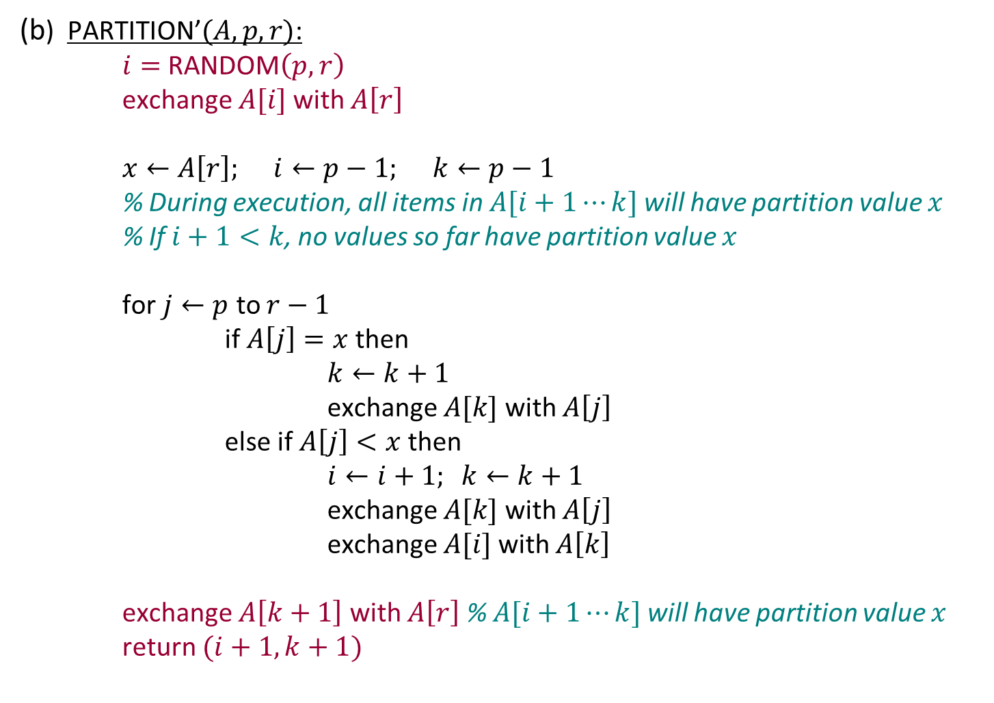
Solution 3
(b) PARTITION’$(A,p,r)$:
$i=$RANDOM$\left(p,r\right)$
exchange $A[i]$ with $A\left[r\right]$
$x←A\left[r\right]; i←p−1; k←p−1$
% During execution, all items in $A[i+1⋯k]$will have partition value $x$ % If $i+1<k$, no values so far have partition value $x$
for $j←p$ to $r−1$
if $A\left[j\right]=x$ then
$k←k+1$
exchange $A[k]$ with $A\left[j\right]$
else if $A\left[j\right]<x$ then
$i←i+1; k←k+1$
exchange $A[k]$ with $A\left[j\right]$
exchange $A[i]$ with $A\left[k\right]$
exchange $A\left[k+1\right]$ with $A\left[r\right]$ % $A[i+1⋯k]$will have partition value $x$
return $(i+1,k+1)$

Slide 18
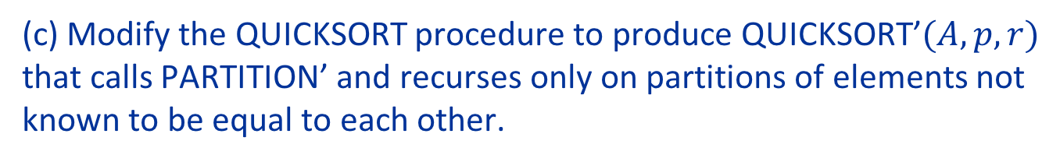
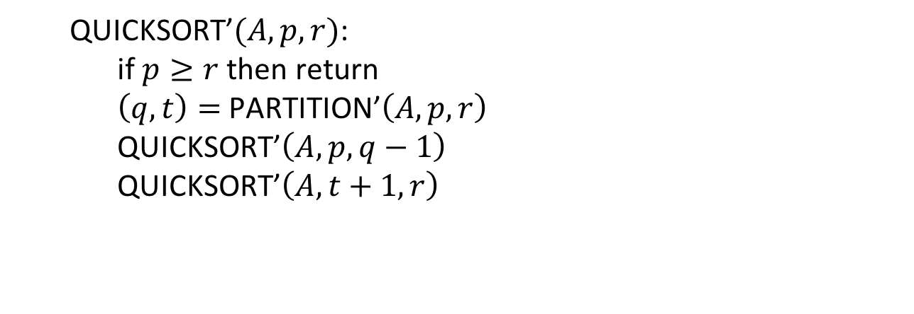
Solution 3
(c) Modify the QUICKSORT procedure to produce QUICKSORT’$(A, p, r)$ that calls PARTITION’ and recurses only on partitions of elements not known to be equal to each other.
QUICKSORT’$(A,p,r)$:
if $p≥r$ then return
$\left(q,t\right)=$PARTITION’$\left(A,p,r\right)$
QUICKSORT’$\left(A,p,q−1\right)$
QUICKSORT’$\left(A,t+1,r\right)$

Slide 19








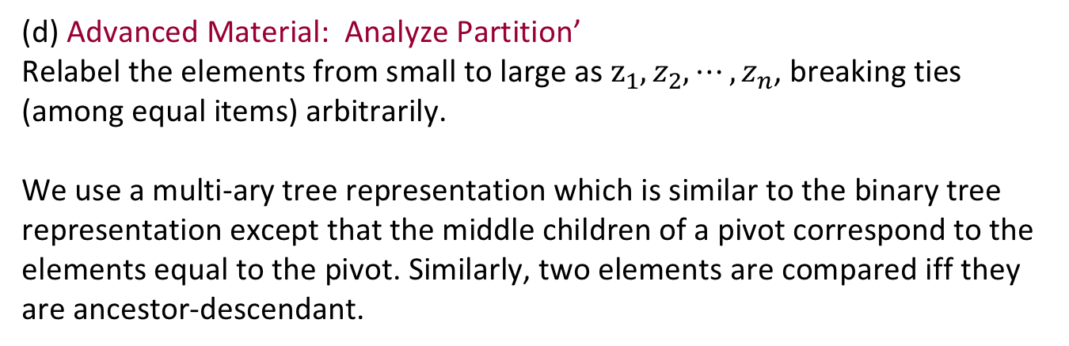











Solution 3
(d) Advanced Material: Analyze Partition’ Relabel the elements from small to large as $z_{1},z_{2},⋯,z_{n}$, breaking ties (among equal items) arbitrarily.
We use a multi-ary tree representation which is similar to the binary tree representation except that the middle children of a pivot correspond to the elements equal to the pivot. Similarly, two elements are compared iff they are ancestor-descendant.
$$z_{10}$$
$$z_{5}$$
$$z_{13}$$
$$z_{3}$$
$$z_{4}$$
$$z_{6}$$
$$z_{8}$$
$$z_{11}$$
$$z_{12}$$
$$z_{16}$$
$$z_{4}=z_{5}=z_{6}$$
$$z_{12}=z_{13}$$
$$z_{2}$$
$$z_{7}$$
$$z_{9}$$
$$z_{15}$$
$$z_{17}$$
$$z_{1}$$
$$z_{14}$$

Slide 20
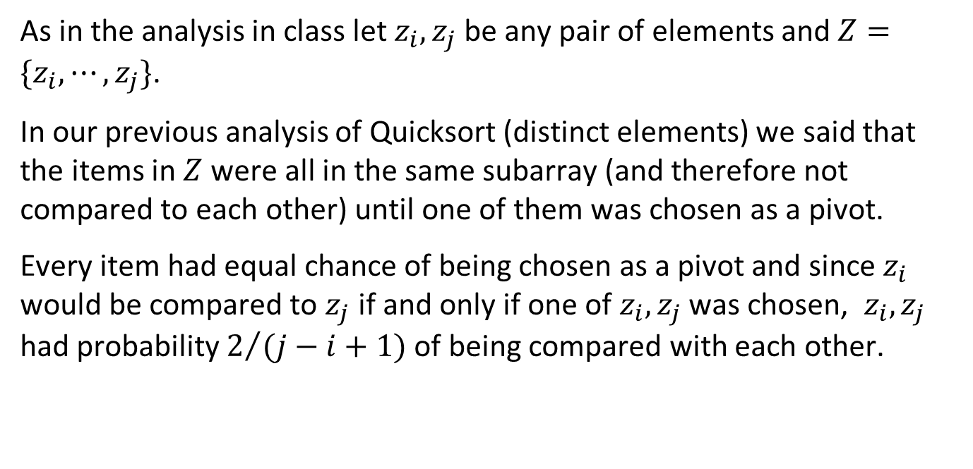
Solution 3
As in the analysis in class let $z_{i}, z_{j}$be any pair of elements and $Z=\{z_{i},⋯,z_{j}\}$.
In our previous analysis of Quicksort (distinct elements) we said that the items in $Z$ were all in the same subarray (and therefore not compared to each other) until one of them was chosen as a pivot.
Every item had equal chance of being chosen as a pivot and since $z_{i}$ would be compared to $z_{j}$ if and only if one of $z_{i}, z_{j}$ was chosen, $z_{i}, z_{j}$ had probability $2/{(j−i+1)}$ of being compared with each other.

Slide 21
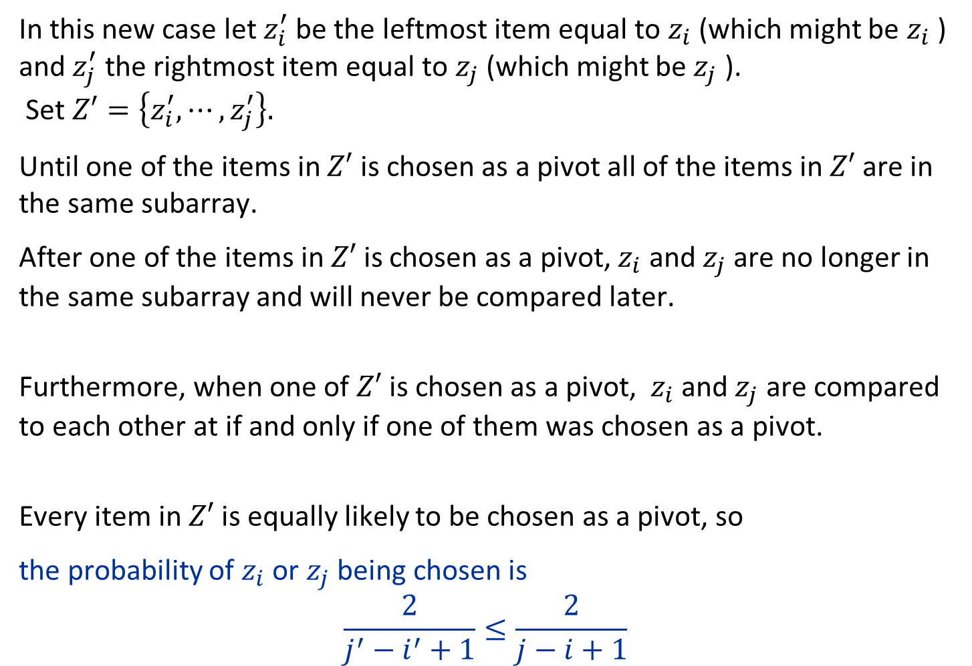
Solution 3
In this new case let $z_{i}^{′}$ be the leftmost item equal to $z_{i}$ (which might be $z_{i}$ ) and $z_{j}^{′}$ the rightmost item equal to $z_{j}$ (which might be $z_{j}$ ). Set $Z′=\left\{z_{i}^{′},⋯,z_{j}^{′}\right\}.$
Until one of the items in $Z′$ is chosen as a pivot all of the items in $Z′$ are in the same subarray.
After one of the items in $Z′$is chosen as a pivot, $z_{i}$ and $z_{j}$ are no longer in the same subarray and will never be compared later.
Furthermore, when one of $Z′$is chosen as a pivot, $z_{i}$ and $z_{j}$ are compared to each other at if and only if one of them was chosen as a pivot.
Every item in $Z′$ is equally likely to be chosen as a pivot, so
the probability of $z_{i}$ or $z_{j}$ being chosen is
$$\frac{2}{j^{′}−i^{′}+1}≤\frac{2}{j−i+1}$$

Slide 22
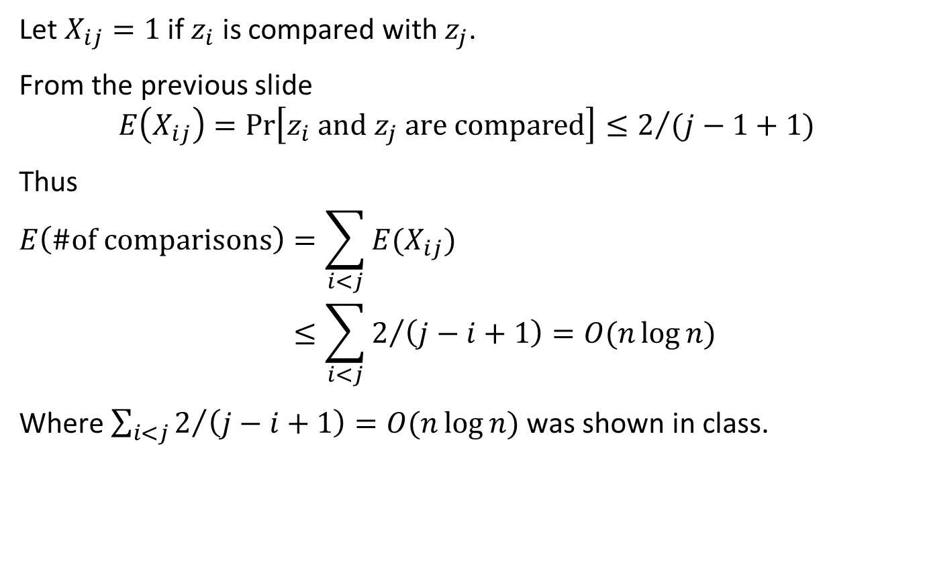
Solution 3
Let $X_{ij}=1$ if $z_{i}$ is compared with $z_{j}$.
From the previous slide
$$E\left(X_{ij}\right)=\operatorname{Pr}\left[z_{i} \text{and} z_{j} \text{are} \text{compared}\right]≤2/{(j−1+1)}$$
Thus
$$E\left(\#\text{of} \text{comparisons}\right)=\sum_{i<j}{E(X_{ij})} \\ ≤\sum_{i<j}{2/{\left(j−i+1\right)}}=O(n\log{n})$$
Where $\sum_{i<j}{2/{\left(j−i+1\right)=O(n\log{n})}}$ was shown in class.

Slide 23
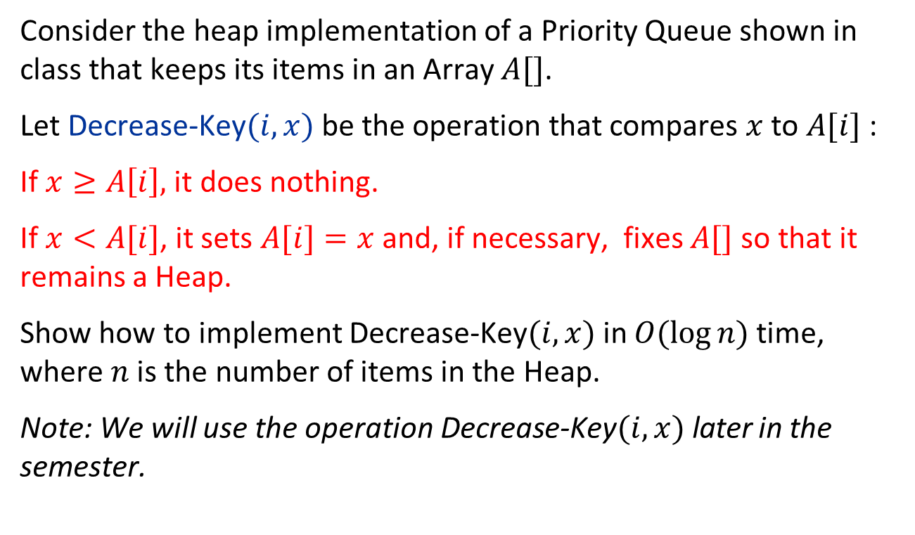
Question 4
Consider the heap implementation of a Priority Queue shown in class that keeps its items in an Array $A[]$.
Let Decrease-Key$(i, x)$be the operation that compares $x$ to $A[i]$ :
If $x≥A\left[i\right],$ it does nothing.
If $x<A[i]$, it sets $A[i]=x$ and, if necessary, fixes $A[]$ so that it remains a Heap.
Show how to implement Decrease-Key$(i, x)$in $O(log⁡n)$time, where $n$ is the number of items in the Heap.
Note: We will use the operation Decrease-Key$(i,x)$later in the semester.

Slide 24

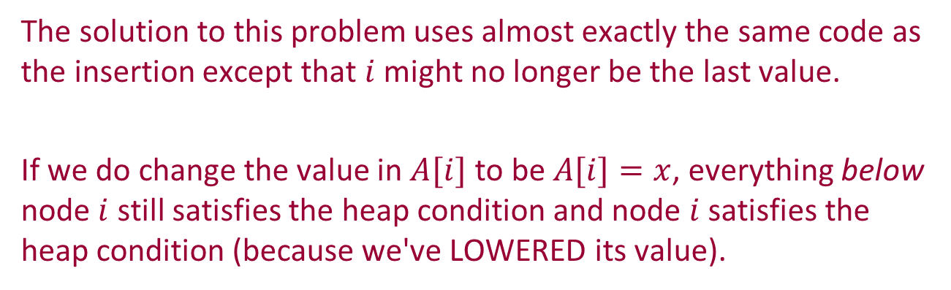
Solution 4
Recall the code for inserting an item into a heap. We inserted the item into location i which was the LAST item in the heap and then bubbled it up to its proper place.
The solution to this problem uses almost exactly the same code as the insertion except that $i$ might no longer be the last value.
If we do change the value in $A[i]$ to be $A[i]=x$, everything below node $i$ still satisfies the heap condition and node $i$ satisfies the heap condition (because we've LOWERED its value).
The only problem might be that ancestors of $i$ might have values that are greater than $A[i]$. We can fix this by bubbling $A[i]$ up to its proper value.

Slide 25
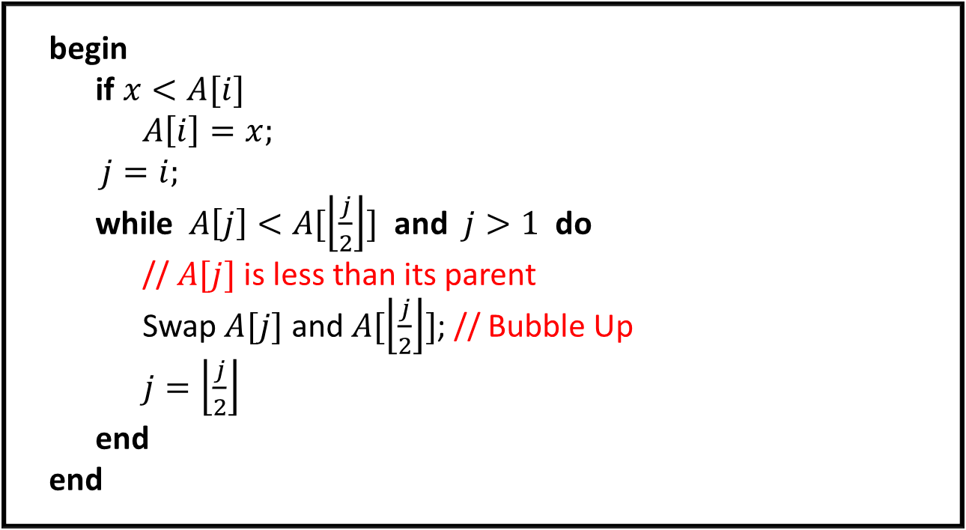
Solution 4
begin
if $x<A[i]$
$A\left[i\right]=x;$
$j=i;$
while $A\left[j\right]<A[\left\lfloor \frac{j}{2}\right\rfloor ]$ and $j>1$ do
// $A[j]$ is less than its parent
Swap $A[j]$ and $A[\left\lfloor \frac{j}{2}\right\rfloor ]$; // Bubble Up
$j=\left\lfloor \frac{j}{2}\right\rfloor$
end
end
See external PowerPoint for example

