Slide 1
COMP 3711 Spring 2019
Answer to Midterm DP Question

Slide 2
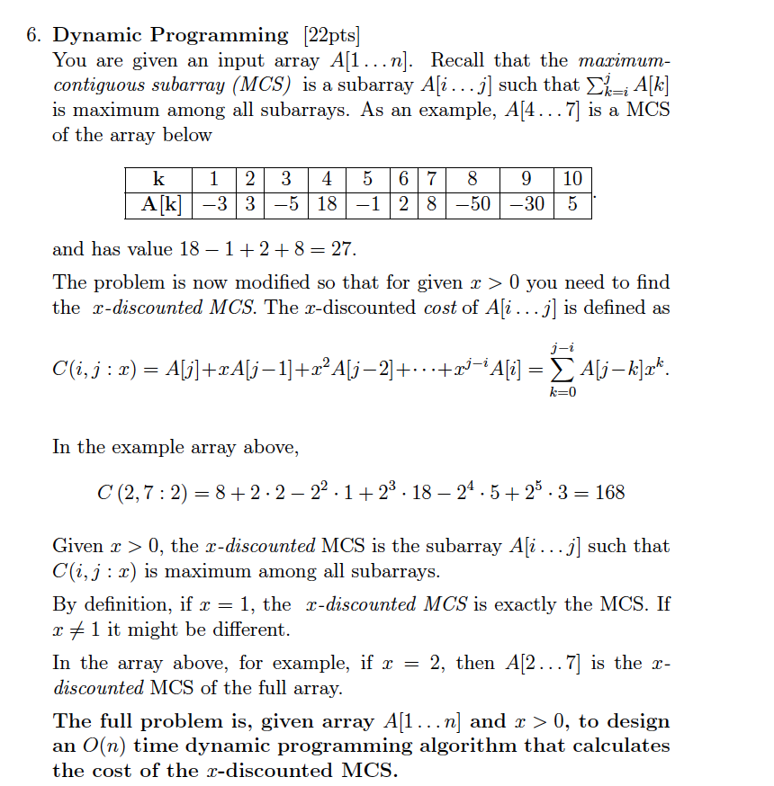

Slide 3
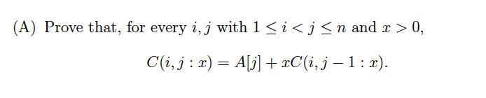
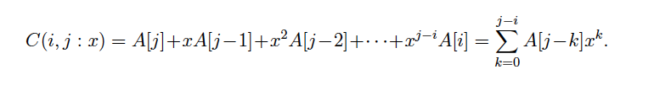
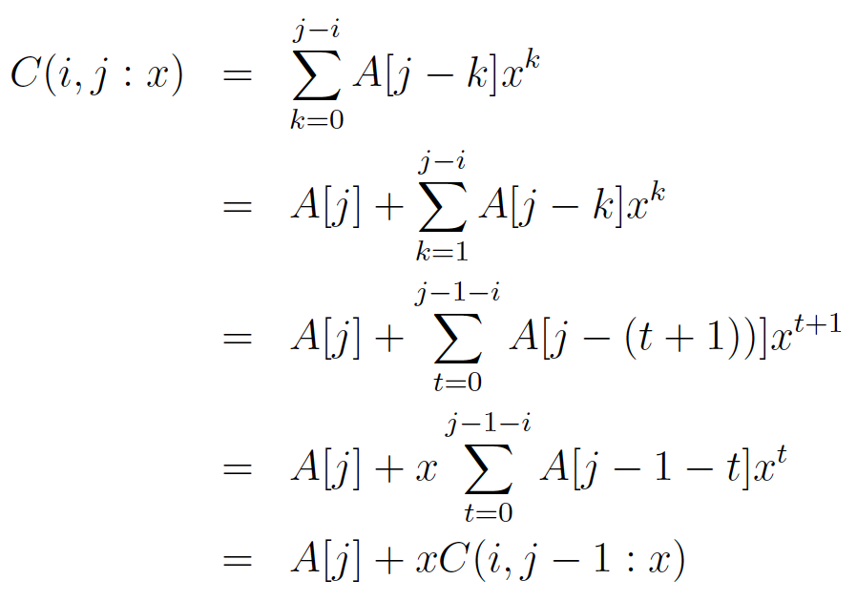
Note that this follows directly from the definition!
Part (A) was meant to provide you with a pathway for finding the recurrence relation.

Slide 4
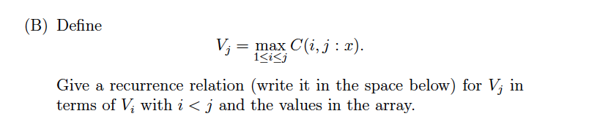
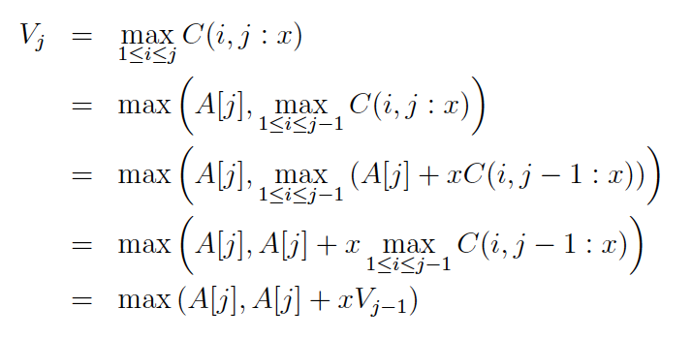
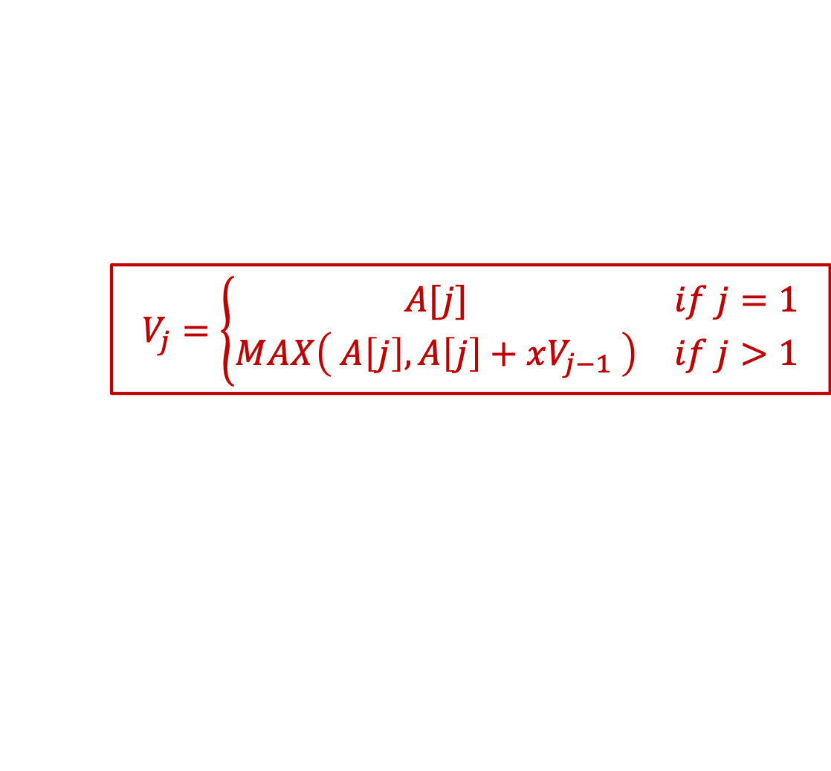
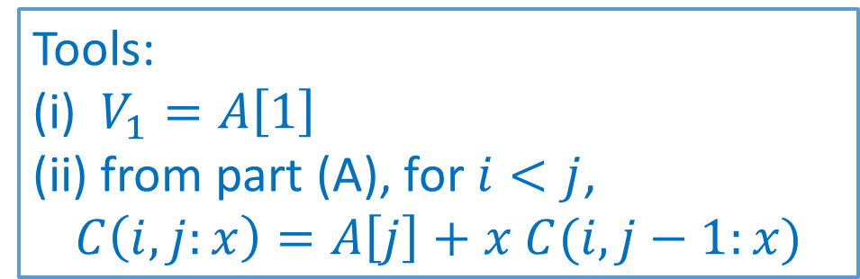
Tools: (i) $V_{1}=A\left[1\right]$ (ii) from part (A), for $i<j$,
$$C\left(i,j:x\right)=A\left[j\right]+x C(i,j−1:x)$$
$$V_{j}=\left\{\begin{matrix}A[j] & if j=1 \\ MAX\left( A\left[j\right], A\left[j\right]+xV_{j−1} \right) & if j>1\end{matrix}\right.$$

Slide 5
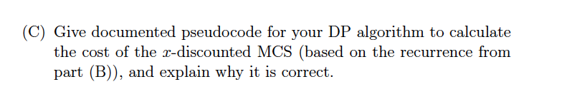
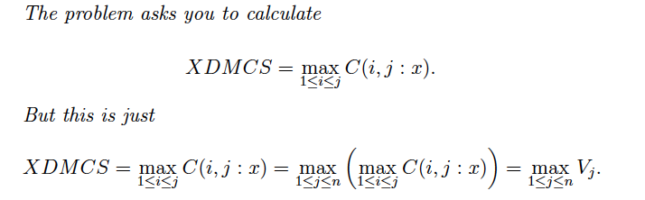
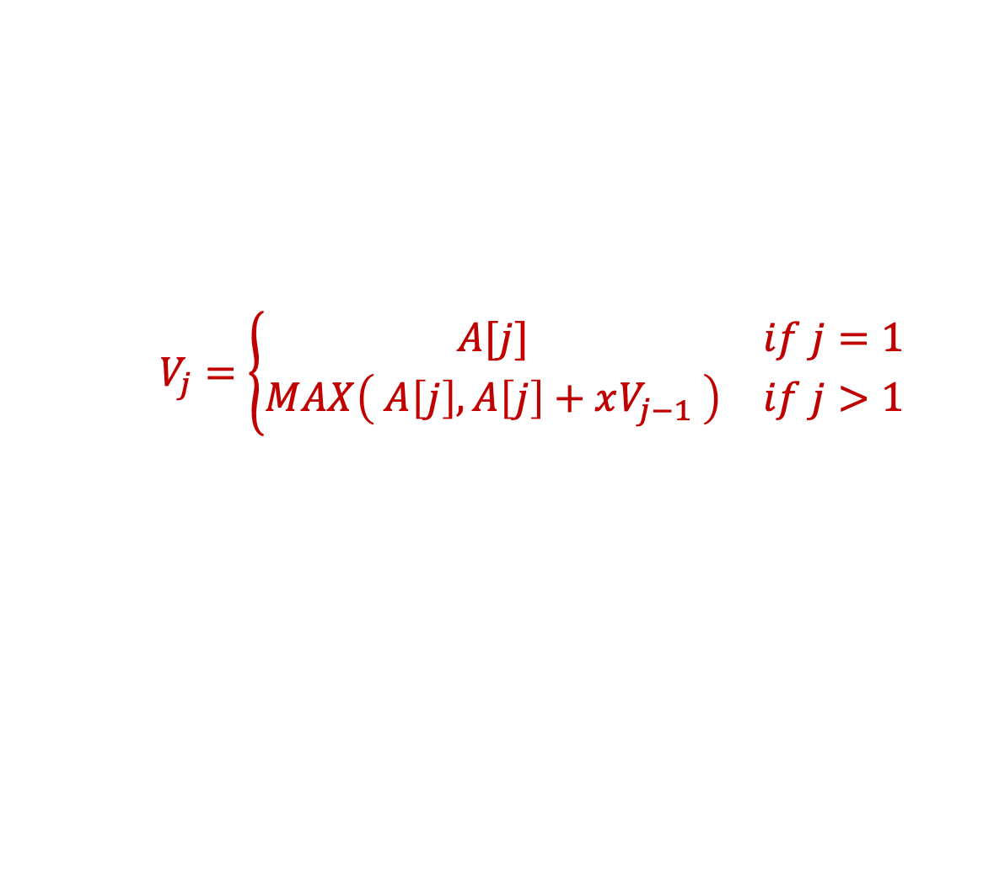
$$V_{j}=\left\{\begin{matrix}A[j] & if j=1 \\ MAX\left( A\left[j\right], A\left[j\right]+xV_{j−1} \right) & if j>1\end{matrix}\right.$$

Slide 6
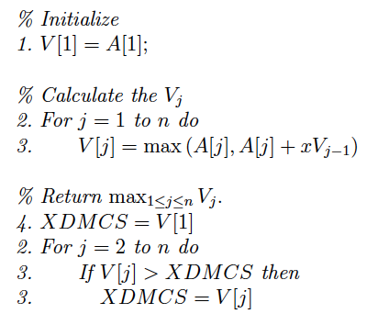
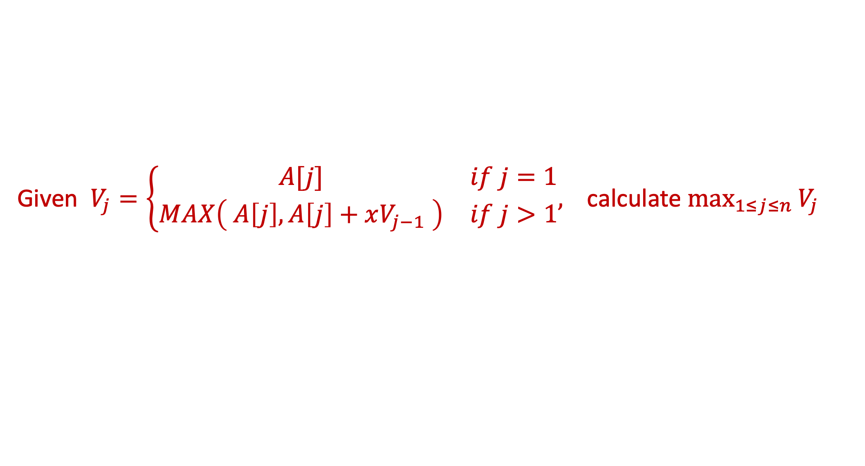
Given $V_{j}=\left\{\begin{matrix}A[j] & if j=1 \\ MAX\left( A\left[j\right], A\left[j\right]+xV_{j−1} \right) & if j>1\end{matrix},\right.$ calculate $\max_{1≤j≤n}{V_{j}}$
A simple O(n) loop solves the problem

