Slide 1
The Maximum Subarray Problem A DP Approach

Slide 2
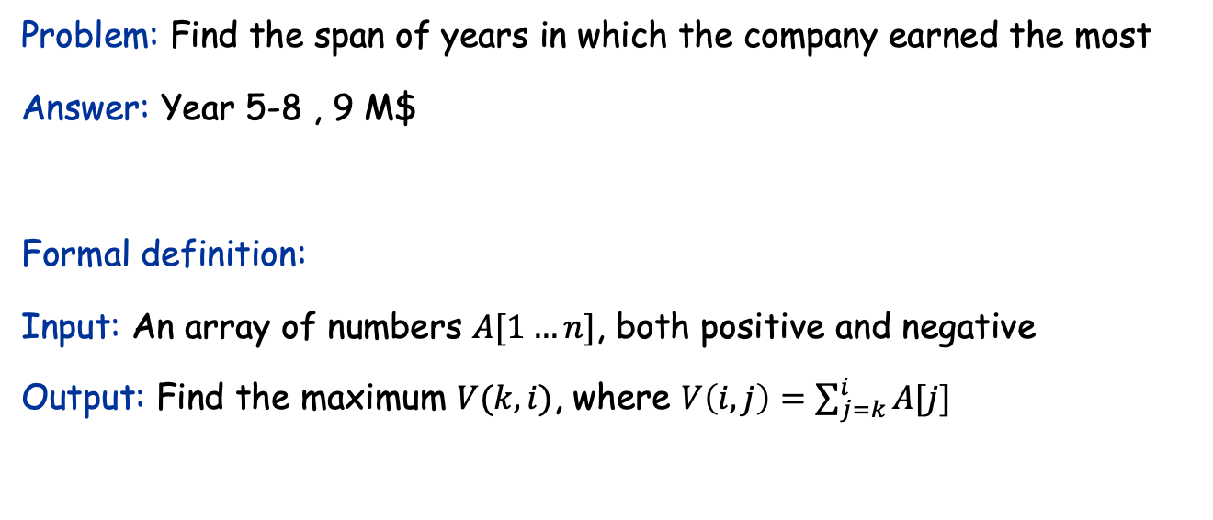
The Maximum Subarray Problem: A DP solution
Input: Profit history of a company. Money earned/lost each year.
Year | 1 | 2 | 3 | 4 | 5 | 6 | 7 | 8 | 9
Profit (M$) | 3 | 2 | 1 | -7 | 5 | 2 | -1 | 3 | -1
Problem: Find the span of years in which the company earned the most
Answer: Year 5-8 , 9 M$
Formal definition:
Input: An array of numbers $A[1…n]$, both positive and negative
Output: Find the maximum $V(k, i)$, where $V\left(i,j\right)=\sum_{j=k}^{i}{A[j]}$

Slide 3
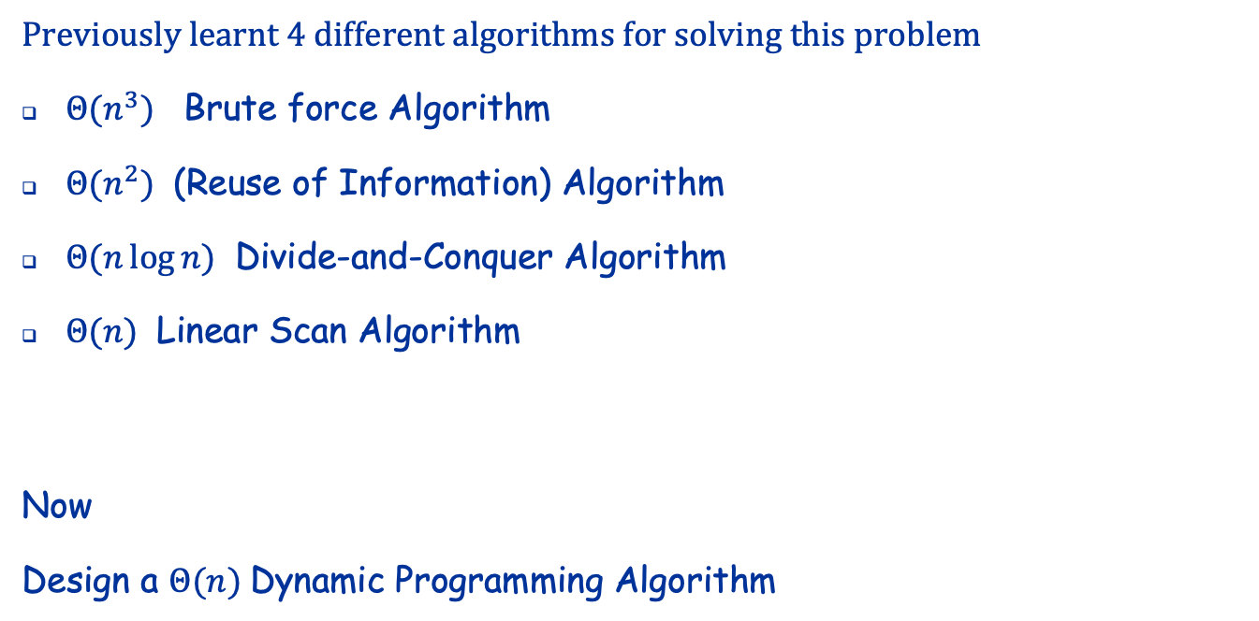
Recall
Previously learnt 4 different algorithms for solving this problem
$Θ(n^{3})$ Brute force Algorithm
$Θ(n^{2})$ (Reuse of Information) Algorithm
$Θ(n\log{n})$ Divide-and-Conquer Algorithm
$Θ(n)$ Linear Scan Algorithm
Now
Design a $Θ(n)$Dynamic Programming Algorithm

Slide 4

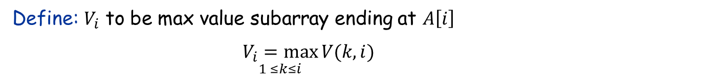


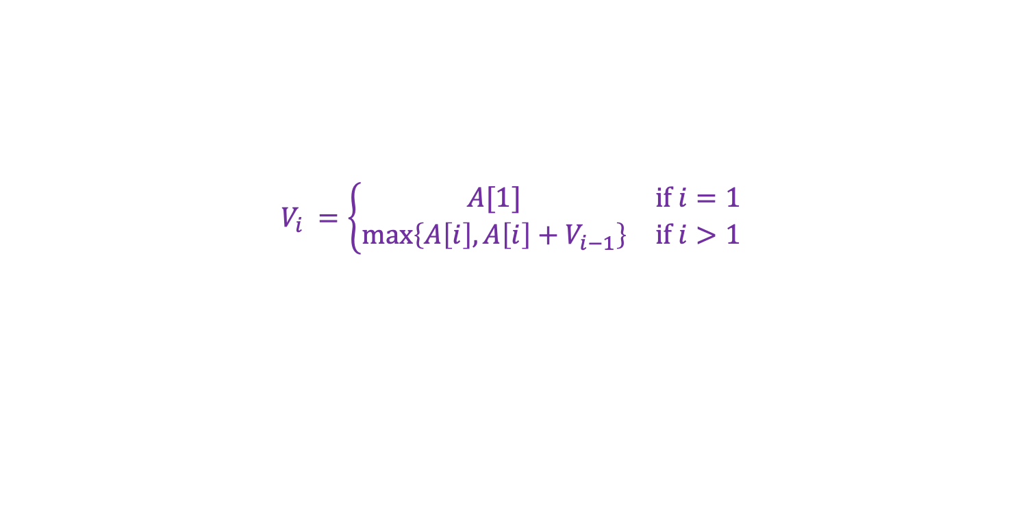

A dynamic programming (Θ(𝑛)) algorithm
Define: $V_{i}$ to be max value subarray ending at $A\left[i\right]$
$\underset{1 ≤k≤i}{V_{i}=max}{V(k,i)}$
The main observation is that if $V_{i}≠A\left[i\right]=V(i,i)$ then
$$V_{i} = A\left[i\right]+{\max_{1≤k<i}{V(k,i−1)}}$$
$$=A\left[i\right]+V_{i−1}$$
$$…$$ | $$A[k]$$ | $$…$$ | $$A[i−1]$$ | $$A[i]$$ | $…$ | $$A[n]$$
$$V_{i−1}$$
$$Vi$$
This immediately implies DP Recurrence
$$V_{i} =\left\{\begin{matrix}A[1] & if i=1 \\ max\left\{A\left[i\right],A\left[i\right]+V_{i−1}\right\} & if i>1\end{matrix}\right.$$

Slide 5

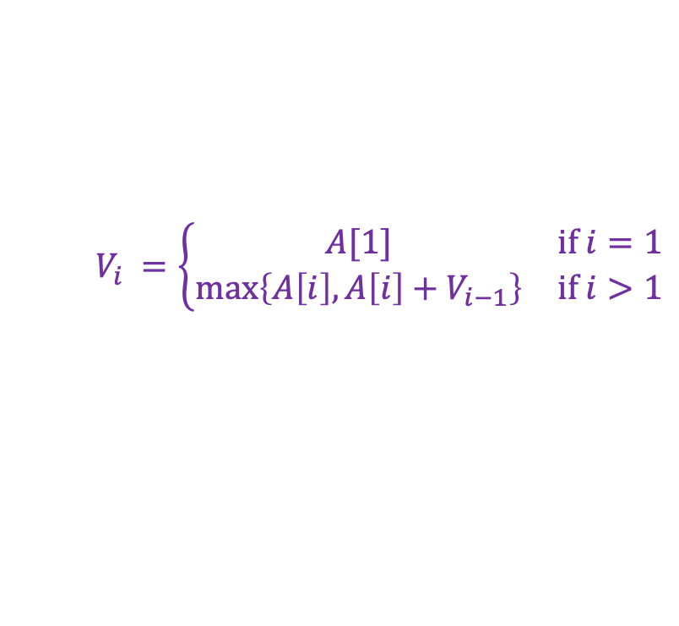
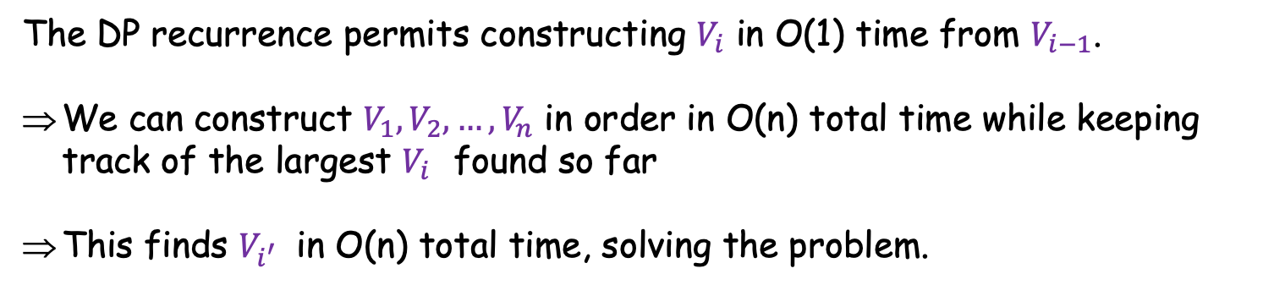

The DP recurrence
We just saw
$$V_{i} =\left\{\begin{matrix}A[1] & if i=1 \\ max\left\{A\left[i\right],A\left[i\right]+V_{i−1}\right\} & if i>1\end{matrix}\right.$$
$$V_{i} \underset{1≤k≤i}{=max}{V(k,i)}$$
where
Original problem then becomes finding $i′$ such that
$$V_{i^{′}} \underset{1≤i≤n}{=max}{V_{i}}$$
The DP recurrence permits constructing $V_{i}$ in O(1) time from $V_{i−1}$.
We can construct $V_{1},V_{2},…,V_{n}$ in order in O(n) total time while keeping track of the largest $V_{i}$found so far
This finds $V_{i^{′}}$ in O(n) total time, solving the problem.
Note: This algorithm turns out to be very similar to the linear scan algorithm we developed in class, but found using DP reasoning

Slide 6

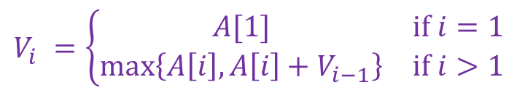

Implementation
Derived recurrence that
$$V_{i} =\left\{\begin{matrix}A[1] & if i=1 \\ max\left\{A\left[i\right],A\left[i\right]+V_{i−1}\right\} & if i>1\end{matrix}\right.$$
$$V_{i} \underset{1≤k≤i}{=max}{V(k,i)}$$
where
and need to find $i′$ such that
$$V_{i^{′}} \underset{1≤i≤n}{=max}{V_{i}}$$
This is very straightforward. Next slides give actual code, and a worked example

Slide 7

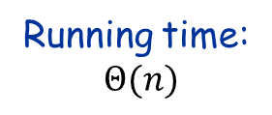

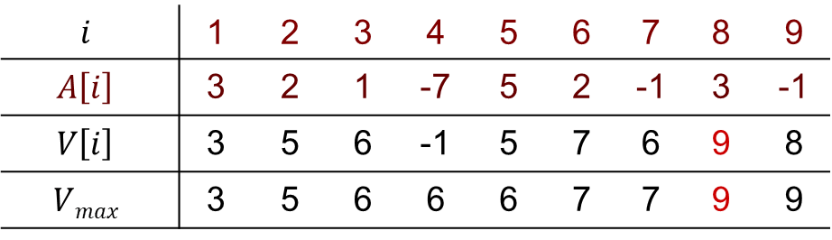

Version 1
Store $Vi$ in a table $V[1, 2, …,n]$, at each step calculating $V\left[i\right]$ from $V\left[i−1\right]$
Base condition: $V\left[1\right]←A\left[1\right]$ Recurrence:$V\left[i\right]←\max\left(A\left[i\right], A\left[i\right]+V\left[i−1\right]\right)$
let $V[1, 2, …,n]$ be an array storing $V_{i}$
$V\left[1\right]←A\left[1\right]$
$Vmax←A[1]$
for $i←2$ to $n$ do
$V[i]←\max{(A[i], A[i]+V[i−1])}⁡$
if $Vmax<V[i]$
then $Vmax←V[i]$
end if
return $Vmax$
Running time:
$Θ(n)$
$$i$$ | 1 | 2 | 3 | 4 | 5 | 6 | 7 | 8 | 9
$$A\left[i\right]$$ | 3 | 2 | 1 | -7 | 5 | 2 | -1 | 3 | -1
$$V\left[i\right]$$ | 3 | 5 | 6 | -1 | 5 | 7 | 6 | 9 | 8
$$Vmax$$ | 3 | 5 | 6 | 6 | 6 | 7 | 7 | 9 | 9
Solution is $V\left[8\right]$

Slide 8


Version 2
Simplified: We only need to remember the last $Vi$ ( call it $V$ ) and $Vmax$
Base condition: $V←A[1]$
Recurrence:$V←\max{(A[i], A[i]+V)}$
$V←A[1]$
$Vmax←A[1]$
for $i←2$ to $n$ do
$V←\max{(A[i], A[i]+V)}⁡$
if $Vmax<V$
then $Vmax←V$
end if
return $Vmax$
Running time:
$Θ(n)$
This gets same result as Version 1, but is simpler!

Slide 9
Next pages provide a detailed walk-through of how Version 1 fills in the DP table.

Slide 10
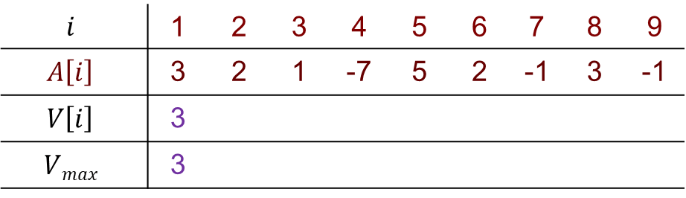
Version 1
Store $Vi$ in a table $V[1, 2, …,n]$, at each step calculating $V\left[i\right]$ from $V\left[i−1\right]$
Base condition: $V\left[1\right]←A\left[1\right]$ Recurrence:$V\left[i\right]←\max\left(A\left[i\right], A\left[i\right]+V\left[i−1\right]\right)$
let $V[1, 2, …,n]$ be an array storing $V_{i}$
$V\left[1\right]←A\left[1\right]$
$Vmax←A[1]$
for $i←2$ to $n$ do
$V[i]←\max{(A[i], A[i]+V[i−1])}⁡$
if $Vmax<V[i]$
then $Vmax←V[i]$
end if
return $Vmax$
Running time:
$Θ(n)$
$$i$$ | 1 | 2 | 3 | 4 | 5 | 6 | 7 | 8 | 9
$$A\left[i\right]$$ | 3 | 2 | 1 | -7 | 5 | 2 | -1 | 3 | -1
$$V\left[i\right]$$ | 3
$$Vmax$$ | 3
$Vmax=V\left[1\right]=A\left[1\right]=3$

Slide 11
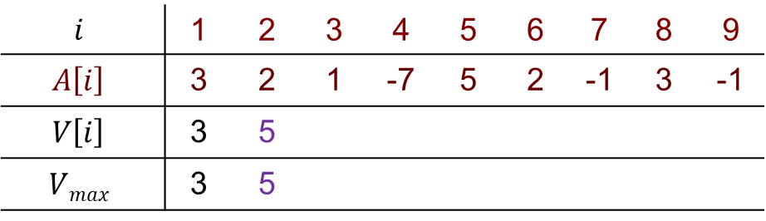
Version 1
Store $Vi$ in a table $V[1, 2, …,n]$, at each step calculating $V\left[i\right]$ from $V\left[i−1\right]$
Base condition: $V\left[1\right]←A\left[1\right]$ Recurrence:$V\left[i\right]←\max\left(A\left[i\right], A\left[i\right]+V\left[i−1\right]\right)$
let $V[1, 2, …,n]$ be an array storing $V_{i}$
$V\left[1\right]←A\left[1\right]$
$Vmax←A[1]$
for $i←2$ to $n$ do
$V[i]←\max{(A[i], A[i]+V[i−1])}⁡$
if $Vmax<V[i]$
then $Vmax←V[i]$
end if
return $Vmax$
Running time:
$Θ(n)$
$$i$$ | 1 | 2 | 3 | 4 | 5 | 6 | 7 | 8 | 9
$$A\left[i\right]$$ | 3 | 2 | 1 | -7 | 5 | 2 | -1 | 3 | -1
$$V\left[i\right]$$ | 3 | 5
$$Vmax$$ | 3 | 5
$Vmax=\max\left(A\left[2\right],A\left[2\right]+V\left[1\right]\right)=max⁡(2, 2+3)=5$

Slide 12
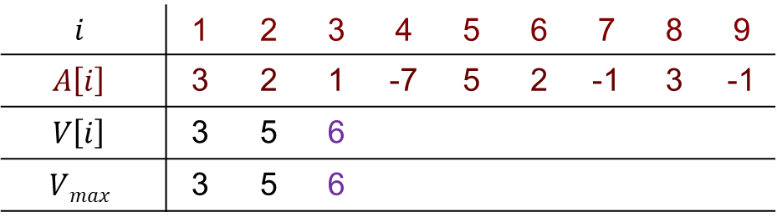
Version 1
Store $Vi$ in a table $V[1, 2, …,n]$, at each step calculating $V\left[i\right]$ from $V\left[i−1\right]$
Base condition: $V\left[1\right]←A\left[1\right]$ Recurrence:$V\left[i\right]←\max\left(A\left[i\right], A\left[i\right]+V\left[i−1\right]\right)$
let $V[1, 2, …,n]$ be an array storing $V_{i}$
$V\left[1\right]←A\left[1\right]$
$Vmax←A[1]$
for $i←2$ to $n$ do
$V[i]←\max{(A[i], A[i]+V[i−1])}⁡$
if $Vmax<V[i]$
then $Vmax←V[i]$
end if
return $Vmax$
Running time:
$Θ(n)$
$$i$$ | 1 | 2 | 3 | 4 | 5 | 6 | 7 | 8 | 9
$$A\left[i\right]$$ | 3 | 2 | 1 | -7 | 5 | 2 | -1 | 3 | -1
$$V\left[i\right]$$ | 3 | 5 | 6
$$Vmax$$ | 3 | 5 | 6
$Vmax=\max\left(A\left[3\right],A\left[3\right]+V\left[2\right]\right)=max⁡(1, 1+5)=6$

Slide 13
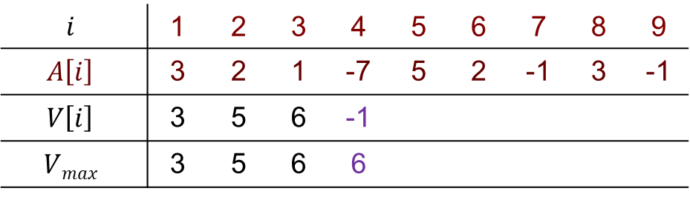
Version 1
Store $Vi$ in a table $V[1, 2, …,n]$, at each step calculating $V\left[i\right]$ from $V\left[i−1\right]$
Base condition: $V\left[1\right]←A\left[1\right]$ Recurrence:$V\left[i\right]←\max\left(A\left[i\right], A\left[i\right]+V\left[i−1\right]\right)$
let $V[1, 2, …,n]$ be an array storing $V_{i}$
$V\left[1\right]←A\left[1\right]$
$Vmax←A[1]$
for $i←2$ to $n$ do
$V[i]←\max{(A[i], A[i]+V[i−1])}⁡$
if $Vmax<V[i]$
then $Vmax←V[i]$
end if
return $Vmax$
Running time:
$Θ(n)$
$$i$$ | 1 | 2 | 3 | 4 | 5 | 6 | 7 | 8 | 9
$$A\left[i\right]$$ | 3 | 2 | 1 | -7 | 5 | 2 | -1 | 3 | -1
$$V\left[i\right]$$ | 3 | 5 | 6 | -1
$$Vmax$$ | 3 | 5 | 6 | 6
$Vmax=6>max\left(A\left[4\right],A\left[4\right]+V\left[3\right]\right)=\max\left(−7, −7+6\right)=−1$

Slide 14
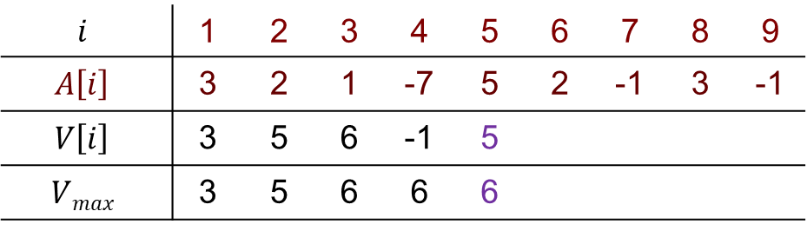
Version 1
Store $Vi$ in a table $V[1, 2, …,n]$, at each step calculating $V\left[i\right]$ from $V\left[i−1\right]$
Base condition: $V\left[1\right]←A\left[1\right]$ Recurrence:$V\left[i\right]←\max\left(A\left[i\right], A\left[i\right]+V\left[i−1\right]\right)$
let $V[1, 2, …,n]$ be an array storing $V_{i}$
$V\left[1\right]←A\left[1\right]$
$Vmax←A[1]$
for $i←2$ to $n$ do
$V[i]←\max{(A[i], A[i]+V[i−1])}⁡$
if $Vmax<V[i]$
then $Vmax←V[i]$
end if
return $Vmax$
Running time:
$Θ(n)$
$$i$$ | 1 | 2 | 3 | 4 | 5 | 6 | 7 | 8 | 9
$$A\left[i\right]$$ | 3 | 2 | 1 | -7 | 5 | 2 | -1 | 3 | -1
$$V\left[i\right]$$ | 3 | 5 | 6 | -1 | 5
$$Vmax$$ | 3 | 5 | 6 | 6 | 6
$Vmax=6>max\left(A\left[5\right],A\left[5\right]+V\left[4\right]\right)=\max\left(5, 5−1\right)=5$

Slide 15
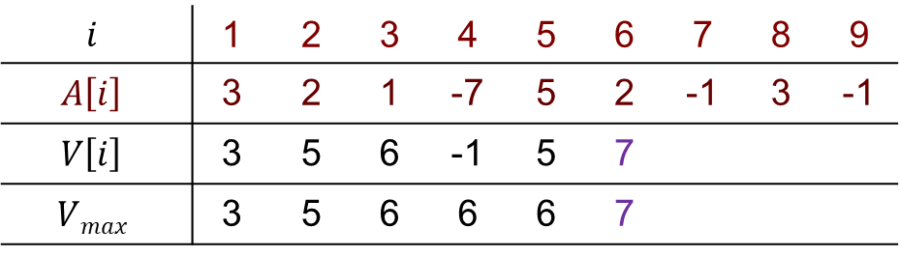
Version 1
Store $Vi$ in a table $V[1, 2, …,n]$, at each step calculating $V\left[i\right]$ from $V\left[i−1\right]$
Base condition: $V\left[1\right]←A\left[1\right]$ Recurrence:$V\left[i\right]←\max\left(A\left[i\right], A\left[i\right]+V\left[i−1\right]\right)$
let $V[1, 2, …,n]$ be an array storing $V_{i}$
$V\left[1\right]←A\left[1\right]$
$Vmax←A[1]$
for $i←2$ to $n$ do
$V[i]←\max{(A[i], A[i]+V[i−1])}⁡$
if $Vmax<V[i]$
then $Vmax←V[i]$
end if
return $Vmax$
Running time:
$Θ(n)$
$$i$$ | 1 | 2 | 3 | 4 | 5 | 6 | 7 | 8 | 9
$$A\left[i\right]$$ | 3 | 2 | 1 | -7 | 5 | 2 | -1 | 3 | -1
$$V\left[i\right]$$ | 3 | 5 | 6 | -1 | 5 | 7
$$Vmax$$ | 3 | 5 | 6 | 6 | 6 | 7
$Vmax=\max\left(A\left[6\right],A\left[6\right]+V\left[5\right]\right)=\max\left(2, 2+5\right)=7$

Slide 16
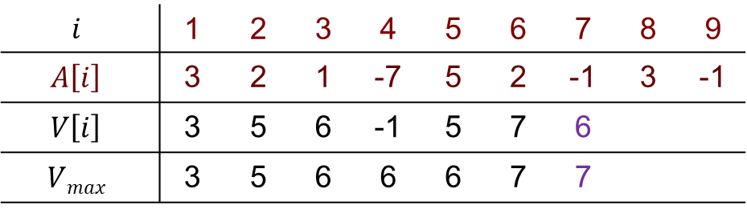
Version 1
Store $Vi$ in a table $V[1, 2, …,n]$, at each step calculating $V\left[i\right]$ from $V\left[i−1\right]$
Base condition: $V\left[1\right]←A\left[1\right]$ Recurrence:$V\left[i\right]←\max\left(A\left[i\right], A\left[i\right]+V\left[i−1\right]\right)$
let $V[1, 2, …,n]$ be an array storing $V_{i}$
$V\left[1\right]←A\left[1\right]$
$Vmax←A[1]$
for $i←2$ to $n$ do
$V[i]←\max{(A[i], A[i]+V[i−1])}⁡$
if $Vmax<V[i]$
then $Vmax←V[i]$
end if
return $Vmax$
Running time:
$Θ(n)$
$$i$$ | 1 | 2 | 3 | 4 | 5 | 6 | 7 | 8 | 9
$$A\left[i\right]$$ | 3 | 2 | 1 | -7 | 5 | 2 | -1 | 3 | -1
$$V\left[i\right]$$ | 3 | 5 | 6 | -1 | 5 | 7 | 6
$$Vmax$$ | 3 | 5 | 6 | 6 | 6 | 7 | 7
$Vmax=7>max\left(A\left[7\right],A\left[7\right]+V\left[6\right]\right)=\max\left(−1, −1+7\right)=6$

Slide 17
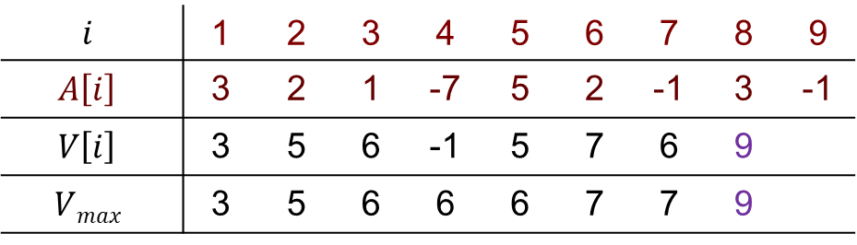
Version 1
Store $Vi$ in a table $V[1, 2, …,n]$, at each step calculating $V\left[i\right]$ from $V\left[i−1\right]$
Base condition: $V\left[1\right]←A\left[1\right]$ Recurrence:$V\left[i\right]←\max\left(A\left[i\right], A\left[i\right]+V\left[i−1\right]\right)$
let $V[1, 2, …,n]$ be an array storing $V_{i}$
$V\left[1\right]←A\left[1\right]$
$Vmax←A[1]$
for $i←2$ to $n$ do
$V[i]←\max{(A[i], A[i]+V[i−1])}⁡$
if $Vmax<V[i]$
then $Vmax←V[i]$
end if
return $Vmax$
Running time:
$Θ(n)$
$$i$$ | 1 | 2 | 3 | 4 | 5 | 6 | 7 | 8 | 9
$$A\left[i\right]$$ | 3 | 2 | 1 | -7 | 5 | 2 | -1 | 3 | -1
$$V\left[i\right]$$ | 3 | 5 | 6 | -1 | 5 | 7 | 6 | 9
$$Vmax$$ | 3 | 5 | 6 | 6 | 6 | 7 | 7 | 9
$Vmax=\max\left(A\left[8\right],A\left[8\right]+V\left[7\right]\right)=\max\left(3, 3+6\right)=9$

Slide 18
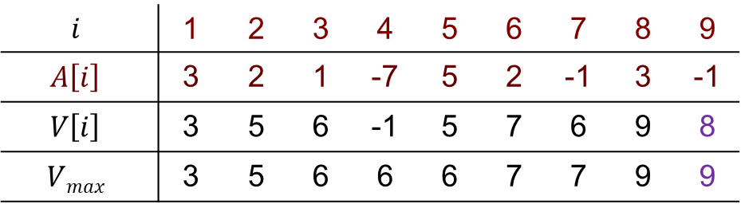
Version 1
Store $Vi$ in a table $V[1, 2, …,n]$, at each step calculating $V\left[i\right]$ from $V\left[i−1\right]$
Base condition: $V\left[1\right]←A\left[1\right]$ Recurrence:$V\left[i\right]←\max\left(A\left[i\right], A\left[i\right]+V\left[i−1\right]\right)$
let $V[1, 2, …,n]$ be an array storing $V_{i}$
$V\left[1\right]←A\left[1\right]$
$Vmax←A[1]$
for $i←2$ to $n$ do
$V[i]←\max{(A[i], A[i]+V[i−1])}⁡$
if $Vmax<V[i]$
then $Vmax←V[i]$
end if
return $Vmax$
Running time:
$Θ(n)$
$$i$$ | 1 | 2 | 3 | 4 | 5 | 6 | 7 | 8 | 9
$$A\left[i\right]$$ | 3 | 2 | 1 | -7 | 5 | 2 | -1 | 3 | -1
$$V\left[i\right]$$ | 3 | 5 | 6 | -1 | 5 | 7 | 6 | 9 | 8
$$Vmax$$ | 3 | 5 | 6 | 6 | 6 | 7 | 7 | 9 | 9
$Vmax=9>max\left(A\left[9\right],A\left[9\right]+V\left[8\right]\right)=\max\left(−1, −1+9\right)=8$

Slide 19
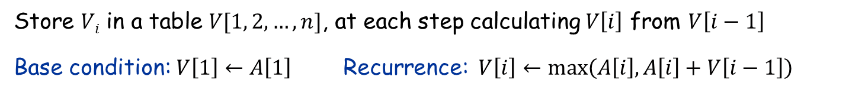
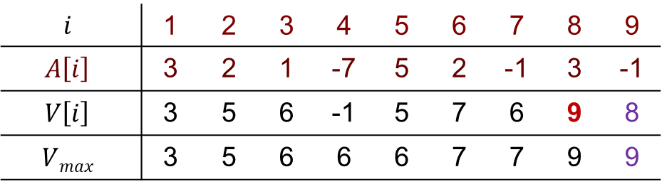
Version 1
Store $Vi$ in a table $V[1, 2, …,n]$, at each step calculating $V\left[i\right]$ from $V\left[i−1\right]$
Base condition: $V\left[1\right]←A\left[1\right]$ Recurrence:$V\left[i\right]←\max\left(A\left[i\right], A\left[i\right]+V\left[i−1\right]\right)$
let $V[1, 2, …,n]$ be an array storing $V_{i}$
$V\left[1\right]←A\left[1\right]$
$Vmax←A[1]$
for $i←2$ to $n$ do
$V[i]←\max{(A[i], A[i]+V[i−1])}⁡$
if $Vmax<V[i]$
then $Vmax←V[i]$
end if
return $Vmax$
Running time:
$Θ(n)$
$$i$$ | 1 | 2 | 3 | 4 | 5 | 6 | 7 | 8 | 9
$$A\left[i\right]$$ | 3 | 2 | 1 | -7 | 5 | 2 | -1 | 3 | -1
$$V\left[i\right]$$ | 3 | 5 | 6 | -1 | 5 | 7 | 6 | 9 | 8
$$Vmax$$ | 3 | 5 | 6 | 6 | 6 | 7 | 7 | 9 | 9
Solution is $V\left[8\right]$
$Vmax=9>max\left(A\left[9\right],A\left[9\right]+V\left[8\right]\right)=\max\left(−1, −1+9\right)=8$

