Slide 1
COMP3711: Design and Analysis of Algorithms
Tutorial 6
HKUST

Slide 2
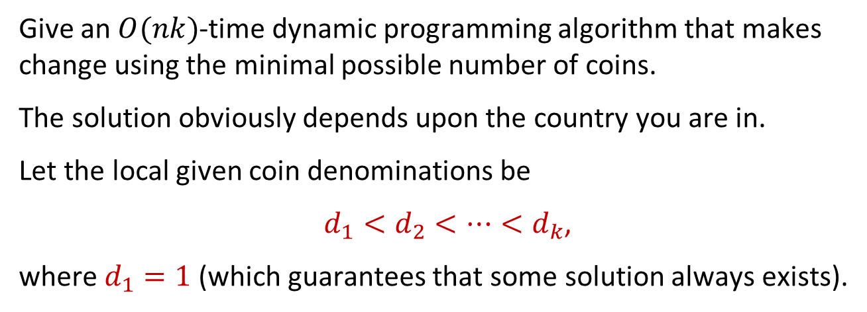
Question 1
Give an $O(nk)$-time dynamic programming algorithm that makes change using the minimal possible number of coins.
The solution obviously depends upon the country you are in.
Let the local given coin denominations be
$d_{1}<d_{2}<⋯<d_{k}$,
where $d_{1}=1$(which guarantees that some solution always exists).

Slide 3


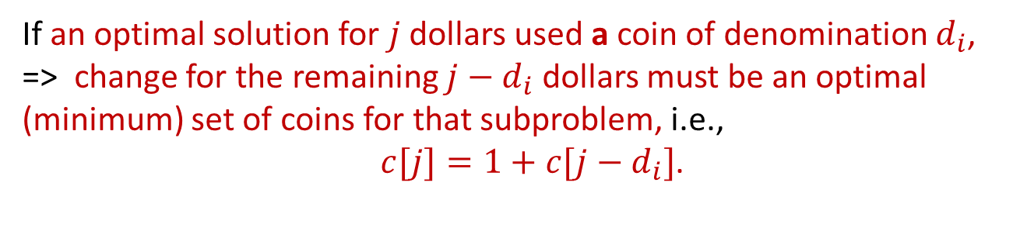

Solution 1
This problem has the optimal substructure property.
If an optimal solution for $j$ dollars used a coin of denomination $d_{i}$, => change for the remaining $j−d_{i}$ dollars must be an optimal (minimum) set of coins for that subproblem, i.e., $c[j]=1+c[j−d_{i}]$.
As base cases, we have that $c[j]=∞$ for all $j<0$ and $c\left[0\right]=0\text{.}$
$c[j]=∞$ for $j<0$, indicates that $j<0$is “impossible”. It’s not actually stored in a table.
The recurrence finds the best way to give change assuming that first coin has value $d_{j}$ and then takes the minimum value over all possible $j$. This yields
$$c\left[j\right]=\left\{\begin{aligned}∞ \text{if} j<0, \\ 0 \text{if} j=0, \\ 1+\min_{1≤i≤k}{\{c\left[j−d_{i}\right]\}} \text{if} j>1.\end{aligned}\right.$$

Slide 4
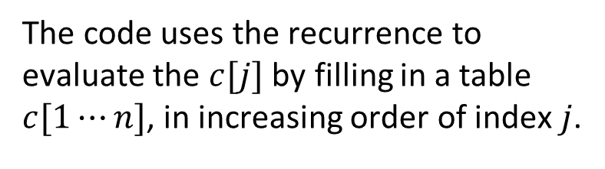
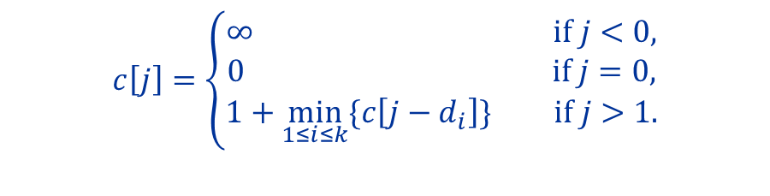
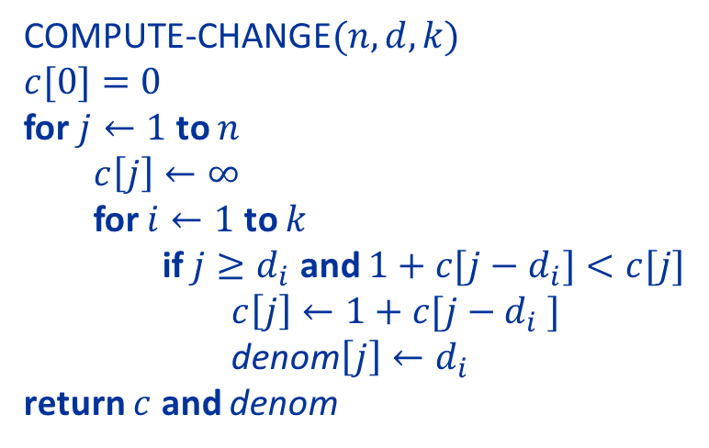
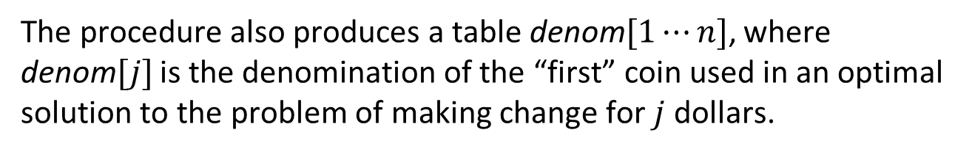
Solution 1
The code uses the recurrence to evaluate the $c[j]$ by filling in a table $c[1⋯n]$, in increasing order of index $j$.
$$c\left[j\right]=\left\{\begin{aligned}∞ \text{if} j<0, \\ 0 \text{if} j=0, \\ 1+\min_{1≤i≤k}{\{c\left[j−d_{i}\right]\}} \text{if} j>1.\end{aligned}\right.$$
Note: code avoids explicitly calling $c[j]$ for $j<0,$ by checking $j≥d_{i}$ before looking up $c[j−d_{i}]$.
The procedure also produces a table denom$[1⋯n]$, where denom$[j]$ is the denomination of the “first” coin used in an optimal solution to the problem of making change for $j$ dollars.
COMPUTE-CHANGE$(n,d,k)$
$$c[0]=0$$
for $j←1$ to $n$
$c\left[j\right]←∞$
for $i←1$ to $k$
if $j≥d_{i}$ and $1+c[j−d_{i}]<c[j]$
$c\left[j\right]←1+c[j−d_{i} ]$
denom$\left[j\right]←d_{i}$
return $c$ and denom

Slide 5
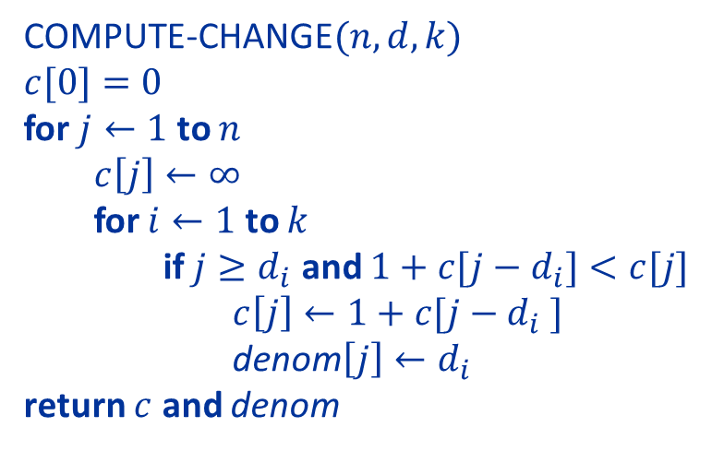
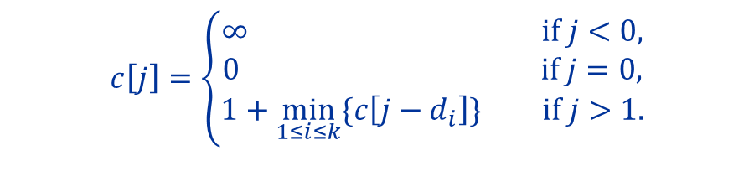
Solution 1
COMPUTE-CHANGE$(n,d,k)$
$$c[0]=0$$
for $j←1$ to $n$
$c\left[j\right]←∞$
for $i←1$ to $k$
if $j≥d_{i}$ and $1+c[j−d_{i}]<c[j]$
$c\left[j\right]←1+c[j−d_{i} ]$
denom$\left[j\right]←d_{i}$
return $c$ and denom
$$c\left[j\right]=\left\{\begin{aligned}∞ \text{if} j<0, \\ 0 \text{if} j=0, \\ 1+\min_{1≤i≤k}{\{c\left[j−d_{i}\right]\}} \text{if} j>1.\end{aligned}\right.$$
This procedure obviously runs in $O(nk)$time.

Slide 6
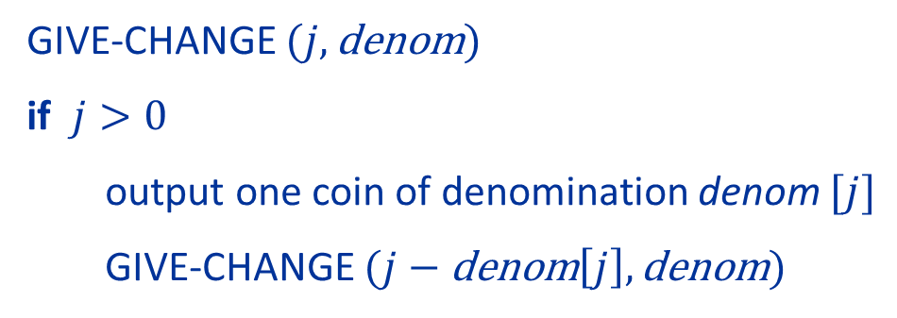
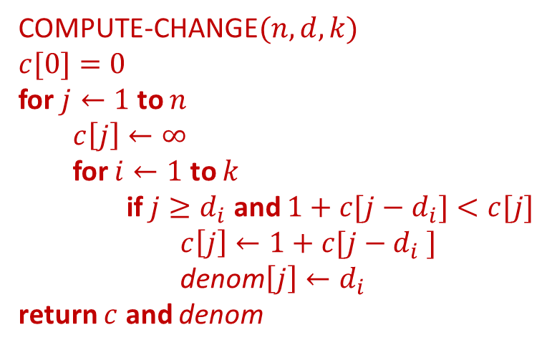
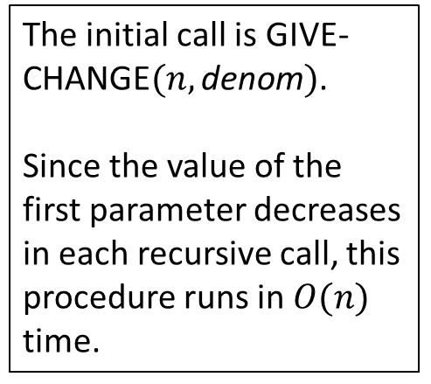
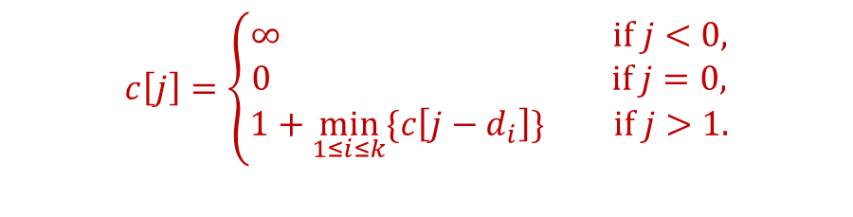
Solution 1
COMPUTE-CHANGE$(n,d,k)$
$$c[0]=0$$
for $j←1$ to $n$
$c\left[j\right]←∞$
for $i←1$ to $k$
if $j≥d_{i}$ and $1+c[j−d_{i}]<c[j]$
$c\left[j\right]←1+c[j−d_{i} ]$
denom$\left[j\right]←d_{i}$
return $c$ and denom
$$c\left[j\right]=\left\{\begin{aligned}∞ \text{if} j<0, \\ 0 \text{if} j=0, \\ 1+\min_{1≤i≤k}{\{c\left[j−d_{i}\right]\}} \text{if} j>1.\end{aligned}\right.$$
The procedure below outputs the coins used in the optimal solution computed by COMPUTE-CHANGE:
The initial call is GIVE-CHANGE$(n,\text{denom})$.
Since the value of the first parameter decreases in each recursive call, this procedure runs in $O(n)$ time.

Slide 7
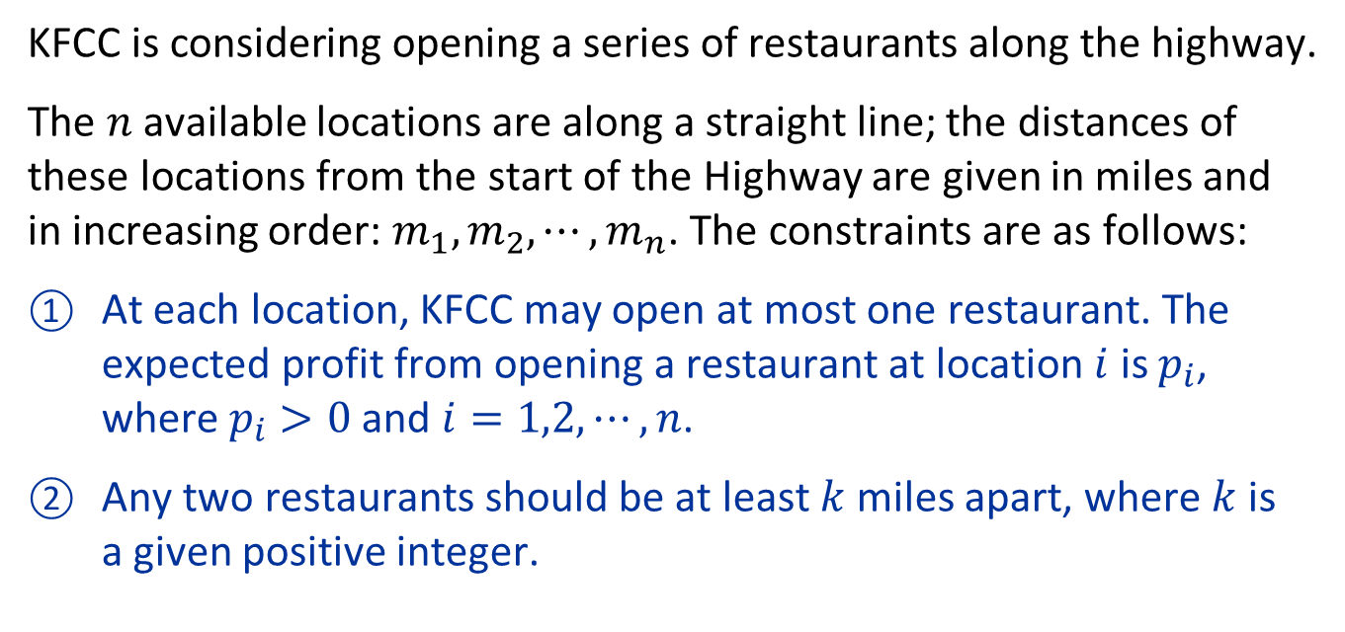
Question 2
KFCC is considering opening a series of restaurants along the highway.
The $n$ available locations are along a straight line; the distances of these locations from the start of the Highway are given in miles and in increasing order: $m_{1},m_{2},⋯,m_{n}$. The constraints are as follows:
At each location, KFCC may open at most one restaurant. The expected profit from opening a restaurant at location $i$ is $p_{i}$, where $p_{i}>0$ and $i=1,2,⋯,n$.
Any two restaurants should be at least $k$ miles apart, where $k$ is a given positive integer.
Give a dynamic programming algorithm that determines a set of locations at which to open restaurants that maximizes the total expected profit.

Slide 8
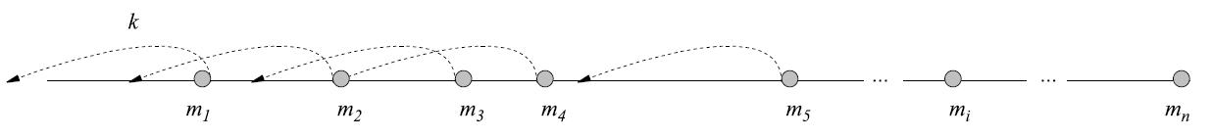
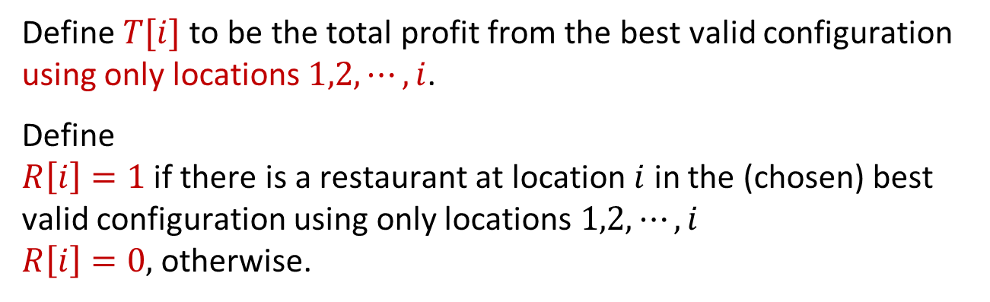
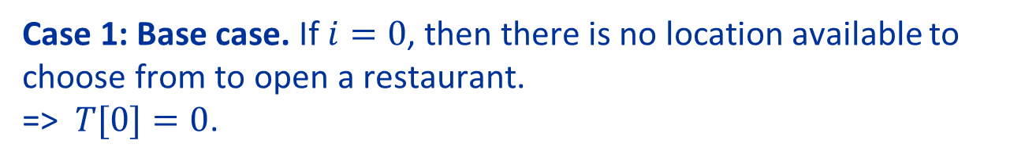
Solution 2: Step 1: Space of Subproblems
Define $T[i]$ to be the total profit from the best valid configuration using only locations $1,2,⋯,i$.
Define $R\left[i\right]=1$ if there is a restaurant at location $i$ in the (chosen) best valid configuration using only locations $1,2,⋯,i$ $R\left[i\right]=0,$ otherwise.
Case 1: Base case. If $i=0$, then there is no location available to choose from to open a restaurant. => $T[0]=0$.

Slide 9
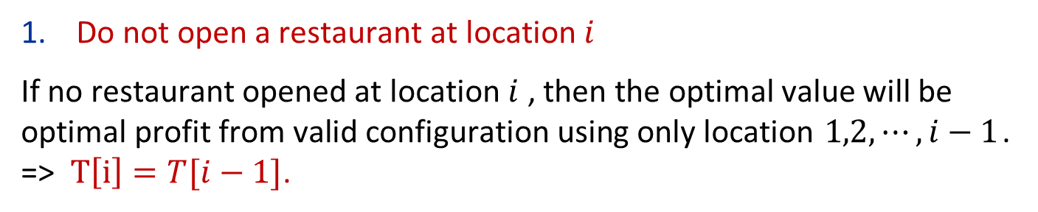
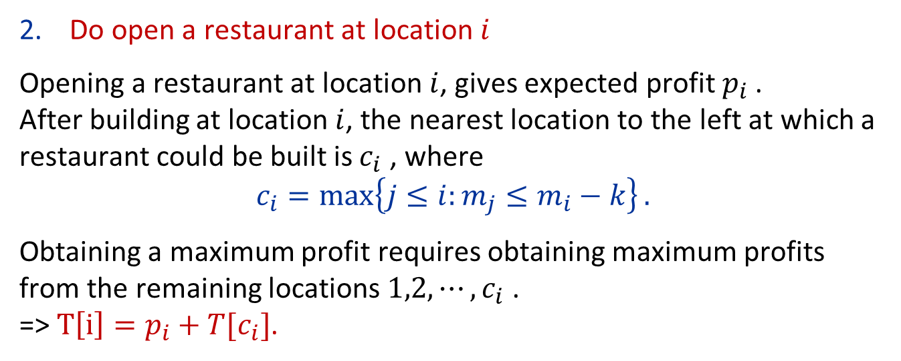
Solution 2: Step 2: Recursive Formulation
Case 2: General case. If $i>0$, there are two options.
Do not open a restaurant at location $i$
If no restaurant opened at location $i$ , then the optimal value will be optimal profit from valid configuration using only location $1,2,⋯,i−1$. => $T\left[i\right]=T[i−1]$.
Do open a restaurant at location $i$
Opening a restaurant at location $i$, gives expected profit $p_{i}$ . After building at location $i$, the nearest location to the left at which a restaurant could be built is $c_{i}$ , where
$$c_{i}=\max\left\{j≤i:m_{j}≤m_{i}−k\right\}.$$
Obtaining a maximum profit requires obtaining maximum profits from the remaining locations $1,2,⋯,c_{i}$ . => $T\left[i\right]=p_{i}+T[c_{i}]$.

Slide 10
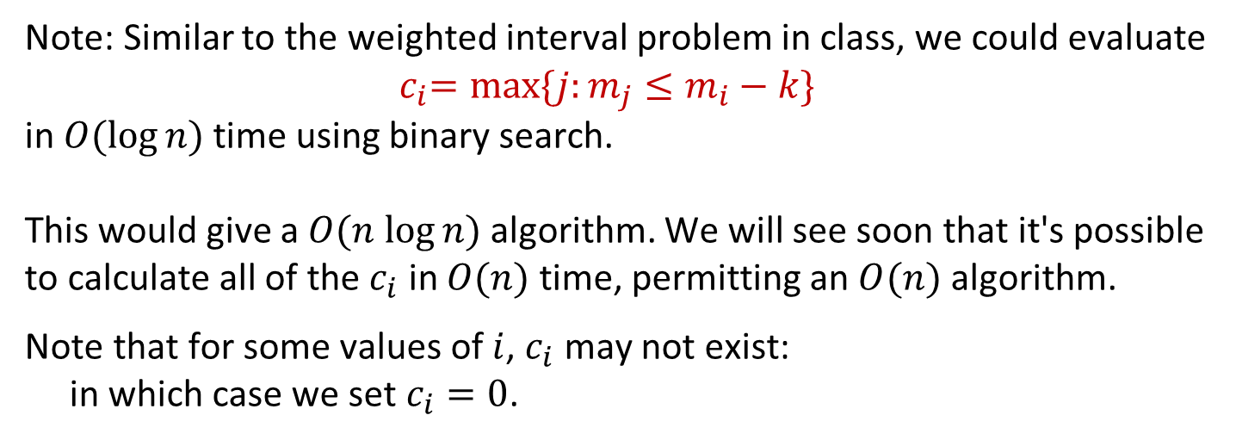
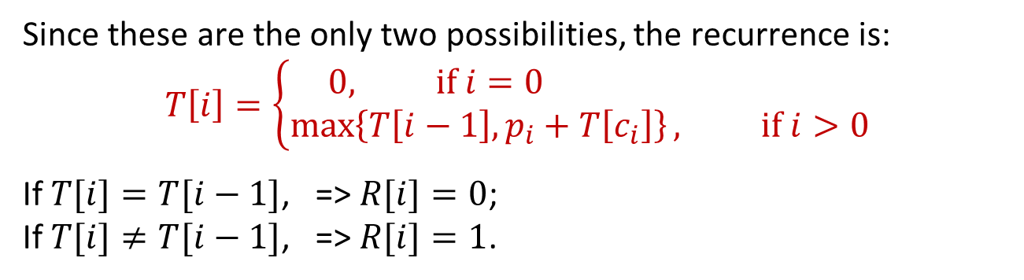
Solution 2: Step 2: Recursive Formulation
Since these are the only two possibilities, the recurrence is:
$$T\left[i\right]=\left\{\begin{aligned}0, \text{if} i=0 \\ \max\left\{T\left[i−1\right],p_{i}+T\left[c_{i}\right]\right\}, \text{if} i>0\end{aligned}\right.$$
If $T[i]=T[i−1]$, => $R[i]=0$; If $T[i]≠T[i−1]$, => $R[i]=1$.
Note: Similar to the weighted interval problem in class, we could evaluate ${ c}_{i}=max⁡\{j:m_{j}≤m_{i}−k\}$ in $O(log⁡n)$ time using binary search. This would give a $O(n log⁡n)$ algorithm. We will see soon that it's possible to calculate all of the $c_{i}$ in $O(n)$ time, permitting an $O(n)$ algorithm.
Note that for some values of $i$, $c_{i}$ may not exist: in which case we set $c_{i}=0$.

Slide 11
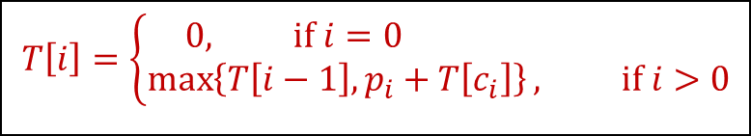
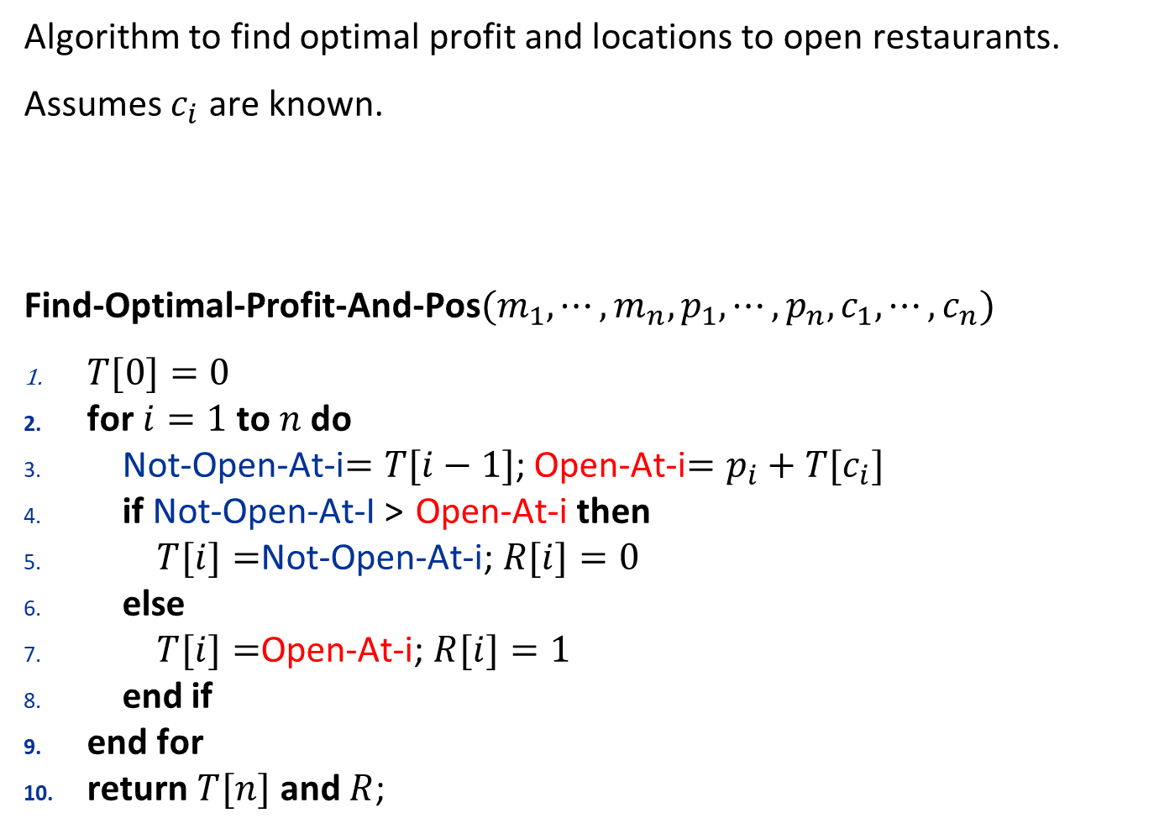
Solution 2: Algorithm
Algorithm to find optimal profit and locations to open restaurants.
Assumes $c_{i}$ are known.
Find-Optimal-Profit-And-Pos$(m_{1},⋯,m_{n},p_{1},⋯,p_{n},c_{1},⋯,c_{n})$
$T[0]=0$
for $i=1$ to $n$ do
Not-Open-At-i$=T[i−1]$; Open-At-i$=p_{i}+T[c_{i}]$
if Not-Open-At-I > Open-At-i then
$T[i]=$Not-Open-At-i; $R[i]=0$
else
$T[i]=$Open-At-i; $R[i]=1$
end if
end for
return $T[n]$ and $R$;
$$T\left[i\right]=\left\{\begin{aligned}0, \text{if} i=0 \\ \max\left\{T\left[i−1\right],p_{i}+T\left[c_{i}\right]\right\}, \text{if} i>0\end{aligned}\right.$$

Slide 12
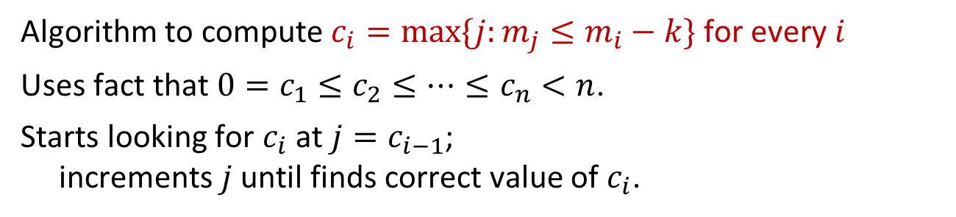
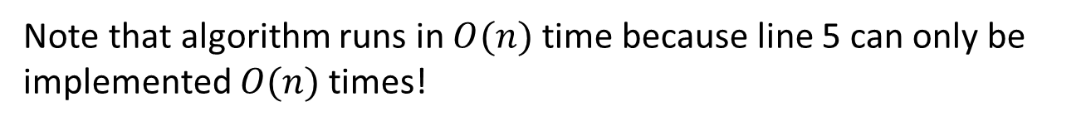
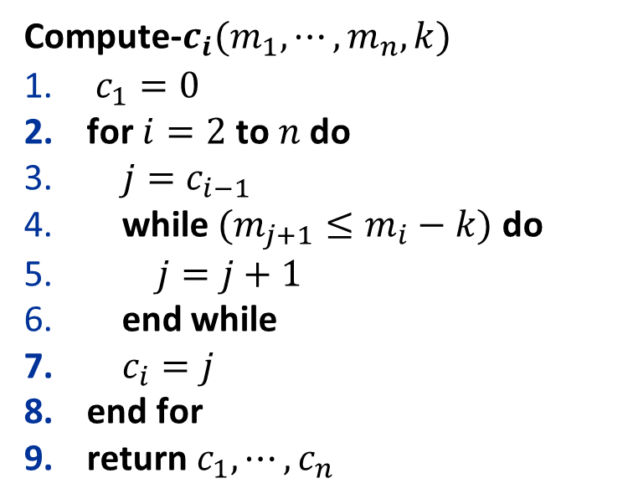
Solution 2: Algorithm for finding $c_{i}$
Algorithm to compute $c_{i}=max⁡\{j:m_{j}≤m_{i}−k\}$ for every $i$
Uses fact that $0=c_{1}≤c_{2}≤⋯≤c_{n}<n$.
Starts looking for $c_{i}$ at $j=c_{i−1}$; increments $j$ until finds correct value of $c_{i}$.
Note that algorithm runs in $O(n)$ time because line 5 can only be implemented $O(n)$ times!
Compute-$c_{i}(m_{1},⋯,m_{n},k)$
$c_{1}=0$
for $i=2$ to $n$ do
$j=c_{i−1}$
while $(m_{j+1}≤m_{i}−k)$ do
$j=j+1$
end while
$c_{i}=j$
end for
return $c_{1},⋯,c_{n}$

Slide 13
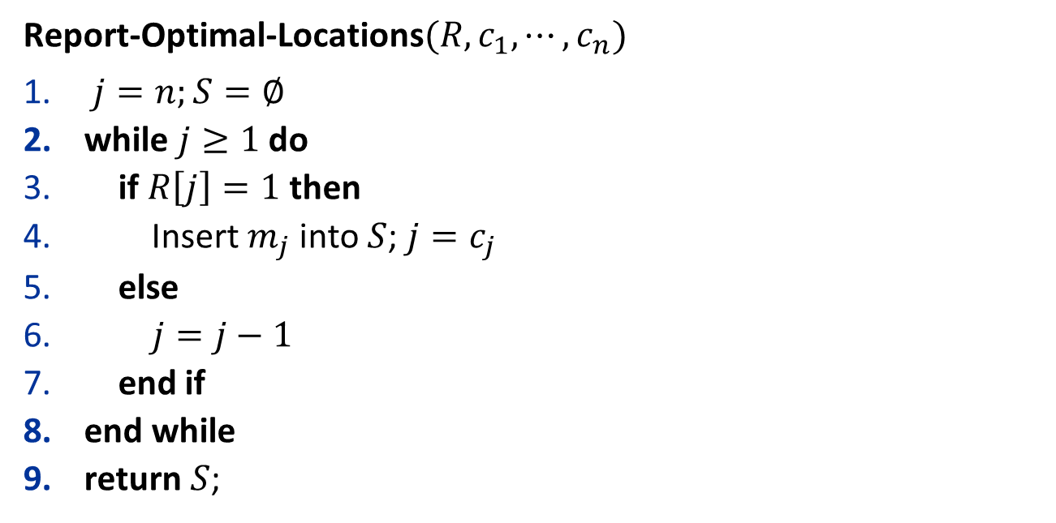
Solution 2: Location Reporting
Algorithm to report optimal locations to open restaurants
Report-Optimal-Locations$(R,c_{1},⋯,c_{n})$
$j=n;S=∅$
while $j≥1$ do
if $R\left[j\right]=1$ then
Insert $m_{j}$ into $S$; $j=c_{j}$
else
$j=j−1$
end if
end while
return $S$;

Slide 14
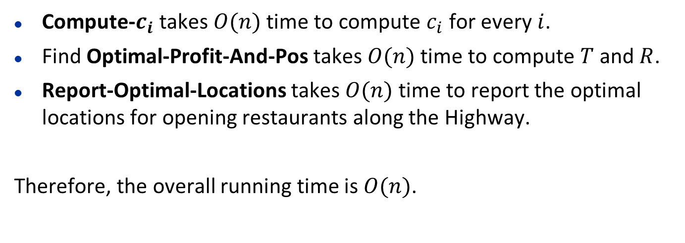
Solution 2: Time Analysis:
Compute-$c_{i}$ takes $O(n)$ time to compute $c_{i}$ for every $i$.
Find Optimal-Profit-And-Pos takes $O(n)$ time to compute $T$ and $R$.
Report-Optimal-Locations takes $O(n)$ time to report the optimal locations for opening restaurants along the Highway.
Therefore, the overall running time is $O(n)$.

