Slide 1
COMP3711: Design and Analysis of Algorithms
Tutorial 6b
HKUST

Slide 2
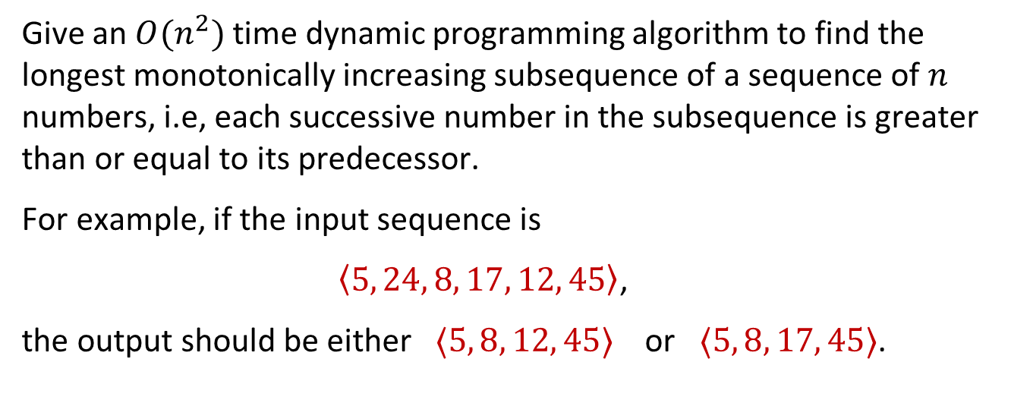
Question 1
Give an $O(n^{2})$ time dynamic programming algorithm to find the longest monotonically increasing subsequence of a sequence of $n$ numbers, i.e, each successive number in the subsequence is greater than or equal to its predecessor.
For example, if the input sequence is
$\left\langle 5, 24, 8, 17, 12, 45\right\rangle$,
the output should be either $⟨5, 8, 12, 45⟩$ or $⟨5, 8, 17, 45⟩$.

Slide 3
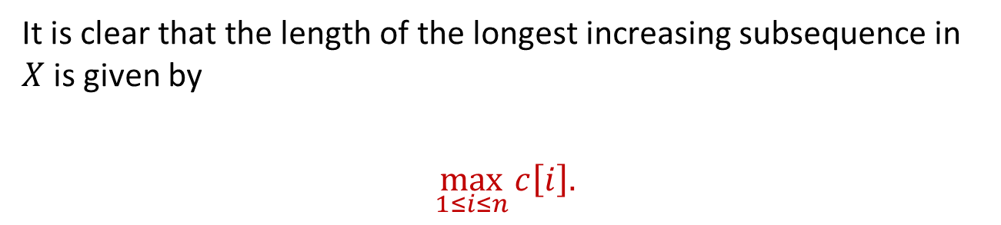
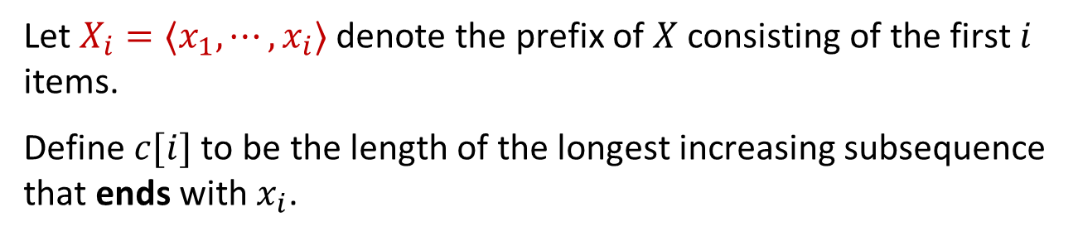
Solution 1
We first give an algorithm which finds the length of the longest increasing subsequence; later, we will modify it to report a subsequence with this length.
Let $X_{i}=⟨x_{1},⋯,x_{i}⟩$ denote the prefix of $X$ consisting of the first $i$ items.
Define $c[i]$ to be the length of the longest increasing subsequence that ends with $x_{i}$.
It is clear that the length of the longest increasing subsequence in $X$ is given by
$$\max_{1≤i≤n}{c\left[i\right].}$$

Slide 4
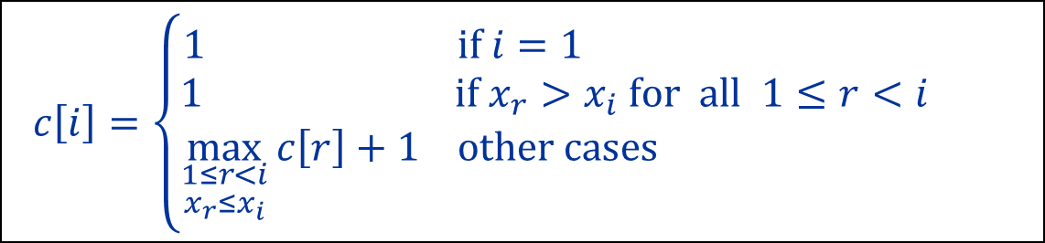
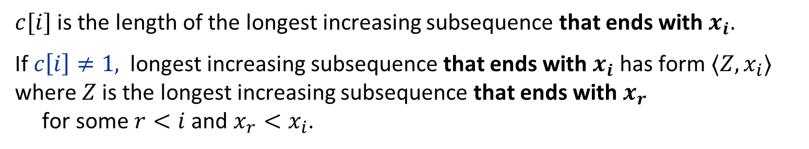
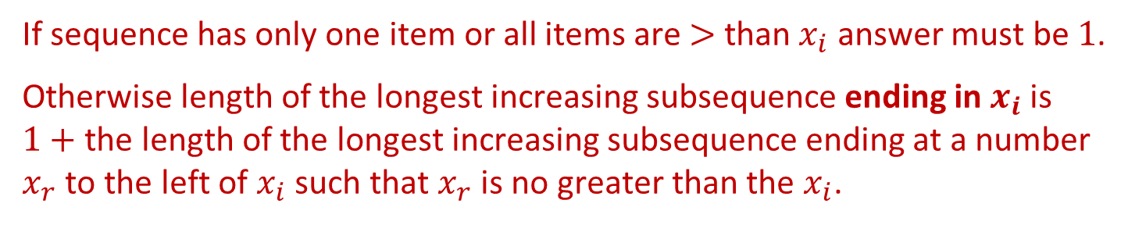
Solution 1
$c[i]$ is the length of the longest increasing subsequence that ends with $x_{i}$.
If $c\left[i\right]≠1,$ longest increasing subsequence that ends with $x_{i}$ has form $⟨Z,x_{i}⟩$ where $Z$ is the longest increasing subsequence that ends with $x_{r}$ for some $r<i$ and $x_{r}<x_{i}$.
If sequence has only one item or all items are $>$ than $x_{i}$ answer must be $1$.
Otherwise length of the longest increasing subsequence ending in $x_{i}$ is $1+$ the length of the longest increasing subsequence ending at a number $x_{r}$ to the left of $x_{i}$ such that $x_{r}$ is no greater than the $x_{i}$.
This yields the following recurrence relation:
$$c\left[i\right]=\left\{\begin{aligned}1 \text{if} i=1 \\ 1 \text{if} x_{r}>x_{i} \text{for} all 1≤r<i \\ \max_{\begin{aligned}1≤r<i \\ x_{r}≤x_{i}\end{aligned}}{c\left[r\right]+1 \text{other} \text{cases} }\end{aligned}\right.$$

Slide 5
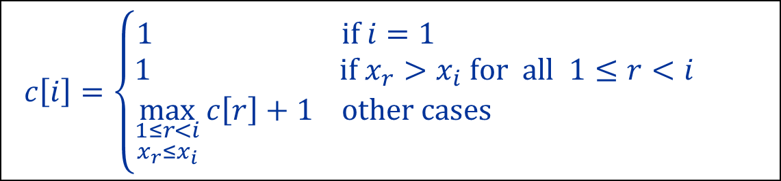
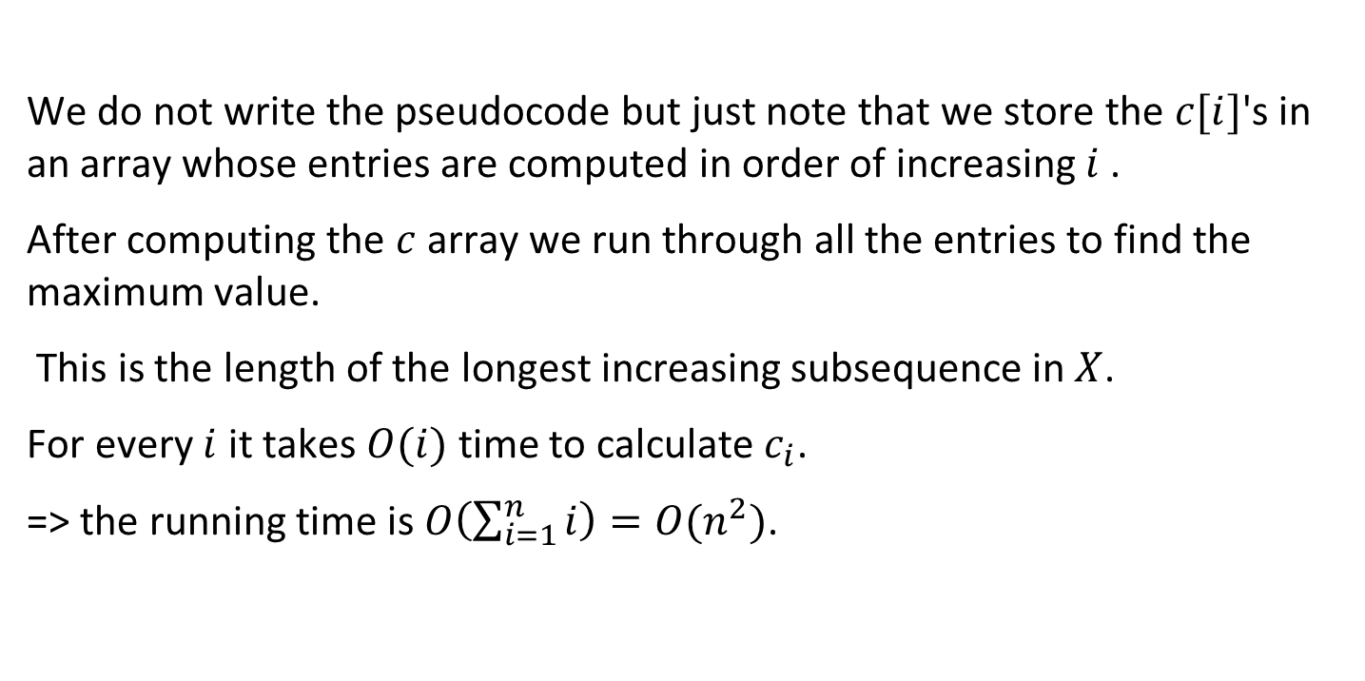
Solution 1
$$c\left[i\right]=\left\{\begin{aligned}1 \text{if} i=1 \\ 1 \text{if} x_{r}>x_{i} \text{for} all 1≤r<i \\ \max_{\begin{aligned}1≤r<i \\ x_{r}≤x_{i}\end{aligned}}{c\left[r\right]+1 \text{other} \text{cases} }\end{aligned}\right.$$
We do not write the pseudocode but just note that we store the $c[i]$'s in an array whose entries are computed in order of increasing $i$ .
After computing the $c$ array we run through all the entries to find the maximum value.
This is the length of the longest increasing subsequence in $X$.
For every $i$ it takes $O(i)$ time to calculate $c_{i}$.
=> the running time is $O\left(\sum_{i=1}^{n}{i}\right)=O(n^{2})$.

Slide 6
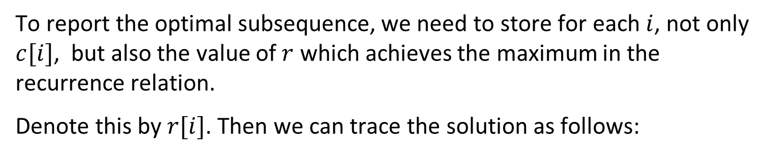
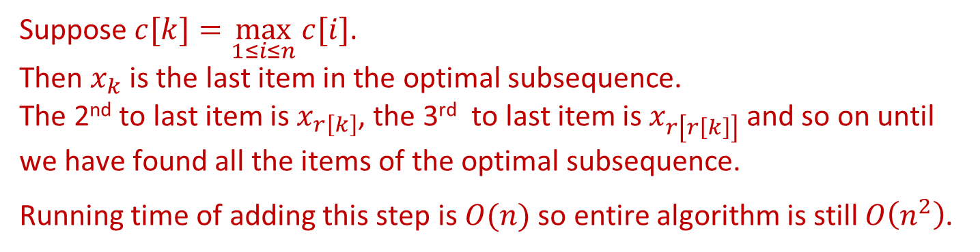
Solution 1
$$c\left[i\right]=\left\{\begin{aligned}1 \text{if} i=1 \\ 1 \text{if} x_{r}>x_{i} \text{for} all 1≤r<i \\ \max_{\begin{aligned}1≤r<i \\ x_{r}≤x_{i}\end{aligned}}{c\left[r\right]+1 \text{other} \text{cases} }\end{aligned}\right.$$
To report the optimal subsequence, we need to store for each $i$, not only $c[i]$, but also the value of $r$ which achieves the maximum in the recurrence relation.
Denote this by $r[i]$. Then we can trace the solution as follows:
Suppose $c[k]=\max_{1≤i≤n}{c[i]}$. Then $x_{k}$ is the last item in the optimal subsequence. The 2nd to last item is $x_{r\left[k\right]}$, the 3rd to last item is $x_{r\left[r\left[k\right]\right]}$ and so on until we have found all the items of the optimal subsequence.
Running time of adding this step is $O(n)$ so entire algorithm is still $O\left(n^{2}\right)$.

Slide 7
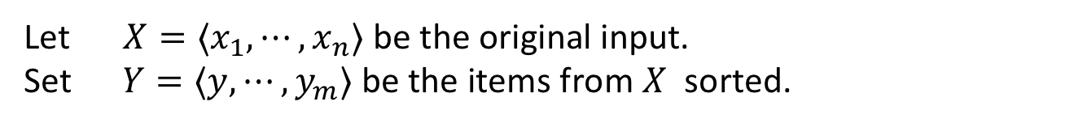
Solution 1: Alternative Solution
This problem can also be solved using the Longest Common Subsequence Algorithm
Let $X=⟨x_{1},⋯,x_{n}⟩$ be the original input. Set $Y=⟨y,⋯,y_{m}⟩$ be the items from $X$ sorted.
Example: $X=\left\langle 5, 24, 8, 17, 12, 45, 12\right\rangle$, $Y=\left\langle 5, 8, 12, 12, 17, 24, 45\right\rangle$
Then LCS(X, Y) is exactly the Longest Increasing Subsequence of X (why?)

Slide 8
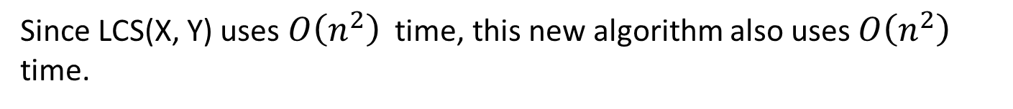

Solution 1: Alternative Solution
This problem can also be solved using the Longest Common Subsequence Algorithm
Let $X=⟨x_{1},⋯,x_{n}⟩$ be the original input. Set $Y=⟨y,⋯,y_{m}⟩$ be the items from $X$ sorted.
Example: $X=\left\langle 5, 24, 8, 17, 12, 45, 12\right\rangle$, $Y=\left\langle 5, 8, 12, 12, 17, 24, 45\right\rangle$
Then LCS(X, Y) is exactly the Longest Increasing Subsequence of X (why?)
Since LCS(X, Y) uses $O\left(n^{2}\right)$ time, this new algorithm also uses $O\left(n^{2}\right)$ time.
Surprisingly, there is also an $O\left(n\log{n}\right)$ algorithm for solving the problem. See
https://www.cs.princeton.edu/courses/archive/spring13/cos423/lectures/LongestIncreasingSubsequence.pdf

Slide 9
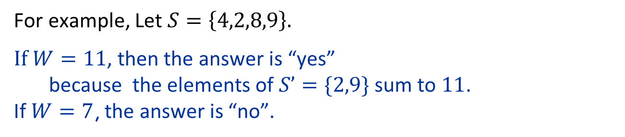
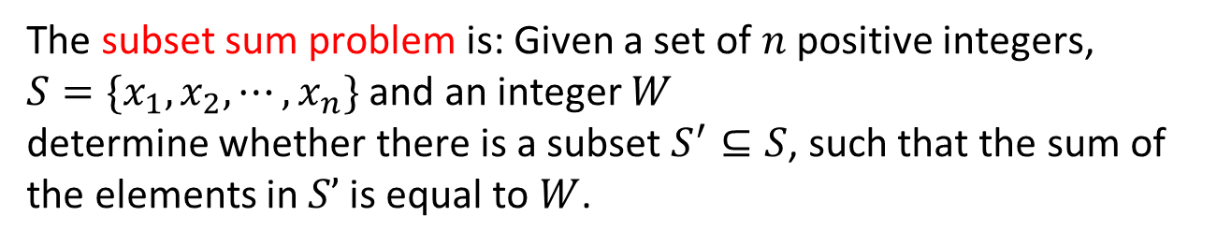
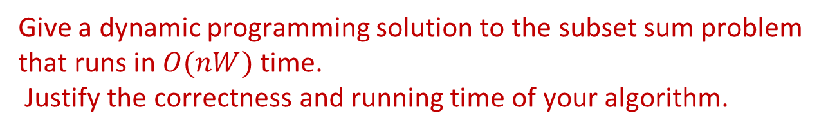
Question 2
The subset sum problem is: Given a set of $n$ positive integers, $S=\{x_{1},x_{2},⋯,x_{n}\}$ and an integer $W$ determine whether there is a subset $S^{′}⊆S$, such that the sum of the elements in $S’$ is equal to $W$.
For example, Let $S=\left\{4,2,8,9\right\}.$
If $W=11$, then the answer is “yes” because the elements of $S’=\{2,9\}$ sum to $11$. If $W=7$, the answer is “no”.
Give a dynamic programming solution to the subset sum problem that runs in $O(nW)$ time. Justify the correctness and running time of your algorithm.

Slide 10
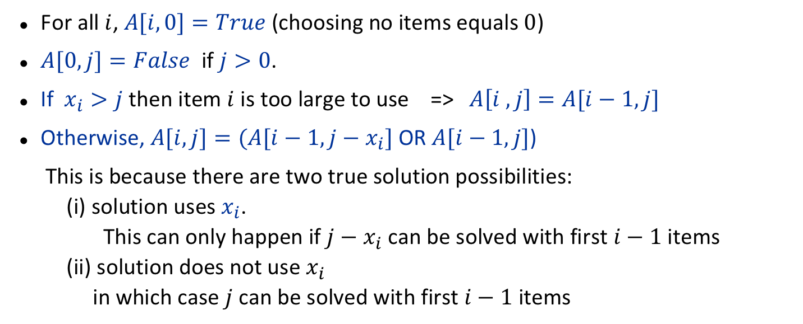
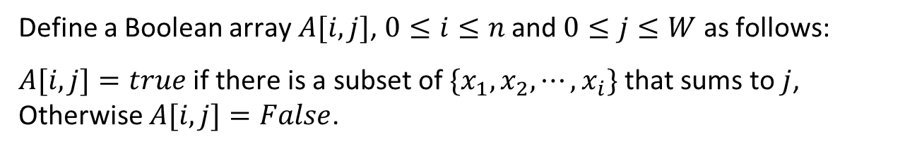
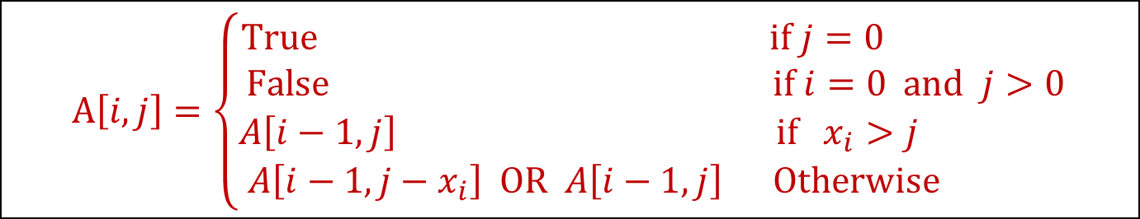
Solution 2
Define a Boolean array $A[i,j]$, $0≤i≤n$ and $0≤j≤W$ as follows:
$A[i,j]=true$ if there is a subset of $\{x_{1},x_{2},⋯,x_{i}\}$ that sums to $j$, Otherwise $A[i,j]=False$.
For all $i$, $A[i,0]=True$ (choosing no items equals $0$)
$A[0,j]=False$ if $j>0$.
If $x_{i}>j$ then item $i$ is too large to use => $A\left[i ,j\right]=A[i−1,j]$
Otherwise, $A[i,j]=(A[i−1,j−x_{i}]$ OR $A[i−1,j]$)
This is because there are two true solution possibilities: (i) solution uses $x_{i}$. This can only happen if $j−x_{i}$ can be solved with first $i−1$ items (ii) solution does not use $x_{i}$ in which case $j$ can be solved with first $i−1$ items
$$A\left[i,j\right]=\left\{\begin{matrix}True & if j=0 \\ False & if i=0 and j>0 \\ A\left[i−1,j\right] & if{ x}_{i}>j \\ A\left[i−1,j−x_{i}\right] OR A\left[i−1,j\right] & Otherwise \end{matrix}\right.$$

Slide 11

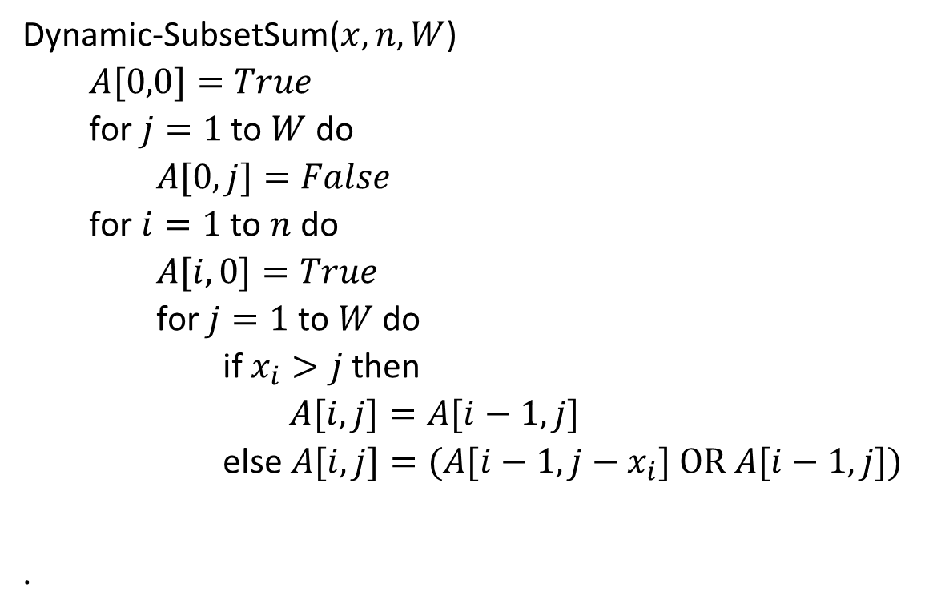
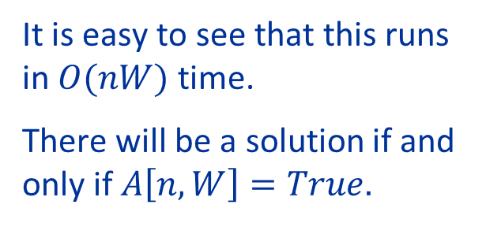
Solution 2
$$A\left[i,j\right]=\left\{\begin{matrix}True & if j=0 \\ False & if i=0 and j>0 \\ A\left[i−1,j\right] & if{ x}_{i}>j \\ A\left[i−1,j−x_{i}\right] OR A\left[i−1,j\right] & Otherwise \end{matrix}\right.$$
Dynamic-SubsetSum($x,n,W$)
$A[0,0]=True$
for $j=1$ to $W$ do
$A[0,j]=False$
for $i=1$ to $n$ do
$A[i,0]=True$
for $j=1$ to $W$ do
if $x_{i}>j$ then
$A[i,j]=A[i−1,j]$
else $A[i,j]=(A[i−1,j−x_{i}] \text{OR} A[i−1,j])$
.
It is easy to see that this runs in $O(nW)$ time.
There will be a solution if and only if $A\left[n,W\right]=True.$

Slide 12
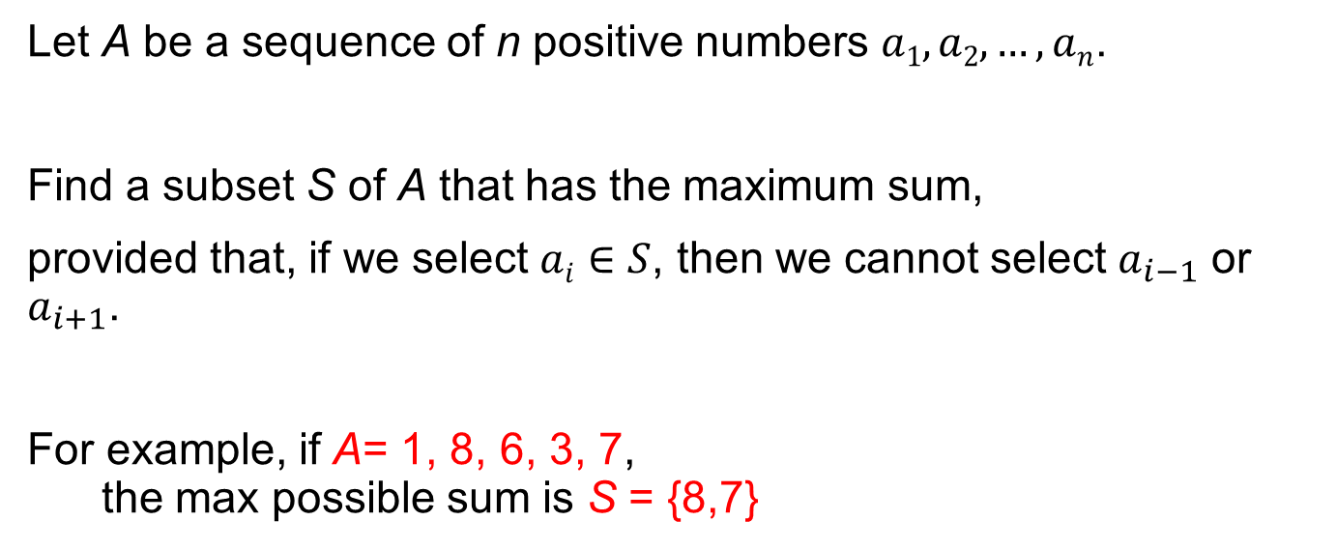
Question 3: The (Restricted) Max-Sum Problem
Let A be a sequence of n positive numbers $a1, a2, …, an$.
Find a subset S of A that has the maximum sum,
provided that, if we select $ai∈S$, then we cannot select $a_{i−1}$ or $a_{i+1}$.
For example, if A= 1, 8, 6, 3, 7, the max possible sum is S = {8,7}

Slide 13
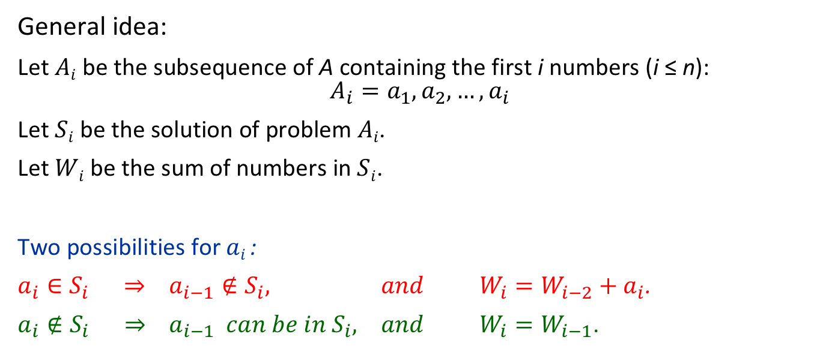

Solution 3: Dynamic Programming Solution
General idea:
Let $Ai$ be the subsequence of A containing the first i numbers (i ≤ n):
$$A_{i}=a_{1},a_{2},…,a_{i}$$
Let $Si$ be the solution of problem $Ai$.
Let $Wi$ be the sum of numbers in $Si$.
Two possibilities for $ai$ :
$a_{i}∈S_{i} ⇒ a_{i−1}∉S_{i}, and { W}_{i}=W_{i−2}+a_{i}$.
$a_{i}∉S_{i} ⇒ a_{i−1} can be in{ S}_{i}, and { W}_{i}=W_{i−1}$.
Solution is larger of the two cases.
$W_{i}=max ⁡\{W_{i−2}+a_{i}, W_{i−1}\}.$
Solve the problem incrementally from smaller to larger, i.e. for A₁, A₂, ..., A_{n}. The final solution is A_{n}.

Slide 14
Solution 3: DP pseudocode
W[1] = a₁ ; b[1] = true
// in general b[i] = true means that a_{i} is in S_{i}
If a₂ > a₁
W[2] = a₂ ; b[2] = true // a₂ is in S₂
else
W[2] = a₁ ; b[2] = false // a₂ is not in S₂
for i =3 to n
If W[i−2] + a_{i} > W[i−1]
W[i] = W[i−2] + a_{i}
b[i] = true // a_{i} is in S_{i}
else
W[i] = W[i−1]
b[i] = false // a_{i} is not in S_{i}
Initial Conditions
Recursive Solution
W[1] = 1, b[1] = 1
W[2] = 8, b[2] = 1
W[3] = 8, b[3] = 0
W[4] = 11, b[4] = 1
W[5] = 15, b[5] = 1
Cost: Θ(n)
Example: for A= 1, 8, 6, 3, 7, we have

Slide 15
Solution 3: Printing
i = n
while i > 0
if b[i] is true
Output a_{i}
i = i−2
else
i = i−1
W[1] = 1, b[1] = 1
W[2] = 8, b[2] = 1
W[3] = 8, b[3] = 0
W[4] = 11, b[4] = 1
W[5] = 15, b[5] = 1
Example: for A= 1, 8, 6, 3, 7, we have
b[5] = 1; therefore, we print a₅ = 7 and set i=3
b[3] = 0; therefore, we set i=2
b[2] = 1; therefore, we print a₂ = 8 and set i=0

