Slide 1
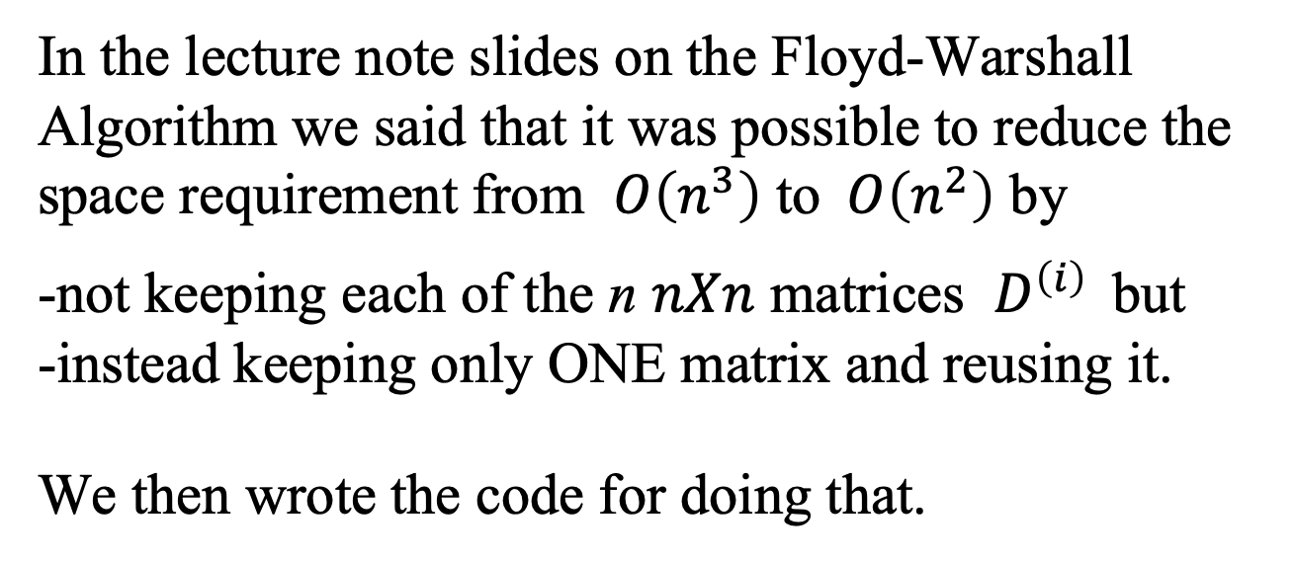
In the lecture note slides on the Floyd-Warshall Algorithm we said that it was possible to reduce the space requirement from $O\left(n^{3}\right)$ to$O\left(n^{2}\right)$ by
-not keeping each of the n $nXn$ matrices $D^{\left(i\right) }$ but -instead keeping only ONE matrix and reusing it.
We then wrote the code for doing that.
Why does this space-reduced code work and give the correct answer?

Slide 2
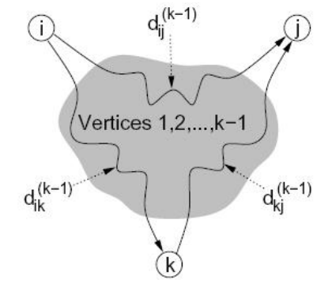
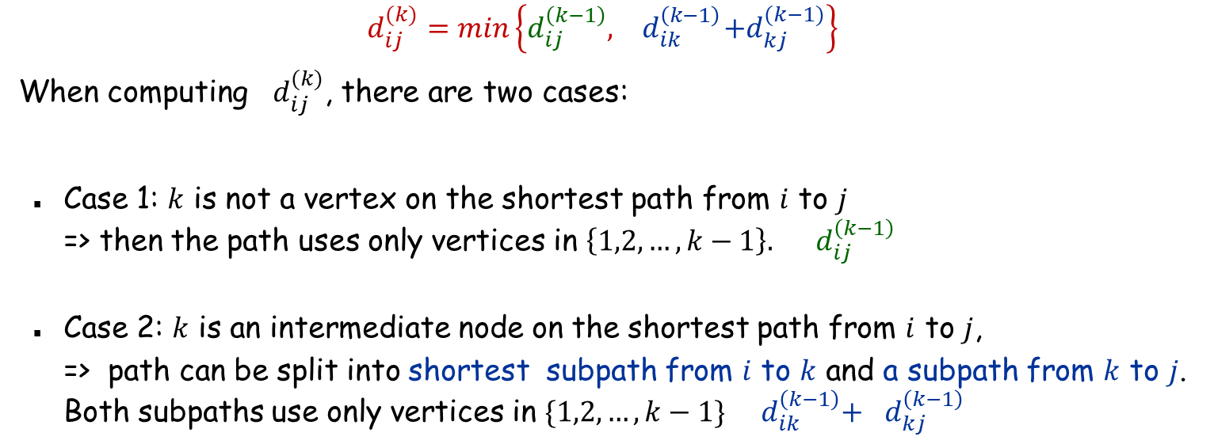
Recurrence
$$d_{ij}^{(k)}=min\left\{d_{ij}^{\left(k−1\right)},{ d}_{ik}^{\left(k−1\right)}+d_{kj}^{(k−1)}\right\}$$
When computing $d_{ij}^{(k)}$, there are two cases:
Case 1: $k$ is not a vertex on the shortest path from $i$ to $j$ => then the path uses only vertices in $\left\{1,2,…,k−1\right\}.$ ${ d}_{ij}^{\left(k−1\right)}$
Case 2: $k$ is an intermediate node on the shortest path from $i$ to $j$, => path can be split into shortest subpath from $i$ to $k$ and a subpath from $k$ to $j$. Both subpaths use only vertices in $\{1,2,…,k−1\}$ ${ d}_{ik}^{\left(k−1\right)}+$ ${ d}_{kj}^{\left(k−1\right)}$

Slide 3
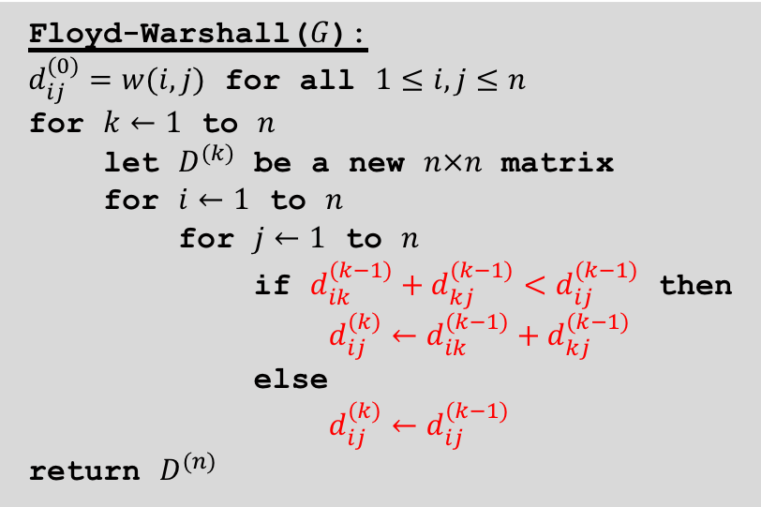
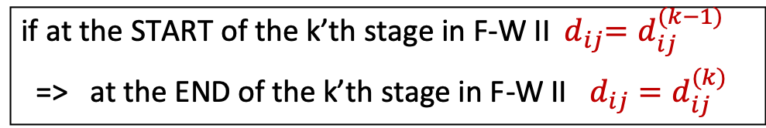
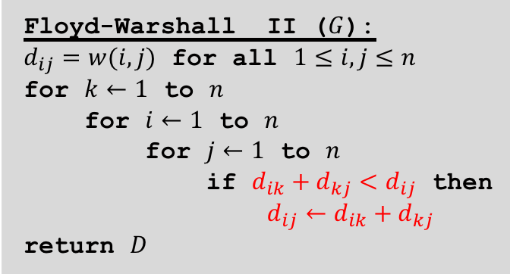
The Floyd-Warshall Algorithm
Floyd-Warshall($G$):
$d_{ij}^{(0)}=w(i,j)$ for all $1≤i,j≤n$ for $k←1$ to $n$
let $D^{(k)}$ be a new $n×n$ matrix
for $i←1$ to $n$
for $j←1$ to $n$
if $d_{ik}^{(k−1)}+d_{kj}^{(k−1)}<d_{ij}^{(k−1)}$ then
$d_{ij}^{(k)}←d_{ik}^{(k−1)}+d_{kj}^{(k−1)}$
else
$d_{ij}^{(k)}←d_{ij}^{(k−1)}$
return $D^{(n)}$
Floyd-Warshall II ($G$):
$d_{ij}=w(i,j)$ for all $1≤i,j≤n$ for $k←1$ to $n$
for $i←1$ to $n$
for $j←1$ to $n$
if $d_{ik}+d_{kj}<d_{ij}$ then
$d_{ij}←d_{ik}+d_{kj}$
return $D$
Surprising discovery: If we just drop all the superscripts, i.e., the algorithm just uses one $n×n$ array $D$=> the algorithm still works! WHY?
We will show that
if at the START of the k’th stage in F-W II ${ d}_{ij}=d_{ij}^{(k−1)}$
=> at the END of the k’th stage in F-W II $d_{ij}=d_{ij}^{(k)}$
Note that if this statement is correct => at the very end of the algorithm, $d_{ij}{=d}_{ij}^{(n)}$ holds the correct answer

Slide 4
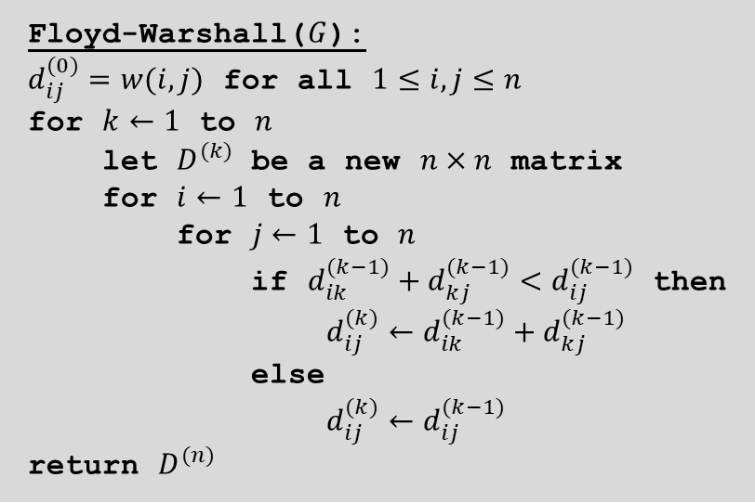
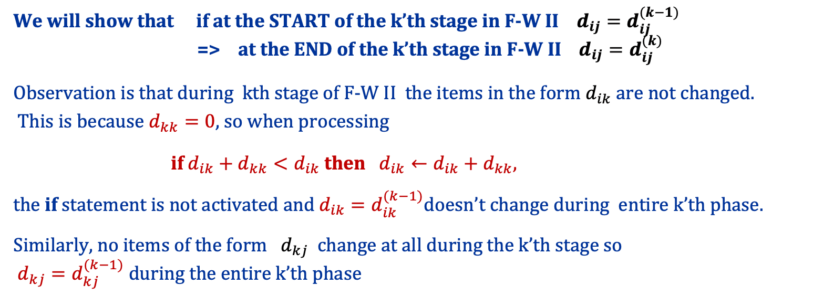
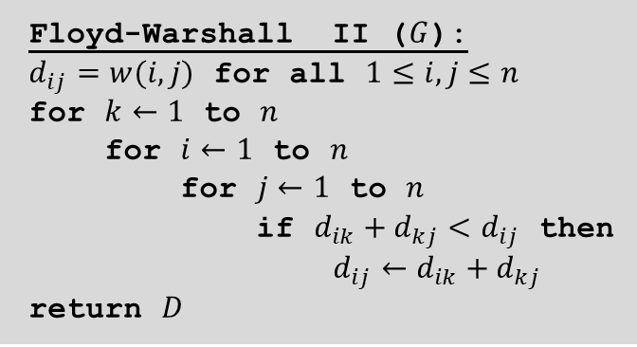
Floyd-Warshall($G$):
$d_{ij}^{(0)}=w(i,j)$ for all $1≤i,j≤n$ for $k←1$ to $n$
let $D^{(k)}$ be a new $n×n$ matrix
for $i←1$ to $n$
for $j←1$ to $n$
if $d_{ik}^{(k−1)}+d_{kj}^{(k−1)}<d_{ij}^{(k−1)}$ then
$d_{ij}^{(k)}←d_{ik}^{(k−1)}+d_{kj}^{(k−1)}$
else
$d_{ij}^{(k)}←d_{ij}^{(k−1)}$
return $D^{(n)}$
Floyd-Warshall II ($G$):
$d_{ij}=w(i,j)$ for all $1≤i,j≤n$ for $k←1$ to $n$
for $i←1$ to $n$
for $j←1$ to $n$
if $d_{ik}+d_{kj}<d_{ij}$ then
$d_{ij}←d_{ik}+d_{kj}$
return $D$
We will show that if at the START of the k’th stage in F-W II $d_{ij}=d_{ij}^{(k−1)}$ => at the END of the k’th stage in F-W II $d_{ij}=d_{ij}^{(k)}$
Observation is that during kth stage of F-W II the items in the form $d_{ik}$ are not changed. This is because $d_{kk}=0$, so when processing
if $d_{ik}+d_{kk}<d_{ik}$ then $d_{ik}←d_{ik}+d_{kk},$
the if statement is not activated and $d_{ik}=d_{ik}^{(k−1)}$doesn’t change during entire k’th phase.
Similarly, no items of the form ${ d}_{kj}$ change at all during the k’th stage so $d_{kj}=d_{kj}^{(k−1)}$ during the entire k’th phase

Slide 5

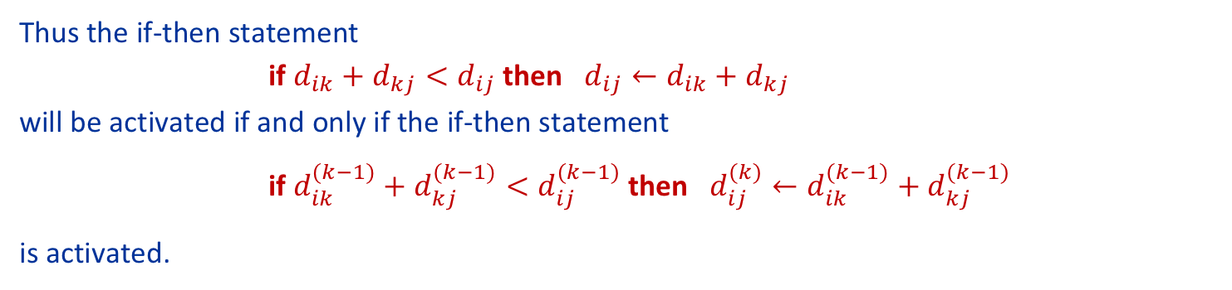
Floyd-Warshall($G$):
$d_{ij}^{(0)}=w(i,j)$ for all $1≤i,j≤n$ for $k←1$ to $n$
let $D^{(k)}$ be a new $n×n$ matrix
for $i←1$ to $n$
for $j←1$ to $n$
if $d_{ik}^{(k−1)}+d_{kj}^{(k−1)}<d_{ij}^{(k−1)}$ then
$d_{ij}^{(k)}←d_{ik}^{(k−1)}+d_{kj}^{(k−1)}$
else
$d_{ij}^{(k)}←d_{ij}^{(k−1)}$
return $D^{(n)}$
Floyd-Warshall II ($G$):
$d_{ij}=w(i,j)$ for all $1≤i,j≤n$ for $k←1$ to $n$
for $i←1$ to $n$
for $j←1$ to $n$
if $d_{ik}+d_{kj}<d_{ij}$ then
$d_{ij}←d_{ik}+d_{kj}$
return $D$
We will show that if at the START of the k’th stage in F-W II $d_{ij}=d_{ij}^{(k−1)}$ => at the END of the k’th stage in F-W II $d_{ij}=d_{ij}^{(k)}$
Just saw that during the entire k’th phase $d_{ik}=d_{ik}^{(k−1)}$ and $d_{kj}=d_{kj}^{(k−1)}$.
Thus the if-then statement if $d_{ik}+d_{kj}<d_{ij}$ then $d_{ij}←d_{ik}+d_{kj}$ will be activated if and only if the if-then statement
if $d_{ik}^{(k−1)}+d_{kj}^{(k−1)}<d_{ij}^{(k−1)}$ then $d_{ij}^{(k)}←d_{ik}^{(k−1)}+d_{kj}^{(k−1)}$
is activated.
=> at the end of the phase $d_{ij}=d_{ij}^{(k)}$

