Slide 1
Max Flow Matching Algorithm
Version of April 29, 2019

Slide 2
Bipartite Matching Example
X
Y
X
Y
1
1'
1
1'
2
2'
2
2'
3
3'
3
3'
4
4'
4
4'
5
5'
5
5'
Matching
1-2', 3-1', 4-5'
Max Matching
1-1', 2-2', 3-3' 4-4'

Slide 3
Bipartite Matching Example
X
Y
1
1'
Find a
Maximum Bipartite Matching
in the graph using the Max-Flow Method
taught in class
2
2'
3
3'
4
4'
5
5'

Slide 4
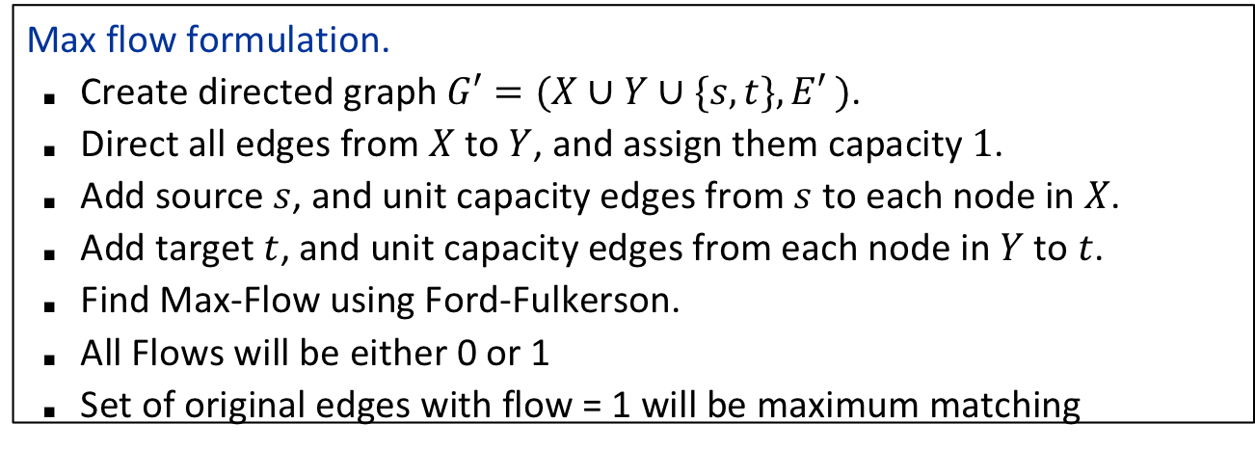




From bipartite matching to flow
Max flow formulation.
Create directed graph $G′=(X∪Y∪\{s, t\}, E′ )$.
Direct all edges from $X$ to $Y$, and assign them capacity $1$.
Add source $s$, and unit capacity edges from $s$ to each node in $X$.
Add target $t$, and unit capacity edges from each node in $Y$ to $t$.
Find Max-Flow using Ford-Fulkerson.
All Flows will be either 0 or 1
Set of original edges with flow = 1 will be maximum matching
$$G′$$
1
$$1$$
1'
1
2
2'
1
s
3
3'
t
4
4'
$$X$$
5
5'
$$Y$$

Slide 5
0/1
All edges will have capacity 1.
Graph starts with flow 0 on every edge.
1
1'
0/1
0/1
0/1
2
0/1
2'
0/1
0/1
0/1
0/1
0/1
0/1
s
3
3'
t
0/1
0/1
0/1
0/1
4
4'
0/1
0/1
0/1
0/1
5
5'
0/1
Important Observation.
All of the capacities are integers.
=> All flows and residual capacities created by the F-F algorithm will be integers.
In particular, since all original capacities are 1, all flows are either 0 or 1.
=> In intermediate residual graphs, every edge e appears
either in original direction with capacity 1 (when f(e)=0) or in reverse direction with capacity 1 (when f(e)=1)
No edge appears in BOTH directions.

Slide 6
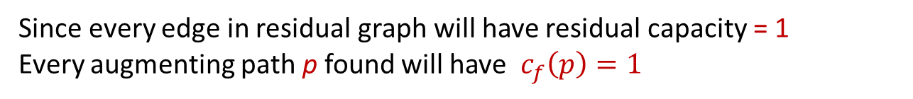
0/1
All edges will have capacity 1.
Graph starts with flow 0 on every edge.
1
1'
0/1
0/1
0/1
2
0/1
2'
0/1
0/1
0/1
0/1
0/1
0/1
s
3
3'
t
0/1
0/1
0/1
0/1
4
4'
0/1
0/1
0/1
0/1
5
5'
0/1
=> In intermediate residual graphs, every edge e appears
either in original direction with capacity 1 (when f(e)=0) or in reverse direction with capacity 1 (when f(e)=1)
Since every edge in residual graph will have residual capacity = 1
Every augmenting path p found will have $c_{f}\left(p\right)=1$

Slide 7
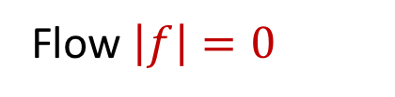
0/1
Flow $\left|f\right|=0$
1
1'
0/1
0/1
0/1
2
0/1
2'
0/1
0/1
0/1
0/1
0/1
0/1
s
3
3'
t
0/1
0/1
0/1
0/1
4
4'
0/1
0/1
0/1
0/1
5
5'
0/1
Residual Network & Augmenting Path
1
1
1'
1
1
1
2
1
2'
1
1
1
1
1
s
3
3'
t
1
1
1
1
4
4'
1
1
1
1
5
5'
1

Slide 8
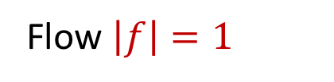
0/1
Flow $\left|f\right|=1$
1
1'
1/1
1/1
0/1
2
0/1
2'
1/1
0/1
0/1
0/1
0/1
0/1
s
3
3'
t
0/1
0/1
0/1
0/1
4
4'
0/1
0/1
0/1
0/1
5
5'
0/1
Residual Network & Augmenting Path
1
1
1'
1
1
1
Note that edges from old augmenting path flipped direction.
2
1
2'
1
1
1
1
1
s
3
3'
t
1
1
1
1
Green edges will denote flipped direction
4
4'
1
1
1
1
5
5'
1

Slide 9
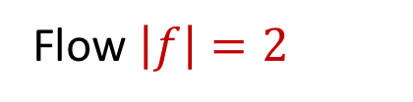
0/1
Flow $\left|f\right|=2$
1
1'
1/1
1/1
1/1
2
0/1
2'
1/1
0/1
1/1
1/1
0/1
0/1
s
3
3'
t
0/1
0/1
0/1
0/1
4
4'
0/1
0/1
0/1
0/1
5
5'
0/1
Residual Network & Augmenting Path
1
1
1'
1
1
1
2
1
2'
1
1
1
1
1
s
3
3'
t
1
1
1
1
4
4'
1
1
1
1
5
5'
1

Slide 10
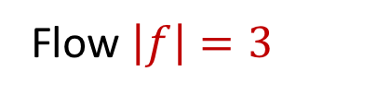
0/1
Flow $\left|f\right|=3$
1
1'
1/1
1/1
1/1
2
0/1
2'
1/1
0/1
1/1
1/1
0/1
0/1
s
3
3'
t
1/1
0/1
0/1
0/1
4
4'
0/1
0/1
1/1
1/1
5
5'
0/1
Residual Network & Augmenting Path
1
1
1'
1
1
1
Note that there is no augmenting path of length 3!
2
1
2'
1
1
1
1
1
s
3
3'
t
1
1
1
1
4
4'
1
1
1
1
5
5'
1

Slide 11
0/1
Flow $\left|f\right|=3$
1
1'
1/1
1/1
1/1
2
0/1
2'
1/1
0/1
1/1
1/1
0/1
0/1
s
3
3'
t
1/1
0/1
0/1
0/1
4
4'
0/1
0/1
1/1
1/1
5
5'
0/1
Residual Network & Augmenting Path
1
1
1'
1
1
1
Note that there is no augmenting path of length 3!
2
1
2'
1
1
1
1
1
s
3
3'
t
1
1
1
1
4
4'
This augmenting path will both delete edges from matching and add edges to matching.
1
1
1
1
5
5'
1

Slide 12
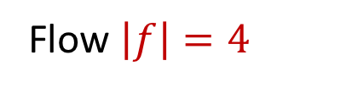
1/1
Flow $\left|f\right|=4$
1
1'
0/1
1/1
1/1
2
0/1
2'
1/1
0/1
0/1
1/1
1/1
1/1
s
3
3'
t
1/1
1/1
0/1
0/1
4
4'
1/1
0/1
0/1
1/1
5
5'
1/1
Residual Network & Augmenting Path
1
1
1'
1
1
1
No augmenting path exists.
This is a Max-Flow
2
1
2'
1
1
1
1
1
s
3
3'
t
1
1
1
1
4
4'
1
1
1
1
5
5'
1

Slide 13
1/1
Flow $\left|f\right|=4$
1
1'
0/1
1/1
1/1
2
0/1
2'
1/1
0/1
0/1
Max Matching
is the 4 (red) edges with flow = 1
1/1
1/1
1/1
s
3
3'
t
1/1
1/1
0/1
0/1
4
4'
1/1
0/1
0/1
1/1
5
5'
1/1
Residual Network & Augmenting Path
1
1
1'
1
1
1
No augmenting path exists.
This is a Max-Flow
2
1
2'
1
1
1
1
1
s
3
3'
t
1
1
1
1
4
4'
1
1
1
1
5
5'
1

Slide 14
Another look
It is instructive to look at the flows created step-by-step in the algorithm and the corresponding matchings they define.
The matching edges will be defined by the middle edges that have non-zero flow pushed across them
The first three augmenting paths will each add one new edge to the matching without removing any of the old edges
The last augmenting path will REMOVE all three old edges and create four new matching edges to replace them.

Slide 15
0/1
Flow $\left|f\right|=0$
1
1'
0/1
0/1
0/1
2
0/1
2'
0/1
0/1
0/1
0/1
0/1
0/1
s
3
3'
t
0/1
0/1
0/1
0/1
4
4'
0/1
0/1
0/1
0/1
5
5'
0/1
Consider Flows and Corresponding Matchings
1
1'
2
2'
3
3'
4
4'
5
5'

Slide 16
0/1
Flow $\left|f\right|=1$
1
1'
1/1
1/1
0/1
2
0/1
2'
1/1
0/1
0/1
0/1
0/1
0/1
s
3
3'
t
0/1
0/1
0/1
0/1
4
4'
0/1
0/1
0/1
0/1
5
5'
0/1
Consider Flows and Corresponding Matchings
1
1'
2
2'
3
3'
4
4'
5
5'

Slide 17
0/1
Flow $\left|f\right|=2$
1
1'
1/1
1/1
1/1
2
0/1
2'
1/1
0/1
1/1
1/1
0/1
0/1
s
3
3'
t
0/1
0/1
0/1
0/1
4
4'
0/1
0/1
0/1
0/1
5
5'
0/1
Consider Flows and Corresponding Matchings
1
1'
2
2'
3
3'
4
4'
5
5'

Slide 18
0/1
Flow $\left|f\right|=3$
1
1'
1/1
1/1
1/1
2
0/1
2'
1/1
0/1
1/1
1/1
0/1
0/1
s
3
3'
t
1/1
0/1
0/1
0/1
4
4'
0/1
0/1
1/1
1/1
5
5'
0/1
Consider Flows and Corresponding Matchings
1
1'
2
2'
3
3'
4
4'
5
5'

Slide 19
1/1
Flow $\left|f\right|=4$
1
1'
0/1
1/1
1/1
2
0/1
2'
1/1
0/1
0/1
1/1
1/1
1/1
s
3
3'
t
1/1
1/1
0/1
0/1
4
4'
1/1
0/1
0/1
1/1
5
5'
1/1
Consider Flows and Corresponding Matchings
1
1'
2
2'
3
3'
4
4'
5
5'

