Slide 1
The Taxi Scheduling Problem
Version of 18/04/2019

Slide 2
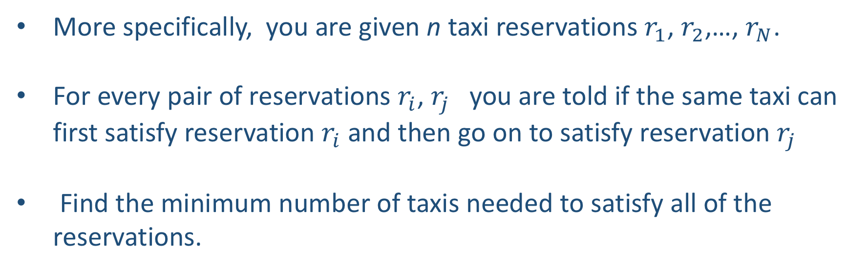
The Problem
Consider a taxi company that has received many reservations
It wants to calculate the minimum number of taxis it will need to service all of those requests. How can it do this?
More specifically, you are given n taxi reservations $r_{1}$, $r_{2}$,…, $r_{N}$.
For every pair of reservations $r_{i}$, $r_{j}$ you are told if the same taxi can first satisfy reservation $r_{i}$ and then go on to satisfy reservation $r_{j}$
Find the minimum number of taxis needed to satisfy all of the reservations.

Slide 3
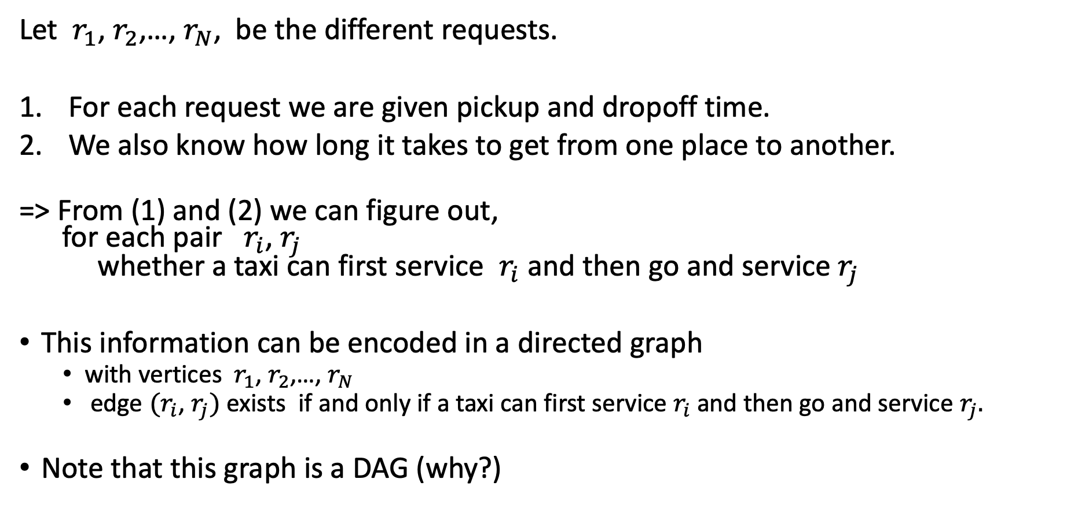
A Graph Representation
Let $r_{1}$, $r_{2}$,…, $r_{N}$, be the different requests.
For each request we are given pickup and dropoff time.
We also know how long it takes to get from one place to another.
=> From (1) and (2) we can figure out, for each pair $r_{i}$, $r_{j}$ whether a taxi can first service $r_{i}$and then go and service $r_{j}$
This information can be encoded in a directed graph
with vertices $r_{1}$, $r_{2}$,…, $r_{N}$
edge ${(r}_{i}$, $r_{j})$ exists if and only if a taxi can first service${ r}_{i}$and then go and service $r_{j}.$
Note that this graph is a DAG (why?)

Slide 4
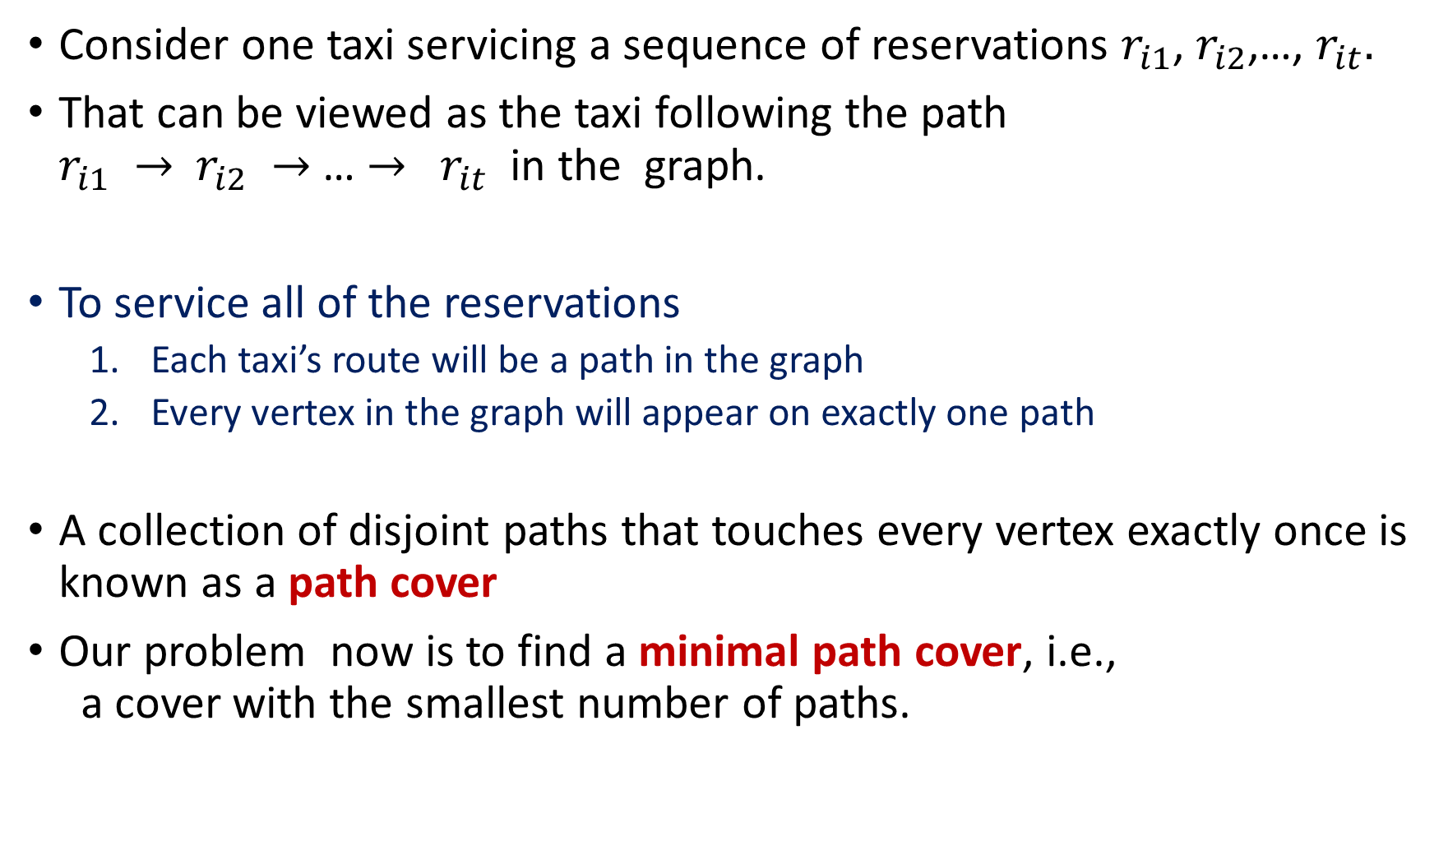
Consider one taxi servicing a sequence of reservations $r_{i1}$, $r_{i2}$,…, $r_{it}.$
That can be viewed as the taxi following the path $r_{i1} →$ $r_{i2} →$… $→$ $r_{it}$ in the graph.
To service all of the reservations
Each taxi’s route will be a path in the graph
Every vertex in the graph will appear on exactly one path
A collection of disjoint paths that touches every vertex exactly once is known as a path cover
Our problem now is to find a minimal path cover, i.e., a cover with the smallest number of paths.

Slide 5
r
2
5
e
3
t
x
6
4
7
The smallest path cover for this DAG has size 3

Slide 6
r
2
5
e
3
t
x
6
4
7
The smallest path cover for this DAG has size 3
Note: the smallest path cover is not necessarily unique. There are other path covers of size 3

Slide 7
r
Suppose that after finding the path cover we removed all the edges and then reinserted the path edges one at a time, in any order.
2
5
e
3
t
x
6
# paths
# path edges
4
7
10
0
Consider relationship between # paths and # path edges
9
1
8
2
7
3
At start, each vertex is in its own path, so there are N paths
6
4
5
5
Each new edge added combines two old paths, and thus decreases the number of paths by one
4
6
3
7

Slide 8
r
Suppose that after finding the path cover we removed all the edges and then reinserted the path edges one at a time, in any order.
2
5
e
3
t
x
6
# paths
# path edges
4
7
10
0
The total number of paths at the end is N – M, where M is the number of edges in the cover
=> reducing the number of paths is same as maximizing the number of edges added
9
1
8
2
7
3
6
4
5
5
Note that the only constraint on adding edges is that each vertex can have at most one edge entering it and one edge leaving it.
4
6
3
7

Slide 9
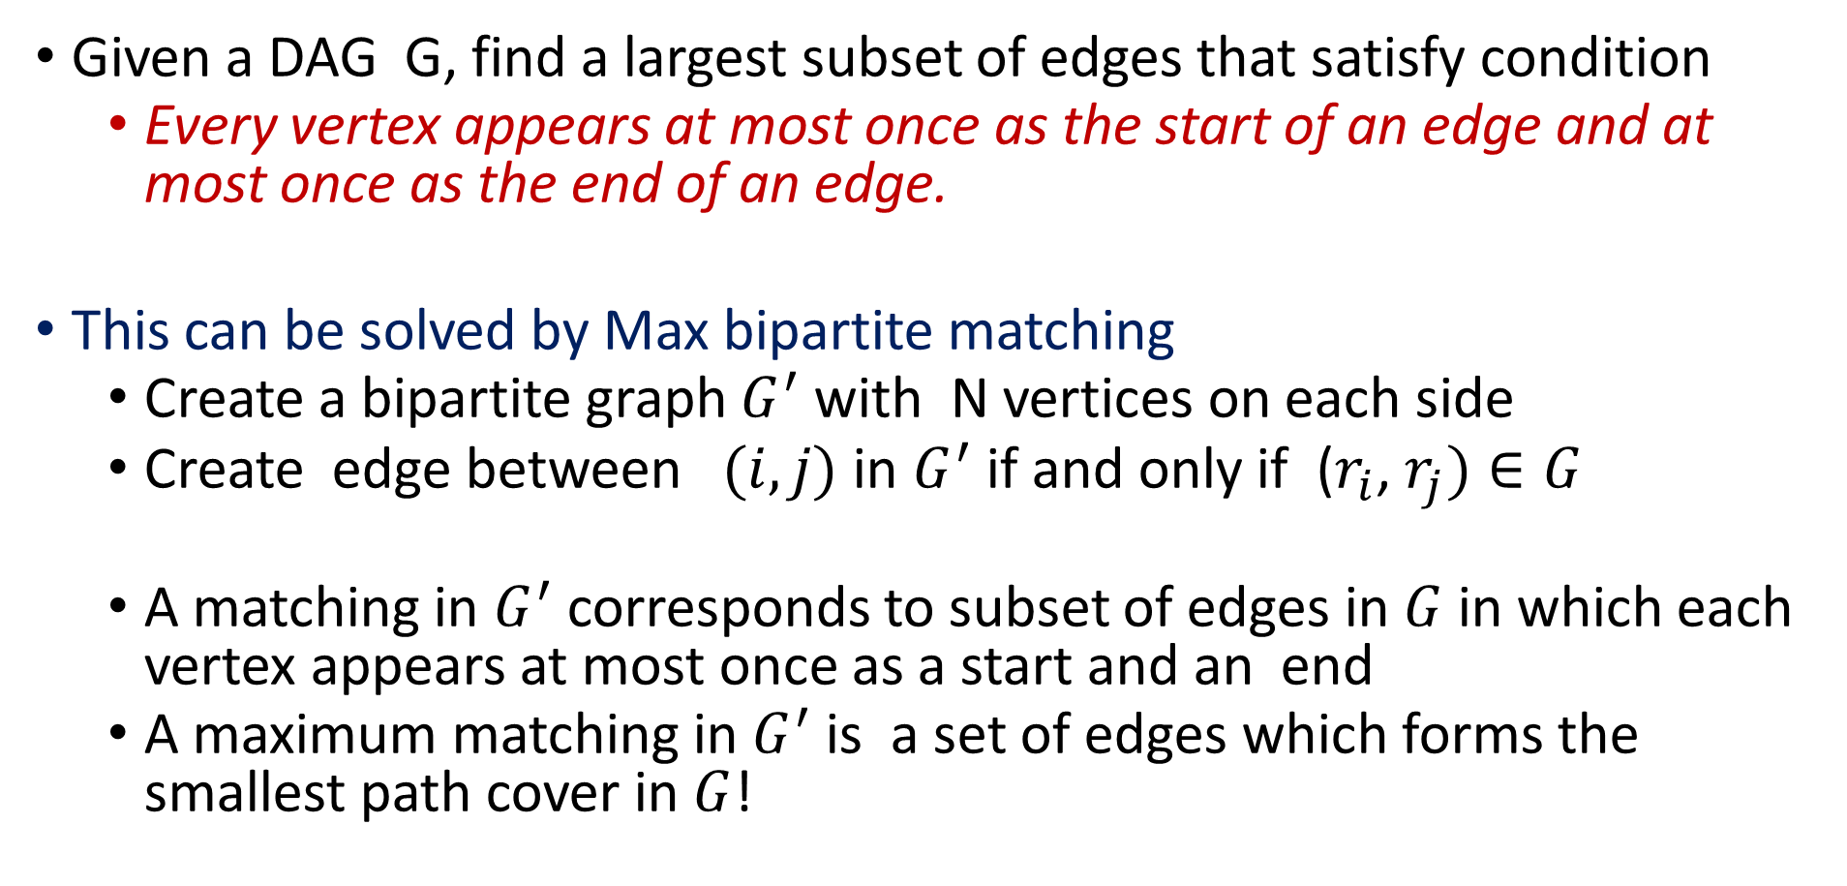
“New” Problem
Given a DAG G, find a largest subset of edges that satisfy condition
Every vertex appears at most once as the start of an edge and at most once as the end of an edge.
This can be solved by Max bipartite matching
Create a bipartite graph $G^{′}$ with N vertices on each side
Create edge between $(i,j)$ in $G^{′}$ if and only if ($r_{i}$, $r_{j})∈G$
A matching in $G^{′}$ corresponds to subset of edges in $G$ in which each vertex appears at most once as a start and an end
A maximum matching in $G^{′}$ is a set of edges which forms the smallest path cover in $G$!

Slide 10
r
2
5
r
r
e
e
e
3
t
x
2
2
6
3
3
4
7
4
4
5
5
6
6
t
t
7
7
x
x

Slide 11
r
2
5
r
r
e
e
e
3
t
x
2
2
6
3
3
4
7
4
4
The colored edges to the left are a maximal matching of the graph
5
5
6
6
t
t
7
7
x
x

Slide 12
r
2
5
r
r
e
e
e
3
t
x
2
2
6
3
3
4
7
4
4
The colored edges to the left are a maximal matching of the graph
They correspond to a minimal path cover!
5
5
6
6
t
t
7
7
x
x

Slide 13
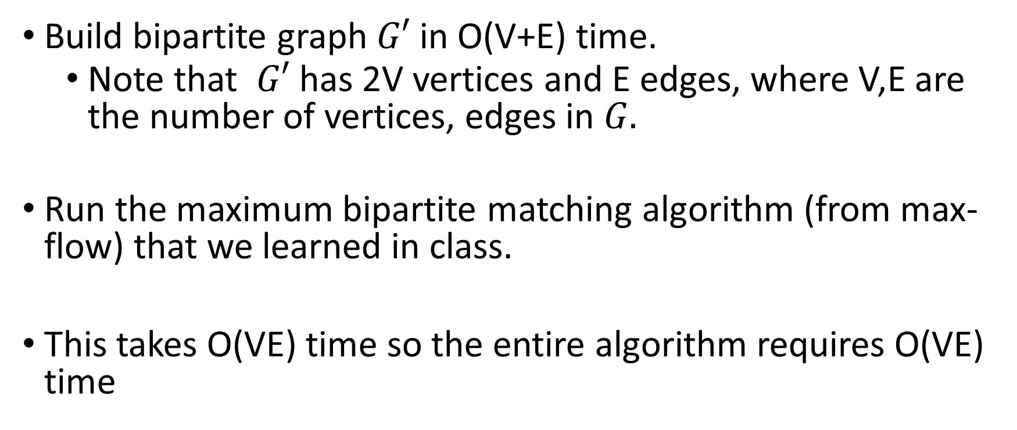
The Algorithm
Build bipartite graph $G′$ in O(V+E) time.
Note that $G′$ has 2V vertices and E edges, where V,E are the number of vertices, edges in $G.$
Run the maximum bipartite matching algorithm (from max-flow) that we learned in class.
This takes O(VE) time so the entire algorithm requires O(VE) time

