Slide 1
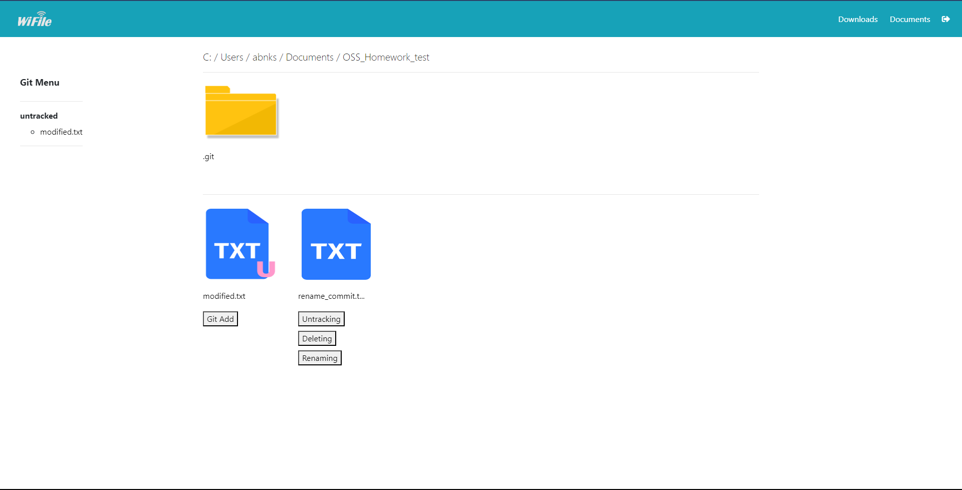
Git Menu Area
Git Init / Git commit
Git Status
Folder Area
File Area
Git version control menu

Slide 2




Untracked
Modified
Staged
Committed
Unmodified

Slide 3
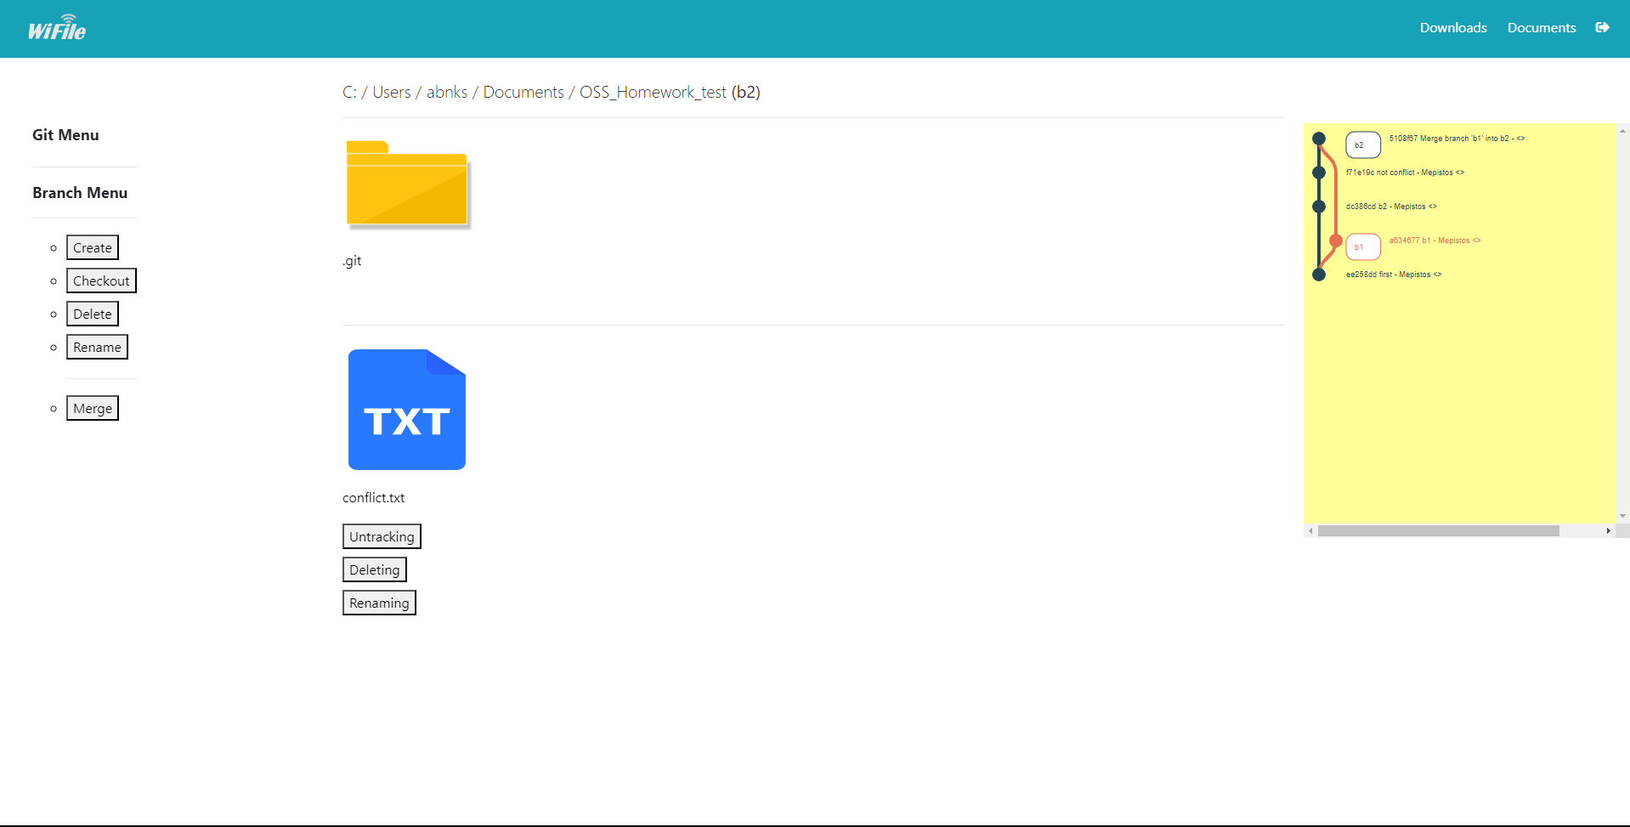
Git Menu Area
Branch Menu
Merge Button
Current Branch Name
Git History(log) Area

Slide 4
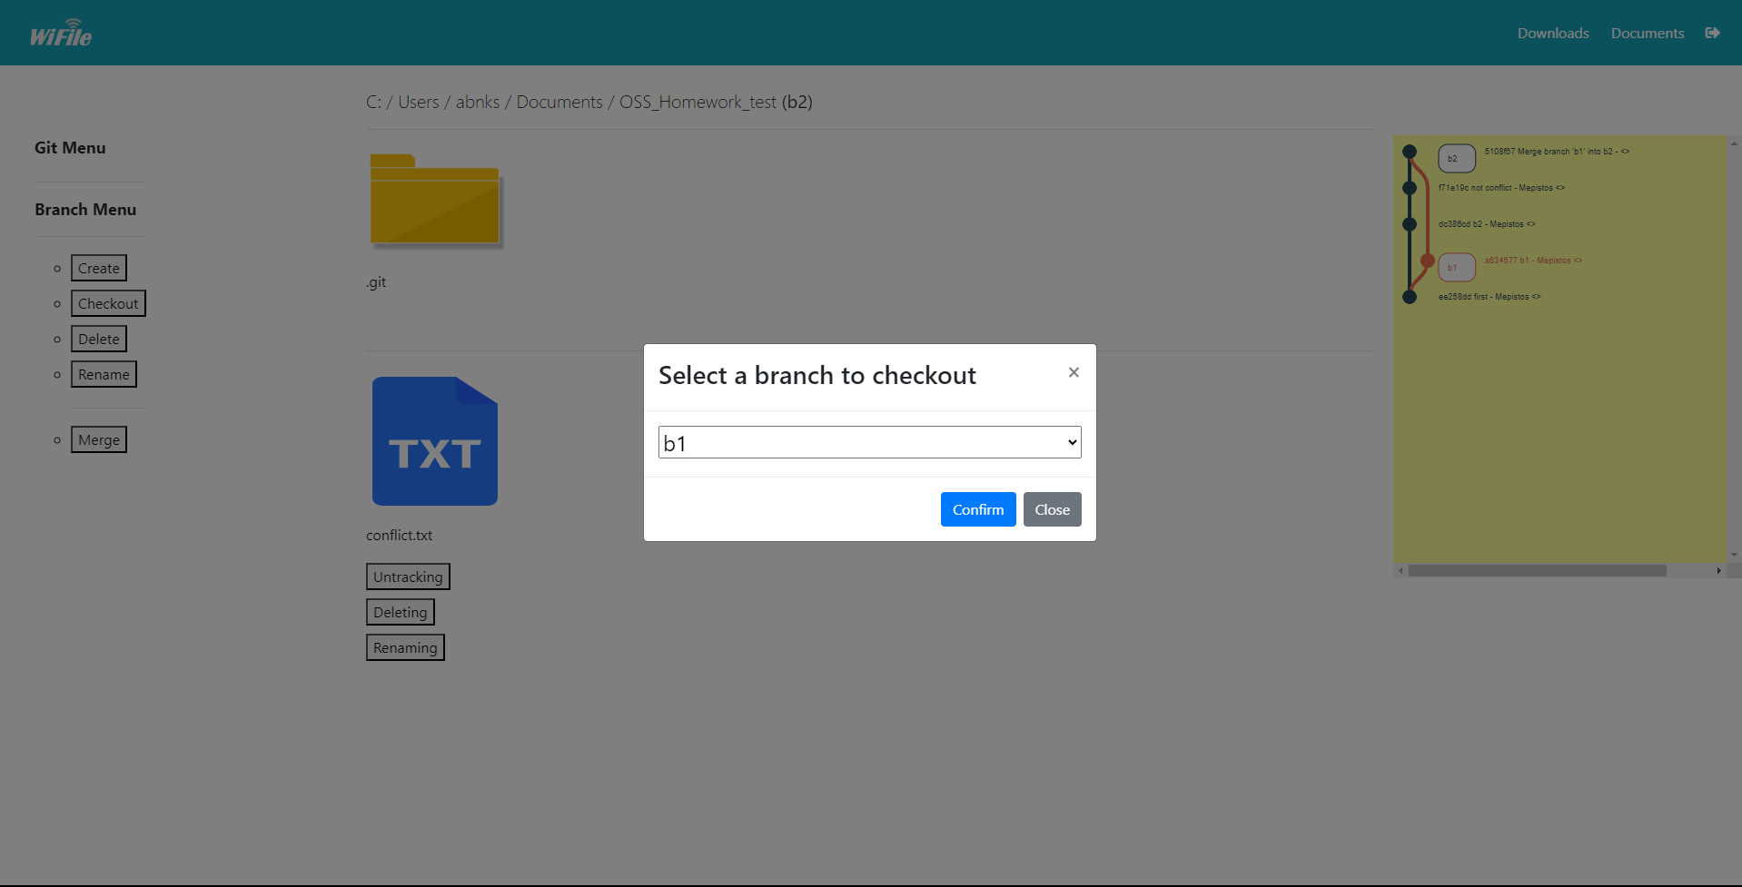
Branch Checkout Form

