Slide 1
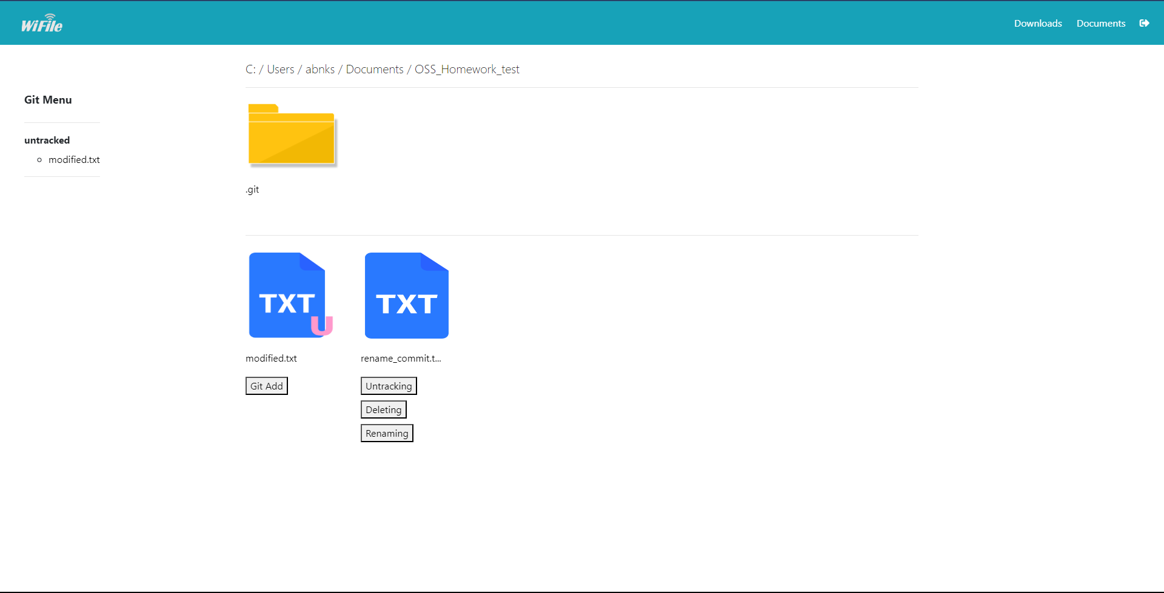
Git Menu Area
Git Init / Git commit
Git Status
Folder Area
File Area
Git version control menu

Slide 2




Untracked
Modified
Staged
Committed
Unmodified

