Slide 1
Face recognition and temperature detection using thermal images and convolutional neural networks
Presented by
Tuan
Posts and Telecommunications Institute of Technology (PTIT)
Oct., 2021
Notes:
Mobile Radio Communications Lab

Slide 2
Contents
1. Data
2. Methods
3. Simulations
4. Future works

Slide 3
1. Data
1.1) Grayscale thermal images
1.2) Raw thermal images

Slide 4
1.1) Grayscale thermal images
Terravic Facial Infrared Database.
Can be downloaded from
http://vcipl-okstate.org/pbvs/bench/
Face images of 20 people, but often only download 18 people.
107, 50, 70 images of each person used as training, validation, testing datasets.

Slide 5
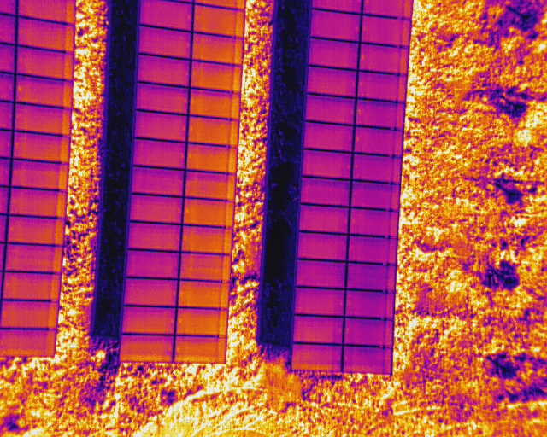
1.2) Raw thermal image
Due to lack of input data, only a raw thermal image is used for simulation as follows

Slide 6
2. Method
2.1) Face recognition
2.2) Temperature detection

Slide 7
2.1) Face recognition
Using a convolutional neural network to detection human faces.
Estimation of the model performance

Slide 8
2.2) Temperature detection
Calculation of temperature for each pixels of the raw thermal image.
The average temperature of entire pixels temperatures is considered as the object temperature.

Slide 9
3. Simulation results
3.1) Face recognition
3.2) Temperature detection

Slide 10
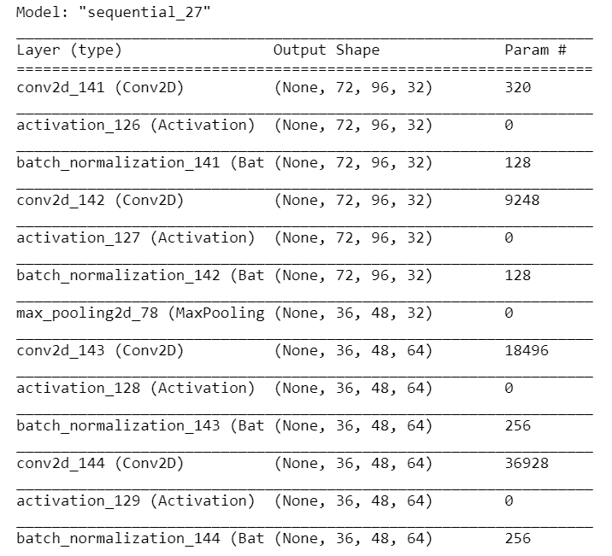
3.1) Face recognition
Performance parameters: Accuracy.

Slide 11
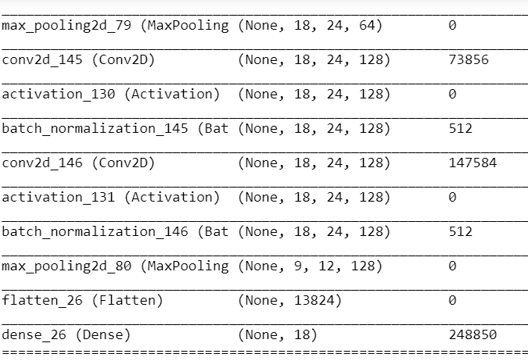
3.1) Face recognition

Slide 12
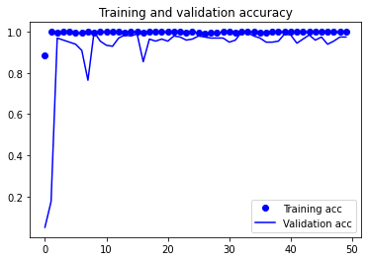
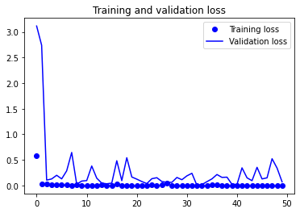
3.1) Face recognition
Train and validate the CNN model on training and validation datasets.
The epochs from 25-30 result stable accuracies as shown in above figures

Slide 13
3.1) Face recognition
The detection performance of the CNN model on testing dataset is 97%.

Slide 14
3.2) Temperature detection
The temperatures are computed for individual pixels of the thermal image.
The average temperature of all pixels is considered as the temperature of the object
The temperature of object in the given image is about 43 oC.

Slide 15
4) Future works
Collection of raw thermal images which can be used for face recognition and human temperature detection.
Improvement performance of the proposed model.
Application of intelligent algorithm to detection human face area (not entire image) for better temperature prediction and face recognition.

Slide 16
THANK YOU!

