Slide 1
runExperiment Thread
Start
Stir off
Measure FP, Temp, OD
sysData[M][‘OD’][‘ON’] == 1
Y
RegulateOD
N
Custom Program Thread
Start
CycleTime
sysData[M][‘Custom’][‘ON’] == 1
Y
elapsedTimeSeconds2
Stir on
N
Store all results in each array
Writing Results to data files
End
sleeptime
Sleep for the duration of sleeptime
Is it still going?
Y
runExperiment Thread
Start
N
End
time

Slide 2
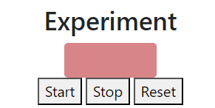
When experiment begins
ExperimentStartStop
Start
turnEverythingOff
Thermostat on
Thermostat Thread
Start
runExperiment start
runExperiment Thread
Start
Thermostat Thread
End
Y
Is it still going?
Start
Y
runExperiment Thread
N
Is it still going?
Start
End
N
Y
Thermostat Thread
End
Is it still going?
Start
Y
runExperiment Thread
N
Is it still going?
Start
End
N
Y
End
Is it still going?
Y
N
Is it still going?
End
N
End
time

Slide 3
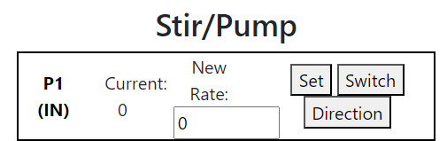
PumpModulation Thread
Start
When the pump starts running
sysDevices[M][item][‘active’] == 1
Y
Sleep for 0.02 seconds
N
In most cases
Y
Turn things off to begin
N
Is it off?
Y
End
cycletime
elapsedTimeSeconds
N
Turn on the pump in the direction of the target value
The target value of the pump1
Ontime
Sleep for the duration of Ontime
cycletime = sysData[M][‘Experiment’][‘cycleTime’]*1.05
The target value != 1
Y
Turn off the pump
Ontime = cycletime * abs(the target value)
N
currentThread == sysDevices[M][item][‘threadCount’]
is omitted
If Offtime > 0.0, sleep for the duration of Offtime
Offtime
Is it still going?
Y
PumpModulation Thread
Start
N
End
time

Slide 4
When experiment begins with the pump
PumpModulation Thread
ExperimentStartStop
Start
Start
turnEverythingOff
Y
PumpModulation Thread
Is it still going?
Start
Thermostat on
Thermostat Thread
N
End
Start
runExperiment start
runExperiment Thread
Y
Is it still going?
Start
Thermostat Thread
N
End
Y
End
Is it still going?
Start
Y
runExperiment Thread
N
Is it still going?
Start
End
N
Y
End
Is it still going?
Y
N
Is it still going?
End
N
End
time

Slide 5










If the target value < 1
$abs(\text{T}\text{he} \text{target} value)= \frac{Ontime}{cycletime}$
$\text{cycletime}≈Ontime+Offtime$
Original chibio pump
$\text{cycletime}$
On
Off
On
Off
time
$$Ontime$$
$$Offtime$$
Changed chibio pump
$abs(\text{T}\text{he} \text{target} value)= \frac{t_{on}}{period}$
$\text{cycletime}$
$period$
time
$$t_{on}$$
$$t_{off}$$

