Slide 1
28 x 28
3 X 3 X 32
Filters
28 X 28 X 32
Feature Maps
1 X 128
Dense
10 outputs
Flatten
Convolution layer

Slide 2
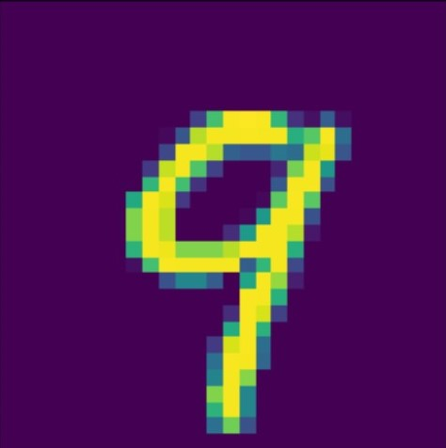
Weight 2
+
Weight 3 (bias)
Weight 4
+
Weight 5 (bias)
3 X 3 X 32
Filters
Weight 0 + weight 1
28 X 28 X 32
Feature Maps
10 outputs
Flatten
Convolution layer
1 X 128
Dense

Slide 3
TensorFlow 2.0
Graph-based mode
Eager mode
Keras API
Deep learning frameworks
Dynamic
Graph based

