Slide 1
Enabling Spatial Analysis – Point data to MultiPolygons
Presented by,
Sathwik Mohan Vangari
ML Engineer, Colaberry Inc.

Slide 2
Agenda
Motivation for a MultiPolygon
The approach
Points Vs Raster – Binary image
The concave hull – Creating an alpha shape
Multiple polygons – Combining the multiple polygons
The convex hull – The big picture
Unmapped area – Addressing the gaps
Shared boundary – bridging the gaps

Slide 3
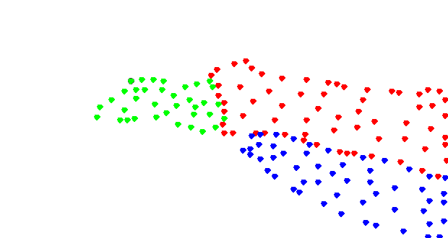
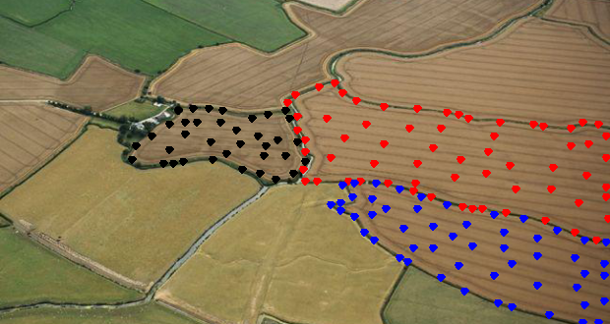
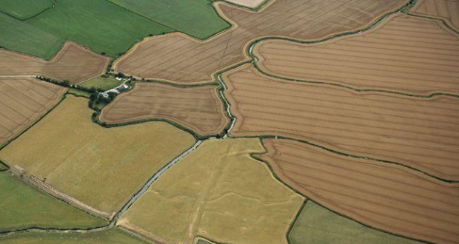
Motivation for a MultiPolygon
Comparable spatial characteristics
Space split by features
Enabling prediction of new samples
Use Cases
Fertilizers and crop yield
Organic food certification

Slide 4
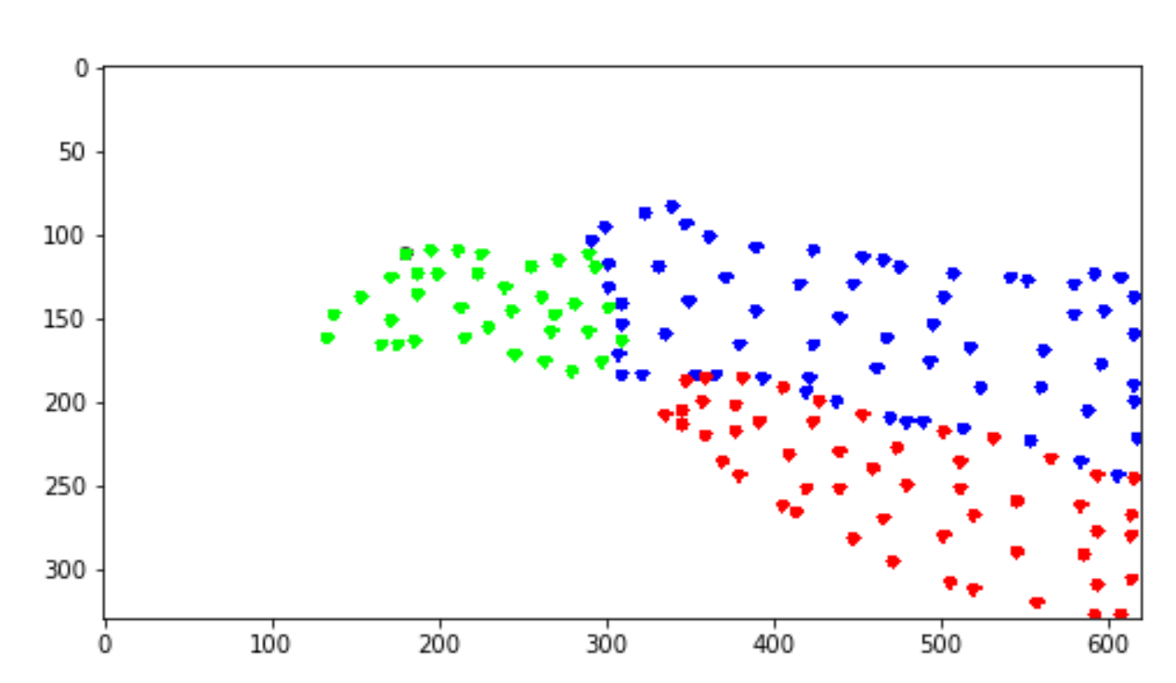
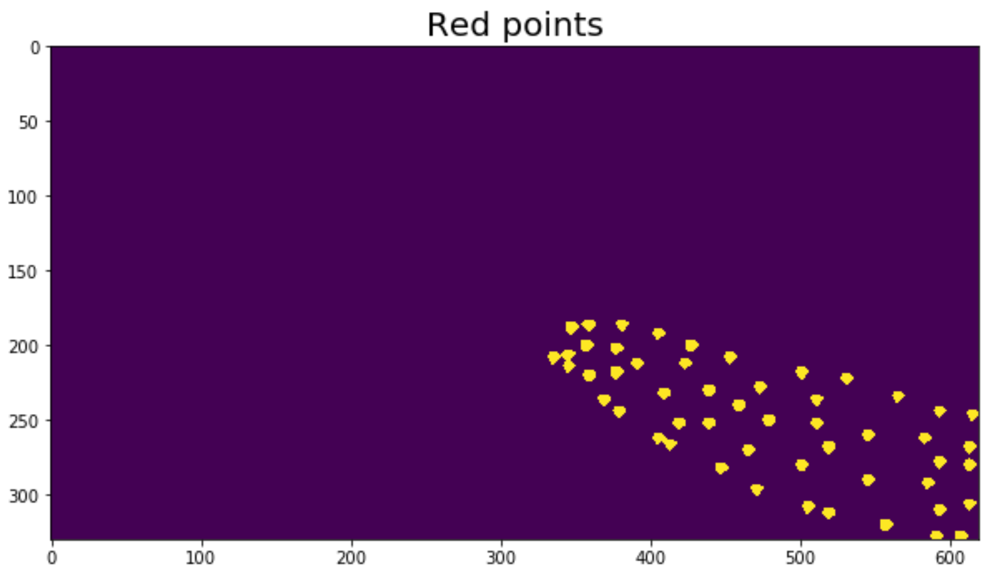
Points Vs Raster
Raster Image Binarized Image

Slide 5
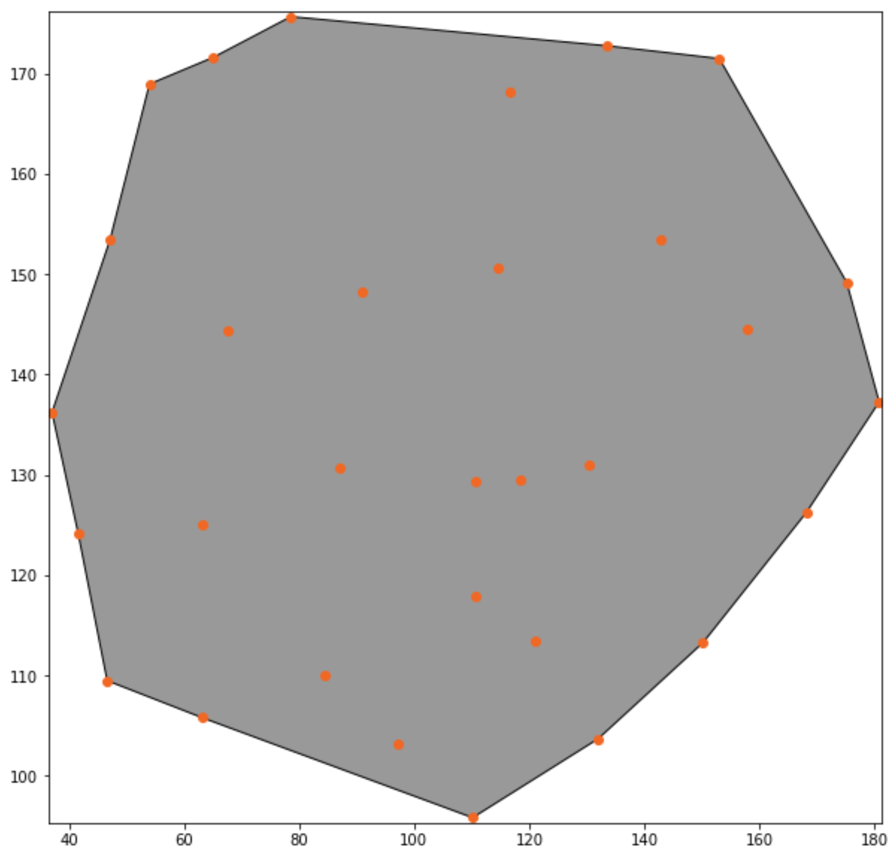
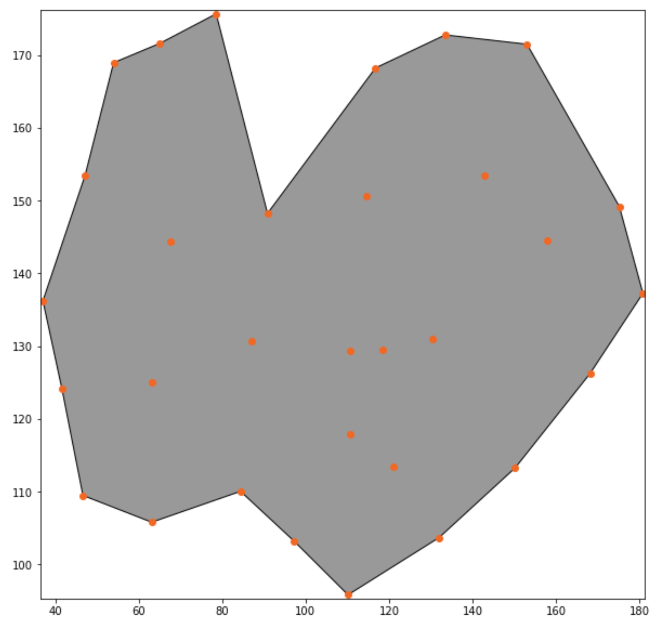
Concave hull
Minimizing area of enclosure
Alpha shape
alpha = 0.01
alpha = 0.055

Slide 6
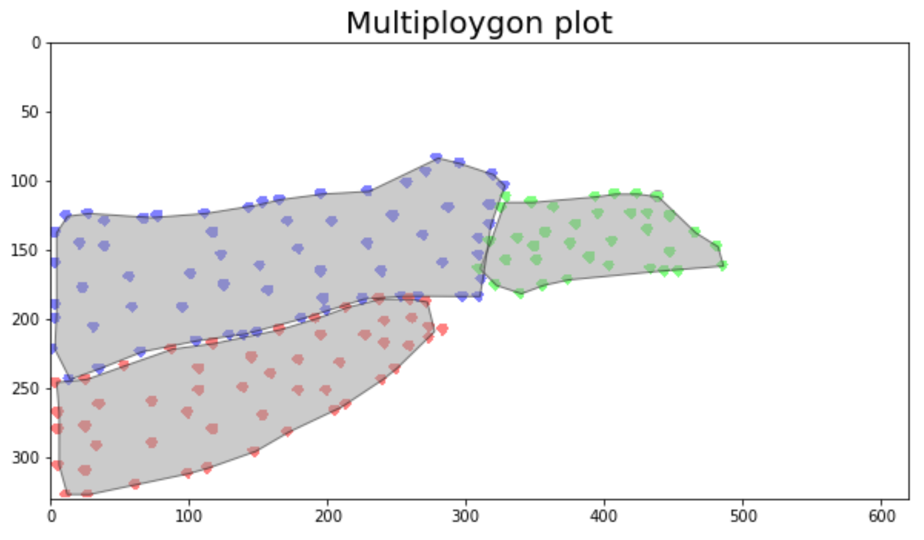
Multiple Polygons
Address the gaps to convert Multiple Polygons into a MultiPolygon

Slide 7
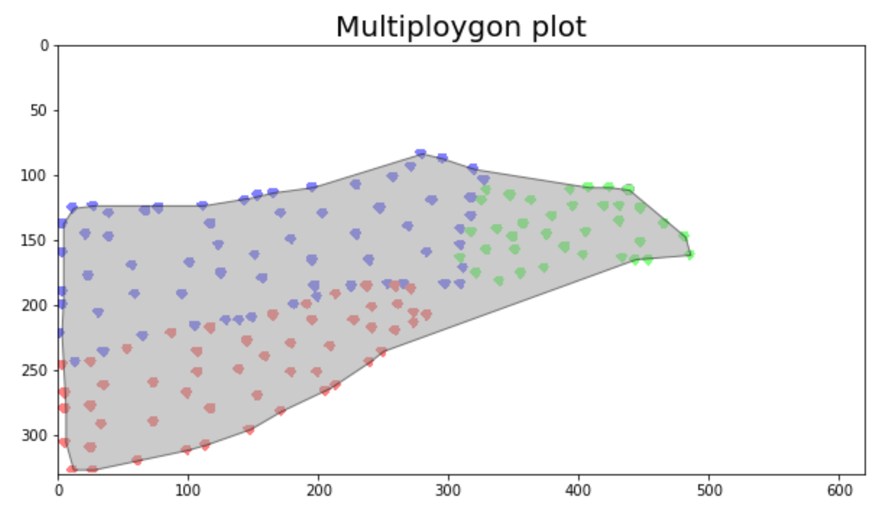
The big picture
A maximum area enclosure with all points irrespective of class

Slide 8
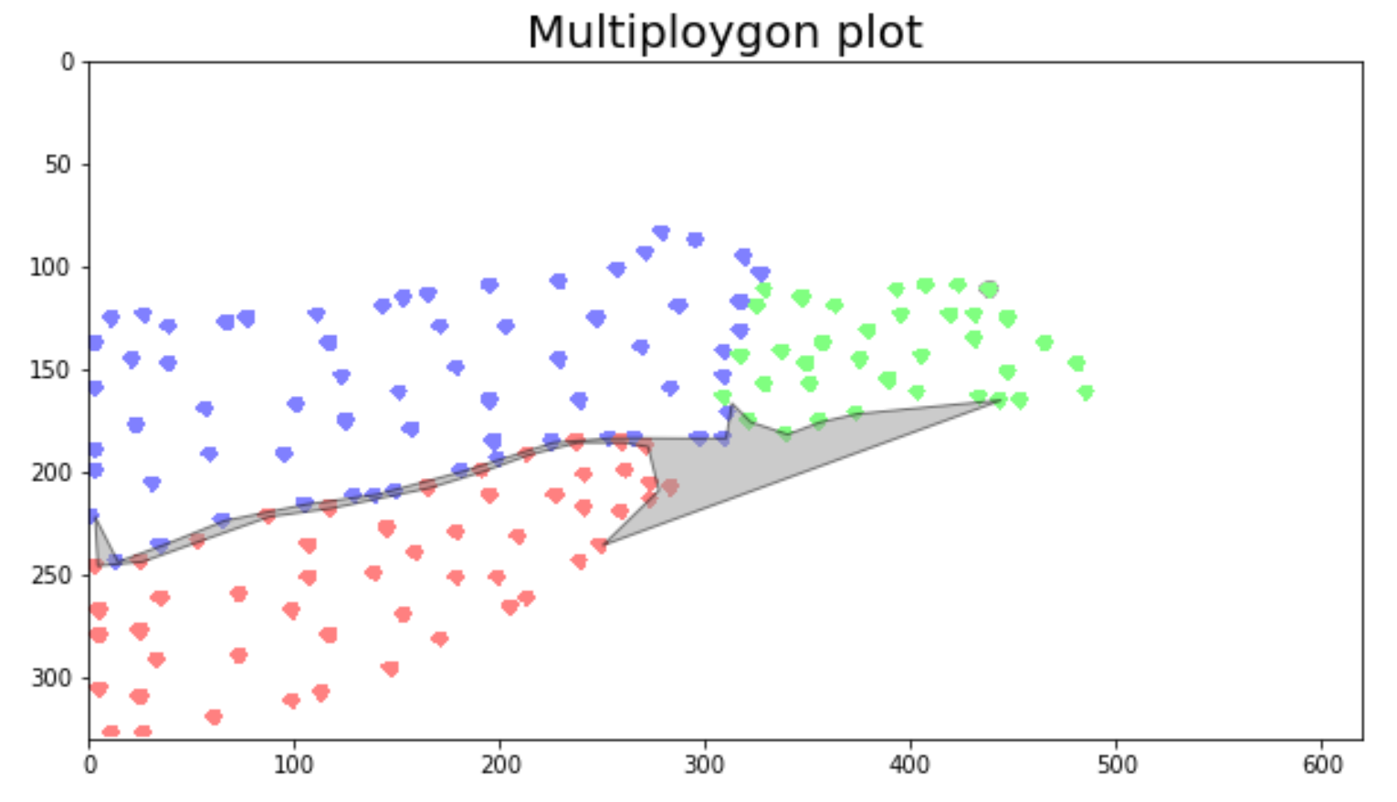
Unmapped area
Tackle the significant unmapped areas first

Slide 9
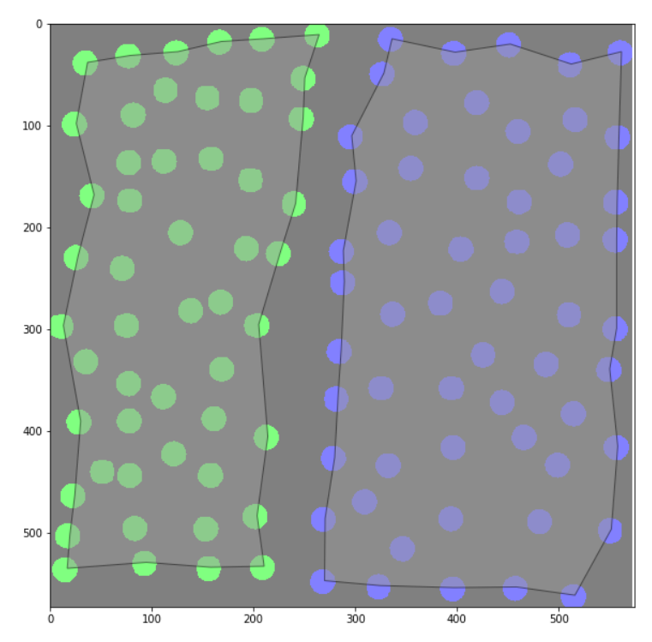
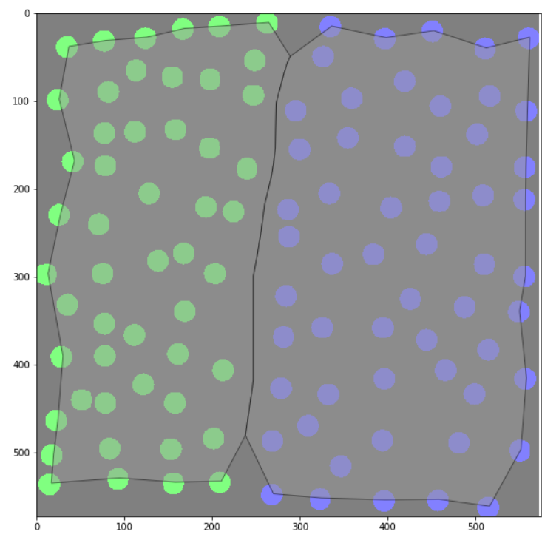
Shared Boundary – (1/2)
Before After

Slide 10
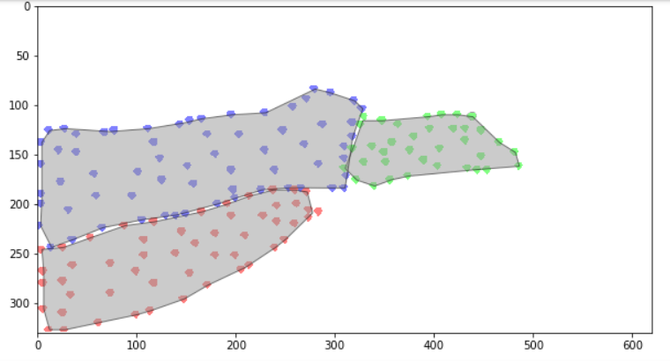
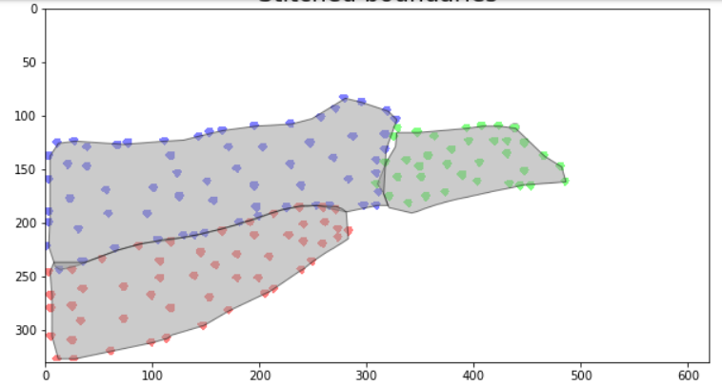
Shared Boundary – (2/2)
Before After

Slide 11
Thank you! Reach out to us: sathwik@colaberry.com pawan@colaberry.com Recommended access to the material: https://refactored.ai Notebook source code: https://github.com/colaberry/FOSS4GNA18

