Slide 1
Comparing Models
Imagine you have 2 different probabilistic classification models
  e.g. logistic regression vs Support vector Machine
How do you know which one is better?
How do you communicate your belief?
Can you provide quantitative evidence beyond a gut feeling and subjective interpretation?

Slide 2
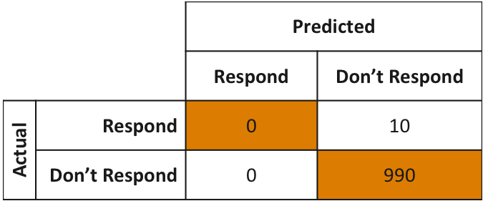
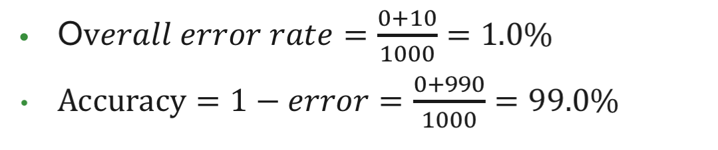
The Confusion Matrix

Slide 3

So What is a Confusion Matrix?
a: number of positive instances predicted as positive (true positive)
b: number of positive instances predicted as negative (false negative)
c: number of negative instances predicted as positive (false positive)
d: number of negative instances predicted as negative (true negative)

Slide 4
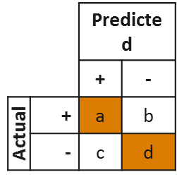



Confusion Matrix Terms
Accuracy: Proportion of correct predictions
Sensitivity (True Positive Rate): Proportion of positive cases correctly classified as positive
Specificity (True Negative Rate): Proportion of negative cases correctly classified as negative

Slide 5




Confusion Matrix Terms
False Positive Rate: Proportion of negative cases incorrectly
classified as positive
False Negative Rate: Proportion of positive cases incorrectly classified as negative
Precision: Proportion of predicted positive cases that were correctly classified

Slide 6
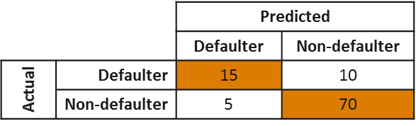
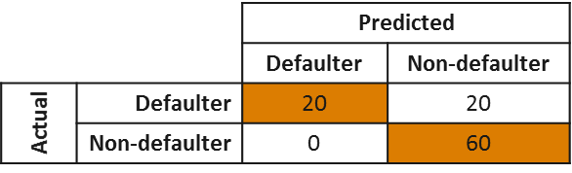












Confusion Matrix Example

Slide 7
Confusion Matrix Example
Assume:
  It costs our organization $20,000 when we loan to a defaulter
  We lose $5,000 in revenue when we refuse a loan to a non-defaulter
But what if:
  It costs our organization $4,000 when we loan to a defaulter
  We lose $10,000 in revenue when we refuse a loan to a non-defaulter

Slide 8
ROC Curves
Receiver operator characteristic
Summarize & present performance of any binary classification model
Models ability to distinguish between false & true positives

Slide 9
The Receiver Operating Characteristics (ROC) Curve
The Receiver Operating Characteristics (ROC) Curve is used in signal detection to characterize the tradeoff between hit rate and false alarm rate
Characterizes the performance of a model using a wide range of cutoff values
Plots performance of classifier in terms of its true positive (vertical axis) and false positive (horizontal axis) rates
True positive rate – the percentage of cases that are positive and are correctly predicted as positive among all the positive cases
False positive rate – the percentage of cases that are negative and are incorrectly predicted as positive among all negative cases

Slide 10
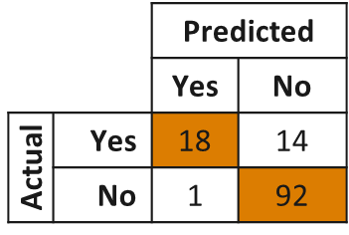
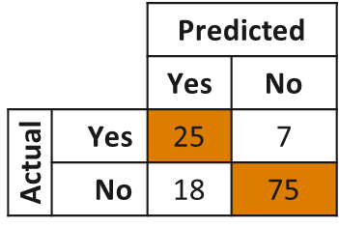







ROC Curve Example
Consider a T4 test used to predict whether patients have hypothyroidism which ranges from 0 to 14
Cutoff 1
If T4<5, then disease
Cutoff 2
If T4<7, then disease
Cutoff 3
If T4<9, then disease

Slide 11






ROC Curve Example
What about extreme values for cutoffs?
Cutoff 0
If T4<0, then disease
Cutoff 3
If T4<14, then disease

Slide 12
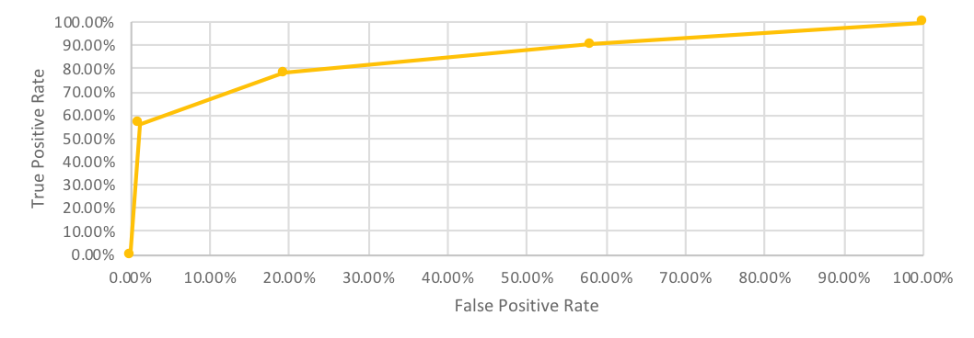
ROC Curve Example
Cutoff | True Positive Rate | False Positive Rate
Very Low | 0.00% | 0.00%
5 | 56.25% | 1.08%
7 | 78.25% | 19.35%
9 | 90.63% | 58.06%
Very High | 100.00% | 100.00%

Slide 13
Key Aspects of the ROC Curve
Perfect
Prediction
Predict
all “1”
True Positive Rate
Below the diagonal → Worse than random guessing
Predict
all “0”
False Positive Rate

Slide 14
Accuracy
What does this mean?
What is the difference between “accuracy” and an “accurate prediction”?
Table Interpretation
(True Positives) + (True Negatives)
(True Positives) + (True Negatives)
+ (False Positives) + (False Negatives)

