Slide 1
Agenda
Python Overview
Variables, Operators and Assignments
Data Types

Slide 2
Questions and Answers
How do we communicate with the computer?
Programming languages
How do we get computers to perform complicated tasks?
Tasks are broken down into a sequence of instructions
Why Python?
Powerful, easy to download, write and read, Object Oriented

Slide 3
Questions and Answers
How did the language Python get its name?
Named for the British comedy group Monty Python (really!)
What is an interpreted language?
Uses an interpreter, translates high-level language one statement at a time into machine language and then runs

Slide 4
Questions and Answers
What are the meanings of the terms “programmer” and “user”?
Programmer: a person who solves problems by writing programs on a computer
User: any person who runs a program
What is the meaning of the term “code”?
Python statements that the programmer writes

Slide 5
Questions and Answers
Are there certain characteristics that all programs have in common?
Input, processing, output
What are the meanings of the terms “hardware” and “software”?
Hardware: physical components of the computer
Software: the programs

Slide 6
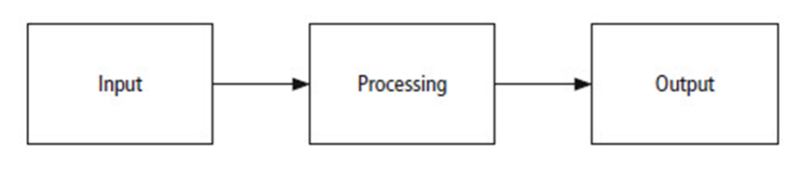
Program Development Cycle
The problem solving process.

Slide 7
Program Planning
Analyze: Define the problem.
Design: Plan the solution to the problem.
Code: Translate the algorithm into a programming language.
Test and correct: Locate and remove any errors in the program.
Complete the documentation: Organize all the material that describes the program.

Slide 8
Data Types, Variables, Functions

Slide 9
Numbers
Arithmetic Operators
Addition, subtraction, multiplication, division, and exponentiation.
Result of a division is always a float
Result of the other operations is a float if …
Either of the numbers is a float
Otherwise is an int.

Slide 10
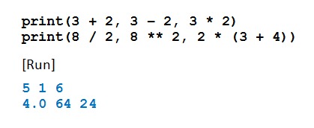
The print Function
Used to display numbers on the monitor
If n is a number, print(n) displays number n.
The print function can display the result of evaluated expressions
A single print function can display several values
Example : Program demonstrates operations

Slide 11
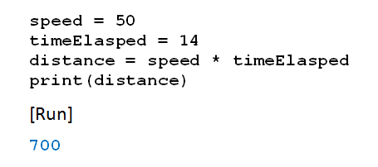
Variables
In mathematics problems, quantities are referred to by names
Names given to the values are called variables
Example: Program uses speed, time … calculates distance

Slide 12
Variables
Assignment statements
Expression on right evaluated
That value assigned to variable

Slide 13
Variables
Variable names in Python
Begin with letter or underscore _
Can only consist of letters, numbers, underscores
Recommend using descriptive variable names
Convention will be
Begin with lowercase
Use cap for additional “word” in the name
Example: rateOfChange

Slide 14
Variables
Names in Python are case-sensitive
There are thirty-three words, called reserved words (or keywords)
Have special meanings in Python
Cannot be used as variable names

Slide 15
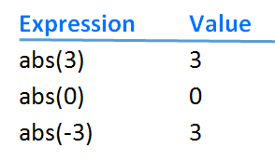
The abs Function

Slide 16
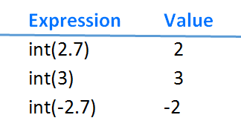
The int Function

Slide 17
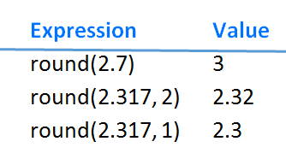
The round Function

Slide 18
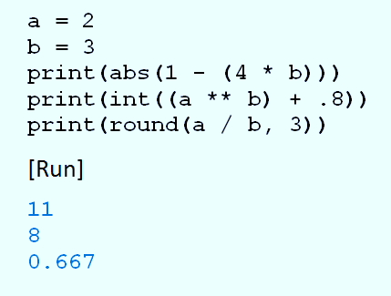
abs, int, and round Example
Example: Program evaluates functions, prints results

Slide 19
Augmented Assignments
Remember: expression on right side of assignment statement evaluated before assignment is made var = var + 1
Python has special operator to accomplish same thing var += 1

Slide 20
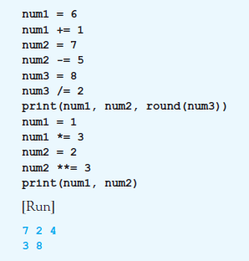
Augmented Assignments
Example: Program illustrates different augmented assignment operators.

Slide 21
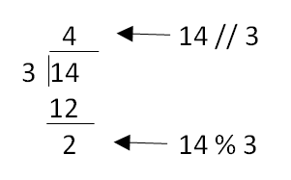
Two Other Integer Operators
Integer division operator
Written //
Modulus operator
Written %

Slide 22
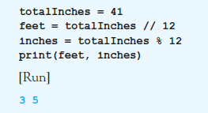
Two Other Integer Operators
Example: converts 41 inches to 3 feet, 5 inches:

Slide 23
Parentheses, Order of Precedence
Parentheses used to clarify meaning of an expression
Order of precedence
Terms inside parentheses (inner to outer)
Exponentiation
Multiplication, division (ordinary and integer), modulus
Addition and subtraction

Slide 24
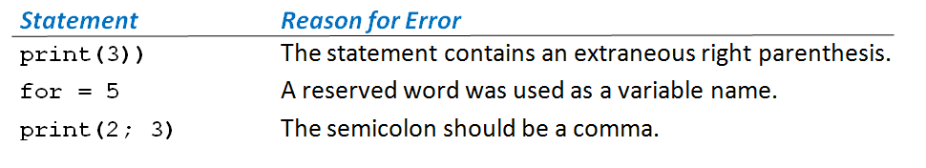
Syntax Errors
Grammatical and punctuation errors are called syntax errors.
Three Syntax Errors

Slide 25
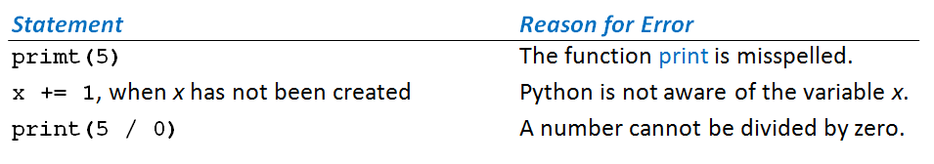
Runtime Errors
Errors discovered while program is running called runtime errors or exceptions
Three Runtime Errors

Slide 26
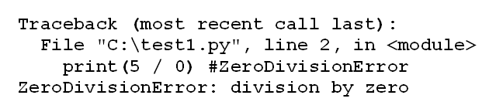
Runtime Errors
When Python encounters exception
Terminates execution of program, displays message
An Error Message for an Exception Error

Slide 27
Logic Error
Occurs when a program does not perform the way it was intended
Example average = firstNum + secondNum / 2
Syntax correct, logic wrong: should be average = (firstNum + secondNum) / 2
Logic errors are most difficult type of error to locate

Slide 28

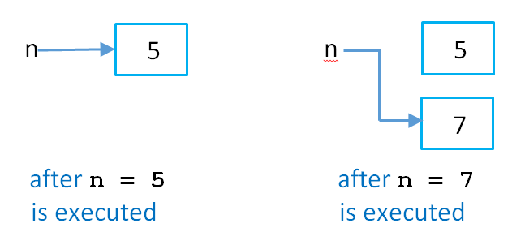
Numeric Objects in Memory
Consider this code:
This is what happens:
Numeric objects in memory.

Slide 29
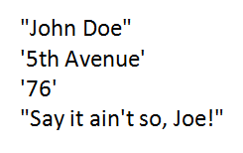
String Literals
Sequence of characters that is treated as a single item
Written as a sequence of characters surrounded by either single quotes (') or double quotes (").
Opening and closing quotation marks must be the same type

Slide 30
String Variables
Variables also can be assigned string values
Created (come into existence) the first time they appear in assignment statements
When an argument of a print statement
Quotation marks not included in display

Slide 31
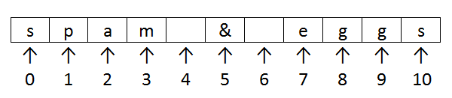
Indices and Slices
Position or index of a character in a string
Identified with one of the numbers 0, 1, 2, 3, . . . .
Indices of the characters of the string "spam & eggs".

Slide 32
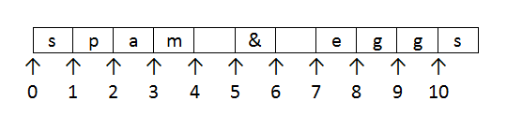
Indices and Slices
If str1 is a string, then str1[m:n] is the substring beginning at position m and ending at position n - 1
Example “spam & eggs”[2:7]
Aid to visualizing slices.

Slide 33
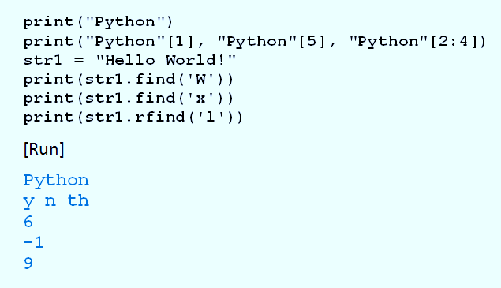
Indices and Slices
Example: Program shows use of indices

Slide 34
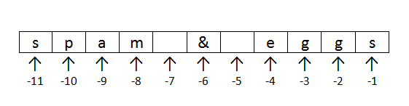
Negative Indices
Python allows strings to be indexed by their position with regards to the right
Use negative numbers for indices.
Negative indices of the characters of the string "spam & eggs".

Slide 35
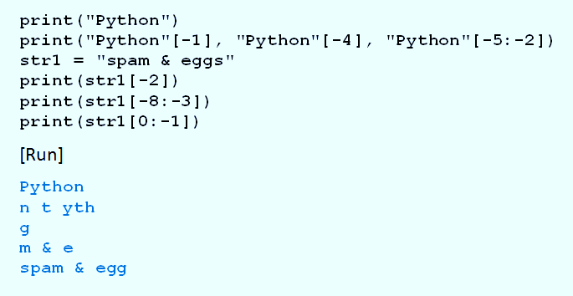
Negative Indices
Example: Program illustrates negative indices.

Slide 36
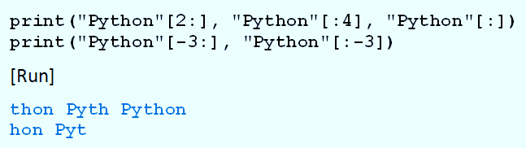
Default Bounds for Slices
Example: Program illustrates default bounds

Slide 37
String Concatenation
Two strings can be combined to form a new string
Consisting of the strings joined together
Represented by a plus sign
Combination of strings, plus signs, functions, and methods can be evaluated
Called a string expression

Slide 38
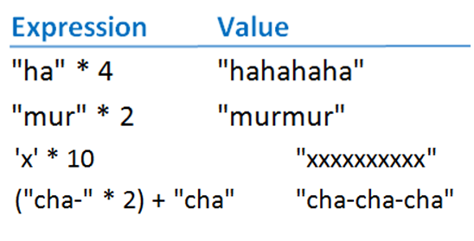
String Repetition
Asterisk operator can be used with strings to repeatedly concatenate a string with itself

Slide 39
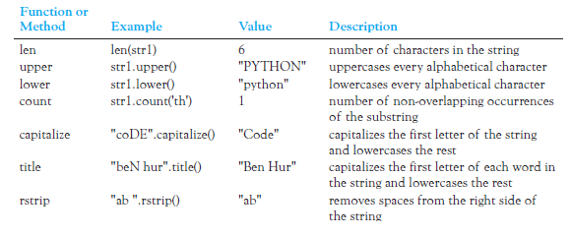
String Functions and Methods
String Operations (str1 = "Python")

Slide 40

Chained Methods
Lines can be combined into a single line said to chain the two methods
Executed from left to right

Slide 41
The input Function
Prompts the user to enter data
User types response, presses ENTER key
Entry assigned to variable on left

Slide 42
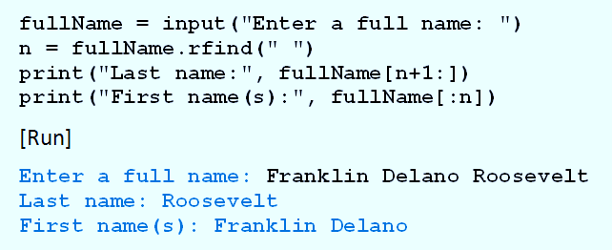
The input Function
Example: Program parses a name

Slide 43
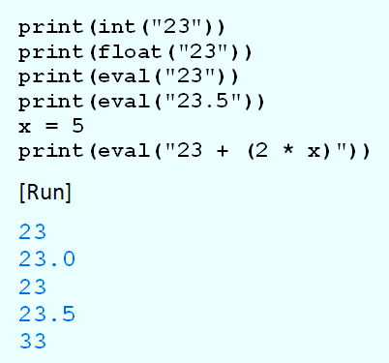
More String Functions
Example: Program shows use of int, float, and eval functions

Slide 44
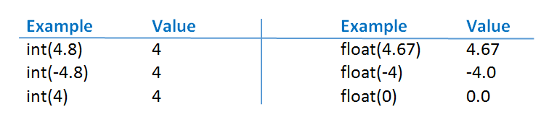
String Functions with Numbers
int and float also work with numbers
The str function converts a number to its string representation
-

Slide 45
Internal Documentation
Benefits of documentation
Other people easily understand program.
You can better understand program when you read it later.
Long programs are easier to read
Purposes of individual pieces can be determined at a glance.

Slide 46
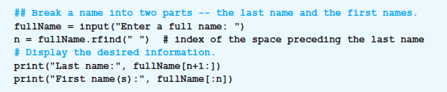
Internal Documentation
Example: Program shows use of documentation.

Slide 47

Line Continuation
A long statement can be split across two or more lines
End each line with backslash character ( \ )
Alternatively any code enclosed in a pair of parentheses can span multiple lines.
This is preferred style for most Python programmers

Slide 48
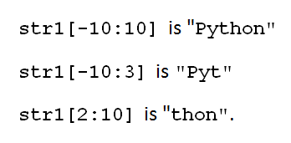
Indexing and Slicing Out of Bounds
Python does not allow out of bounds indexing for individual characters of strings
Does allow out of bounds indices for slices
Given: str1 = “Python”
Then print(str1[7]) print(str1[-7])
These are OK

Slide 49
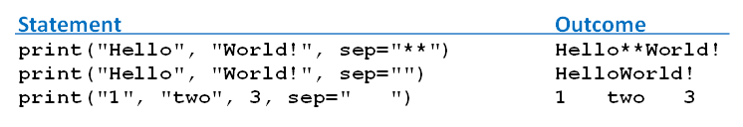
Optional print Argument sep
Consider statement print(value0, value1, …, valueN)
Print function uses string consisting of one space character as separator
Optionally change the separator to any string we like with the sep argument

Slide 50
Escape Sequences
Short sequences placed in strings
Instruct cursor or permit some special characters to be printed.
First character is always a backslash (\).
\t induces a horizontal tab
\n induces a newline operation

Slide 51
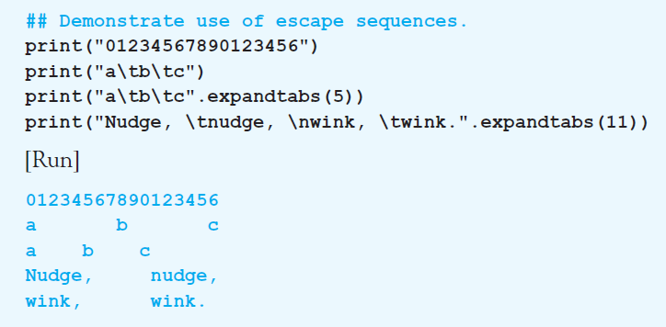
Escape Sequences
Example: Program demonstrates the use of the escape sequences \t and \n.

Slide 52
Escape Sequences
Backslash also used to treat quotation marks as ordinary characters.
\” causes print function to display double quotation mark
\\ causes print function to display single backslash

Slide 53
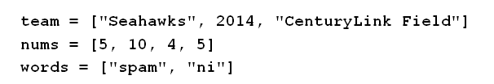
The list Object
A list is an ordered sequence of Python objects
Objects can be of any type
Objects do not have to all be the same type.
Constructed by writing items enclosed in square brackets … items separated by commas.

Slide 54
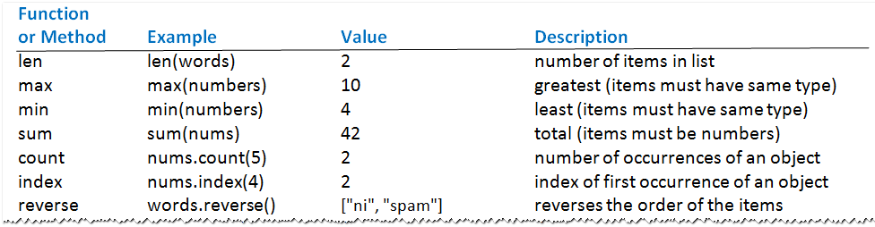
The list Object
List operations (The lists team, num, and words given in previous slide)

Slide 55
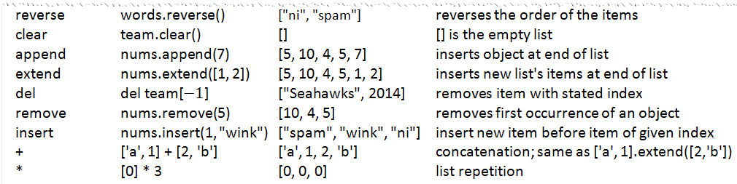
The list Object
List operations (The lists team, num, and words given in previous slide)

Slide 56
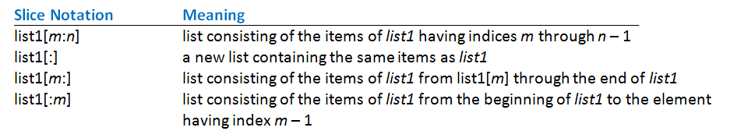
Slices
A slice of a list is a sub list specified with colon notation
Analogous to a slice of a string
Meanings of slice notations

Slide 57
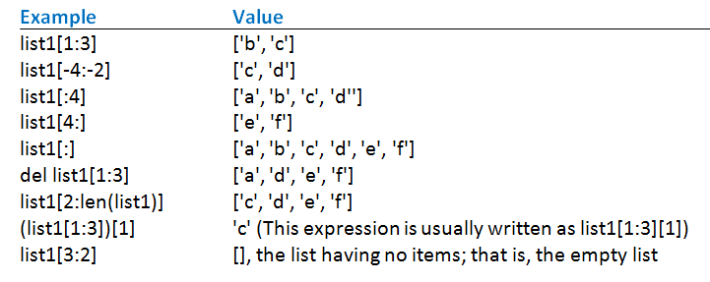
Slices
Examples of slices where list1 = ['a', 'b', 'c', 'd', 'e', 'f'].

Slide 58
The split and join Methods
Split method turns single string into list of substrings
Join method turns a list of strings into a single string.
Notice that these methods are inverses of each other

Slide 59
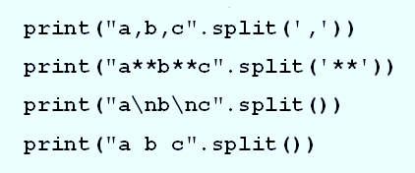
The split and join Methods
Example: These statements each display list ['a', 'b', 'c'].

Slide 60
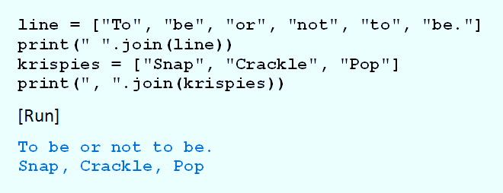
The split and join Methods
Example: Program shows how join method used to display items from list of strings.

Slide 61
The tuple Object
Tuples, like lists, are ordered sequences of items
Difference – tuples cannot be modified in place
Have no append, extend, or insert method
Items of tuple cannot be directly deleted, sorted, or altered

Slide 62
The tuple Object
All other list functions and methods apply
Items can be accessed by indices
Tuples can be sliced, concatenated, and repeated
Tuples written as comma-separated sequences enclosed in parentheses
Can also be written without the parentheses.

Slide 63
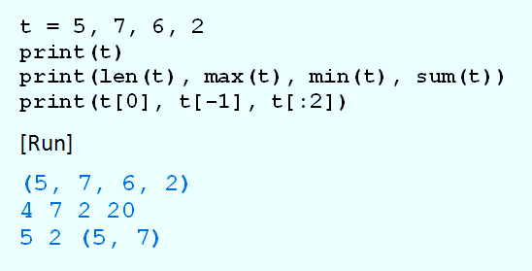
The tuple Object
Example: Program shows tuples have several of same functions as lists.

Slide 64
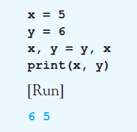
The tuple Object
Example: Program swaps values of two variables

Slide 65
Nested Lists
Beside numbers or strings, items can be lists or tuples.
Consider a list of tuples named L L[0] is the first tuple L[0][0] is the first item in the first tuple
And L[-1] is the last tuple L[-1][-1] is the last item in the last tuple

Slide 66
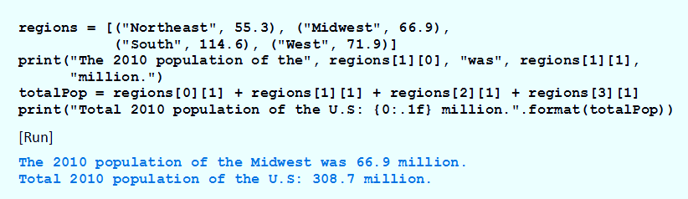
Nested Lists
Example: Program manipulates regions contains four tuples, each tuple gives name and 2010 population (in millions) of a region

Slide 67
Immutable and Mutable Objects
An object is an entity
Holds data.
Has operations and/or methods that can manipulate the data.
When variable created with assignment statement
Value on the right side becomes an object in memory
Variable references (points to) object

Slide 68
Immutable and Mutable Objects
When list altered
Changes made to the object in list's memory location
Contrast when value of variable is number, string, or tuple … when value changed,
Python designates a new memory location to hold the new value
And the variable references that new object

Slide 69
Immutable and Mutable Objects
Another way to say this
Lists can be changed in place
Numbers, strings, and tuples cannot
Objects changed in place are mutable
Objects that cannot be changed in place are immutable

Slide 70
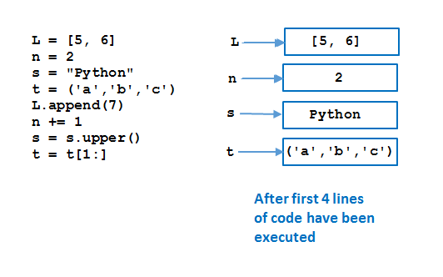
Immutable and Mutable Objects
Memory allocation corresponding to a program.

Slide 71
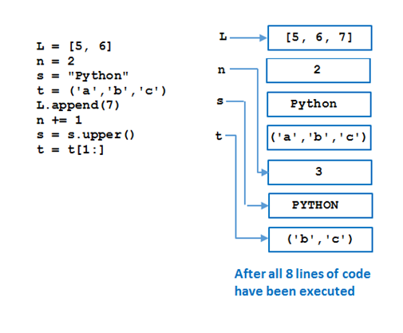
Immutable and Mutable Objects
Memory allocation corresponding to a program.

Slide 72
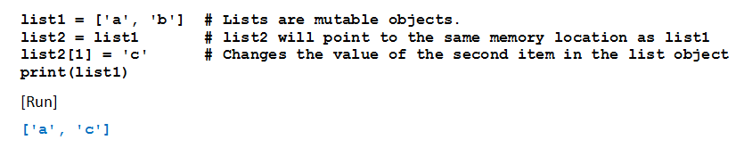
Copying Lists
Consider results of this program
All because lists are mutable

Slide 73
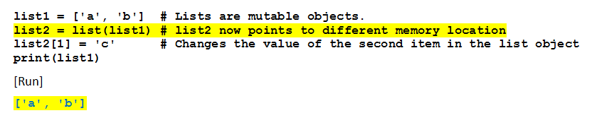
Copying Lists
Now note change in line 2
Third line of code will not affect memory location pointed to by list1

Slide 74
Indexing, Deleting, and Slicing Out of Bounds
Python does not allow out of bounds indexing for individual items in lists and tuples
But does allow it for slices
Given list1 = [1, 2, 3, 4, 5]
Then print(list1[7]) print(list1[-7]) del list1[7]

Slide 75
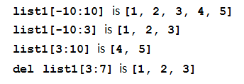
Indexing, Deleting, and Slicing Out of Bounds
If left index in slice too far negative
Slice will start at the beginning of the list
If right index is too large,
Slice will go to the end of the list.

Slide 76
Structures that Control Flow

Slide 77
Relational and Logical Operators
A condition is an expression
Involving relational operators (such as < and >=)
Logical operators (such as and, or, and not)
Evaluates to either True or False
Conditions used to make decisions
Control loops
Choose between options

Slide 78
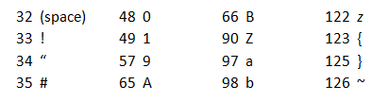
ASCII Values
ASCII values determine order used to compare strings with relational operators.
Associated with keyboard letters, characters, numerals
ASCII values are numbers ranging from 32 to 126.
A few ASCII values.

Slide 79

ASCII Values
The ASCII standard also assigns characters to some numbers above 126.
A few of the higher ASCII values.
Functions chr(n) and ord(str) access ASCII values

Slide 80
Relational Operators
Relational operator less than (<) can be applied to
Numbers
Strings
Other objects
For strings, the ASCII table determines order of characters

Slide 81
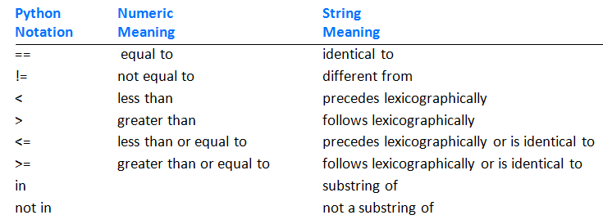
Relational Operators
Relational operators.

Slide 82
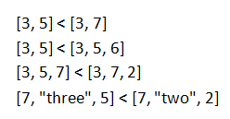
Relational Operators
Some rules
An int can be compared to a float.
Otherwise, values of different types cannot be compared
Relational operators can be applied to lists or tuples

Slide 83
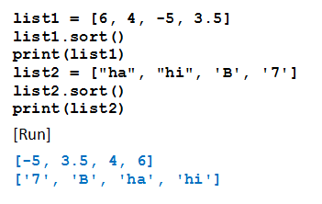
Sorting the Items in a List
Items in a list of items having same data type can be ordered with the sort method
Example: Program illustrates how Python orders two simple lists

Slide 84
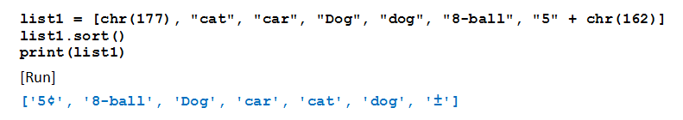

Sorting the Items in a List
Example: Items in a complicated list of strings.
Example: Items in a list of tuples

Slide 85
Logical Operators
Enables combining multiple relational operators
Logical operators are the reserved words and, or, and not
Conditions that use these operators are called compound conditions

Slide 86
Logical Operators
Given: cond1 and cond2 are conditions
cond1 and cond2 true only if both conditions are true
cond1 or cond2 true if either or both conditions are true
not cond1 is false if the condition is true, true if the condition is false

Slide 87

Logical Operators
Example: Given n = 4, answ = “Y” Determine expressions = True or False

Slide 88
Short-Circuit Evaluation
Consider the condition cond1 and cond2
If Python evaluates cond1 as false, it does not bother to check cond2
Similarly with cond1 or cond2
If Python finds cond1 true, it does not bother to check further
Think why this feature helps for (number != 0) and (m == (n / number))

Slide 89


The bool Data Type
Objects True and False are said to have Boolean data type
Of data type bool.
What do these lines display?

Slide 90

Methods that Return Boolean Values
Methods that return either True or False.
Methods that return either True or False.

Slide 91



Simplifying Conditions
Lists or tuples can sometimes be used to simplify long compound conditions

Slide 92
Simplifying Conditions
Use of De Morgan’s Laws
not(cond1 and cond2) is the same as not(cond1) or not(cond2)
not(cond1 or cond2) is the same as not(cond1) and not(cond2)

Slide 93
Decision Structures

Slide 94

if-else Statements
Also known as branching structures
Allow program to decide on course of action
Based on whether a certain condition is true or false.
Form:

Slide 95

if-else Statements
Example: Program finds larger of two numbers input by user.

Slide 96

if-else Statements
Example: if-else statement in program has relational operators in its condition.

Slide 97
if Statements
The else part of an if-else statement can be omitted
When the condition is false
Execution continues with line after the if statement block

Slide 98

if Statements
Example: Program contains two if statements

Slide 99

Nested if-else Statements
Indented blocks of if-else and if statements can contain other if-else and if statements
The if-else statements are said to be nested
Consider the task of interpreting a beacon
The color of the beacon light atop Boston’s old John Hancock building forecasts the weather

Slide 100

Nested if-else Statements
Example: Program requests a color (Blue or Red) and a mode (Steady or Flashing) as input
Then displays the weather forecast

Slide 101

Nested if-else Statements
Example: Program requests a color (Blue or Red) and a mode (Steady or Flashing) as input
Then displays the weather forecast

Slide 102

Nested if-else Statements
Example: Program requests costs, revenue for company
Displays “Break even”, profit, or loss

Slide 103

Nested if-else Statements
Example: Program requests costs, revenue for company
Displays “Break even”, profit, or loss

Slide 104

The elif Clause
Allows for more than two possible alternatives with inclusion of elif clauses.

Slide 105

The elif Clause
Example: Program reports if the two numbers are equal.

Slide 106


The elif Clause
Example: program assumes that the user will graduate and determines if they will graduate with honors.

Slide 107

Input Validation with if-elif-else Statements
Example: Program uses the method isdigit to guard against improper input.

Slide 108

Input Validation with if-elif-else Statements
Example: Program uses the method isdigit to guard against improper input.

Slide 109

True and False
Example: Program illustrates truth values of objects

Slide 110

The while Loop
Executes a block of code repeatedly
while loop repeatedly executes an indented block of statements
As long as a certain condition is met
Form
Continuation condition is a boolean expression

Slide 111

The while Loop
Example: Program displays 1 – 5, after loop terminates, num will be 6

Slide 112

The while Loop
Example: Input validation.

Slide 113

The while Loop
Example: Find min, max, average.

Slide 114

The while Loop
Example: Find min, max, average.

Slide 115

The while Loop
Example: Stores the numbers in a list, and then uses list methods and functions to determine the requested values.

Slide 116

The while Loop
Example: Determines when bank deposit reaches one million dollars

Slide 117
The break Statement
Causes an exit from anywhere in the body of a loop
When break is executed
Loop immediately terminates
Break statements usually occur in if statements

Slide 118

The break Statement
Example: Program uses break to avoid two input statements.

Slide 119
The continue Statement
When continue executed in a while loop
Current iteration of the loop terminates
Execution returns to the loop’s header
Usually appear inside if statements.

Slide 120

The continue Statement
Example: Searches a list for the first int object that is divisible by 11.

Slide 121

Creating a Menu
Example: Uses a menu to obtain facts about the United States.

Slide 122

The continue Statement
Example: Uses a menu to obtain facts about the United States.

Slide 123

Infinite Loops
Example: Condition number >= 0 always true.

Slide 124

The for Loop
Used to iterate through a sequence of values
General form of a for loop
Sequence can be
Arithmetic progression of numbers
String
List
File object

Slide 125
The for Loop
Variable is successively assigned each value in the sequence
Indented block of statements executed after each assignment
Physical indentation tells interpreter where block starts and stops

Slide 126

Looping Through Arithmetic Progression of Numbers
Range function is used to generate an arithmetic progression

Slide 127

Looping Through Arithmetic Progression of Numbers
Example: Code displays four integers and their squares
:

Slide 128

Step Values for the range Function
Variation of the range function generates a sequence of integers
Successive integers differ by a value other than 1
Examples

Slide 129

Step Values for the range Function
If negative step value is used and initial value is greater than terminating value,
Range function generates a decreasing sequence
Examples:

Slide 130
Nested for Loops
Body of for loop can contain any type of Python statement
Can contain another for loop.
Second loop must be completely contained inside the first loop
Must have a different loop variable

Slide 131

Nested for Loops
Example: Program displays a multiplication table for the integers from 1 to 5

Slide 132

Nested for Loops
Example: Program uses nested for loops to display a triangle of asterisks.

Slide 133

Looping Through Characters of a String
Example: Program requests a word as input and displays it backwards.

Slide 134

Looping Through Items of a List or Tuple
Example: Program displays the months whose names contains the letter r.

Slide 135

Looping Through Items of a List or Tuple
Example: Program replaces the name of each month with its three-letter abbreviation.

Slide 136


Looping Through Items of a List or Tuple
Example: Program uses nested for loops with list of ranks, list of suits
Creates list consisting of 52 cards in deck of cards

Slide 137

Looping Through Lines of Text File
Reads each line of the file in succession
Executes indented block of statement(s) for each line
First line establishes connection between program and file

Slide 138

Looping Through Lines of Text File
Example: Program requests a first name and then displays names of U.S. presidents having that first name

Slide 139

Populating a List with Contents of a Text File
One way of placing the contents of a text file into a list.

Slide 140
Functions

Slide 141

Built-in Functions
Like miniature programs
Receive input
Process the input
Have output
Some Python built-in functions.

Slide 142

Built-in Functions
Output of functions is a single value
Function is said to return its output
Items inside parentheses called arguments
Examples:

Slide 143

User-defined Functions
Defined by statements of the form
par1, par2 are variables (called parameters)
Expression evaluates to a literal of any type
Header must end with colon
Each statement in block indented same

Slide 144
User-defined Functions
Passing parameters
We consider here pass by position
Arguments in calling statement matched to the parameters in function header based on order
Parameters and return statements optional in function definitions
Function names should describe the role performed

Slide 145

Functions Having One Parameter
Header of the fahrenheitToCelsius function

Slide 146

Functions Having One Parameter
Example: Program uses the function fahrenheitToCelsius

Slide 147

Functions Having One Parameter
Example: Program uses the function firstName

Slide 148
Passing a Value to a Function
If the argument in a function call is a variable
Object pointed to by the argument variable (not the argument variable itself) passed to a parameter variable
Object is immutable, there is no possibility that value of the argument variable will be changed by a function call

Slide 149

Passing a Value to a Function
Example: Program shows there is no change in the value of the argument

Slide 150

Passing a Value to a Function
Passing a value to a function.

Slide 151
Functions Having Several Parameters
Must be the same number of arguments as parameters in the function
Data types of arguments’ values must be compatible with data types expected by the parameters
Must also be in the same order

Slide 152

Functions Having Several Parameters
Example: Program uses the function pay.

Slide 153

Functions Having Several Parameters
Passing arguments to a function.

Slide 154

Functions Having Several Parameters
Example: Function computes the balance in a saving account

Slide 155

Functions Having Several Parameters
Example: Function computes the balance in a saving account

Slide 156

Boolean- and List-valued Functions
Example: Program uses a Boolean-valued function to determine whether input is a vowel word

Slide 157

Boolean- and List-valued Functions
Example: Program uses a list-valued function

Slide 158

Functions that do not Return Values
Example: Program displays three verses of children’s song.

Slide 159

Functions without Parameters
Example: Program calculates the population density of a state

Slide 160

Functions without Parameters
Example: Program calculates the population density of a state

Slide 161
Scope of Variables
Variable created inside a function can only be accessed by statements inside that function
Ceases to exist when the function is exited
Variable is said to be local to function or to have local scope
If variables created in two different functions have the same name
They have no relationship to each other

Slide 162

Scope of Variables
Example: Variable x in the function main, variable x in the function trivial are different variables

Slide 163

Scope of Variables
Example: Variable x created in function main not recognized by function trivial.

Slide 164

Scope of Variables
Scope of a variable is the portion of the program that can refer to it
To make a variable global, place assignment statement that creates it at top of program.
Any function can read the value of a global variable
Value cannot be altered inside a function unless

Slide 165

Scope of Variables
Example: Program contains a global variable

Slide 166
Named Constants
Program sometimes employs a special constant used several times in program
Convention programmers use
Create a global variable
Name written in uppercase letters with words separated by underscore
In Python, programmer is responsible for not changing value of the variable

Slide 167
Library Modules
A library module is a file with extension .py
Contains functions and variables
Can be used (imported) by any program
can be created in IDE or any text editor
Looks like an ordinary Python program
To gain access to the functions and variables
place a statement of the form import moduleName at the beginning of the program

Slide 168

Library Modules
Consider a file with pay and futureValue functions
Save as finance.py in same folder as previous examples
Rewrite example as

Slide 169

Library Modules
Several modules from the standard library.

Slide 170
Functions Calling Other Functions
Function can call another function
When the called function terminates
Control returns to the place in calling function just after where function call occurred.
Example: Function firstPart calls the function secondPart.

Slide 171

Functions Calling Other Functions

Slide 172
Functions Returning Multiple Values
Functions can return any type of object
Function can return a tuple.
Example: balanceAndInterest function returns a tuple
Giving values associated with deposit into savings account.

Slide 173

Functions Returning Multiple Values

Slide 174

Functions Returning Multiple Values
Example: Variation of Example has the input, processing, and output performed individually by three functions.

Slide 175


List Comprehension
Simpler way to apply a certain function to each item of a list
Use list comprehension
The for clause in a list comprehension can optionally be followed by an if clause.

Slide 176

List Comprehension
Examples of list comprehension.

Slide 177
Default Values
Parameters of a function can have default values
Assigned to them when no values are passed to them
Format for definition using default values

Slide 178


Default Values
Three function calls

Slide 179

Default Values
Example: Program gives user three tries to answer question

Slide 180


Passing by Parameter Name
Arguments can be passed to functions by using names of the corresponding parameters
Instead of relying on position
Given
Could use

Slide 181

Passing by Parameter Name
Example: Several ways to pass values

Slide 182

Passing by Parameter Name
Example: Several ways to pass values

Slide 183
Custom Sorting
Functions can be used to order the items by any criteria we choose
With a list of strings, we can sort them by
Length
Last characters
Number of vowels
… by many other properties

Slide 184

Custom Sorting
Example: Program sorts list of words using each of three properties mentioned above

Slide 185

Custom Sorting
Example: Program sorts list of words using each of three properties mentioned above

Slide 186
Lambda Expressions
The lambda operator or lambda function is a way to create small anonymous functions, i.e. functions without a name.
These functions are throw-away functions, i.e. they are just needed where they have been created. Lambda functions are mainly used in combination with the functions filter(), map() and reduce().
The lambda feature was added to Python due to the demand from Lisp programmers.

Slide 187
Lambda Expressions
One-line mini-functions
Can be used where a simple function is required.
Compute a single expression
Cannot be used as a replacement for complex functions
Format
Where expression is the value to be returned

Slide 188
Lambda Expressions
Example:
f = lambda x, y : x + y
f(1,1)
Answer = 2
Lambda function highlighted

Slide 189

The sorted Function
Contrast with sort function
sort function alters order of items in a list
sorted function returns a new ordered list
Both can make use of the optional arguments key and reverse.
sorted function also can be used with lists, strings, and tuples

Slide 190

The sorted Function
Values produced by sorted function (list1 = ["white", "blue", "red"])

Slide 191
Sets
A list is an ordered collection of items
Possibly with repetitions
Delimited with [ ]
A set is an unordered collection of items
No duplicates
Delimited with { }

Slide 192

Sets
Set methods (words = {"spam", "ni"})

Slide 193

Set-theoretic Methods
Methods that create new sets from two existing sets
Merge two sets
Intersection of two sets
Set difference

Slide 194
Dictionaries
Lists are ordered sets of objects, whereas dictionaries are unordered sets.
But the main difference is that items in dictionaries are accessed via keys and not via their position.
A dictionary is an associative array (also known as hashes).
Any key of the dictionary is associated (or mapped) to a value.
The values of a dictionary can be any Python data type. So dictionaries are unordered key-value-pairs.

Slide 195

Dictionaries
Consider this function
A mini English-Spanish dictionary
A function of this type is called a mapping
Python has an efficient and flexible mapping device, called a dictionary
The value of translate["blue"] is "aloz"

Slide 196
Dictionaries
Python dictionary is defined as
A collection of comma separated pairs
Of the form ”key:value”
Enclosed in curly braces.
Value associated with key1 is given by the expression dictionaryName[key1].

Slide 197


Dictionaries
Example
Dictionary Operations

Slide 198

Dictionaries
Dictionary Operations

Slide 199

Dictionaries
Dictionary Operations

Slide 200

Dictionaries
Example: Program illustrates many of the functions and methods for dictionaries.

Slide 201

Dictionaries
Example: Program illustrates many of the functions and methods for dictionaries.

Slide 202

The dict Function
List of 2-item lists or 2-item tuples can be converted to a dictionary with dict function
Example

