Slide 1
Dimensionality Reduction
Dimensionality reduction is an effective approach to downsizing data
Many data mining techniques are not effective for high-dimensional data
Curse of Dimensionality
Statistical methods count observations that occur in a given space
As dimensions increase, observations in space become sparser
i.e., convergence of any estimator to the true value is very slow in a high dimensional space
Intrinsic dimension often small, we may not need too many explanatory variables
Airplane Deicing Costs
Snowplow Costs
Heat stroke
Temperature?

Slide 2
Dimensionality Reduction: Applications
Customer relationship management
Text mining
Image retrieval
Protein classification
Face recognition
Handwritten digit recognition
Intrusion detection

Slide 3
Main Approaches
Feature Selection
Chooses an optimal subset of features (i.e., dimensions) based on an objective function
Only a subset of the original features are selected
Reduces dimensionality and noise
Can improve the speed of learning, predictive accuracy, etc.
Feature Extraction (Reduction)
Maps original high-dimensional data onto a lower-dimensional space
Criterion can be different based on different problem settings
Unsupervised setting: minimize information loss
Supervised setting: maximize class discrimination

Slide 4
Principal Components Analysis

Slide 5


Dimensionality Reduction and PCA
Principal Components Analysis (PCA) is a classical linear approach to dimension reduction
Projects high-dimensional data onto a lower dimensional sub-space using linear transformation
All dimension reduction techniques involve some degree of information loss
Goal of PCA is to reduce dimensionality while retaining as much variation as possible in the dataset
$$X=\left[\begin{matrix}a_{1} \\ a_{2} \\ … \\ a_{N}\end{matrix}\right]⇒PCA ⇒Y=\left[\begin{matrix}b_{1} \\ b_{2} \\ … \\ b_{K}\end{matrix}\right]$$
$$where K≪N$$

Slide 6


Some Matrix Terminology
Matrix is a rectangular array of rows (m) and columns (n)
If m=n, the matrix is square
Principal: Diagonal from upper-left to lower right of a matrix
Principal elements: Elements of the principal
Trace: Sum of the principal elements
Principal (Diagonal)
$$\left[\begin{matrix}5 & 2 & 4 \\ −3 & 6 & 2 \\ 3 & −3 & 1\end{matrix}\right]$$
$$trace=\left(5+6+1\right)=12$$

Slide 7
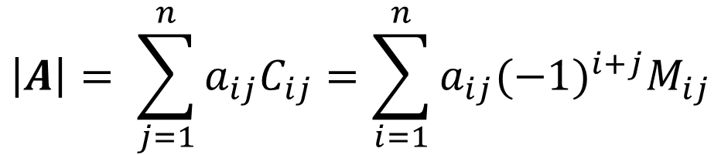
Determinants
Loose definition: A function that associates at scalar to a square matrix
A matrix with a nonzero determinant is called non-singular (it has an inverse)
The determinant of matrix A is denoted |A| or det(A)
Laplace’s Formula
M_{ij}: the i, j minor matrix of A. Obtained by removing row i and column j
C_{ij}: the scalar cofactor of A
$$\left|A\right|= \sum_{j=1}^{n}{a_{ij}C_{ij}}=\sum_{i=1}^{n}{a_{ij}{(−1)}^{i+j}M_{ij}}$$

Slide 8
PCA Methodology
Given a dataset comprising Nx1 vectors x₁, x₂, …, x_{M}
Step 1: Calculate the mean of each attribute
Step 2: Calculate the variance/covariance matrix
Calculate the variance of each attribute
Calculate the covariance of the attributes
Construct the matrix
Step 3: Compute the Eigenvalues of the covariance matrix and order them from largest to smallest
Step 4: Compute the Eigenvectors of the covariance matrix for the associated with the Eigenvalues
Step 5: Keep terms corresponding to the K largest Eigenvalues

Slide 9
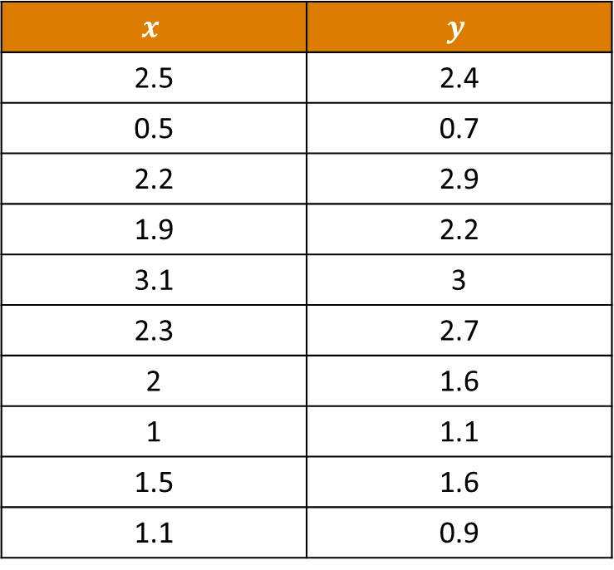
Example Data
$$x$$ | $$y$$
2.5 | 2.4
0.5 | 0.7
2.2 | 2.9
1.9 | 2.2
3.1 | 3
2.3 | 2.7
2 | 1.6
1 | 1.1
1.5 | 1.6
1.1 | 0.9

Slide 10
Plot the Data

Slide 11
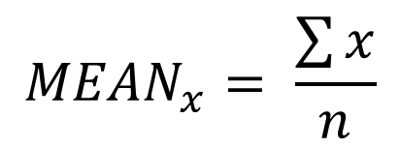
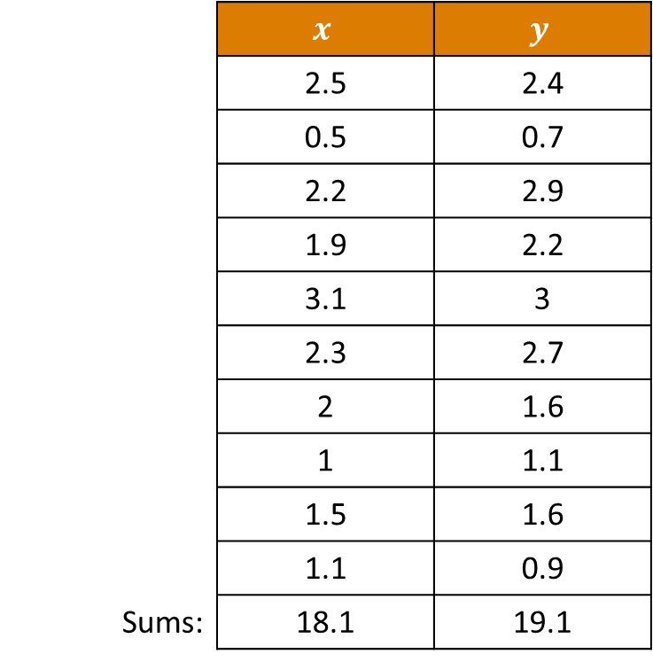
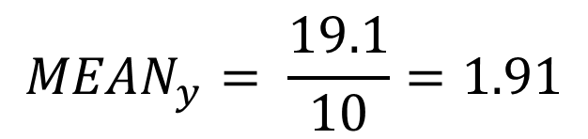
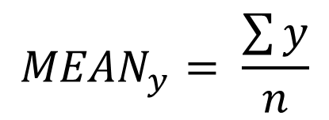
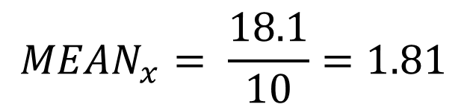
Step 1: Calculate Means
 | $$x$$ | $$y$$
 | 2.5 | 2.4
 | 0.5 | 0.7
 | 2.2 | 2.9
 | 1.9 | 2.2
 | 3.1 | 3
 | 2.3 | 2.7
 | 2 | 1.6
 | 1 | 1.1
 | 1.5 | 1.6
 | 1.1 | 0.9
Sums: | 18.1 | 19.1
$${MEAN}_{x}= \frac{\sum{x}}{n}$$
$${MEAN}_{x}= \frac{18.1}{10}=1.81$$
$${MEAN}_{y}= \frac{\sum{y}}{n}$$
$${MEAN}_{y}= \frac{19.1}{10}=1.91$$

Slide 12
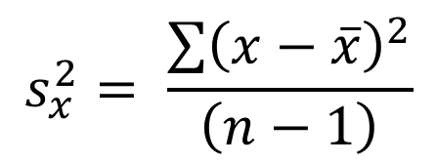
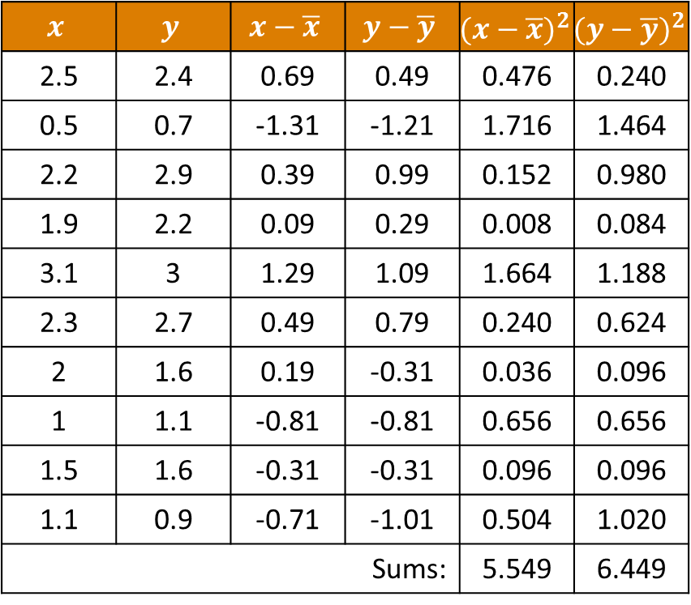
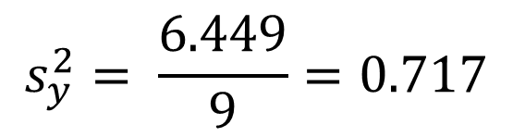
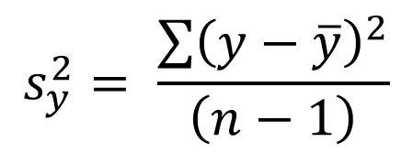
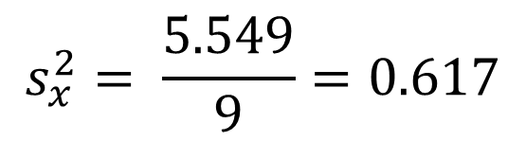
Step 2a: Calculate Variances
$$x$$ | $$y$$ | $$x−\overline{x}$$ | $$y−\overline{y}$$ | $${(x−\overline{x})}^{2}$$ | $${(y−\overline{y})}^{2}$$
2.5 | 2.4 | 0.69 | 0.49 | 0.476 | 0.240
0.5 | 0.7 | -1.31 | -1.21 | 1.716 | 1.464
2.2 | 2.9 | 0.39 | 0.99 | 0.152 | 0.980
1.9 | 2.2 | 0.09 | 0.29 | 0.008 | 0.084
3.1 | 3 | 1.29 | 1.09 | 1.664 | 1.188
2.3 | 2.7 | 0.49 | 0.79 | 0.240 | 0.624
2 | 1.6 | 0.19 | -0.31 | 0.036 | 0.096
1 | 1.1 | -0.81 | -0.81 | 0.656 | 0.656
1.5 | 1.6 | -0.31 | -0.31 | 0.096 | 0.096
1.1 | 0.9 | -0.71 | -1.01 | 0.504 | 1.020
Sums: |  |  |  | 5.549 | 6.449
$$s_{x}^{2}= \frac{\sum{{\left(x−\overline{x}\right)}^{2}}}{\left(n−1\right)}$$
$$s_{x}^{2}= \frac{5.549}{9}=0.617$$
$$s_{y}^{2}= \frac{\sum{{\left(y−\overline{y}\right)}^{2}}}{\left(n−1\right)}$$
$$s_{y}^{2}= \frac{6.449}{9}=0.717$$

Slide 13
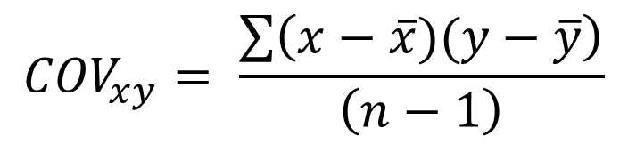
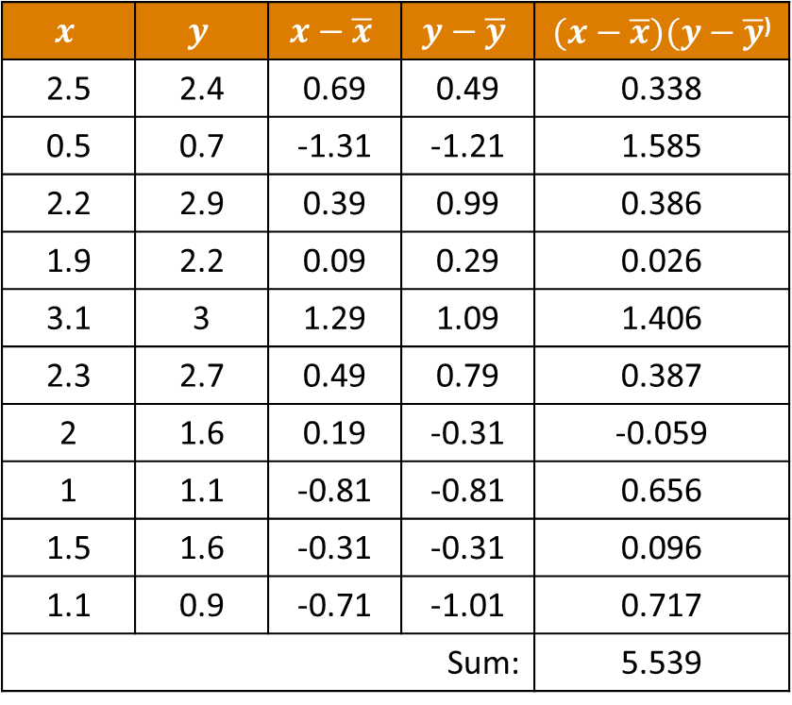
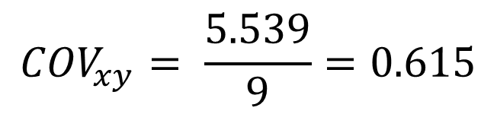
Step 2b: Calculate Covariance
$$x$$ | $$y$$ | $$x−\overline{x}$$ | $$y−\overline{y}$$ | $(x−\overline{x})(y−\overline{y}$⁾
2.5 | 2.4 | 0.69 | 0.49 | 0.338
0.5 | 0.7 | -1.31 | -1.21 | 1.585
2.2 | 2.9 | 0.39 | 0.99 | 0.386
1.9 | 2.2 | 0.09 | 0.29 | 0.026
3.1 | 3 | 1.29 | 1.09 | 1.406
2.3 | 2.7 | 0.49 | 0.79 | 0.387
2 | 1.6 | 0.19 | -0.31 | -0.059
1 | 1.1 | -0.81 | -0.81 | 0.656
1.5 | 1.6 | -0.31 | -0.31 | 0.096
1.1 | 0.9 | -0.71 | -1.01 | 0.717
Sum: |  |  |  | 5.539
$${COV}_{xy}= \frac{\sum{\left(x−\overline{x})(y−\overline{y}\right)}}{\left(n−1\right)}$$
$${COV}_{xy}= \frac{5.539}{9}=0.615$$

Slide 14
Step 2c: Construct Variance/Covariance Matrix
Variance of x
 | x | y
x | 0.616 | 0.615
y | 0.615 | 0.716
Variance of y
Covariance of x and y

Slide 15
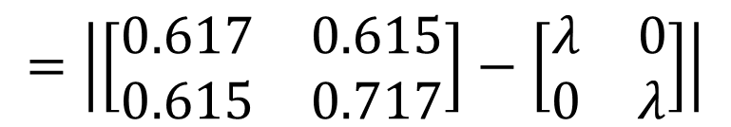
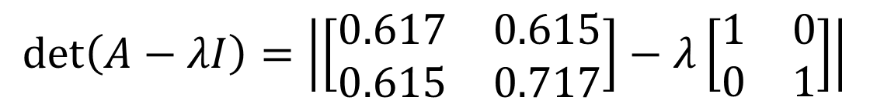
Step 3: Compute Eigenvalues
An Eigenvalue is a measure of the variation within the data along a particular path (Eigenvector)
Given
λ: Scalar
I: Identity Matrix
A: Non-singular matrix (our variance/covariance matrix)
For what value of λ is det (A-λI)=0?
$$\det\left(A−λI\right)=\left|\left[\begin{matrix}0.617 & 0.615 \\ 0.615 & 0.717\end{matrix}\right]−λ\left[\begin{matrix}1 & 0 \\ 0 & 1\end{matrix}\right]\right|$$
$$=\left|\left[\begin{matrix}0.617 & 0.615 \\ 0.615 & 0.717\end{matrix}\right]−\left[\begin{matrix}λ & 0 \\ 0 & λ\end{matrix}\right]\right|$$

Slide 16
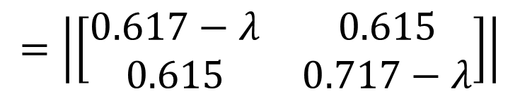

Step 3: Compute Eigenvalues
$$=\left|\left[\begin{matrix}0.617−λ & 0.615 \\ 0.615 & 0.717−λ\end{matrix}\right]\right|$$
$$=\left(0.617−λ\right)\left(0.717−λ\right)−{0.615}^{2}$$
Characteristic Equation
$$=\left(0.442\right)−\left(0.617λ\right)−\left(0.717λ\right)+λ^{2}−{0.615}^{2}$$
$$=λ^{2}−1.334λ+0.064$$

Slide 17

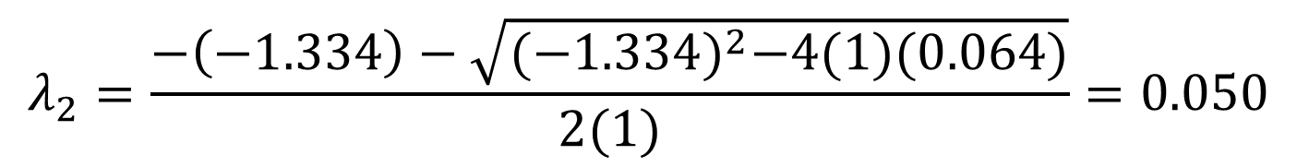
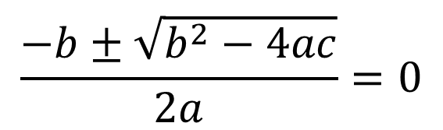
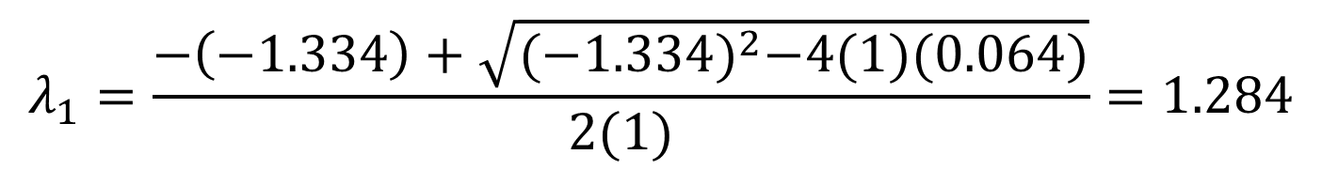


Step 3: Compute Eigenvalues
$$A=1$$
$$\frac{−b±\sqrt{b^{2}−4ac}}{2a}=0$$
$$B=−1.334$$
$$C=0.064$$
$$λ_{1}=\frac{−\left(−1.334\right)+\sqrt{{(−1.334)}^{2}−4(1)(0.064)}}{2(1)}=1.284$$
$$λ_{2}=\frac{−\left(−1.334\right)−\sqrt{{(−1.334)}^{2}−4(1)(0.064)}}{2(1)}=0.050$$

Slide 18
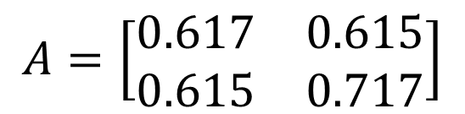
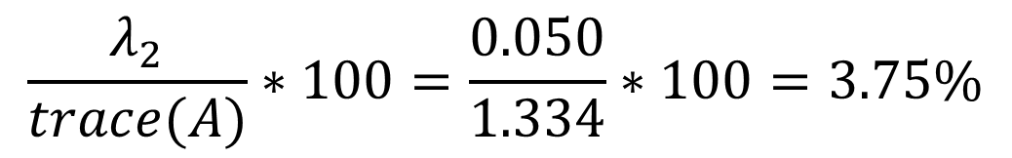
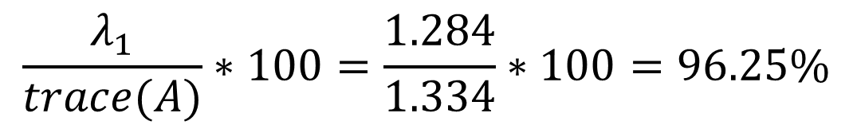
Observation
$$A=\left[\begin{matrix}0.617 & 0.615 \\ 0.615 & 0.717\end{matrix}\right]$$
$$trace\left(A\right)=\left(0.617+0.717\right)=1.334$$
$${(λ}_{1}+λ_{2})=\left(1.284+0.050\right)=1.334$$
You can write Eigenvalues as a percentage of trace(A)
$$\frac{λ_{1}}{trace(A)}∗100=\frac{1.284}{1.334}∗100=96.25\%$$
$$\frac{λ_{2}}{trace(A)}∗100=\frac{0.050}{1.334}∗100=3.75\%$$
The largest Eigenvalue (λ₁) is referred to as the principal Eigenvalue

Slide 19
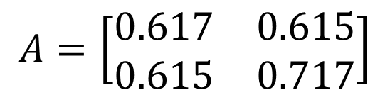
Another Observation
The product of the Eigenvalues is the determinant of the matrix
$$A=\left[\begin{matrix}0.617 & 0.615 \\ 0.615 & 0.717\end{matrix}\right]$$
$$det\left(A\right)=\left(0.617∗0.717\right)−(0.615∗0.615)=0.064$$
$${(λ}_{1}∗λ_{2})=\left(1.284∗0.050\right)=0.064$$

Slide 20
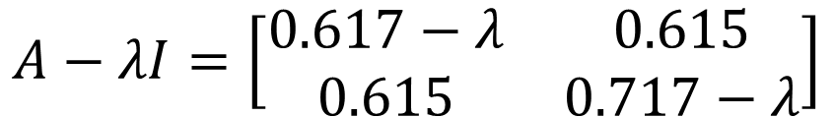
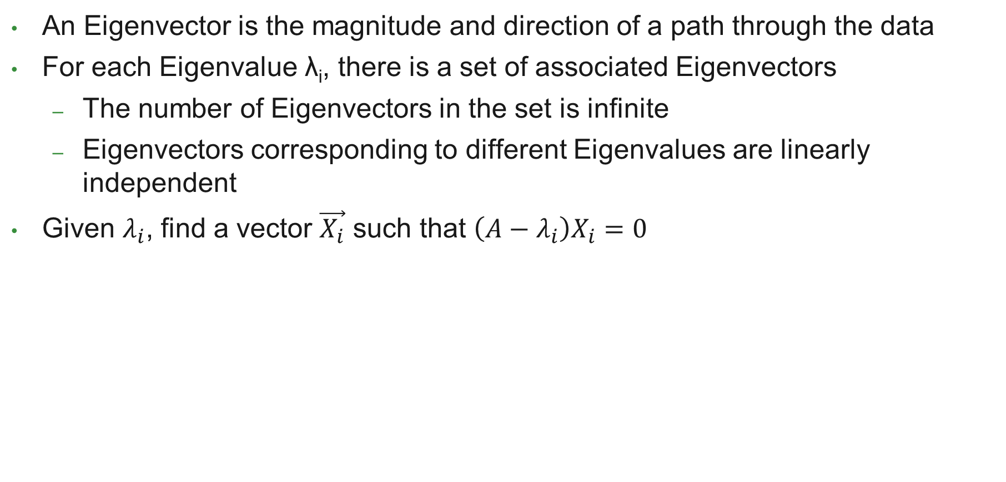
Step 4: Calculate Eigenvectors
An Eigenvector is the magnitude and direction of a path through the data
For each Eigenvalue λ_{i}, there is a set of associated Eigenvectors
The number of Eigenvectors in the set is infinite
Eigenvectors corresponding to different Eigenvalues are linearly independent
Given $λ_{i}$, find a vector $\vec{X_{i}}$ such that $\left(A−λ_{i}\right)X_{i}=0$
$$A−λI=\left[\begin{matrix}0.617−λ & 0.615 \\ 0.615 & 0.717−λ\end{matrix}\right]$$

Slide 21

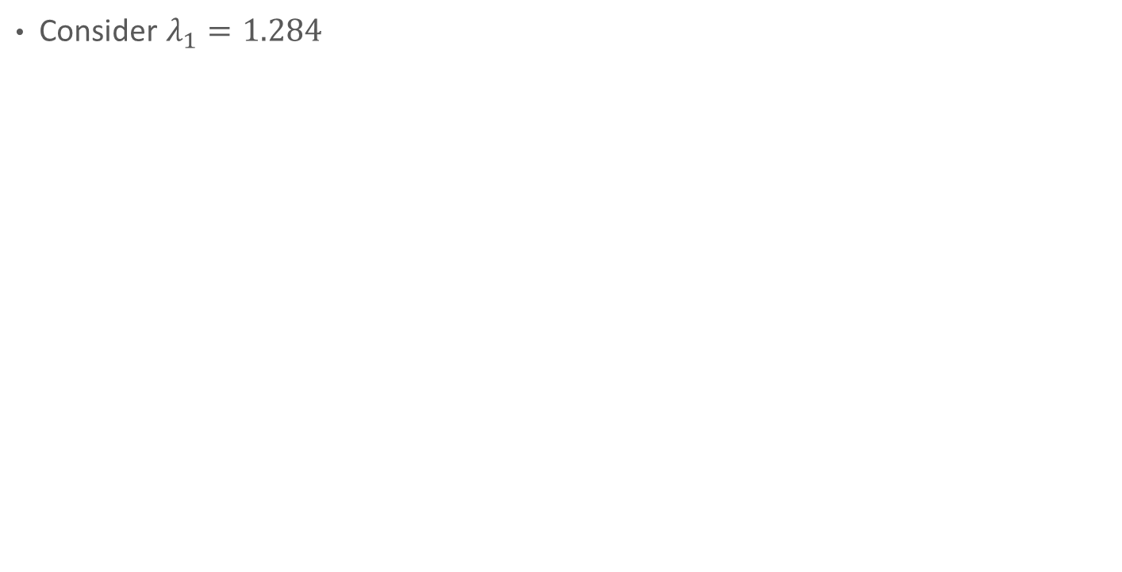

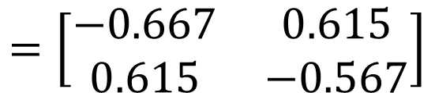
Step 4: Calculate Eigenvectors
Consider $λ_{1}=1.284$
$$A−λ_{1}I=A−1.284I=\left[\begin{matrix}0.617−1.284 & 0.615 \\ 0.615 & 0.717−1.284\end{matrix}\right]$$
$$=\left[\begin{matrix}−0.667 & 0.615 \\ 0.615 & −0.567\end{matrix}\right]$$
$$\left(A−λ_{1}I\right)X_{1}=0⇒\left[\begin{matrix}−0.667 & 0.615 \\ 0.615 & −0.567\end{matrix}\right]\left[\begin{matrix}x_{1} \\ x_{2}\end{matrix}\right]=\left[\begin{matrix}0 \\ 0\end{matrix}\right]$$
$$−0.667x_{1}+0.615x_{2}=0$$
$$0.615x_{1}+(−0.567)x_{2}=0$$

Slide 22




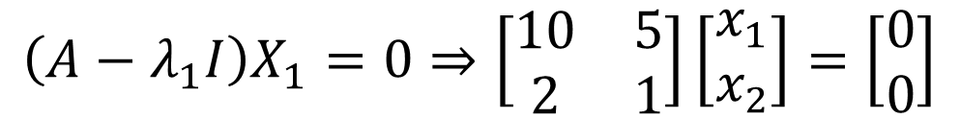
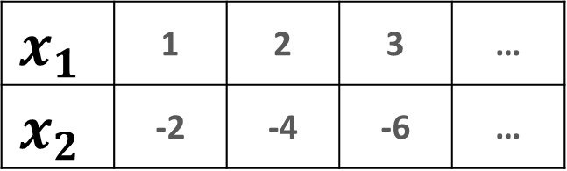


Step 4: Calculate Eigenvectors
Lets simplify the math…
Assume
$$A=\left[\begin{matrix}13 & 5 \\ 2 & 4\end{matrix}\right]$$
$$λ_{1}=3$$
$$λ_{2}=14$$
$$A−λ_{1}I=A−3I=\left[\begin{matrix}13−3 & 5 \\ 2 & 4−3\end{matrix}\right]=\left[\begin{matrix}10 & 5 \\ 2 & 1\end{matrix}\right]$$
$$\left(A−λ_{1}I\right)X_{1}=0⇒\left[\begin{matrix}10 & 5 \\ 2 & 1\end{matrix}\right]\left[\begin{matrix}x_{1} \\ x_{2}\end{matrix}\right]=\left[\begin{matrix}0 \\ 0\end{matrix}\right]$$
$$10x_{1}+5x_{2}=0$$
$$x_{1}$$ | 1 | 2 | 3 | …
$$x_{2}$$ | -2 | -4 | -6 | …
$$x_{1}=−\frac{1}{2}x_{2}$$
$$2x_{1}+1x_{2}=0$$

Slide 23


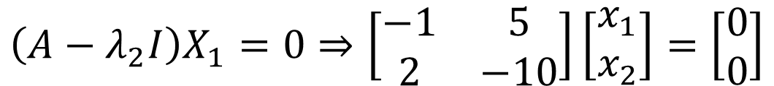
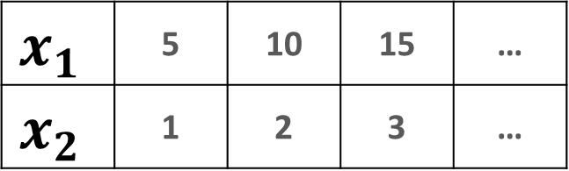

Step 4: Calculate Eigenvectors
Assume
$$A=\left[\begin{matrix}13 & 5 \\ 2 & 4\end{matrix}\right]$$
$$λ_{1}=3$$
$$λ_{2}=14$$
$$A−λ_{2}I=A−14I=\left[\begin{matrix}13−14 & 5 \\ 2 & 4−14\end{matrix}\right]=\left[\begin{matrix}−1 & 5 \\ 2 & −10\end{matrix}\right]$$
$$\left(A−λ_{2}I\right)X_{1}=0⇒\left[\begin{matrix}−1 & 5 \\ 2 & −10\end{matrix}\right]\left[\begin{matrix}x_{1} \\ x_{2}\end{matrix}\right]=\left[\begin{matrix}0 \\ 0\end{matrix}\right]$$
$$−x_{1}+5x_{2}=0$$
$$x_{1}$$ | 5 | 10 | 15 | …
$$x_{2}$$ | 1 | 2 | 3 | …
$$x_{1}=5x_{2}$$
$$2x_{1}−10x_{2}=0$$

Slide 24
Eigenvalues and Eigenvectors
For our running example:
1st Eigenvalue is associated with significantly more information than the second
Component | Eigenvalue | Eigenvectors
PC1 | 1.284 | 0.6779 | 0.7352
PC2 | 0.050 | -0.7352 | 0.6779

Slide 25
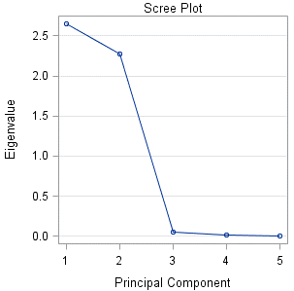
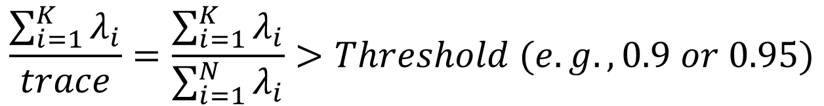
Choosing K
Key question: How many principal components to keep?
Common criterion:
Scree Plot: Plot of the k-th Eigenvalue against k.
As k increases, a drop off typically becomes apparent
The remaining factors are noise
$$\frac{\sum_{i=1}^{K}{λ_{i}}}{trace}=\frac{\sum_{i=1}^{K}{λ_{i}}}{\sum_{i=1}^{N}{λ_{i}}}>Threshold (e.g., 0.9 or 0.95)$$

Slide 26

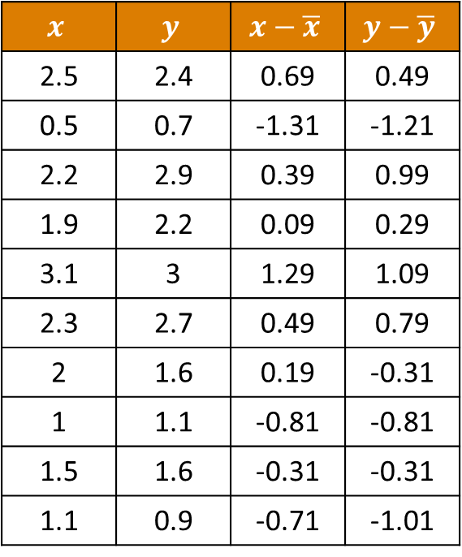
PCA for Dimension Reduction
New reduced dimensions are created by multiplying the matrix of retained Eigenvectors by a matrix of the dimensions minus their means:
$$x$$ | $$y$$ | $$x−\overline{x}$$ | $$y−\overline{y}$$
2.5 | 2.4 | 0.69 | 0.49
0.5 | 0.7 | -1.31 | -1.21
2.2 | 2.9 | 0.39 | 0.99
1.9 | 2.2 | 0.09 | 0.29
3.1 | 3 | 1.29 | 1.09
2.3 | 2.7 | 0.49 | 0.79
2 | 1.6 | 0.19 | -0.31
1 | 1.1 | -0.81 | -0.81
1.5 | 1.6 | -0.31 | -0.31
1.1 | 0.9 | -0.71 | -1.01
$$\left[\begin{matrix}0.69 & 0.49 \\ −1.31 & −1.21 \\ 0.39 & 0.99 \\ 0.09 & 0.29 \\ 1.29 & 1.09 \\ 0.49 & 0.79 \\ 0.19 & −0.31 \\ −0.81 & −0.81 \\ −0.31 & −0.31 \\ −0.71 & −1.01\end{matrix}\right]∙\left[\begin{matrix}0.6779 \\ 0.7352\end{matrix}\right]=\left[\begin{matrix}0.8280 \\ −1.7776 \\ 0.9922 \\ 0.2742 \\ 1.6759 \\ 0.9130 \\ −0.0991 \\ −1.1446 \\ −0.4381 \\ −1.2239\end{matrix}\right]$$

Slide 27
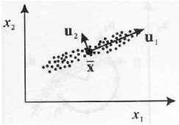
Geometric Interpretation
PCA projects the data along the directions where the data varies the most
These directions are determined by the Eigenvectors of the covariance (or correlation) matrix corresponding to the largest Eigenvalues
The magnitude of the Eigenvalues corresponds to the variance of the data along the Eigenvector directions

