Slide 1
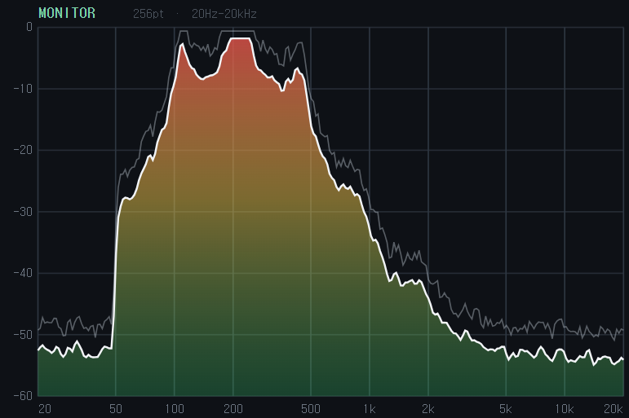
▲
DC9V
Keys
▼
🏠
▲
↩️
GG
◀
▼
▶
MIDI◀
🎧
MIDI▶

