Slide 1
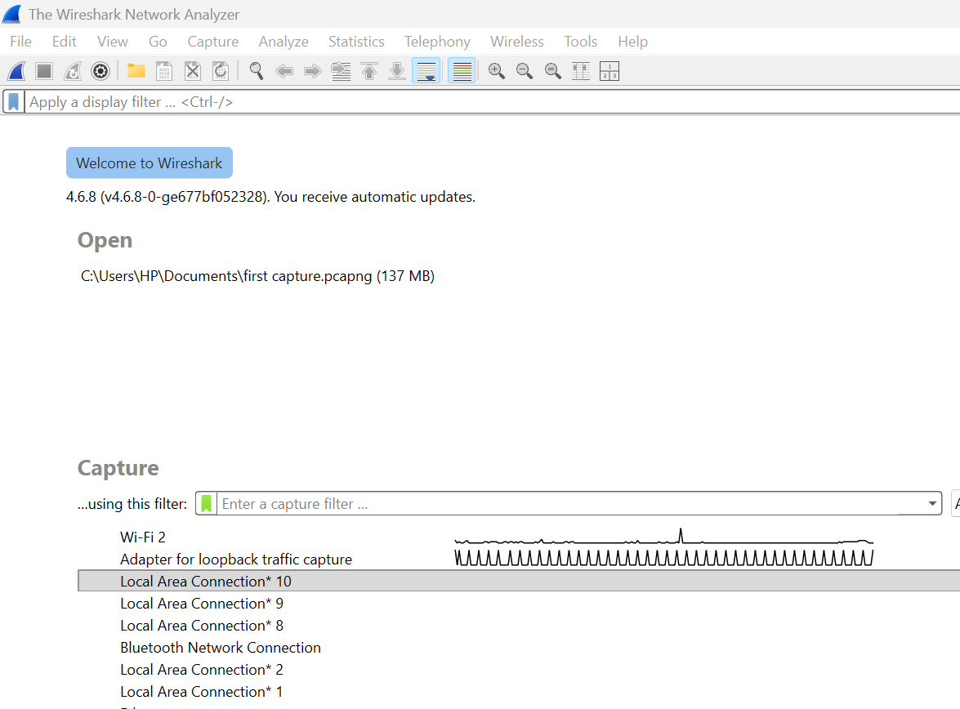
JENECONK ACADEMY
Wireshark Beginner Manual and Packet Analysis Guide
From opening the software to explaining captured traffic with evidence.
Student-facing resource for ethical hacking learners
JENECONK ACADEMY • ETHICAL HACKING RESOURCE • WIRESHARK 4.6.x

Slide 2
Why This Manual Starts Before Packet Analysis
LEARN
Before learning TCP, DNS or TLS, a beginner must know where everything is inside Wireshark.
• Wireshark is a full analysis workspace, not just a capture button.
• Students must know the menus, toolbars, filter boxes, panes, status bar and statistics windows.
• The first skill is answering simple questions: What file is open? Is capture running? How many packets exist? How long did capture last?
• Only after that should packet rows and protocol jargon be explained.
YOUR TURN
After this section, you should be able to guide yourself around the Wireshark screen without guessing.
JENECONK ACADEMY • ETHICAL HACKING RESOURCE • WIRESHARK 4.6.x

Slide 3
Learning Path
1
Launch Screen
2
Menus & Toolbars
3
Open vs Capture
4
Interface Selection
5
Status Bar
6
Capture File Properties
7
Packet List
8
Details & Bytes
9
Filters
10
Protocols
11
Statistics
12
Report
Do not rush. The software tour is part of the cybersecurity skill.
JENECONK ACADEMY • ETHICAL HACKING RESOURCE • WIRESHARK 4.6.x

Slide 4
Ethics and Safe Practice
LEARN
Packet capture can expose private information, so permission and scope must come first.
• Capture only your own device, your own lab, or a network you are explicitly authorised to inspect.
• Protect .pcapng files because they can contain addresses, hostnames, tokens, cookies and unencrypted content.
• Do not teach students that Wireshark is a hacking shortcut; teach it as an evidence and understanding tool.
• Security conclusions require context. A warning, colour or unfamiliar address is not proof of compromise.
YOUR TURN
Write the authorised scope of today's capture in one sentence before starting.
JENECONK ACADEMY • ETHICAL HACKING RESOURCE • WIRESHARK 4.6.x

Slide 5
PART 1
Launch Screen and Workspace Tour
This section explains the exact opening screen shown in your screenshot before any packet jargon appears.
JENECONK ACADEMY • ETHICAL HACKING RESOURCE • WIRESHARK 4.6.x

Slide 6
The Opening Screen When Wireshark Launches
A
Menu Bar: File, Edit, View, Go, Capture, Analyze, Statistics, Telephony, Wireless, Tools, Help.
B
Toolbar: quick buttons for common actions like start/stop capture, open, save, navigation and zoom.
C
Display Filter Bar: hides/shows already-captured packets after a capture file is open.
D
Open: recent saved capture files. Your screenshot shows first capture.pcapng (137 MB).
E
Capture: interfaces you can listen on for live packet capture.
JENECONK ACADEMY • ETHICAL HACKING RESOURCE • WIRESHARK 4.6.x

Slide 7
Window Title: How to Know Where You Are
LEARN
The title bar tells you whether Wireshark is idle, capturing, or viewing a saved file.
• On the welcome screen, the title says The Wireshark Network Analyzer.
• When a saved file is open, the title may show the filename such as first capture.pcapng or capture2.pcap.
• When a live capture is running, the title can show the interface being captured.
• Always check the title bar before teaching: it tells students whether they are looking at a live capture or saved evidence.
YOUR TURN
Look at the screenshots and identify which one is the welcome screen, which is first capture.pcapng, and which is capture2.pcap.
JENECONK ACADEMY • ETHICAL HACKING RESOURCE • WIRESHARK 4.6.x

Slide 8

Menu Bar: The Main Control Centre
File
Open, save, export and file properties
Statistics
Packet counts, duration, endpoints, conversations and graphs
Edit
Find, mark, copy and preferences
Telephony
VoIP/RTP-related analysis
View
Layout, columns, panes, time and colours
Wireless
Wireless-specific tools
Go
Move between packets
Tools
Utilities and extras
Capture
Choose interface and start/stop capture
Help
Docs, manual pages and About/version
Analyze
Filters, decoding, conversations and expert tools
JENECONK ACADEMY • ETHICAL HACKING RESOURCE • WIRESHARK 4.6.x

Slide 9
Toolbar: Shortcuts for Common Actions
• Toolbar icons are shortcuts to commands also found in the menus.
• Start Capture, Stop Capture and Restart Capture are among the most important capture controls.
• Open and Save shortcuts help you work with .pcapng files quickly.
• Navigation arrows help move through packet history or selected packets.
• Zoom and layout icons help make packet text readable during classroom projection.
Beginner rule: if you do not know an icon, use the menu name first. Menus are easier to explain than icons.
JENECONK ACADEMY • ETHICAL HACKING RESOURCE • WIRESHARK 4.6.x

Slide 10
Display Filter Bar: The Box at the Top
This box says: Apply a display filter …
• Use it after packets have been captured or a capture file has been opened.
• It hides packets that do not match the filter; it does not delete them.
• Examples: tcp, udp, dns, tls, ip.addr == 192.168.1.2.
• The arrow at the right applies the filter; pressing Enter also applies it.
• The plus button can help with filter buttons/shortcuts depending on configuration.
If a student says, 'my packets disappeared,' first check whether a display filter is active.
JENECONK ACADEMY • ETHICAL HACKING RESOURCE • WIRESHARK 4.6.x

Slide 11
Open Area: Reopen Saved Evidence
OPEN
This is where recent capture files appear.
Your screenshot shows: C:\Users\HP\Documents\first capture.pcapng (137 MB)
• Click the recent file to load it.
• Or use File → Open to browse for another capture.
• Opening a saved capture does not start a new capture.
• The file size tells you how large the saved evidence is—not how many packets it contains.
JENECONK ACADEMY • ETHICAL HACKING RESOURCE • WIRESHARK 4.6.x

Slide 12
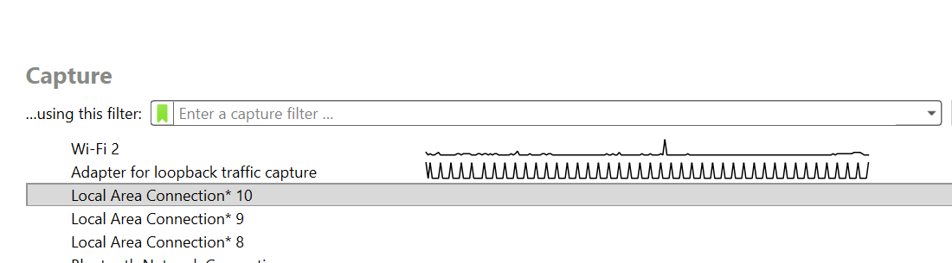
Capture Area: Start Live Packet Capture
• The list contains capture interfaces available on this computer.
• Double-clicking an interface starts a live capture on that interface.
• The small activity graph helps reveal which interface is currently seeing packets.
• Do not choose an interface just because it is highlighted.
In your screenshot, Local Area Connection* 10 is highlighted, but Wi‑Fi 2 is the likely choice for ordinary browser traffic because the computer is using Wi‑Fi.
Highlight ≠ correct interface. Activity + context = better decision.
JENECONK ACADEMY • ETHICAL HACKING RESOURCE • WIRESHARK 4.6.x

Slide 13
What Is a Capture Interface?
LEARN
A capture interface is the specific network doorway Wireshark listens on.
• Wi‑Fi interface: traffic entering/leaving through wireless network adapter.
• Ethernet interface: traffic entering/leaving through the wired network adapter.
• Loopback interface: traffic where the computer talks to itself, such as localhost or 127.0.0.1.
• USBPcap interface: USB-level traffic capture, not ordinary Internet browsing.
• Virtual Windows interfaces may appear as Local Area Connection* entries.
YOUR TURN
Before starting capture, say which interface matches the activity you want to observe and why.
JENECONK ACADEMY • ETHICAL HACKING RESOURCE • WIRESHARK 4.6.x

Slide 14
Your Interface List Explained
Wi‑Fi 2
Use this for ordinary wireless Internet traffic.
Adapter for loopback traffic capture
Use this for localhost/computer-to-itself traffic.
Local Area Connection* 10/9/8/2/1
Often Windows virtual or system-created interfaces. Confirm before use.
Bluetooth Network Connection
Bluetooth networking, not normal Wi‑Fi browsing.
Ethernet
Use if connected with LAN cable.
USBPcap1
USB traffic capture source, not web traffic.
For the beginner browser lesson, Wi‑Fi 2 is the best starting choice in your screenshot.
JENECONK ACADEMY • ETHICAL HACKING RESOURCE • WIRESHARK 4.6.x

Slide 15
Activity Graphs: The Small Moving Lines
• The line beside an interface is a quick activity graph.
• A flat or quiet graph can mean little or no visible traffic at that moment.
• A busy graph means packets are currently being seen on that interface.
• The loopback adapter may show heavy repeated activity if local applications are communicating internally.
• Use activity graphs together with your real connection type: Wi‑Fi, Ethernet, loopback, USB, etc.
JENECONK ACADEMY • ETHICAL HACKING RESOURCE • WIRESHARK 4.6.x

Slide 16
Capture Filter Box: Powerful but Risky for Beginners
This box says: Enter a capture filter …
• A capture filter acts before packets are saved.
• If traffic does not match, it may never enter your capture file.
• For beginner training, leave this empty unless the instructor gives a specific filter.
• Use display filters later for learning because they are safer and reversible.
Capture first. Display-filter afterward.
JENECONK ACADEMY • ETHICAL HACKING RESOURCE • WIRESHARK 4.6.x

Slide 17
Open a File or Start a New Capture?
OPEN SAVED CAPTURE
START LIVE CAPTURE
Use this when you want to analyse packets that were already recorded, such as first capture.pcapng.
Use this when you want Wireshark to begin recording packets from a selected interface now.
Opening a file is analysis of existing evidence. Starting capture creates new evidence.
Saved evidence: File → Open New evidence: double-click interface or Capture → Start
JENECONK ACADEMY • ETHICAL HACKING RESOURCE • WIRESHARK 4.6.x

Slide 18
Status Bar: The Bottom Line of the Window
• Left side: general status messages. In the screenshot it says 'Ready to load or capture'.
• Middle area: packet counters. On the welcome screen it says 'No Packets'.
• Right side: active profile. In the screenshot it says 'Profile: Default'.
• During or after capture, this area can show packet totals, displayed packets, dropped packets and related counters.
The status bar is the fastest place to check whether Wireshark has packets loaded.
JENECONK ACADEMY • ETHICAL HACKING RESOURCE • WIRESHARK 4.6.x

Slide 19
PART 2
Main Menu Tabs and What They Are For
This section answers: when would a student actually click each tab?
JENECONK ACADEMY • ETHICAL HACKING RESOURCE • WIRESHARK 4.6.x

Slide 20
File Menu
LEARN
Use File when the question is about capture files: open, save, export, print or file details.
• Open: load a saved .pcapng/.pcap capture file.
• Save / Save As: preserve the capture for later analysis.
• Export Specified Packets: save selected or filtered packets into a new file.
• Export Objects: extract supported captured objects, where available.
• Print: print packet information.
• File Properties or Capture File Properties access may be available depending on version/menu context.
YOUR TURN
Use File when you need to keep or reopen evidence.
JENECONK ACADEMY • ETHICAL HACKING RESOURCE • WIRESHARK 4.6.x

Slide 21
Edit Menu
LEARN
Use Edit when the question is about finding, marking, copying or changing settings.
• Find Packet: search within packets.
• Mark/Unmark Packet: identify packets you want to return to later.
• Ignore/Unignore Packet: exclude packets from some analyses without deleting them.
• Copy: copy packet fields or values.
• Preferences: configure Wireshark behaviour, appearance, name resolution and protocol settings.
YOUR TURN
Use Edit → Find Packet to search for a packet containing a known IP, protocol field or value.
JENECONK ACADEMY • ETHICAL HACKING RESOURCE • WIRESHARK 4.6.x

Slide 22
View Menu
LEARN
Use View when the question is about how Wireshark looks or displays packet information.
• Show or hide Packet List, Packet Details and Packet Bytes panes.
• Control layout and column display.
• Adjust time display format.
• Control name resolution display.
• Manage colouring rules and packet colourisation.
• Zoom in/out for teaching on a projector.
YOUR TURN
If students cannot see Packet Details or Packet Bytes, check View first.
JENECONK ACADEMY • ETHICAL HACKING RESOURCE • WIRESHARK 4.6.x

Slide 23
Go Menu
LEARN
Use Go when the question is about moving through packets.
• Go to a specific packet number.
• Move to first or last packet.
• Move to previous or next packet.
• Jump between marked packets.
• Navigate in packet history after selecting different packets.
YOUR TURN
If your teacher says 'go to packet 20,' use Go → Go To Packet or click the packet number directly.
JENECONK ACADEMY • ETHICAL HACKING RESOURCE • WIRESHARK 4.6.x

Slide 24
Capture Menu
LEARN
Use Capture when the question is about starting, stopping or configuring live capture.
• Options: choose interfaces and configure capture settings.
• Start: begin capture.
• Stop: stop an active capture.
• Restart: stop and immediately start again.
• Capture Filters: manage filters that decide what gets recorded.
YOUR TURN
Use Capture → Options when you want more control than double-clicking an interface.
JENECONK ACADEMY • ETHICAL HACKING RESOURCE • WIRESHARK 4.6.x

Slide 25
Analyze Menu
LEARN
Use Analyze when the question is about interpreting or controlling packet analysis.
• Display Filters: work with saved or recent display filters.
• Enabled Protocols: choose which protocol dissectors are enabled.
• Decode As: tell Wireshark to interpret traffic as a different protocol where appropriate.
• Follow Stream: reconstruct supported conversations.
• Expert Information: view analysis warnings, notes and errors.
• Conversation Filter: quickly filter around a selected conversation.
YOUR TURN
Use Analyze when you are no longer just collecting packets—you are investigating them.
JENECONK ACADEMY • ETHICAL HACKING RESOURCE • WIRESHARK 4.6.x

Slide 26
Statistics Menu
LEARN
Use Statistics when the question is about totals, summaries, conversations and graphs.
• Capture File Properties: file path, size, first/last packet time, duration and packet statistics.
• Protocol Hierarchy: which protocols appear and how much traffic each accounts for.
• Conversations: pairs of communicating endpoints.
• Endpoints: individual addresses/devices seen in the capture.
• I/O Graphs: packet/byte activity over time.
• TCP Stream Graphs: visual TCP behaviour for selected streams.
YOUR TURN
This is where you answer: How many packets? How long did capture last? Who talked to whom?
JENECONK ACADEMY • ETHICAL HACKING RESOURCE • WIRESHARK 4.6.x

Slide 27
Telephony, Wireless, Tools and Help Menus
LEARN
These menus support specialised analysis and learning.
• Telephony: VoIP, SIP, RTP and related telecom analysis tools.
• Wireless: wireless-specific analysis features where supported by capture hardware and drivers.
• Tools: extra utilities, firewall ACL tools and other supporting functions depending on installation.
• Help: documentation, manual pages, website links and About Wireshark/version information.
• Beginners should not worry if Telephony and Wireless are not used in the first class.
YOUR TURN
Click Help when you need official explanation instead of guessing from random online tutorials.
JENECONK ACADEMY • ETHICAL HACKING RESOURCE • WIRESHARK 4.6.x

Slide 28
PART 3
Where to Find Packet Count and Capture Duration
A beginner must know how to answer basic evidence questions before interpreting traffic.
JENECONK ACADEMY • ETHICAL HACKING RESOURCE • WIRESHARK 4.6.x

Slide 29
Where Do I See the Total Number of Packets?
• On the welcome screen, the status bar says No Packets because no capture file is loaded.
• After capture starts or a saved file is opened, the bottom status area shows packet counters.
• Packets = total captured packets in the file/capture.
• Displayed = packets currently visible after a display filter is applied.
• Dropped appears when Wireshark reports packets it could not capture.
• Ignored/Marked can appear if you ignore or mark packets.
Visible rows are not the total. Scrolling shows more rows, but the status bar and Statistics windows give the count.
JENECONK ACADEMY • ETHICAL HACKING RESOURCE • WIRESHARK 4.6.x

Slide 30
Where Do I See How Long the Capture Took?
BEST PLACE
Statistics → Capture File Properties
• The Time section shows the first packet time, last packet time and the difference between them.
• That difference is the capture duration.
• The Statistics section gives packet counts, bytes, average rates and displayed/marked values.
• The packet-list Time column is useful, but it is not the complete capture summary.
Menu path: Statistics → Capture File Properties
JENECONK ACADEMY • ETHICAL HACKING RESOURCE • WIRESHARK 4.6.x

Slide 31
Capture File Properties: What to Look For
File
Full path, size, format and related file details.
Time
First packet, last packet and elapsed time between them.
Capture
Information about how the capture was made, if stored in the file.
Interfaces
Interfaces involved in the capture.
Statistics
Packet counts, bytes, packet rates and displayed/marked summaries.
Comments
Notes saved with the capture file where supported.
Use this dialog whenever a report needs accurate capture totals or time range.
JENECONK ACADEMY • ETHICAL HACKING RESOURCE • WIRESHARK 4.6.x

Slide 32
Practice: Answer the Evidence Questions
LEARN
When a teacher or client asks basic capture questions, answer from Wireshark—not from guessing.
• Question 1: What is the name of the open capture file?
• Question 2: How many packets are in the capture?
• Question 3: How long did the capture last?
• Question 4: How many packets are currently displayed after any filter?
• Question 5: Were any packets dropped during capture?
• Question 6: What interface or interfaces were used?
YOUR TURN
Open Statistics → Capture File Properties and fill these six answers into your notebook.
JENECONK ACADEMY • ETHICAL HACKING RESOURCE • WIRESHARK 4.6.x

Slide 33
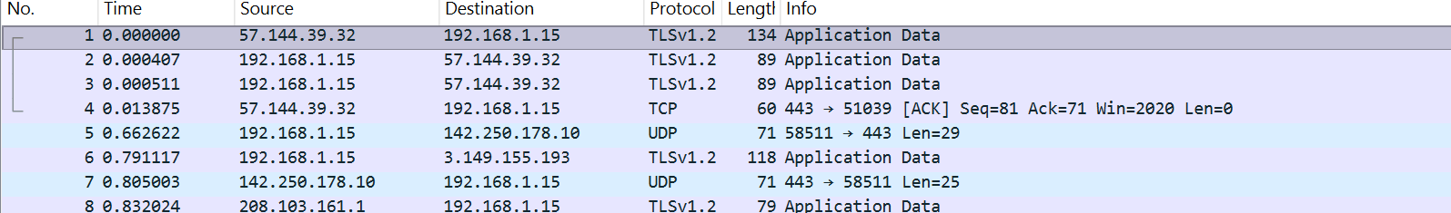
Visible Rows Are Not the Same as Total Packets
• In this screenshot, we can see packet rows 1 to 27 on screen.
• That does not mean the capture contains only 27 packets.
• The packet list is a window into the file, not the whole file at once.
• The scrollbar on the right indicates there are more packets above/below depending on the file and scroll position.
• For the real total, use the bottom status bar or Statistics → Capture File Properties.
JENECONK ACADEMY • ETHICAL HACKING RESOURCE • WIRESHARK 4.6.x

Slide 34
PART 4
Opening a Capture and Reading the Workspace
Now that you know the software, we can open the sample captures and understand the packet screen.
JENECONK ACADEMY • ETHICAL HACKING RESOURCE • WIRESHARK 4.6.x

Slide 35
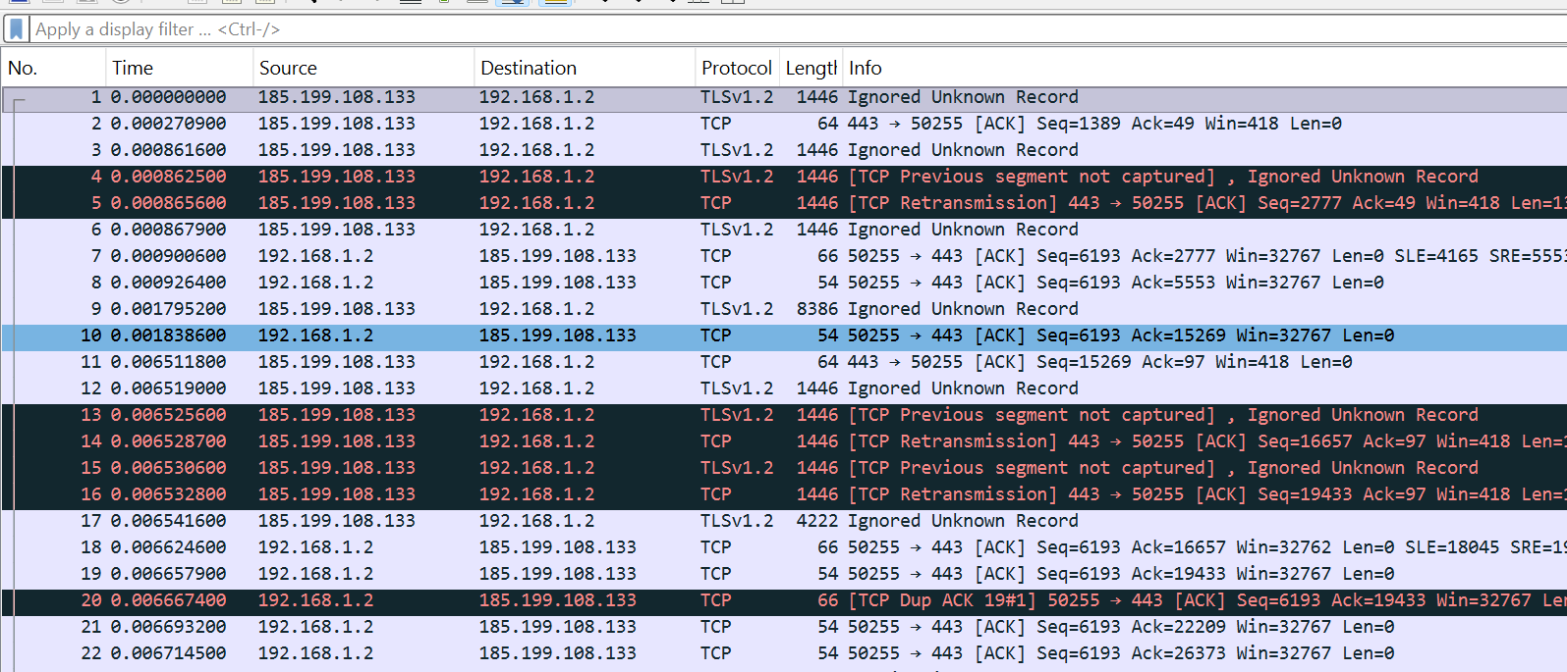
Opening first capture.pcapng
Now the Packet List is populated. Wireshark is no longer on the welcome screen.
JENECONK ACADEMY • ETHICAL HACKING RESOURCE • WIRESHARK 4.6.x

Slide 36
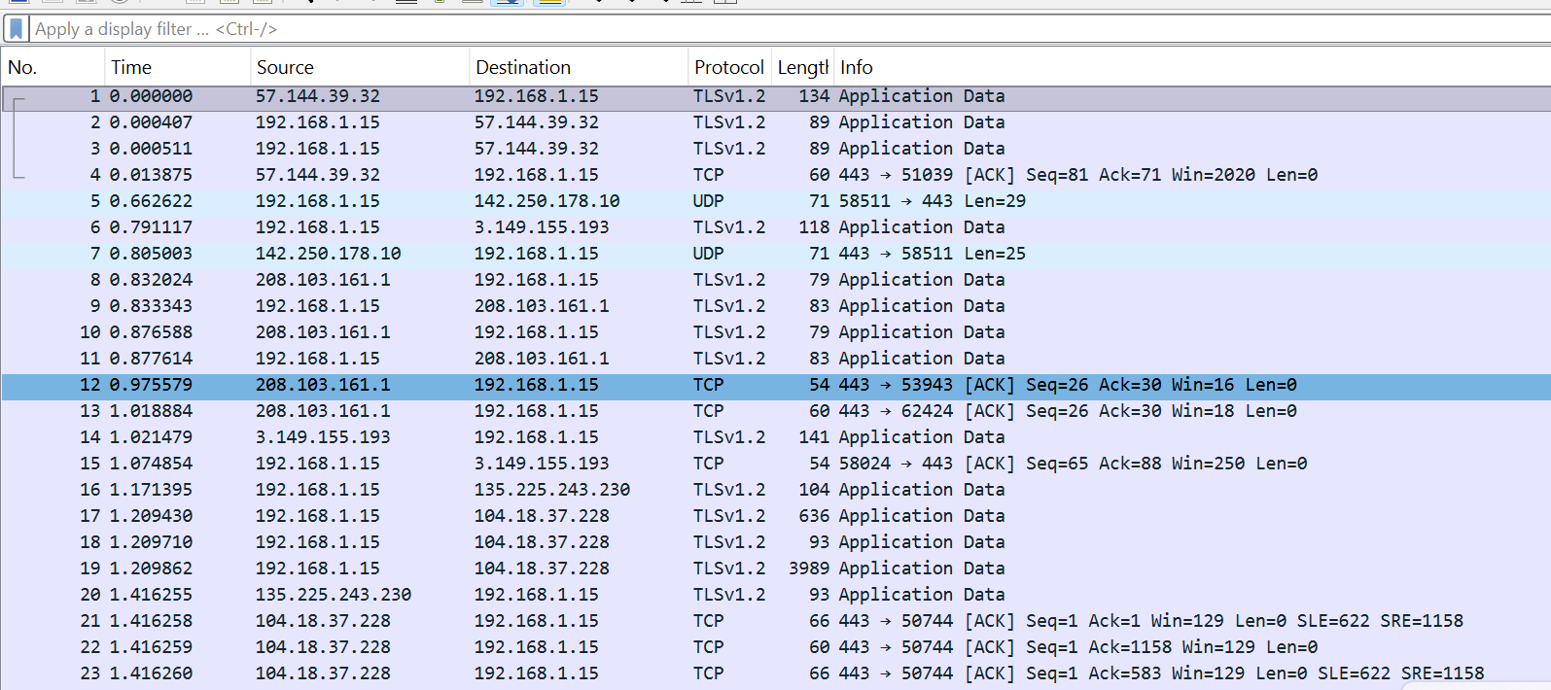
Opening capture2.pcap
The title bar shows capture2.pcap. The packet list begins at packet No. 1 and the Time column starts from 0.
JENECONK ACADEMY • ETHICAL HACKING RESOURCE • WIRESHARK 4.6.x

Slide 37
The Packet Screen Has Three Main Panes
1 Packet List
Rows of captured packets: No., Time, Source, Destination, Protocol, Length and Info.
2 Packet Details
Decoded layers of the selected packet.
3 Packet Bytes
Raw hexadecimal and ASCII representation.
JENECONK ACADEMY • ETHICAL HACKING RESOURCE • WIRESHARK 4.6.x

Slide 38
Packet List Columns
No.
Packet number inside this file.
Time
Seconds/time relative to the chosen display format.
Source
Sender address.
Destination
Receiver address.
Protocol
Protocol Wireshark decoded.
Length
Packet/frame size in bytes.
Info
Short summary of the packet.
Read every row as a sentence before expanding technical details.
JENECONK ACADEMY • ETHICAL HACKING RESOURCE • WIRESHARK 4.6.x

Slide 39
No. and Time Columns
LEARN
The first two columns help you locate packets and understand the sequence.
• No. is the packet number inside the current capture file.
• Time usually starts at 0.000000 for the first packet in the capture file.
• In capture2.pcap, packet 1 shows 0.000000 and packet 27 shows about 1.416264 in the visible area.
• That visible time range is not automatically the full capture duration unless packet 27 is the last packet in the file.
• Use Capture File Properties for the authoritative first/last packet time and duration.
YOUR TURN
Explain why packet No. 27 on screen does not necessarily mean the file has only 27 packets.
JENECONK ACADEMY • ETHICAL HACKING RESOURCE • WIRESHARK 4.6.x

Slide 40
Source and Destination Columns
LEARN
These columns answer who sent the packet and who received it.
• In capture2.pcap, 192.168.1.15 appears repeatedly. That is likely the local device in that capture.
• External-looking addresses such as 57.144.39.32, 142.250.178.10 and 208.103.161.1 are remote endpoints.
• Direction matters: 192.168.1.15 → remote means local outgoing traffic; remote → 192.168.1.15 means incoming traffic.
• Do not call an external IP malicious only because you do not recognise it.
YOUR TURN
Pick packet 5 in capture2 and say who is sending to whom.
JENECONK ACADEMY • ETHICAL HACKING RESOURCE • WIRESHARK 4.6.x

Slide 41
Protocol, Length and Info Columns
LEARN
These columns summarise what kind of communication is happening.
• Protocol shows Wireshark's decoded protocol label, such as TCP, UDP or TLSv1.2.
• Length shows packet size in bytes.
• Info gives a human-readable summary: Application Data, ACK, port numbers, sequence/ack information and analysis notes.
• The Info column is useful, but it is still a summary. Expand Packet Details for evidence.
YOUR TURN
Read packet 12 in capture2 aloud using Source, Destination, Protocol, Length and Info.
JENECONK ACADEMY • ETHICAL HACKING RESOURCE • WIRESHARK 4.6.x

Slide 42
Packet Details Pane: Expand the Selected Packet
• Click one packet row in the Packet List.
• The Packet Details pane shows decoded layers for that selected packet.
• Common layers include Frame, Ethernet II, IPv4, TCP/UDP and application protocols.
• Use the small arrow/triangle beside a layer to expand it.
• Packet Details is where you confirm what the Info column only summarised.
A professional answer points to a field in Packet Details, not only to the coloured row.
JENECONK ACADEMY • ETHICAL HACKING RESOURCE • WIRESHARK 4.6.x

Slide 43
Packet Bytes Pane
LEARN
The Packet Bytes pane shows the underlying bytes of the selected packet.
• The left side shows byte offsets.
• The middle shows hexadecimal bytes.
• The right side shows printable ASCII characters where possible.
• Beginners do not need to memorise hexadecimal immediately.
• Use Packet Bytes to understand that Wireshark is decoding real binary data, not inventing the fields.
YOUR TURN
Click any field in Packet Details and notice how the related bytes are highlighted below.
JENECONK ACADEMY • ETHICAL HACKING RESOURCE • WIRESHARK 4.6.x

Slide 44
PART 5
Reading Real Packet Rows as Network Stories
Now we can begin interpreting protocols using the actual sample captures.
JENECONK ACADEMY • ETHICAL HACKING RESOURCE • WIRESHARK 4.6.x

Slide 45
Case Row: capture2 Packet 12
208.103.161.1 → 192.168.1.15 TCP 443 → 53943 [ACK] Len=0
SOURCE
DESTINATION
PROTOCOL
PORTS
208.103.161.1
192.168.1.15
TCP
443 → 53943
Plain English: a remote endpoint sent a TCP acknowledgement from port 443 to local temporary port 53943.
Len=0 means this TCP segment carries no application payload; it can still carry acknowledgement/control information.
JENECONK ACADEMY • ETHICAL HACKING RESOURCE • WIRESHARK 4.6.x

Slide 46
Case Row: first capture Packet 5
185.199.108.133 → 192.168.1.2 TCP [TCP Retransmission] 443 → 50255 [ACK] Len=1388
• Source: 185.199.108.133 — remote endpoint.
• Destination: 192.168.1.2 — local device in that earlier capture.
• Protocol: TCP.
• Ports: remote port 443 to local temporary port 50255.
• Info: Wireshark believes this segment is a retransmission.
• Len=1388 means it carries TCP payload bytes.
Retransmission is a technical observation to investigate. It is not automatic proof of hacking.
JENECONK ACADEMY • ETHICAL HACKING RESOURCE • WIRESHARK 4.6.x

Slide 47
Encapsulation: Why Packet Details Has Layers
LEARN
Each layer performs a different job, and Wireshark shows them stacked.
• Frame: what Wireshark captured and metadata about the capture.
• Ethernet II: local link delivery using MAC addresses.
• 802.1Q VLAN: VLAN tagging, where present.
• IPv4/IPv6: logical network addressing.
• TCP/UDP: transport ports and delivery behaviour.
• TLS/HTTP/DNS/QUIC: application or security-related protocols above transport.
YOUR TURN
Open a packet and name each layer shown from top to bottom.
JENECONK ACADEMY • ETHICAL HACKING RESOURCE • WIRESHARK 4.6.x

Slide 48
MAC Address vs IP Address
LEARN
Do not confuse local link addresses with routed network addresses.
• MAC addresses operate at the local network/link layer.
• IP addresses operate at the network layer and can represent remote endpoints.
• Your Packet Details may show a local router/ZTE MAC and your Intel adapter MAC while the IP layer shows remote Internet addresses.
• This is normal because frames are rewritten across network hops.
YOUR TURN
Explain why the remote website's MAC address is not normally visible on your laptop's Ethernet/Wi‑Fi frame.
JENECONK ACADEMY • ETHICAL HACKING RESOURCE • WIRESHARK 4.6.x

Slide 49
Private IPv4 Addresses in the Samples
LEARN
The captures show local private addresses such as 192.168.1.2 and 192.168.1.15.
• 192.168.x.x addresses are commonly used inside home, school and office networks.
• Private addresses identify devices inside the local network.
• Remote endpoints usually appear as non-private public IP addresses.
• Filtering by the local private IP is a quick way to isolate traffic involving your machine.
YOUR TURN
Apply ip.addr == 192.168.1.15 on capture2.pcap and observe the result.
JENECONK ACADEMY • ETHICAL HACKING RESOURCE • WIRESHARK 4.6.x

Slide 50
Ports: The Service Clue
LEARN
Ports help identify which transport endpoint is involved in a communication.
• 443 is commonly HTTPS/TLS traffic.
• 80 is commonly HTTP traffic.
• 53 is commonly DNS traffic.
• High temporary ports such as 53943, 50255 or 58511 are often client-side ephemeral ports.
• A port number is a clue, not final proof; confirm with protocol decoding and context.
YOUR TURN
Find one row with 443 → local temporary port and explain the direction.
JENECONK ACADEMY • ETHICAL HACKING RESOURCE • WIRESHARK 4.6.x

Slide 51
TCP Basics
LEARN
TCP is a connection-oriented transport protocol designed for reliable ordered byte streams.
• TCP uses ports to connect application endpoints.
• TCP uses sequence numbers to order bytes.
• TCP uses acknowledgements to confirm received data.
• TCP uses window information for flow control.
• Wireshark adds analysis labels when it detects notable TCP behaviour.
YOUR TURN
When you see [ACK], say what is being acknowledged in plain language.
JENECONK ACADEMY • ETHICAL HACKING RESOURCE • WIRESHARK 4.6.x

Slide 52
Common TCP Flags
LEARN
Flags tell the role of a TCP segment.
• SYN: start/synchronise a connection.
• ACK: acknowledgement information is valid.
• PSH: push data to the application promptly.
• FIN: orderly close.
• RST: reset/abort.
• URG: urgent pointer mechanism; uncommon in everyday traffic.
YOUR TURN
Find a packet with [PSH, ACK]. What two roles are present?
JENECONK ACADEMY • ETHICAL HACKING RESOURCE • WIRESHARK 4.6.x

Slide 53
Seq, Ack, Win and Len
LEARN
These fields explain how TCP tracks delivery and flow.
• Seq: sequence position in the byte stream.
• Ack: next sequence position expected from the other side.
• Win: receive-window value for flow control.
• Len: TCP payload length.
• Len=0 can still be useful because the segment can acknowledge traffic even without application data.
YOUR TURN
Write one plain-English sentence explaining packet 12 from capture2.
JENECONK ACADEMY • ETHICAL HACKING RESOURCE • WIRESHARK 4.6.x

Slide 54
TLSv1.2 and Application Data
LEARN
Modern web and app traffic is commonly encrypted, so you may not see readable website content.
• TLS protects application-layer data.
• Application Data means protected application traffic is flowing.
• Seeing TLSv1.2 or Application Data is normal.
• Do not try to bypass encryption in a class exercise.
• Record endpoints, ports, timing and protocol behaviour instead.
YOUR TURN
Filter tls and identify one encrypted flow without attempting to read the protected content.
JENECONK ACADEMY • ETHICAL HACKING RESOURCE • WIRESHARK 4.6.x

Slide 55
UDP and QUIC
LEARN
Not all web-related traffic is TCP.
• UDP does not use the TCP three-way handshake or TCP sequence/ack reliability.
• QUIC is a modern encrypted transport commonly associated with HTTP/3-style traffic over UDP.
• In capture2, a UDP row shows traffic involving port 443.
• Do not assume UDP 443 is wrong simply because older HTTPS examples used TCP 443.
YOUR TURN
Apply udp and record one UDP conversation.
JENECONK ACADEMY • ETHICAL HACKING RESOURCE • WIRESHARK 4.6.x

Slide 56
DNS, ARP and ICMP
LEARN
These protocols explain name lookup, local address resolution and basic diagnostics.
• DNS translates names into address-related answers.
• ARP maps local IPv4 addresses to MAC addresses on the local link.
• ICMP is used for network control and diagnostics; ping commonly uses Echo Request and Echo Reply.
• These protocols help you understand the environment before analysing encrypted traffic.
YOUR TURN
Capture a ping to your authorised gateway and filter icmp.
JENECONK ACADEMY • ETHICAL HACKING RESOURCE • WIRESHARK 4.6.x

Slide 57
PART 6
Filters, Statistics and Investigation Workflow
These tools turn a busy capture into understandable evidence.
JENECONK ACADEMY • ETHICAL HACKING RESOURCE • WIRESHARK 4.6.x

Slide 58
Starter Display Filters
tcp
Show TCP
quic
Show QUIC
udp
Show UDP
ip.addr == 192.168.1.15
To/from local device in capture2
dns
Show DNS
ip.src == 192.168.1.15
Outgoing from local device
arp
Show ARP
ip.dst == 192.168.1.15
Incoming to local device
icmp
Show ICMP
tcp.port == 443
TCP port 443
tls
Show TLS
udp.port == 443
UDP port 443
JENECONK ACADEMY • ETHICAL HACKING RESOURCE • WIRESHARK 4.6.x

Slide 59
Combine Filters with Logic
LEARN
Use and, or, not and parentheses to focus on exactly what you want.
• `and` means both conditions must be true.
• `or` means either condition can be true.
• `not` excludes matching packets.
• Parentheses make the logic clear.
• Always read your filter aloud before applying it.
ip.addr == 192.168.1.15 and tcp.port == 443
YOUR TURN
Build a filter for traffic involving 192.168.1.15 and TCP port 443.
JENECONK ACADEMY • ETHICAL HACKING RESOURCE • WIRESHARK 4.6.x

Slide 60
How to Return to All Packets
LEARN
Beginners often think packets are gone when only a display filter is hiding them.
• Look at the display filter bar.
• If text is present, a filter may be active.
• Clear the filter text and press Enter.
• Displayed packet count should return to the full captured count.
• Remember: display filters hide; they do not delete.
YOUR TURN
Apply dns, then clear the filter and confirm that all packets return.
JENECONK ACADEMY • ETHICAL HACKING RESOURCE • WIRESHARK 4.6.x

Slide 61
Follow Stream
LEARN
Follow Stream reconstructs a supported conversation so you can read the exchange more naturally.
• Right-click a relevant packet.
• Choose Follow, then select the appropriate stream type such as TCP, UDP, TLS, HTTP/2 or QUIC when available.
• Wireshark applies a conversation filter automatically.
• After closing the stream, clear or adjust the filter if needed.
• Use this for understanding one conversation—not for judging the entire capture.
YOUR TURN
Follow one TCP stream and identify both endpoints.
JENECONK ACADEMY • ETHICAL HACKING RESOURCE • WIRESHARK 4.6.x

Slide 62
Statistics → Protocol Hierarchy
LEARN
Use this before scrolling through thousands of packets.
• Shows which protocols appear in the capture.
• Shows packet and byte percentages.
• Helps answer: What kinds of traffic dominate this capture?
• Remember that one packet can contain multiple protocols, so protocol percentages can exceed simple row-count thinking.
YOUR TURN
Open Protocol Hierarchy and list the top five protocols.
JENECONK ACADEMY • ETHICAL HACKING RESOURCE • WIRESHARK 4.6.x

Slide 63
Statistics → Endpoints and Conversations
LEARN
Use these views to identify who appeared and who talked to whom.
• Endpoints are individual addresses/devices seen in the capture.
• Conversations are pairs of endpoints communicating.
• Sort by packets or bytes to find the busiest communications.
• Use this before accusing an unknown IP address of anything.
• Then apply filters to inspect the important conversations.
YOUR TURN
Open Conversations and identify the busiest IPv4 or TCP conversation.
JENECONK ACADEMY • ETHICAL HACKING RESOURCE • WIRESHARK 4.6.x

Slide 64
Statistics → I/O Graphs
LEARN
I/O Graphs show traffic volume over time.
• Useful for spotting bursts, silence, spikes or repeating patterns.
• Can help compare what happened before, during and after a user action.
• Filters can be used to graph specific protocol traffic.
• Graphs support troubleshooting but still require packet-level evidence.
YOUR TURN
Graph all packets, then graph only tcp traffic if available.
JENECONK ACADEMY • ETHICAL HACKING RESOURCE • WIRESHARK 4.6.x

Slide 65
Analyze → Expert Information
LEARN
Expert Information highlights notable protocol behaviour, but it is not a verdict.
• Expert entries can include notes, warnings and errors depending on protocol analysis.
• Previous segment not captured, retransmission, duplicate ACK and out-of-order labels require context.
• The presence of Expert Info does not prove an attack.
• The absence of Expert Info does not prove there is no issue.
• Use it as a starting point for investigation.
YOUR TURN
Open Expert Information and write one item as: Observation → Possible explanations → What evidence is needed.
JENECONK ACADEMY • ETHICAL HACKING RESOURCE • WIRESHARK 4.6.x

Slide 66
Packet Colours
LEARN
Colours are visual aids created by colouring rules.
• Dark or red-looking rows do not automatically mean hacking.
• Different Wireshark profiles can display colours differently.
• Read the Protocol and Info columns, then expand Packet Details.
• Teach students to say what the packet shows, not what colour it is.
YOUR TURN
Choose one coloured row and explain it without mentioning the colour.
JENECONK ACADEMY • ETHICAL HACKING RESOURCE • WIRESHARK 4.6.x

Slide 67
PART 7
Hands-On Labs and Student Reports
The learner now practises finding software features, totals, time ranges and packet meaning.
JENECONK ACADEMY • ETHICAL HACKING RESOURCE • WIRESHARK 4.6.x

Slide 68
Lab 1 — Launch Screen Tour
LEARN
Goal: prove that you know the Wireshark workspace before starting capture.
• Identify the Menu Bar.
• Identify the Toolbar.
• Identify the Display Filter Bar.
• Identify the Open area.
• Identify the Capture area.
• Identify the Status Bar.
• Name the interface you would choose for browser traffic and explain why.
YOUR TURN
Submit a labelled screenshot or written list of the seven areas.
JENECONK ACADEMY • ETHICAL HACKING RESOURCE • WIRESHARK 4.6.x

Slide 69
Lab 2 — Packet Count and Capture Duration
LEARN
Goal: answer basic evidence questions correctly.
• Open a saved capture file.
• Look at the bottom status bar for packet counters.
• Go to Statistics → Capture File Properties.
• Record total packets, displayed packets, first packet time, last packet time and duration.
• Apply a display filter and check how displayed count changes.
YOUR TURN
Deliverable: packet total, displayed total, capture duration and menu path used.
JENECONK ACADEMY • ETHICAL HACKING RESOURCE • WIRESHARK 4.6.x

Slide 70
Lab 3 — Open vs Capture
LEARN
Goal: distinguish saved evidence from live evidence.
• Open first capture.pcapng.
• Close it or return to the welcome screen.
• Start a fresh capture on the correct interface.
• Stop after 10 seconds.
• Save it as a new .pcapng file.
• Reopen the saved file.
YOUR TURN
Explain the difference between opening a file and starting a capture.
JENECONK ACADEMY • ETHICAL HACKING RESOURCE • WIRESHARK 4.6.x

Slide 71
Lab 4 — Explain One Packet Row
LEARN
Goal: turn a packet row into plain English.
• Choose one TCP row.
• Record No., Time, Source, Destination, Protocol, Length and Info.
• Explain direction using source and destination.
• Explain the port direction.
• State what can be concluded and what cannot.
YOUR TURN
Deliverable: one packet row translated into a beginner-friendly sentence.
JENECONK ACADEMY • ETHICAL HACKING RESOURCE • WIRESHARK 4.6.x

Slide 72
Lab 5 — Filters
LEARN
Goal: use display filters without losing evidence.
• Apply tcp.
• Apply tls.
• Apply ip.addr == your local IP.
• Apply tcp.port == 443.
• Clear the filter and return to all packets.
• Record how the displayed packet count changes.
YOUR TURN
Deliverable: five filters used and what each revealed.
JENECONK ACADEMY • ETHICAL HACKING RESOURCE • WIRESHARK 4.6.x

Slide 73
Lab 6 — Statistics First
LEARN
Goal: avoid random scrolling.
• Open Capture File Properties.
• Open Protocol Hierarchy.
• Open Endpoints.
• Open Conversations.
• Open I/O Graphs.
• Write three facts learned from statistics before inspecting individual packets.
YOUR TURN
Deliverable: three statistics-based observations.
JENECONK ACADEMY • ETHICAL HACKING RESOURCE • WIRESHARK 4.6.x

Slide 74
Student Report Template
Capture filename
________________
Top protocols
________________
Interface / scope
________________
Main endpoints
________________
Total packets
________________
Main conversations
________________
Displayed packets
________________
Important filters used
________________
Capture duration
________________
Findings
________________
First packet / last packet
________________
Limitations
________________
Good reports separate observed evidence from interpretation.
JENECONK ACADEMY • ETHICAL HACKING RESOURCE • WIRESHARK 4.6.x

Slide 75
Common Beginner Mistakes
LEARN
Most early errors come from confusing the software view with the actual evidence.
• Assuming visible rows equal total packets.
• Assuming a highlighted interface is the correct interface.
• Using capture filters too early and losing evidence.
• Thinking display-filtered packets were deleted.
• Calling every red/dark row malicious.
• Using packet colour instead of Packet Details.
• Guessing duration from visible rows instead of Capture File Properties.
YOUR TURN
Pick one mistake and explain how to avoid it in class.
JENECONK ACADEMY • ETHICAL HACKING RESOURCE • WIRESHARK 4.6.x

Slide 76
Publishing This on the Jeneconk Website
LEARN
This deck should function as a public ethical-hacking learning resource.
• Use this PPTX as the downloadable instructor/student deck.
• Create a PDF version for easier reading on phones.
• Create a companion webpage summarising the launch screen, packet count/duration, and first capture workflow.
• Include safety language: authorised capture only.
• Add screenshots gradually as students encounter new Wireshark screens.
YOUR TURN
On the webpage, place 'Where do I find total packets and capture duration?' near the top, not near the end.
JENECONK ACADEMY • ETHICAL HACKING RESOURCE • WIRESHARK 4.6.x

Slide 77
Technical Grounding and Further Reading
• Wireshark User's Guide — user interface, capture workflow, packet panes, status bar and statistics.
• Wireshark Capture File Properties documentation — file details, time, capture environment, interfaces and statistics.
• Wireshark Statistics documentation — Protocol Hierarchy, Conversations, Endpoints, I/O Graphs and protocol-specific statistics.
• Wireshark Display Filter documentation — syntax and field-based filtering.
• Wireshark Expert Information documentation — warnings, notes and protocol-analysis observations.
Official documentation hub: https://www.wireshark.org/docs/
Use official documentation when menu labels or protocol behaviour change between releases.
JENECONK ACADEMY • ETHICAL HACKING RESOURCE • WIRESHARK 4.6.x

Slide 78
FINAL PRINCIPLE
First know the workspace. Then read the packets. Then make evidence-based conclusions.
Where are the packets? How many are there? How long did the capture last? What does one row prove?
Practice • Analyse • Understand • Secure
JENECONK ACADEMY • ETHICAL HACKING RESOURCE • WIRESHARK 4.6.x

