Slide 1
AVFoundation
William Colbert

Slide 2
Table of Contents
What is AVFoundation
UIImagePickerController vs AVCaptureSession
Components of AVFoundation Media Capture
From Zero to AVCaptureVideoPreviewLayer

Slide 3
What is AVFoundation
One of many IOS frameworks, which can be used to create, edit, re-create media files.
Retrieve input streams from devices and capture and playback such media.

Slide 4
UIImagePickerController vs AVCaptureSession
Use UIImagePickerController when you need minimal control over handling of streams.
Use AVFoundation when you need to manipulate input streams or re-encode etc.
Use AVFoundation to have more control over viewing of Image / Video Preview of input stream.

Slide 5
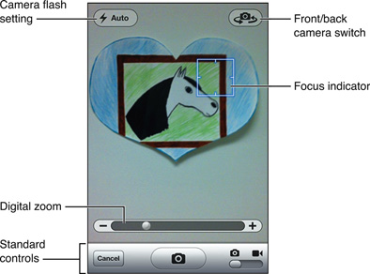
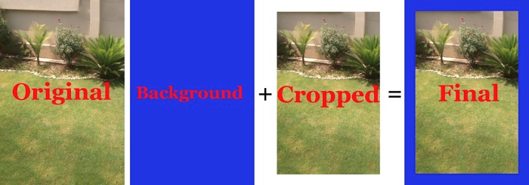

Slide 6
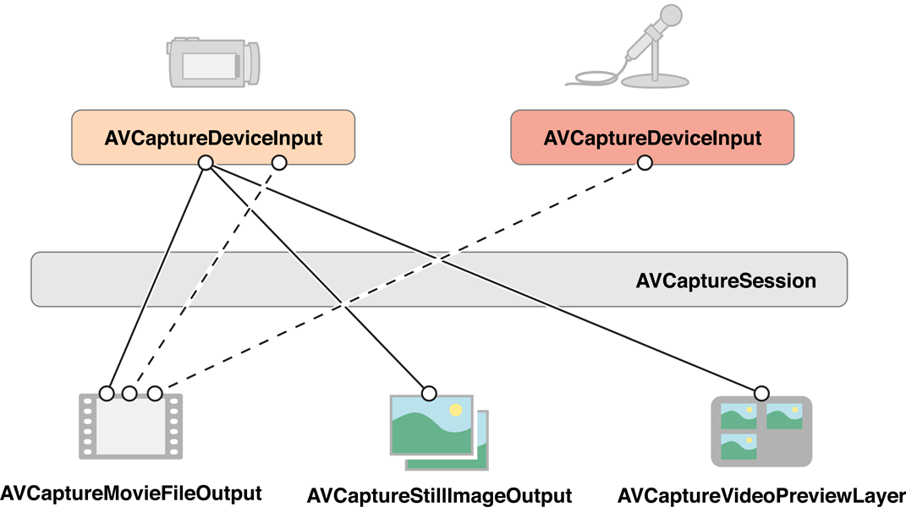
Components of AVFoundation Media Capture
AVCaptureDeviceInput
AVCaptureSession
AVCaptureVideoPreviewLayer
AVCaptureMovieFileOutput
AVCaptureStillImageOutput

Slide 7
From Zero to AVCaptureVideoPreviewLayer
Live Coding

Slide 8
Thank You

