Slide 1
<MeritBadge> <Programming /> </MeritBadge>
Presentation by Zach Colbert
Adapted from materials by Robert Baker

Slide 2



About Me

Slide 3


About Me
{ }

Slide 4
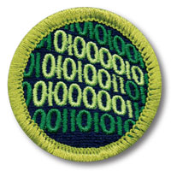
Requirements

Slide 5
What is Programming?
Writing instructions for a machine.
Computers do very simple math – we build on that to do complicated tasks.
Programming is not just for software developers anymore.
Programmed devices are everywhere – someone has to program them!
Different industries use different techniques, languages, systems…
This merit badge just scrapes the surface.

Slide 6
Programming Safety

Slide 7
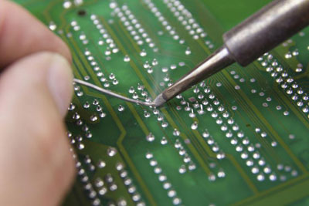
Equipment Safety
Electric Discharges
Keep liquids away!
Power cords in good condition.
Unplug from power before removing components.
Cuts and Scrapes
Watch out for sharp metal parts, solder joints, cardboard boxes...

Slide 8
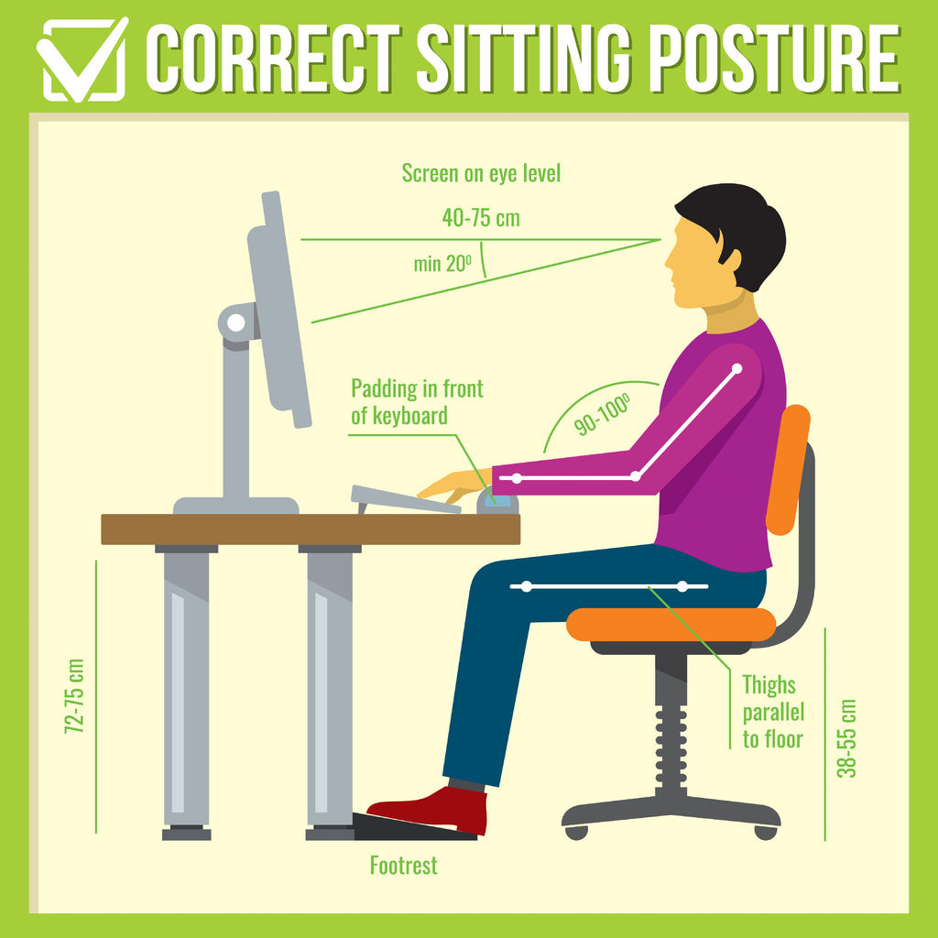
Repetitive Stress Injury
Symptoms: Pain, swelling, tingling, numbness in the hands or wrists.
Watch your posture.
Feet flat on the floor.
Back and wrists straight.
Eyes level.
Is your chair comfy? Can you adjust it?
Stand up once in a while!
Resource: Cleveland Clinic

Slide 9
Eye Strain
Symptoms: Itchy, dry eyes; blurry vision; headache; light sensitivity.
Limit screen time, and take regular breaks with the 20-20-20 rule.
Adjust settings for brightness, text size, etc.
Resource: Mayo Clinic

Slide 10
History of Computers

Slide 11
Before Computers
Jacquard Loom

Slide 12
Before Computers
Babbage Machine

Slide 13
Before Computers
Hollerith Machine

Slide 14
The First Computers
Women Computers

Slide 15
Early Computers
ENIAC

Slide 16
Pre-Modern Computers
Integrated Circuits

Slide 17
Modern Computers
Microprocessors

Slide 18
History of Programming

Slide 19
Machine Language

Slide 20
Assembly Lanugages

Slide 21
High-Level Languages

Slide 22
Modern Languages

Slide 23
Language Types

Slide 24
Use Cases

Slide 25
Compiled vs. Interpreted

Slide 26
Categorizing Languages
Summarize the last few slides

Slide 27
Title Card Template

