Slide 1
<MeritBadge>
<Programming />
</MeritBadge>
Presentation by Zach Colbert
Adapted from Materials by Robert Baker

Slide 2



About Me

Slide 3


About Me
{ }

Slide 4
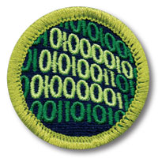
Requirements

Slide 5
What is Programming?
Writing instructions for a machine.
Computers do very simple math – we build on that to do complicated tasks.

Slide 6
What is Programming?
Not just for software developers anymore.
Programmed devices are everywhere – someone has to make them work!
Different industries use different techniques, languages, systems…
This merit badge just scrapes the surface.

Slide 7
{ Programming Safety }

Slide 8
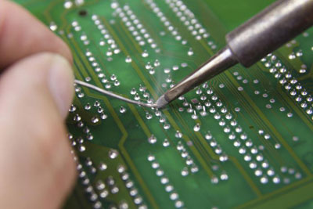
Equipment Safety
Electric Discharges
Keep liquids away!
Power cords in good condition.
Unplug from power before removing components.
Cuts and Scrapes
Watch out for sharp metal parts, solder joints, cardboard boxes...

Slide 9
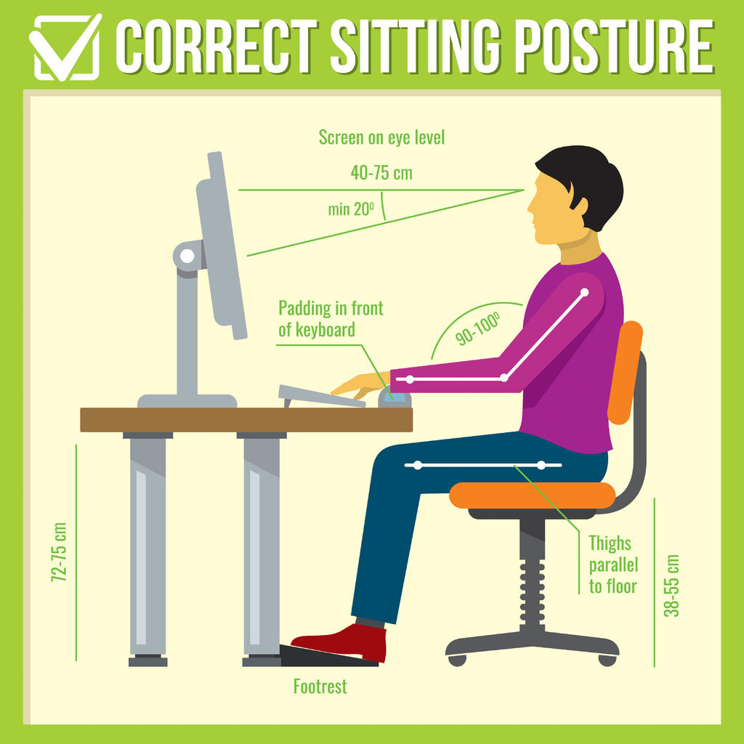
Repetitive Stress Injury
Symptoms
Pain, swelling, tingling, numbness in the hands or wrists.
Tips
Watch your posture.
Feet flat on the floor.
Back and wrists straight.
Eyes level.
Is your chair comfy? Can you adjust it?

Slide 10
Repetitive Stress Injury
Tips
Stand up and stretch frequently!
Resource: Cleveland Clinic

Slide 11
Eye Strain
Symptoms
Itchy, dry eyes
Blurry vision
Headache
Sensitivity to light
Resource: Mayo Clinic
Tips
Limit screen time.
Take regular breaks with the 20-20-20 rule.
Adjust screen settings for brightness, text size, etc.

Slide 12
{ History of Computers }

Slide 13
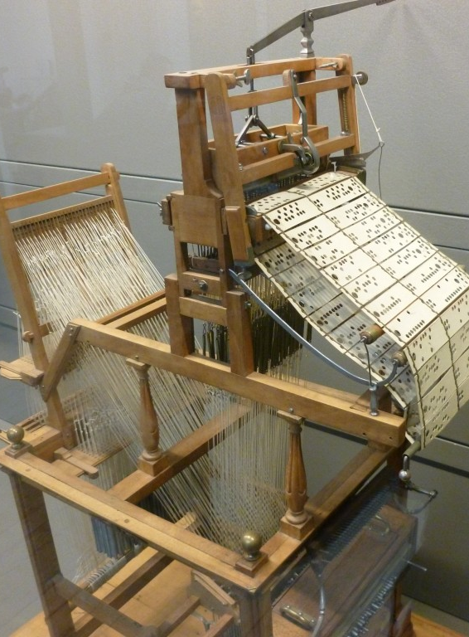
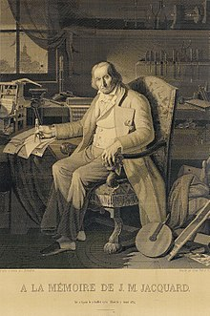
Before Computers
1800s: Programmed Machines in Factories
1804: Joseph Jacquard
Mechanical loom.
Hole-punched cards.
Wove patterns into fabric.
Left: The Jacquard Loom
Right: A portrait of Jacquard woven in silk. The Jacquard Loom required 24,000 punched cards to weave the portrait in 1839.

Slide 14
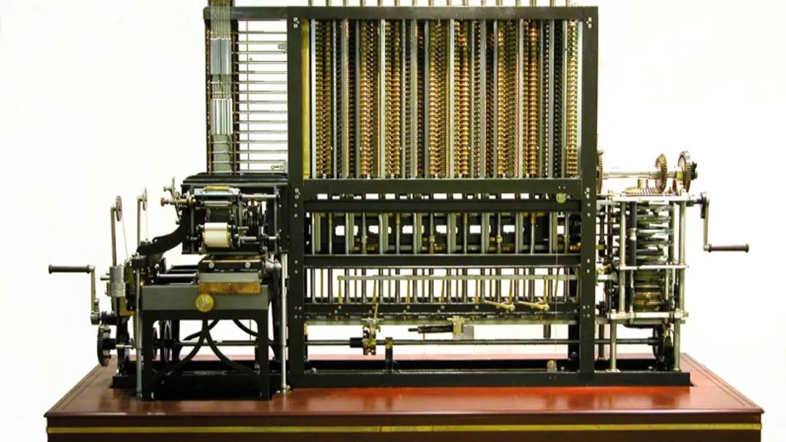
Before Computers
Difference Engines
1819, English mathematician Charles Babbage.
Mechanical calculators for tabulating polynomial functions.
Later designs handled numbers up to 31 digits!
First Babbage engine constructed in 1991.
8 feet high, 5 tons.
Video

Slide 15
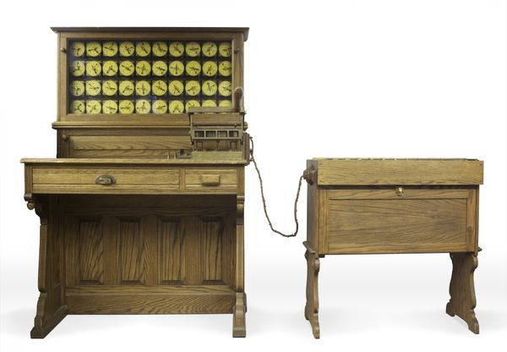
Before Computers
Tabulating Machine
1880s, American inventor Herman Hollerith.
Punched cards – but for data!
Electrical machines for counting.
Used in the 1890 US Census.
Continued to be used by businesses through the 20th century.

Slide 16
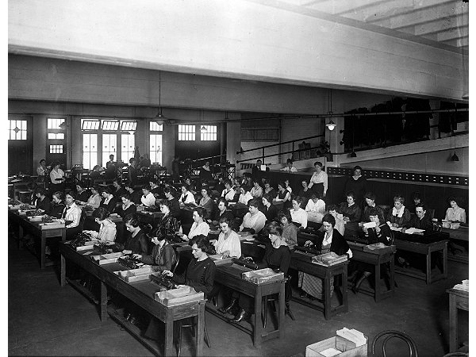
The First Computers
“Computer” used to be a job description, not a machine.
Particularly important during the World Wars for maps, navigation, etc.
Primarily done by women.
Large teams of people worked together to perform and check calculations by hand.
“Kilogirl” – 1000 hours of computing labor.

Slide 17
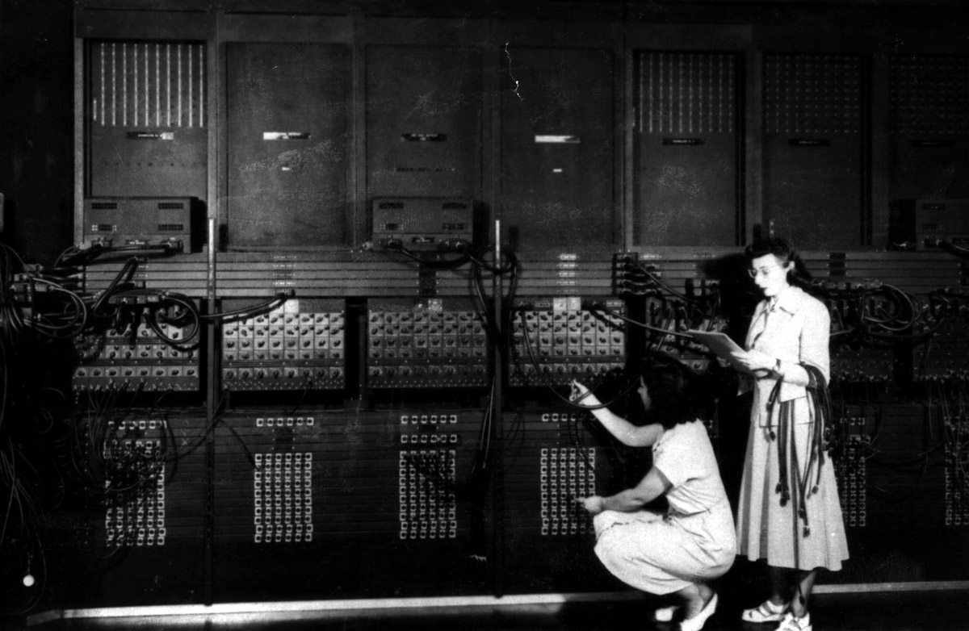
Early Computers
1946: ENIAC
“Electronic Numerical Integrator and Computer”
First general-purpose electronic computer.
Built with vacuum tubes and mechanical switches.
Base 10, not binary.
Developed by the US Army for nuclear research, artillery firing tables.

Slide 18
Early Computers
1951: UNIVAC
“Universal Automatic Computer”
First general-purpose electronic computer for business.
Became popular after correctly predicting outcome of the 1952 US Presidential election.

Slide 19
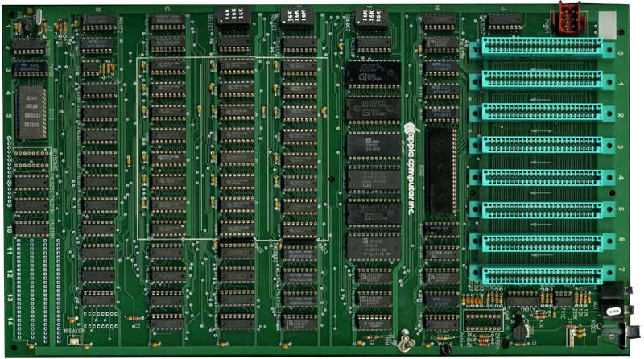
Pre-Modern Computers
Integrated Circuits (ICs)
Vacuum tubes and mechanical switches were large, bulky.
ICs made computers much smaller.
Smaller parts led to more powerful computers.
Left: Motherboard for an Apple II home computer, 1977. All of the black chips make up the central processing unit (CPU). Each is about one inch wide.

Slide 20
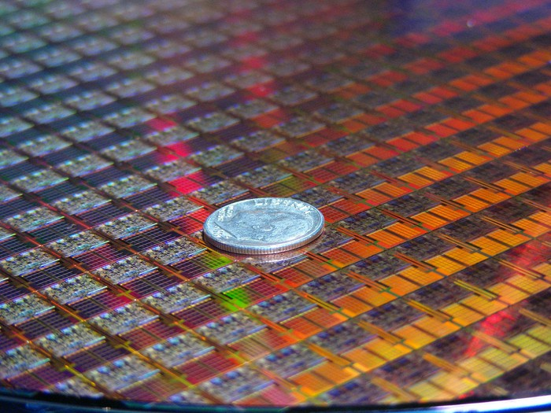
Modern Computers
Microprocessors
You thought ICs were small?
Each small square in the picture is an entire CPU.
Modern computers are many times smaller, many times more powerful than any in history.
~ 10 nanometer transistors.

Slide 21
[ Evolution of Programming Languages ]

Slide 22
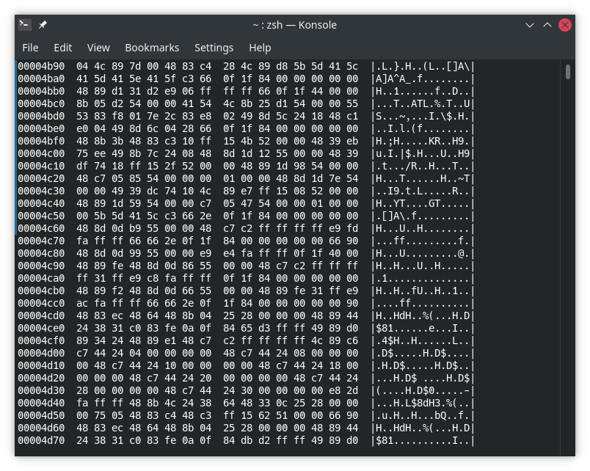
Machine Language (ML)
Binary Numbers → Instructions for the CPU
Hard for humans to read.
Reverse engineers are smart!
Compare to switches.
As fast as your hardware.
All languages end up translated into ML at some point.

Slide 23
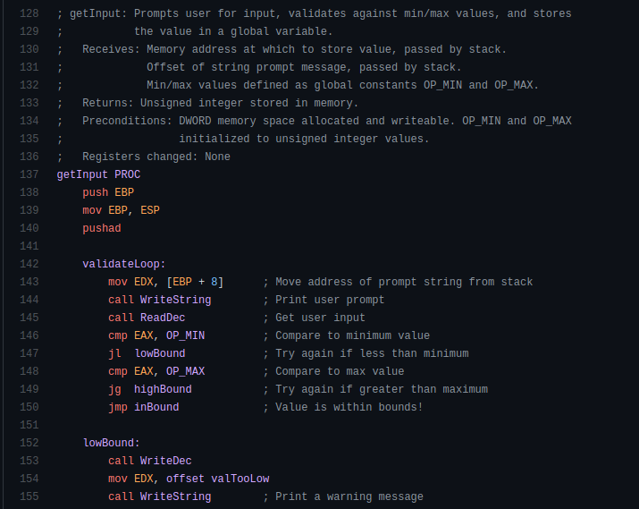
Assembly Language (ASM)
Slightly easier for humans to read and write.
Still very fast.
Instructions map directly to ML.
Not portable.
Each CPU design has its own ASM language.
Why is portability good?
Few people today need to write ASM.

Slide 24
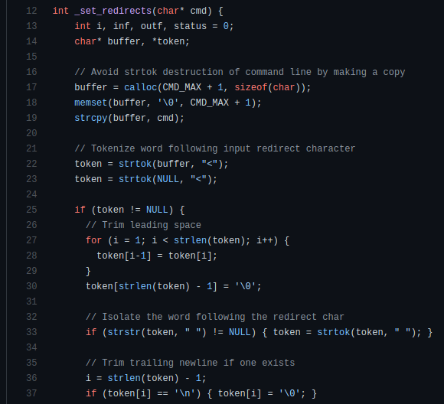
High-Level Languages
Easy for humans to:
Read
Write
Debug
Advanced Features
Abstract away the details, do the tedious stuff for me!
Portable between systems.

Slide 25
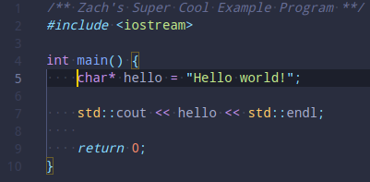
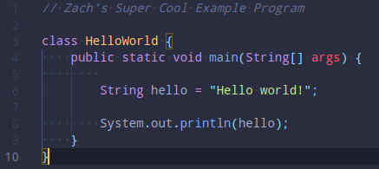
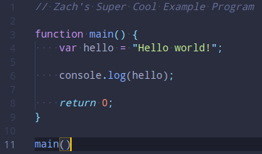
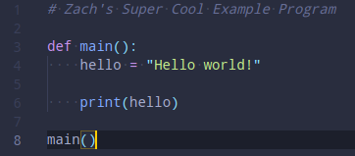
Syntax

Slide 26
Modern Languages
C C++ Java JavaScript HTML CSS Python Ruby PHP OpenCL | SQL MATLAB Erlang Ada Objective-C Swift Mathematica C# Visual Basic Rust | F# R Go PowerShell Bash TypeScript PostScript CoffeeScript Perl x86 MASM | RegEx PL/SQL MIPS ColdFusion LaTeX XML JSON Ladder Logic YAML Batch
This is just a short list!

Slide 27
Language Types
Many ways to classify languages.
One language may fit more than one category.
Examples:
General-Purpose Languages: C, C++, Python, Golang, Javascript
Scripting Languages: PowerShell, Bash, Python, Javascript
Markup Languages: HTML, JSON, LaTeX
Declarative Languages: CSS, SQL, RegEx

Slide 28
Use Cases
Languages have features that make them better for some uses than for others.
Examples:
C++ : General purpose, high performance. Desktop applications.
C : General purpose, high performance. Operating systems and drivers.
Java : General purpose, cross-platform. Desktop and mobile apps.
SQL : Database communication.
HTML : Markup langage for webpage design.
Javascript : Scripting for interactive webpages.

Slide 29
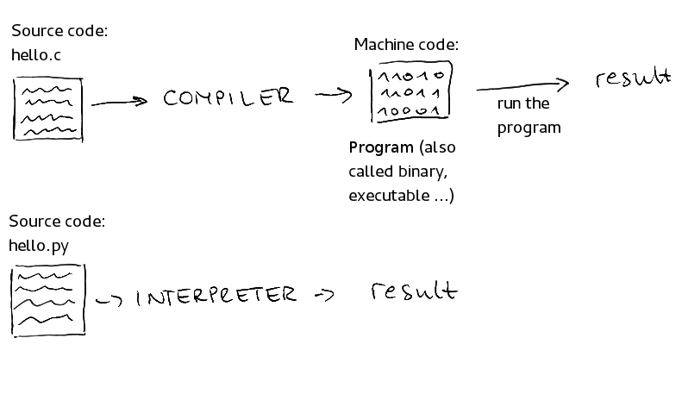
Compiled vs. Interpreted

Slide 30
Categorizing Languages
Levels
Machine Level (binary)
Low Level (ASM)
High Level (C++, Python, …)
Compiled vs. Interpreted
Use Cases
General Purpose (C++, Python)
Scripting (PowerShell, Bash)
Markup (HTML, JSON)
many other categories exist...

Slide 31
{ Programmed Devices }

Slide 32
{ Intellectual Property }

Slide 33
Types of IP
Copyright
Patent
Trademark
Trade Secret

Slide 34
Types of IP
Copyright
Protects expression of ideas, authorship (books, movies, art).
Patent
Protects functional things (machines, items, processes).
Trademark
Protects brands (words and phrases, symbols, logos).
Trade Secret
Protects secret information by never disclosing it.

Slide 35
Owning vs. Licensing Software
Owning
You have the software.
You probably have the code.
You do what you want.
Licensing
You have the software.
You have permission to use the software, with some conditions.
Do I own a copy of Google Chrome?
Do I own a copy of Windows?
Do I own a copy of an app I built?

Slide 36
Licensing Software
Freeware
Shareware
Demo
Public Domain

Slide 37
Licensing Software
Freeware
100% free to use.
Not necessarily free to modify or distribute.
Shareware
Free to use.
You may have to pay later, or pay for extra features.
Not necessarily free to modify or distribute.
Demo
“Free Trial.”
May have restrictions like missing features, limited time.
Not necessarily free to modify or distribute.
Public Domain
Absolutely no ownership.
Free to use, modify, distribute, or even sell.

Slide 38
Licensing Software
Licensed (Commercial)
Subscription-based

Slide 39
Licensing Software
Licensed (Commercial)
You pay once.
You have permission to use the software.
Not free to modify or distribute.
Subscription-based
You pay periodically.
You have permission to use the software.
Not free to modify or distribute.

Slide 40
Licensing Software
Open-Source
You have access to the code.
You can modify and distribute the code – with some restrictions.
Most open source software will allow you to contribute your modifications.
Closed-Source
You don’t have access to the code.

Slide 41
{ Careers in Programming }
https://www.onetonline.org/find/descriptor/result/2.B.3.e?a=1

Slide 42
{ Next Steps }

