Slide 1
Graduate Team 3 Project Title: Using Model Discovery on an ASP.NET application to provide understanding of the systems structure to the Maintenance Team
CS 5340 Software Maintenance
Semester: Spring 2025
Semester Project Final Presentation
Team members: John Williams
Permission is granted for publication on the UCCS website.
Professor: Dr. Armin Moin
Teaching Assistant (TA): Ariful Rabbani

Slide 2
Agenda
_
Semester Project
Research
Live Demo
Q&A

Slide 3
Project Overview
_
License Asset Management Systems (LAMs)
Allows users to purchase software license for specific applications.
Allows developers to embed license requirements in their applications.
The customer: The maintenance team of the License Asset Management System.
The end user: Users of Software that is license controlled by the License Asset Management System.
The problem being addressed:
There is a lack of understanding of the systems structure.
There is a lack of confidence that the system meets the requirements.
The value being added: A better understanding of the systems structure and increase in confidence that the systems meets the requirements.

Slide 4
Work breakdown
_
ID | Description | Status | Owner | Completion Date
M-1 | Review context and use case diagrams | Completed | John | 03/12/25
M-2 | Unit test and document Navigation | Completed | John | 3/12/25
M-3 | Unit test and document the Cart. Refactor Blazor implementation. | Completed | John | 4/14/25
M-4 | Unit test and document Administration | In Progress | John | 4/7/25
M-5 | Unit test and document Security and Deployment | In Progress | John | 4/21/25
https://uccs-team-cs5320.atlassian.net/jira/software/projects/SCRUM/boards/1

Slide 5
Open-source Software License
_
The GitHub repository contains a README.md file with important project information.
Project README
It is also included as part of this package.
Copyright 2024-2025 Johnny C. King and John L Williams Jr
Permission is hereby granted, free of charge, to any person obtaining a copy of this software and associated documentation files (the “Software”), to deal in the Software without restriction, including without limitation the rights to use, copy, modify, merge, publish, distribute, sublicense, and/or sell copies of the Software, and to permit persons to whom the Software is furnished to do so, subject to the following conditions:
The above copyright notice and this permission notice shall be included in all copies or substantial portions of the Software.
THE SOFTWARE IS PROVIDED “AS IS”, WITHOUT WARRANTY OF ANY KIND, EXPRESS OR IMPLIED, INCLUDING BUT NOT LIMITED TO THE WARRANTIES OF MERCHANTABILITY, FITNESS FOR A PARTICULAR PURPOSE AND NONINFRINGEMENT. IN NO EVENT SHALL THE AUTHORS OR COPYRIGHT HOLDERS BE LIABLE FOR ANY CLAIM, DAMAGES OR OTHER LIABILITY, WHETHER IN AN ACTION OF CONTRACT, TORT OR OTHERWISE, ARISING FROM, OUT OF OR IN CONNECTION WITH THE SOFTWARE OR THE USE OR OTHER DEALINGS IN THE SOFTWARE.
This license is also controlled by the Manning Publisher License, who provided a great deal of guidance and source material in the creation of the application. Please read the details in the link provided below.
Manning Publisher License

Slide 6
Open-source Project GitHub Repository
_
Project GitHub Link

Slide 7
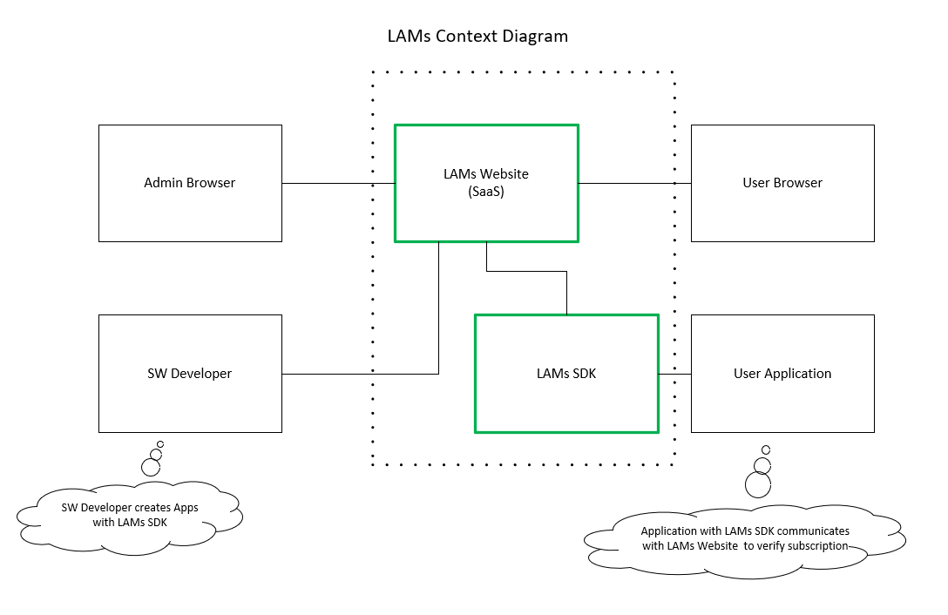
LAMs – License Asset Management System
Future Release

Slide 8
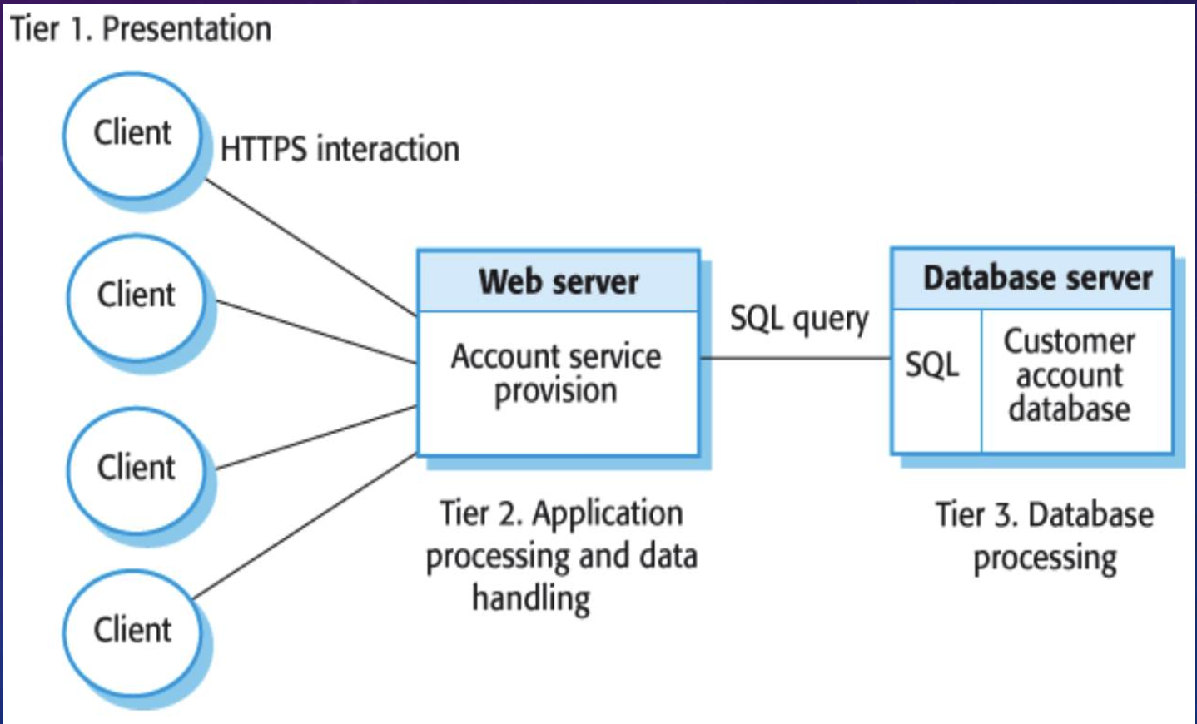
Multi-tier Client Server Architectural Pattern
_
Good for large volume of transactions
Able to scale as more clients sign up for the service it will be better for larger scale
Good for applications where data is volatile

Slide 9
Types of Work
Enhancements
Refactor Blazor implementation
Perfective
Add Unit Test
Add UML Diagrams

Slide 10
Relevance to Classroom Instruction
Context Diagram
UML Use Case Diagrams
Updated to show the systems required features.
Helped create a mental model of the system to increase program comprehension.
UML Class Diagrams
Generated using Enterprise Architect
Unit Test
Added unit test to demonstrate that the system meets the requirements.

Slide 11
Relevance to Classroom Instruction
Component Test (System Test – Unit Test)
Example: Test Viewing the Stores Products
System Testing
Automated Testing
Used Visual Studio Test Explorer to automate testing
Helped ensure that updates did not break the system
Activity based Software Maintenance
Enhancement to refactor Blazor implementation without changing the requirements

Slide 12
Relevance to Classroom Instruction
Evidence Based Software Maintenance
Documentation (Updative)
UML Class Diagram Generation using Enterprise Architect
Automated Testing (Preventative and Perfective)

Slide 13
Research
Using tools for model discovery and maintenance

Slide 14
Background
Legacy systems without UML class diagrams are common.
Software Maintenance Engineers have struggled to understand these complex legacy systems.
Vendors have been working on providing tools that allow the discovery of models within these legacy systems for decades to help engineers understand the structure and behavior of these systems.

Slide 15
Some Existing Tools for Model Discovery
Visual Studio 2022
Enterprise Architect
MoDisco

Slide 16
Experimental Results
Visual Studio 2022
Capable of generating UML Class diagrams one file at a time
Enterprise Architect
Capable of generating UML Class diagrams for an entire Visual Studio Solution or Project
MoDisco
Capabilities not tested

Slide 17
Evaluation
Enterprise Architect is very fast at performing model discovery of an entire Visual Studio Solution in one step.
Model discovery of ASP.NET applications typically took less than one minute using Enterprise Architect.
Model discovery of the same ASP.NET application using Visual Studio tool approximately fifteen minutes due to its one-at-a-time process.

Slide 18
Summary
Model Discovery is a great way to increase the understanding of a legacy system that does not include UML documentation.
There are existing tools that help facilitate model discovery. Enterprise Architect does a great job at processing an entire Visual Studio Solution with one step.

Slide 19
Future Work
Finding ways to extract other types of models, such as activity diagrams for methods and complex properties.
Using model discovery in forward engineering methodologies for reengineering legacy systems.

Slide 20
Live Demo

Slide 21
Questions and Answers

Slide 22
Thank You!
John Williams – jwilli11@uccs.edu

