Slide 1
Graduate Team 3’s semester project: Model Discovery
CS 5340 Software Maintenance
Semester: Spring 2025
Mid-term Presentation
Team members: John Williams
Permission is granted for publication on the UCCS website.
Professor: Dr. Armin Moin
Teaching Assistant (TA): Ariful Rabbani

Slide 2
Agenda
_
Project Overview
Software license
Architectural pattern
Work breakdown
Research
Questions and Answers

Slide 3
Project overview
_
Open-source Project understood by domain experts
Purpose, who is it for?
Software developers who need to control who can use their software
Software users who want to use software products controlled by LAMs
This is accomplished thru an online software subscription service

Slide 4
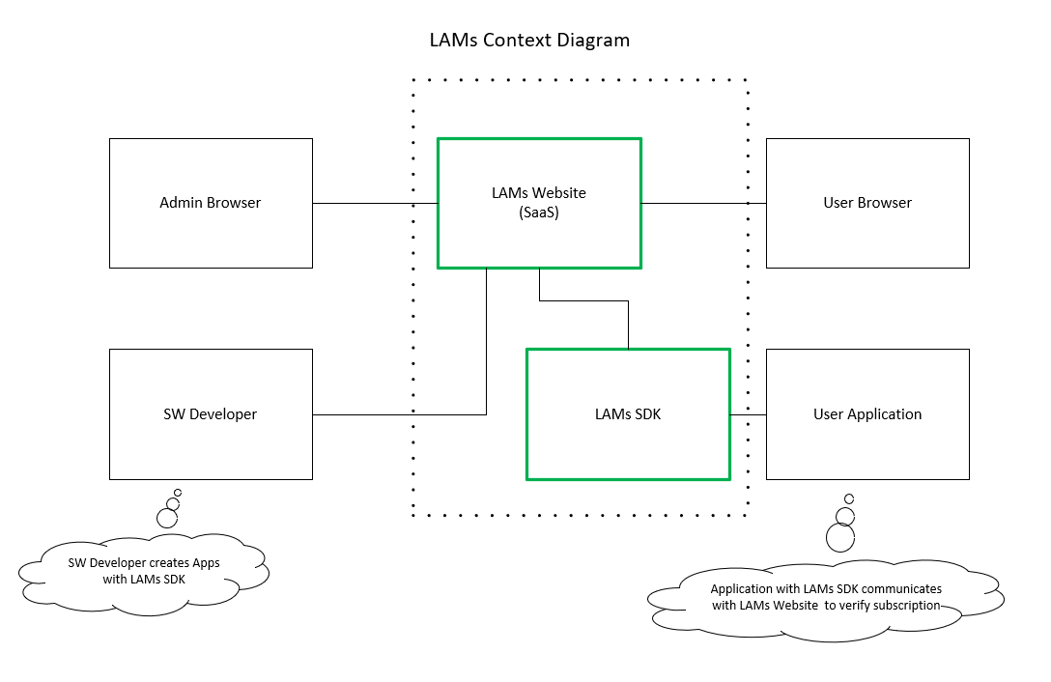
Future Release

Slide 5
Open-source Software License
_
The GitHub repository contains a README.md file with important project information.
https://github.com/colby13king/cs5320-code/blob/master/README.md
It is also included as part of this package.
Copyright 2024-2025 Johnny C. King and John L Williams Jr
Permission is hereby granted, free of charge, to any person obtaining a copy of this software and associated documentation files (the “Software”), to deal in the Software without restriction, including without limitation the rights to use, copy, modify, merge, publish, distribute, sublicense, and/or sell copies of the Software, and to permit persons to whom the Software is furnished to do so, subject to the following conditions:
The above copyright notice and this permission notice shall be included in all copies or substantial portions of the Software.
THE SOFTWARE IS PROVIDED “AS IS”, WITHOUT WARRANTY OF ANY KIND, EXPRESS OR IMPLIED, INCLUDING BUT NOT LIMITED TO THE WARRANTIES OF MERCHANTABILITY, FITNESS FOR A PARTICULAR PURPOSE AND NONINFRINGEMENT. IN NO EVENT SHALL THE AUTHORS OR COPYRIGHT HOLDERS BE LIABLE FOR ANY CLAIM, DAMAGES OR OTHER LIABILITY, WHETHER IN AN ACTION OF CONTRACT, TORT OR OTHERWISE, ARISING FROM, OUT OF OR IN CONNECTION WITH THE SOFTWARE OR THE USE OR OTHER DEALINGS IN THE SOFTWARE.
This license is also controlled by the Manning Publisher License, who provided a great deal of guidance and source material in the creation of the application. Please read the details in the link provided below.
https://www.manning.com/ebook-license

Slide 6
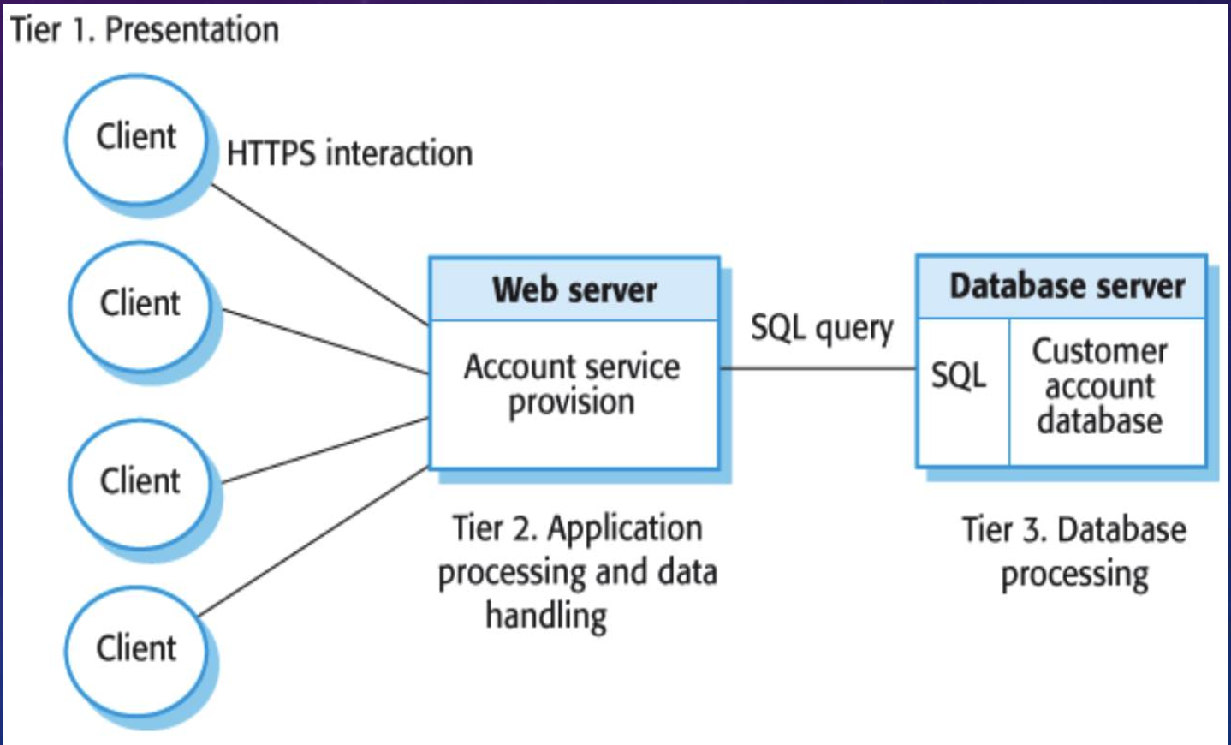
Multi-tier Client Server Architectural Pattern
_
Good for large volume of transactions
Able to scale as more clients sign up for the service it will be better for larger scale
Good for applications where data is volatile

Slide 7
Work breakdown
_
ID | Description | Status | Work Breakdown | Completion Date
M-1 | Review context and use case diagrams | In Progress | John | 03/12/25
M-2 | Unit test and document Navigation | In Progress | John | 3/12/25
M-3 | Unit test and document the Cart. Refactor Blazor implementation. | Not started | John | 3/24/25
M-4 | Unit test and document Administration | Not started | John | 4/7/25
M-5 | Unit test and document Security and Deployment | Not started | John | 4/21/25
https://uccs-team-cs5320.atlassian.net/jira/software/projects/SCRUM/boards/1

Slide 8
Types of Work
Enhancements
Refactor Blazor implementation
Preventative
Add Unit Test
Add UML Diagrams

Slide 9
Research
Using tools for model discovery and maintenance

Slide 10
Phase1: Tool Identification
Tools that are capable of extracting models from existing source code will be identified.
Some time will be spent learning tool capabilities and limitations.

Slide 11
Phase2: Tool Testing & Evaluation
Tools will be tested and evaluated for efficiency and correctness.

Slide 12
Phase 3: Gaps will be identified
Gaps in tool capabilities will be identified and documented.

Slide 13
Phase 4: Proposals for Solutions to gaps
Novel solutions to fill the gaps identified during testing and evaluation will be proposed.

Slide 14
Phase 5: Summary
The results of the tool testing, evaluation, and gap analysis will be summarized.

Slide 15
Questions and Answers

Slide 16
Thank You!
John Williams – jwilli11@uccs.edu

