Slide 1

License Asset Management System (Agile Path) CS 5320 Software Design Fall 2024 Team 10: Colby King and John Williams
__
Instructor: Dr. Armin Moin
TA: Aryan Padiyal
Permission is granted for publication on UCCS Website

Slide 2
Agenda
_
Project Overview
Software license
functional requirements
non-functional requirements
Diagrams
work breakdown
Architecture decisions
Demonstration
questions

Slide 3
Project overview
_
Greenfield Project understood within domain experts
Agile path
Purpose, who is it for?
software developers who do not want their software pirated
Software users who want to purchase and use one or multiple software products
Unique selling point:
Competition: revenera appx ~ $20,000 first year, $10,000 yearly lease
https://www.revenera.com/

Slide 4
Open-source Software License
_
The GitHub repository contains a README.md file with important project information.
https://github.com/colby13king/cs5320-code/blob/master/README.md
It is also included as part of this package.
Copyright 2024 Johnny C. King and John L Williams Jr
Permission is hereby granted, free of charge, to any person obtaining a copy of this software and associated documentation files (the “Software”), to deal in the Software without restriction, including without limitation the rights to use, copy, modify, merge, publish, distribute, sublicense, and/or sell copies of the Software, and to permit persons to whom the Software is furnished to do so, subject to the following conditions:
The above copyright notice and this permission notice shall be included in all copies or substantial portions of the Software.
THE SOFTWARE IS PROVIDED “AS IS”, WITHOUT WARRANTY OF ANY KIND, EXPRESS OR IMPLIED, INCLUDING BUT NOT LIMITED TO THE WARRANTIES OF MERCHANTABILITY, FITNESS FOR A PARTICULAR PURPOSE AND NONINFRINGEMENT. IN NO EVENT SHALL THE AUTHORS OR COPYRIGHT HOLDERS BE LIABLE FOR ANY CLAIM, DAMAGES OR OTHER LIABILITY, WHETHER IN AN ACTION OF CONTRACT, TORT OR OTHERWISE, ARISING FROM, OUT OF OR IN CONNECTION WITH THE SOFTWARE OR THE USE OR OTHER DEALINGS IN THE SOFTWARE.
This license is also controlled by the Manning Publisher License, who provided a great deal of guidance and source material in the creation of the application. Please read the details in the link provided below.
https://www.manning.com/ebook-license

Slide 5
Functional Requirements
_
ID | Description | Status
R-1 | Users can access web site | Done
R-2 | Users can view Products list | Done
R-3 | Users can add Products to Cart | Done
R-4 | Users can view/edit Cart | Done
R-5 | Users can Checkout | Done
R-6 | Users can view their prior Orders | Done
R-7 | Admin can view all Orders | Done
R-8 | Admin can CRUD Product data | Done
R-9 | Software Developer Apps can check that User has a valid license | Done
R-10 | Admin Security | Done
R-11 | Users can pay for software subscription | Not Started

Slide 6
Non-functional (quality) requirements
_
ID | Description | Status
QA-1 | Pages will update within 2 seconds (Usability) | Done
QA-2 | Users will not be able to modify the databases (Security) | Done
QA-3 | The System will be easy to evolve (Maintainability) | Done
QA-4 | The System will be easy to Unit Test (Maintainability) | Done
QA-5 | The System will use bootstrap for common display (Usability) | Done
QA-6 | The System will support an Admin role (Security) | Done

Slide 7

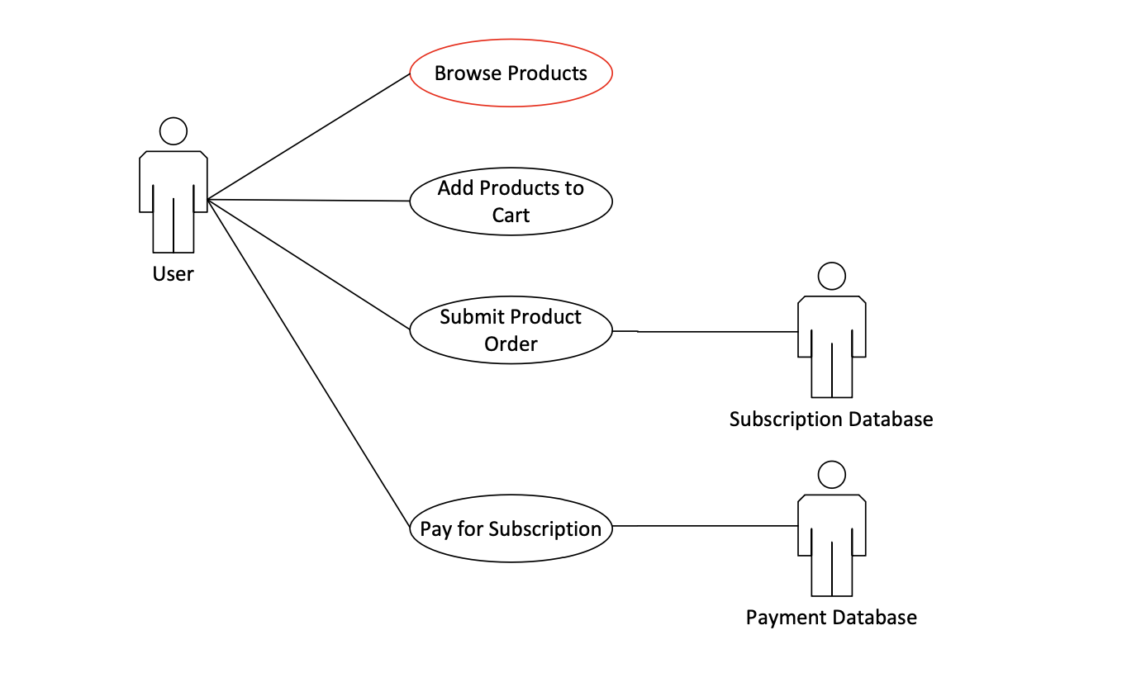
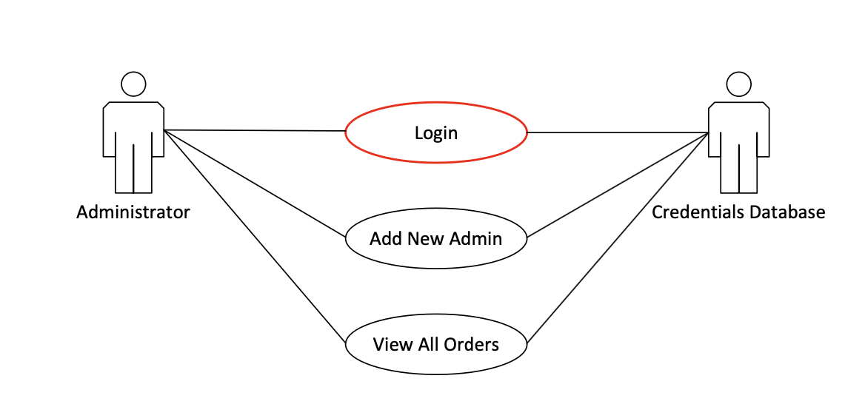
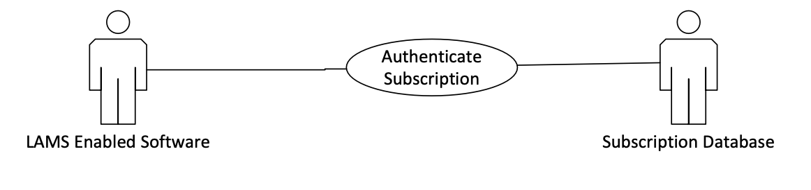
Use case diagrams
_

Slide 8
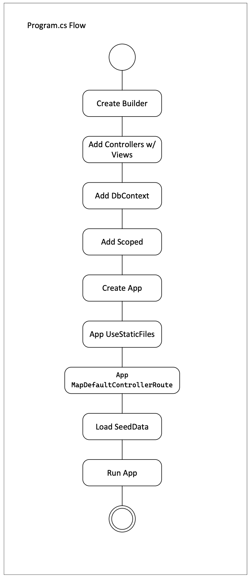
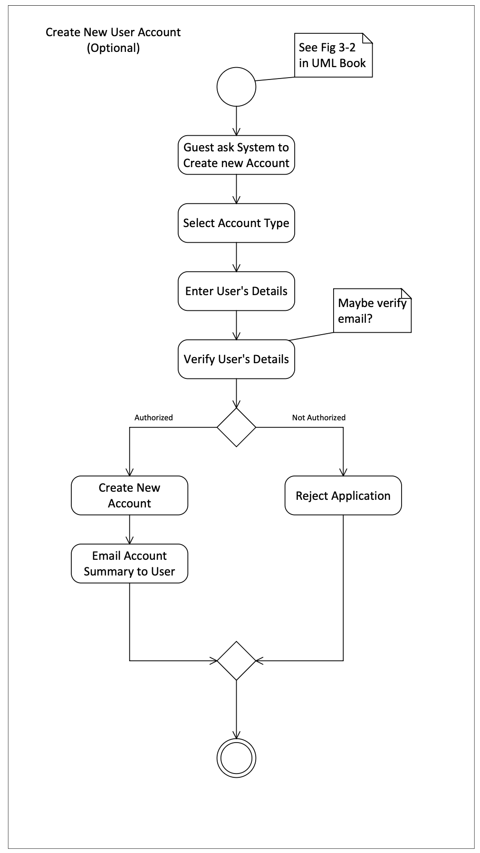
Activity Diagrams
_

Slide 9
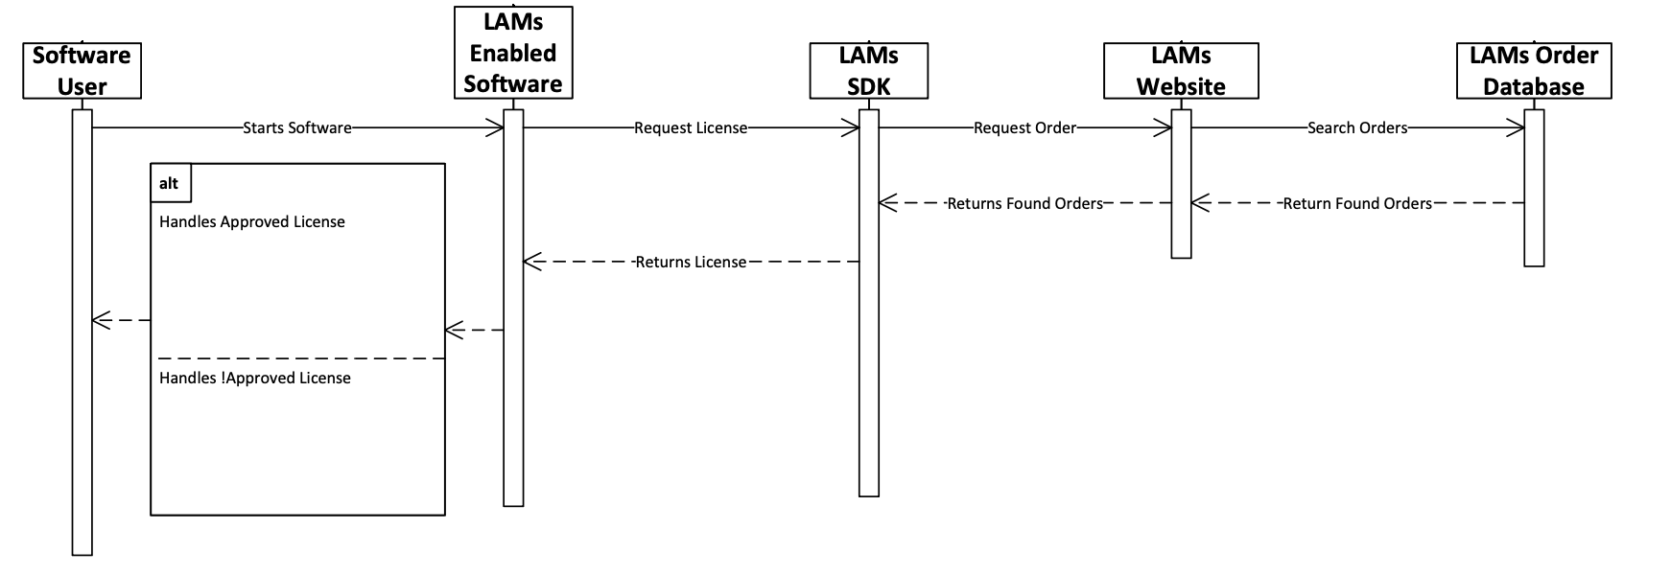
Sequence Diagram
_

Slide 10
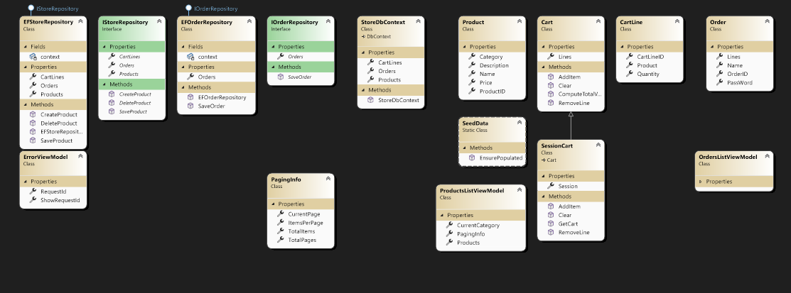
Class diagrams
_
Created by Visual Studio 2022 from source

Slide 11
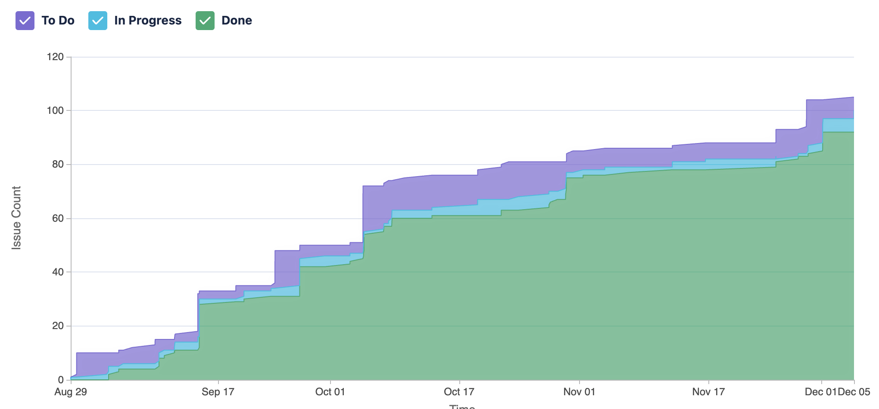
Work breakdown
_
ID | Description | Status | Work Breakdown | Completion Date
R-1 | Users can access web site | Done | John | 09/14/24
R-2 | Users can view Products list | Done | John | 10/01/24
R-3 | Users can add Products to Cart | Done | Colby | 10/30/24
R-4 | Users can view/edit Cart | Done | Colby/John | 11/4/24
R-5 | Users can Checkout | Done | John | 11/10/24
R-6 | Users can view their prior Orders | Done | John | 12/1/24
R-7 | Admin can view all Orders | Done | Colby | 12/1/24
R-8 | Admin can CRUD Product data | Done | Colby | 12/4/24
R-9 | Software Developer Apps can check that User has a valid license | Done | John | 12/6/24
R-10 | Admin Security | Done | John | 12/8/24
Other:
Colby – GitHub, Jira
John – initial project set up
https://uccs-team-cs5320.atlassian.net/jira/software/projects/SCRUM/boards/1

Slide 12
the 8 Architecture decisions
_
Is there a generic application architecture that can act as a template?
- Yes, we started with a generic MVC template in Visual Studio
How will the system be distributed across hardware cores?
- Prototype centralized, production distributed
What architectural patterns might be used?
- Multi-Tier client server architectural pattern
What strategy will be used to control the components of the system?
- MVC will be used to isolate the components

Slide 13
the 8 Architecture decisions cont.
_
How should the architecture be documented?
- Using a variety of UML diagrams to create an architectural description document
What architectural organization is best for delivering the non-functional requirements?
- MVC leads to maintainability
How will components be decomposed into sub-components?
- Objects will be broken down into Models, Views, and Controllers
What approach will be used to structure the system?
- Application will be on server, clients will use web browsers

Slide 14
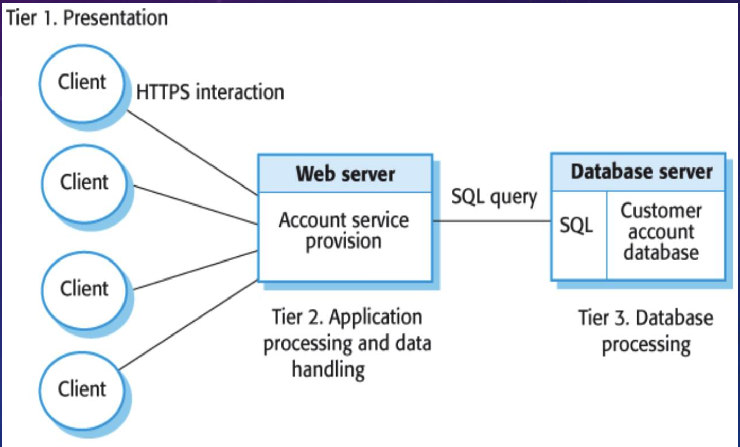
Multi-tier Client Server Architectural Pattern
_
Good for large volume of transactions
Able to scale as more clients sign up for the service it will be better for larger scale
Good for applications where data is volatile

Slide 15
DEMONSTRATION

