Slide 1

License Asset Management System (Agile Path) CS 5320 Software Design Fall 2024 Team 10: Colby King and John Williams
Instructor: Dr. Armin Moin
TA: Aryan Padiyal
Permission is granted for publication on UCCS Website

Slide 2
Project overview
Greenfield Project understood within domain experts
Agile path
Purpose, who is it for?
software developers who do not want their software pirated
Software users who want to purchase and use one or multiple software products
Competition: revenera $20,000 first year, $10000 yearly lease
https://www.revenera.com/

Slide 3
Open-source Software License
The GitHub repository contains a README.md file with important project information.
https://github.com/colby13king/cs5320-code/blob/master/README.md
It is also included as part of this package.
Copyright 2024 Johnny C. King and John L Williams Jr
Permission is hereby granted, free of charge, to any person obtaining a copy of this software and associated documentation files (the “Software”), to deal in the Software without restriction, including without limitation the rights to use, copy, modify, merge, publish, distribute, sublicense, and/or sell copies of the Software, and to permit persons to whom the Software is furnished to do so, subject to the following conditions:
The above copyright notice and this permission notice shall be included in all copies or substantial portions of the Software.
THE SOFTWARE IS PROVIDED “AS IS”, WITHOUT WARRANTY OF ANY KIND, EXPRESS OR IMPLIED, INCLUDING BUT NOT LIMITED TO THE WARRANTIES OF MERCHANTABILITY, FITNESS FOR A PARTICULAR PURPOSE AND NONINFRINGEMENT. IN NO EVENT SHALL THE AUTHORS OR COPYRIGHT HOLDERS BE LIABLE FOR ANY CLAIM, DAMAGES OR OTHER LIABILITY, WHETHER IN AN ACTION OF CONTRACT, TORT OR OTHERWISE, ARISING FROM, OUT OF OR IN CONNECTION WITH THE SOFTWARE OR THE USE OR OTHER DEALINGS IN THE SOFTWARE.
This license is also controlled by the Manning Publisher License, who provided a great deal of guidance and source material in the creation of the application. Please read the details in the link provided below.
https://www.manning.com/ebook-license

Slide 4
Functional Requirements
ID | Description | Status
R-1 | Users can access web site | Done
R-2 | Users can view Products list | Done
R-3 | Users can add Products to Cart | Done
R-4 | Users can view/edit Cart | Done
R-5 | Users can Checkout | Done
R-6 | Users can view their prior Orders | Done
R-7 | Admin can view all Orders | Done
R-8 | Admin can CRUD Product data | Done
R-7 | Software Developer Apps can check that User has a valid license | In Progress

Slide 5
Non-functional (quality) requirements
ID | Description | Status
QA-1 | Pages will update within 2 seconds (Usability) | Done
QA-2 | Users will not be able to modify the databases (Security) | In Progress
QA-3 | The System will be easy to evolve (Maintainability) | Done
QA-4 | The System will be easy to Unit Test (Maintainability) | Done
QA-5 | The System will use bootstrap for common display (Usability) | Done
QA-6 | The System will support an Admin role (Security) | In Progress

Slide 6

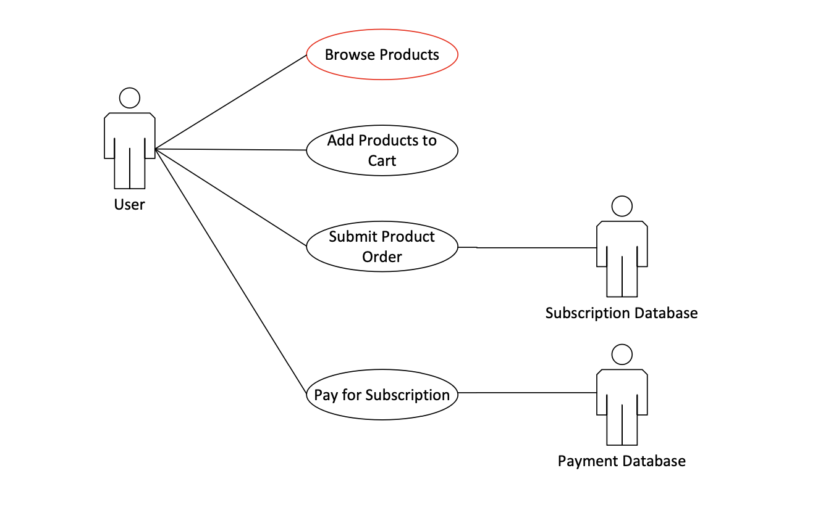
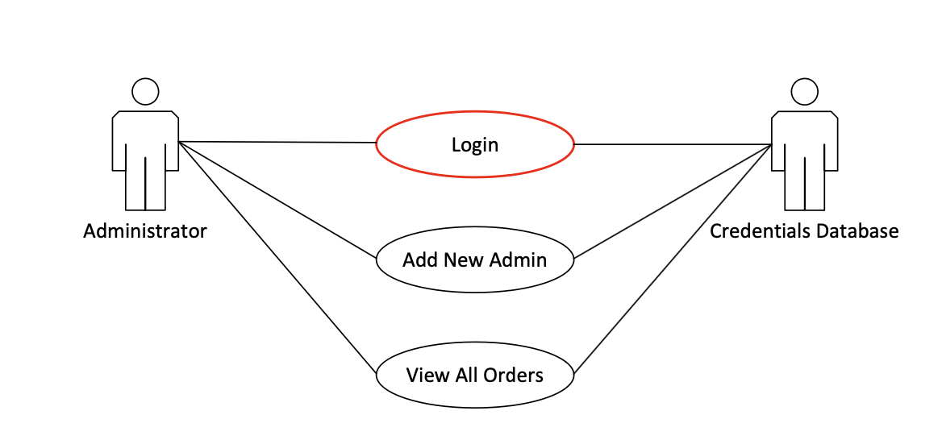
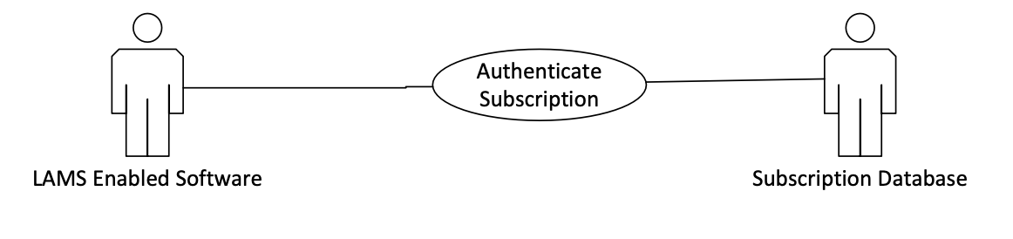
Use case diagrams

Slide 7
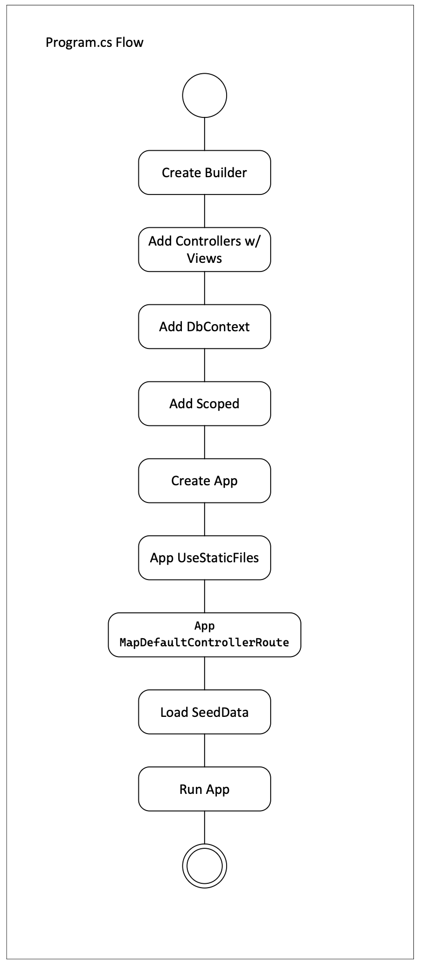
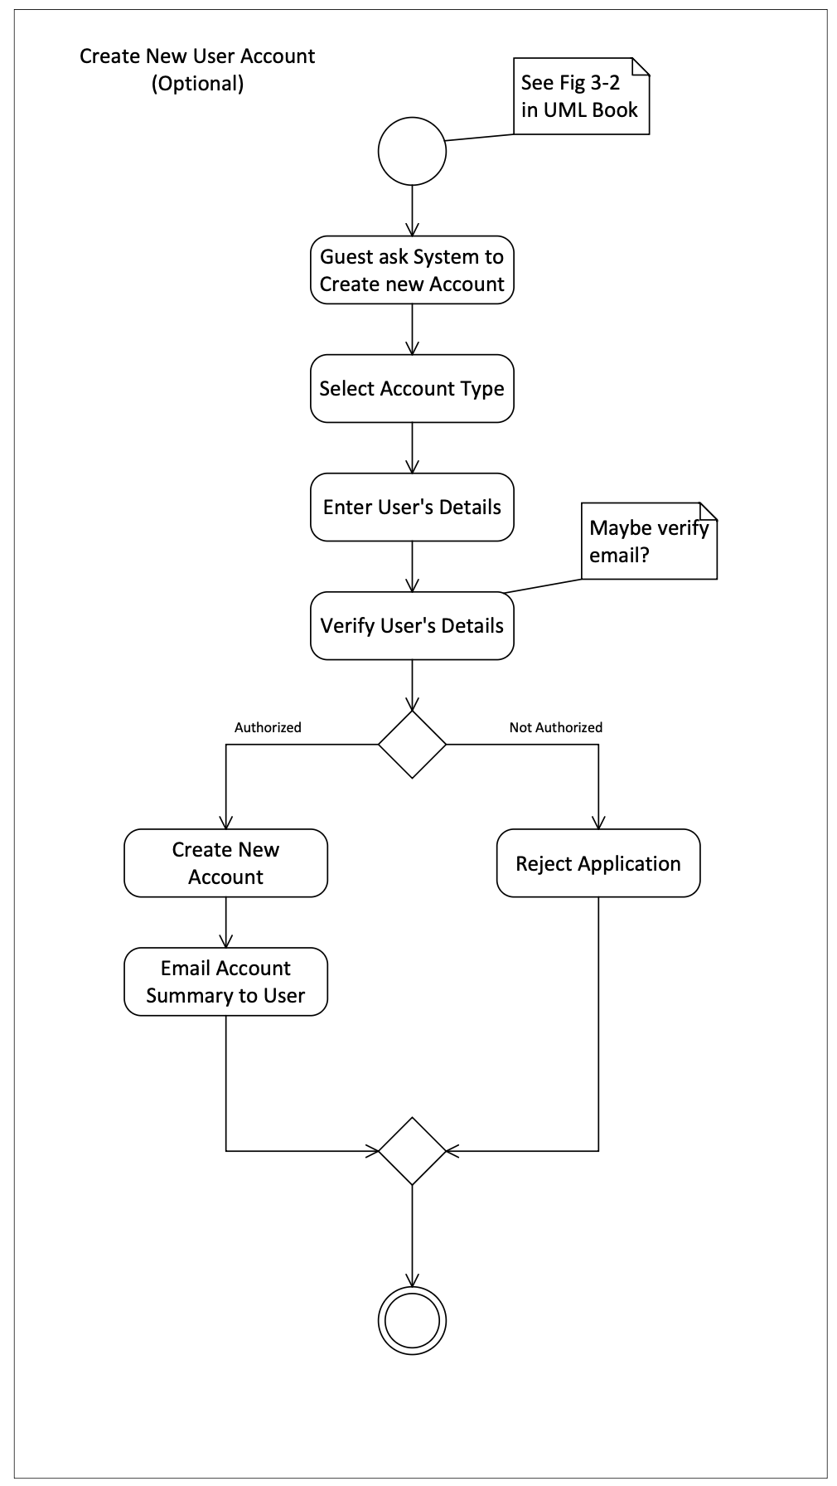
Activity Diagrams

Slide 8
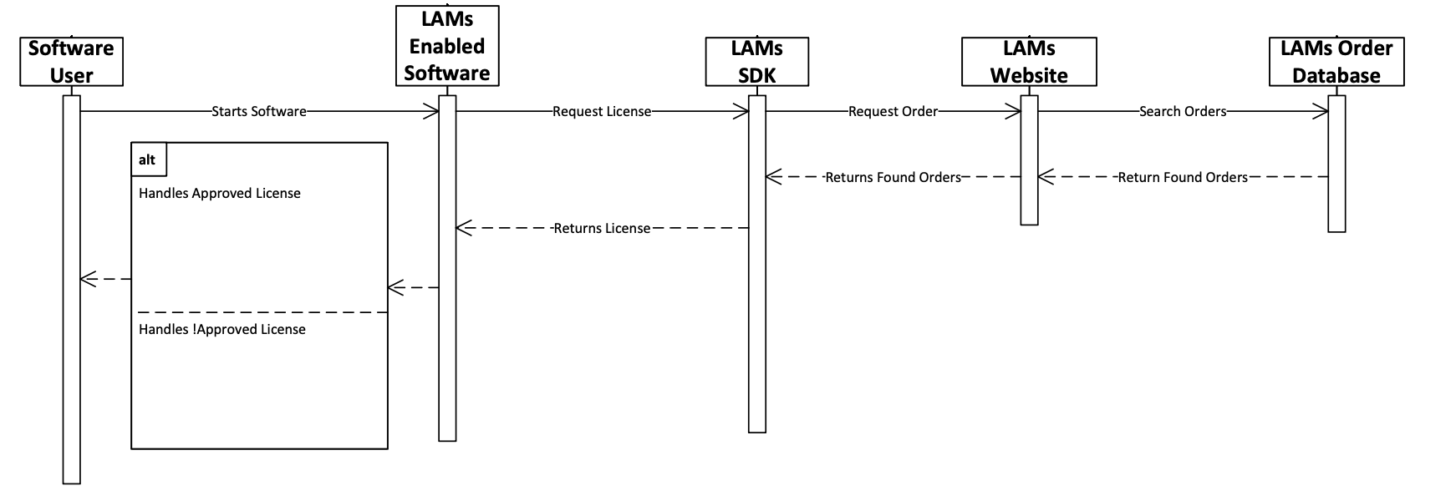
Sequence Diagram

Slide 9
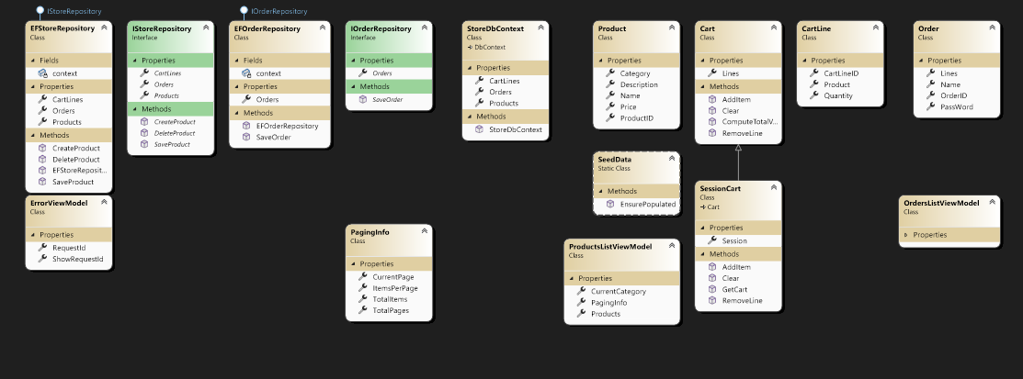
Class diagrams
Created by Visual Studio 2022 from source

Slide 10
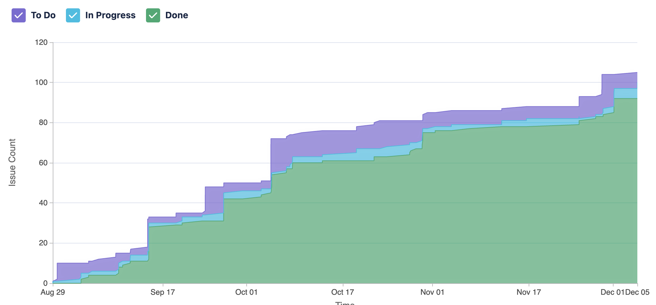
Work breakdown
ID | Description | Status | Work Breakdown
R-1 | Users can access web site | Done | John
R-2 | Users can view Products list | Done | John
R-3 | Users can add Products to Cart | Done | Colby
R-4 | Users can view/edit Cart | Done | Colby/John
R-5 | Users can Checkout | Done | John
R-6 | Users can view their prior Orders | Done | John
R-7 | Admin can view all Orders | Done | Colby
R-8 | Admin can CRUD Product data | Done | Colby
R-7 | Software Developer Apps can check that User has a valid license | In Progress | John
Other:
Colby – GitHub, Jira
John – initial project set up

